Slide 1
USDA FOODS/Food Distribution
SY 2025-26 Orientation Training

Slide 2
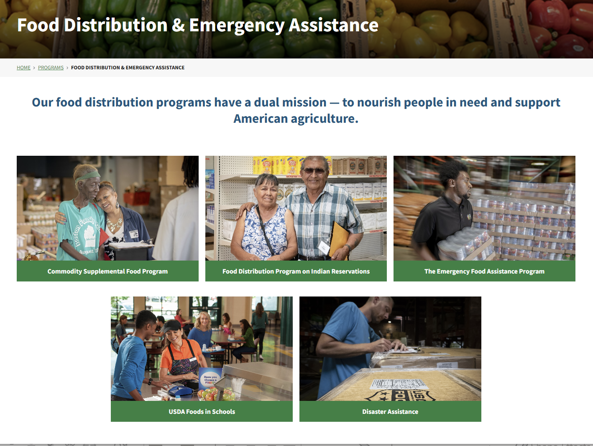

USDA FOODS/Food Distribution

Slide 3
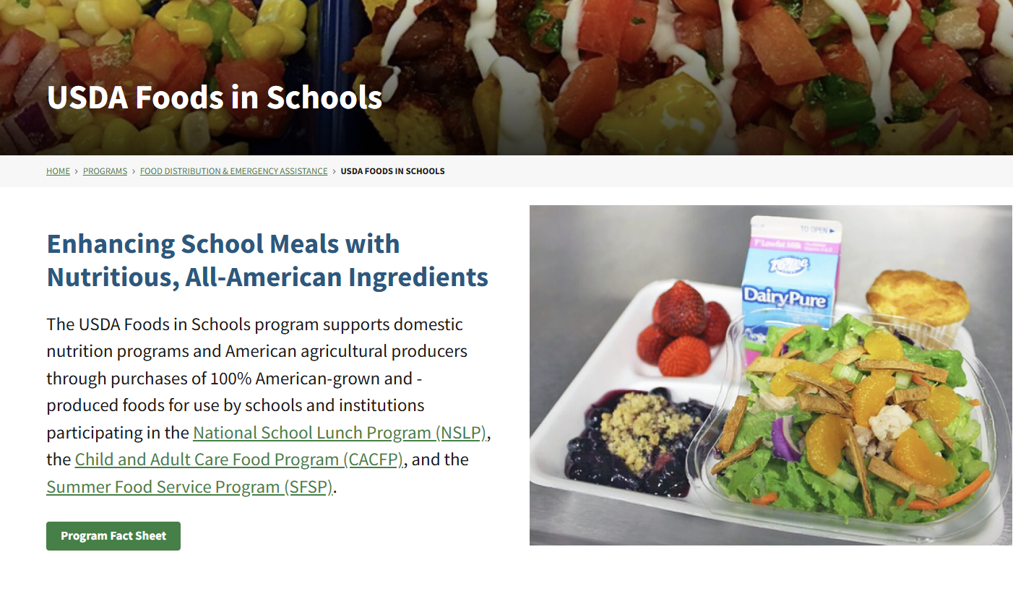
USDA FOODS/Food Distribution

Slide 4
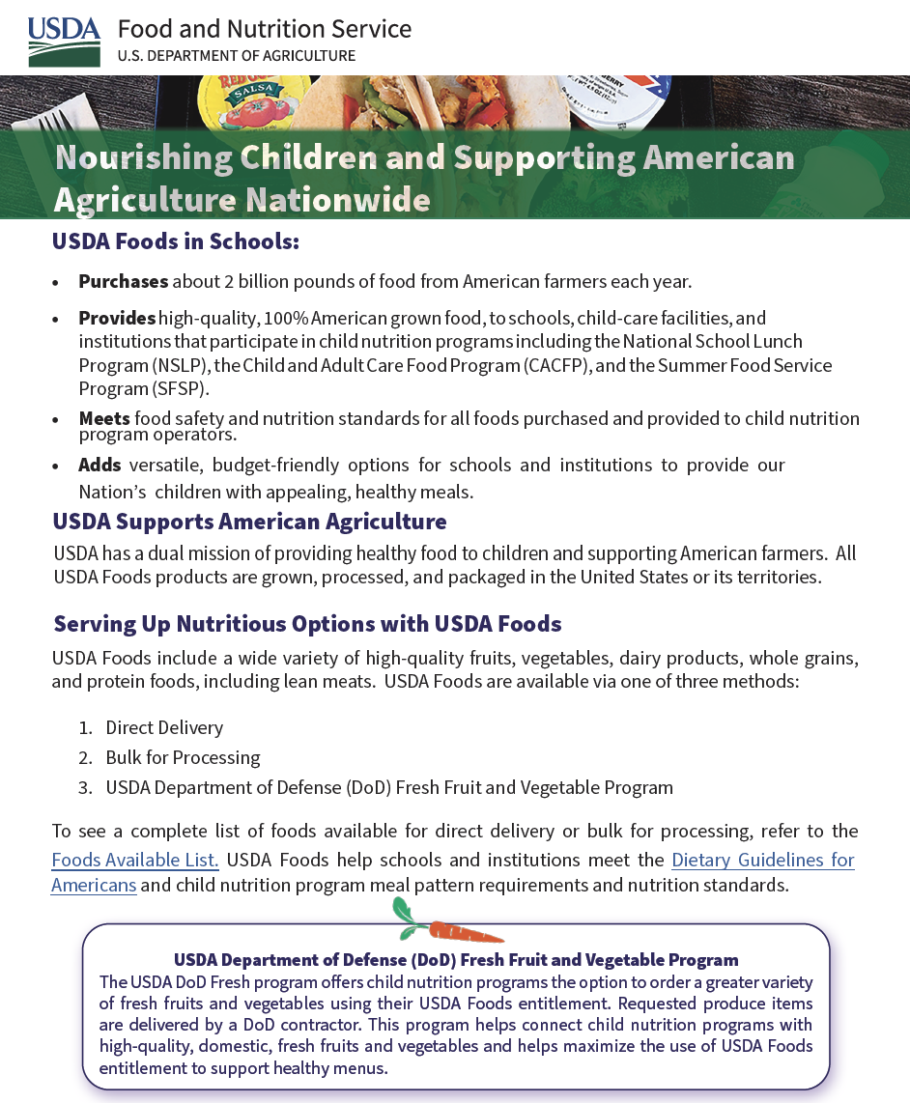


Slide 5
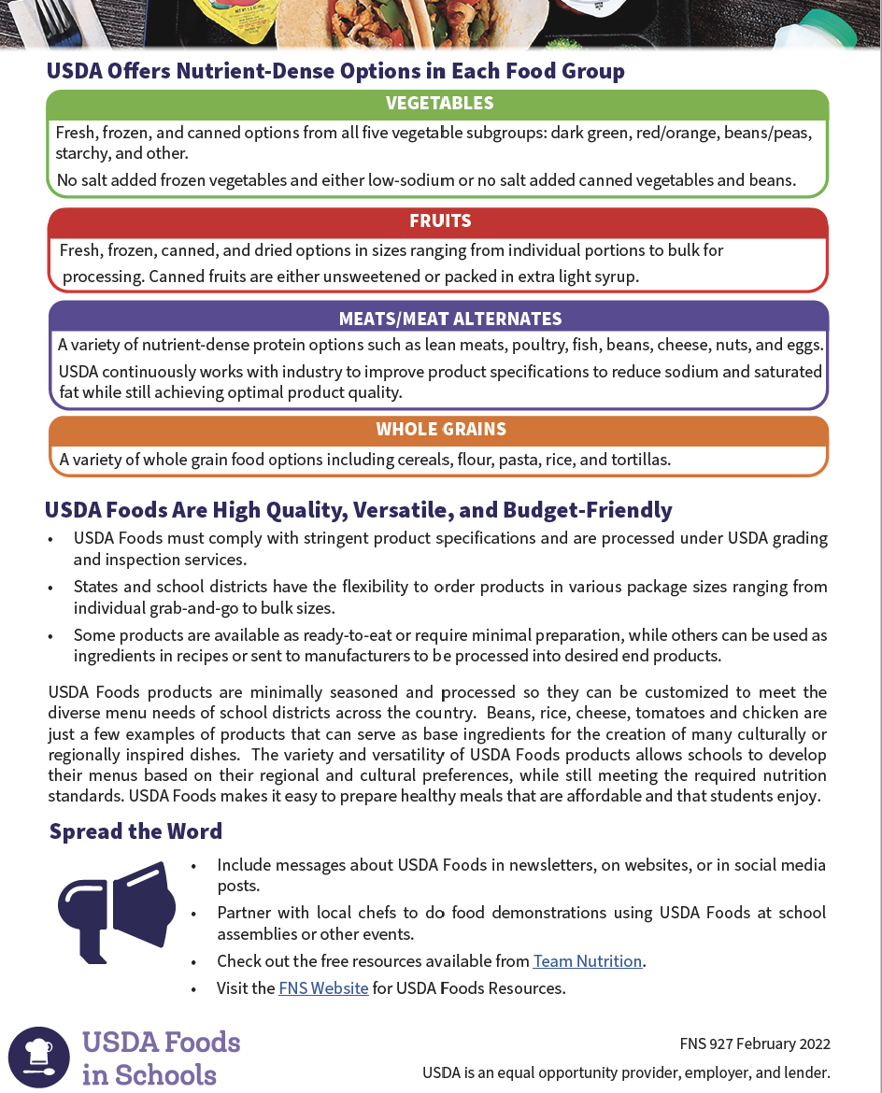

Slide 6
SCHOOL NUTRITION PROGRAM REVENUE
Entitlement – Share of state’s USDA Foods allotment. State spends money on schools’ behalf
Reimbursement – Cash paid for number of meals served

Slide 7
ROLES AND RESPONSIBILITIES
USDA
States - State Distributing Agency (SDA)
Processors
Distributors
Recipient Agency (RA)

Slide 8
STATE ROLES AND RESPONSIBILITIES
Ensures utilization of entitlement
Communicates allocations and surveys to RAs
Consolidates RA orders, coordinates with other SDAs to meet truckload shipping requirements, and forwards requests to USDA for delivery
For Hawaii: 2024 was the first year an order was placed for an RA other than the DOE School Food Services Branch (SFSB)

Slide 9
STATE ROLES AND RESPONSIBILITIES
Determines which Value Pass Through systems will be accepted from processors
Monitors monthly performance reports (MPR) from processors
Signs State Participation Agreements with processors to be able to do business in Hawaii with USDA Foods.

Slide 10
STATE ROLES AND RESPONSIBILITIES
Conducts application/renewal process for RAs to participate in USDA Foods/Food Distribution Program
Monitors, establishes and enforces policies that ensure inventory levels comply with regulation
Provides technical assistance and training to RAs

Slide 11
PROCESSOR ROLES AND RESPONSIBILITIES
Enter into agreements with USDA (NPA) and/or states (processing agreements and SPA) to process USDA Foods
Provides SEPDS to states
Secures performance and surety bonds as required
Responds to bids and contracts from RAs and SDAs for processing USDA Foods

Slide 12
PROCESSOR ROLES AND RESPONSIBILITIES
Maintains tracking system for USDA Foods from receipt through production and delivery
Provides detailed product information for meeting menu and production requirements
Produces products that follow all federal and state requirements including inspections, grading, labeling, etc.

Slide 13
PROCESSOR ROLES AND RESPONSIBILITIES
Meets requirements for child nutrition labeling, as applicable
Provides monthly performance, inventory and production reports to state and FDD
Responds to recalls in accordance with procedures established by USDA

Slide 14
RA ROLES AND RESPONSIBILITIES
Plans menus to meet meal pattern requirements
Determines USDA Foods and quantities to request using entitlement dollars
Forwards responses to surveys to state, designating processor and quantity of USDA Foods to divert

Slide 15
USDA FOODS/Food Distribution
What is ENTITLEMENT?
Participants in the NSLP are eligible for the USDA Foods program
Commodity entitlements are based on a formula that uses a meal rate determined by Congress and the actual number of lunches served between July 1 and June 30 of each year in schools participating in the NSLP.
An estimated entitlement allocation is provided for the start of the school year based on the last completed year with finalized meal counts. The actual entitlement could be adjusted during the school year depending on how the meal counts tally for the current school year.
An RA would receive an allocation determined by its “fair share” that is based on meal counts.

Slide 16
SPENDING YOUR ENTITLEMENT
Department of Defense (DoD) Fresh
– Fresh U.S. Produce
Processing Diversion
– USDA Sends to Contracted Manufacturer
Direct Delivery
– Ready-to-use Products for On-site Preparation

Slide 17
DoD FRESH
Enroll. Must be in Defense Logistics Agency (DLA) distribution area
Request diversion of entitlement
Domestic fruits and vegetables delivered from farmer to school
No additional cost
Bypasses warehouse, storage fees

Slide 18
PROCESSING DIVERSION
Send USDA Foods to processor with school specifications
Schools pay for labor and shipping
Receive consistent product and reduces input costs

Slide 19
PROCESSING DIVERSION
Complicated for schools
Designated person should manage
Costs incurred if processor is late

Slide 20
PROCESSING DIVERSION
Value Pass Through Systems
Rebate/Refund
Direct Discount
Indirect Discount
Fee For Service

Slide 21
DIRECT DELIVERY
Best with proper menu planning (cycle menus) and strategic forecasting
No control over manufacturer for processed products
Sometimes require storage and distribution fees that must be factored into overall cost

Slide 22
MAXIMIZING USDA FOODS
Impacts Food Budget
Lower out-of-pocket expenses
Any entitlement utilization frees up budget for buying commercially

Slide 23
USDA FOODS/Food Distribution
USDA
DEPARTMENT OF DEFENSE
FRESH FRUIT AND VEGETABLE PROGRAM
(DOD FRESH)
Must be ordered online using the Fresh Fruits and Vegetables Order Receipt System (FFAVORS)
Approved User must undergo HCNP orientation before placing orders in FFAVORS
FFAVORS orders must be delivered to the NSLP/SFSP site
FFAVORS produce is only to be used for meals and not for FFVP or snacks
Minimum order for delivery is $150
The Oahu FFAVORS vendor is Manson Products Ph. 808-847-3338
Changes to orders can be made in FFAVORS with at least 4 working days to the delivery date (e.g. at least by Mon. for changes to a Fri. delivery order)
For cancellation of a delivery within 4 days, contact or leave message with Manson order desk if after hours; contact USDA Foods Specialist (Al) Office line 808-784-5566, by Email, or text/call Cell. 808-358-8504.

Slide 24
USDA FOODS/Food Distribution
What is ENTITLEMENT?
Participants in the NSLP are eligible for the USDA Foods program
Commodity entitlements are based on a formula that uses a meal rate determined by Congress and the actual number of lunches served between July 1 and June 30 of each year in schools participating in the NSLP.
An estimated entitlement allocation is provided for the start of the school year based on the last completed year with finalized meal counts. The actual entitlement could be adjusted during the school year depending on how the meal counts tally for the current school year.

Slide 25
USDA FOODS/Food Distribution
CONTACT
USDA Foods Specialist:
Al Tachibana
Office: 808-784-5566
Email: alvin.tachibana@k12.hi.us
Notes:
If you have any questions about the USDA Foods /Commoditties /Food Distribution Program contact

Slide 26
NON-DESCRIMINATION STATEMENT
In accordance with Federal civil rights law and U.S. Department of Agriculture (USDA) civil rights regulations and policies, the USDA, its Agencies, offices, and employees, and institutions participating in or administering USDA programs are prohibited from discriminating based on race, color, national origin, religion, sex, disability, age, marital status, family/parental status, income derived from a public assistance program, political beliefs, or reprisal or retaliation for prior civil rights activity, in any program or activity conducted or funded by USDA (not all bases apply to all programs). Remedies and complaint filing deadlines vary by program or incident.
Persons with disabilities who require alternative means of communication for program information (e.g., Braille, large print, audiotape, American Sign Language, etc.) should contact the State or local Agency that administers the program or contact USDA through the Telecommunications Relay Service at 711 (voice and TTY). Additionally, program information may be made available in languages other than English.
To file a program discrimination complaint, complete the USDA Program Discrimination Complaint Form, AD-3027, found online at How to File a Program Discrimination Complaint and at any USDA office or write a letter addressed to USDA and provide in the letter all of the information requested in the form. To request a copy of the complaint form, call (866) 632-9992. Submit your completed form or letter to USDA by: (1) mail: U.S. Department of Agriculture, Office of the Assistant Secretary for Civil Rights, 1400 Independence Avenue, SW, Mail Stop 9410, Washington, D.C. 20250-9410; (2) fax: (202) 690-7442; or (3) email: program.intake@usda.gov.
USDA is an equal opportunity provider, employer, and lender.

Slide 27
USDA FOODS/Food Distribution
Mahalo!

