Slide 1
Renewal Application
June 2025
Notes:
Aloha! In this presentation, we will discuss the renewal application process. Presented by Hawaii Child Nutrition Programs.

Slide 2
Overview
HCNP Systems
Completing the renewal application
Deadline
Notes:
During this presentation, we will explain:
How to access HCNP Systems,
How to complete the renewal application, and
When the renewal application is due.
This presentation is a review of the renewal application process. We will NOT review each question on the applications, but we will discuss some frequently asked questions and common errors that we find when reviewing the renewal application.

Slide 3
HCNP Systems
HCNP’s web based child nutrition data management program
Go to https://hcnp.hawaii.gov/
Click on ‘HCNP Systems’
Notes:
HCNP Systems is our web based child nutrition data management program. HCNP Systems is where SFAs submit their renewal application, claims, and other important reports and data. To log in to HCNP Systems, go to HCNP’s website (listed on the slide). Then, click on ‘HCNP Systems’.

Slide 4
HCNP Systems
Secure Log In
User Authorization Form
Available at: https://hcnp.hawaii.gov/overview/nslp/
Click on ‘Program Resources’ → ‘HCNP Systems’
Notes:
Each SFA has someone who is designated with Sponsor Admin access. This person is the one with authorization to complete the renewal application.
Remember, your SFA must have at least one person designated with Sponsor Admin access and another person with Sponsor Claims access.
No one is allowed to have access to both Sponsor Admin and Sponsor Claims. Therefore, if you have access to submit claims, you will not be able to complete the renewal application.
Please complete the User Authorization Form for anyone who needs access to the system and/or needs to be inactivated.
This form can be found on HCNP’s public website which is listed on the slide. Click on ‘Program Resources’ and then ‘HCNP Systems’.

Slide 5
SY 25-26 Renewal Application
Email notification was sent on May 30, 2025
Read the instructions carefully before completing the renewal application
Notes:
UPDATED - DONE
On May 30th, 2025, an email notification was sent with information on completing the school year 25-26 Renewal Application.
Please read the email and instructions carefully before completing the renewal application.

Slide 6
HCNP Systems
Notes:
Now, let’s review the renewal process. First, log in to HCNP Systems.
Please remember your HCNP Systems User ID acts as your signature. Therefore, you are accountable for the content of information submitted when using your HCNP Systems User ID. Do NOT share your log in and password with anyone.

Slide 7
Select Program
Notes:
Once you have logged in to HCNP Systems, click on ‘SNP’ (School Nutrition Programs).

Slide 8
Notice Board
Notes:
You’ll see the notice board. Click the “Continue” button.

Slide 9
Select the Program Year
Notes:
UPDATED - DONE:
To begin completing the renewal application for SY 25-26, select Program Year 2026.

Slide 10
Renewal Application
Must complete all three parts:
Application must be in Pending Approval status
Sponsor Application
Site Application(s)
Off-line Forms
Notes:
UPDATED-DONE:
The renewal application consists of 3 parts. All 3 parts must be completed:
Sponsor Application,
Site Application(s), and
Off-line Forms.
Please remember to proceed with completing the renewal application in this order. If any acronyms are used on the Sponsor Application, Site Application(s), and/or the Off-line forms, please spell out the acronyms.
Once you are finished, the application must be in Pending Approval status in order for the Program Specialist to begin the review process. This is VERY important. Every year, a number of SFAs forget to do this. You must double check that the status is in Pending Approval once you are done. We’ll show you towards the end of the presentation how to check what status your application is in.
Now we’ll begin by showing you the first part of the application process, the Sponsor Application.

Slide 11
Check that you are in Program Year 2025
2026
1234-5-ABCDE School
ABCDE School (1234-5)
Notes:
UPDATED - DONE:
This screen shot shows the Sponsor Summary page. We are looking at the “Checklist” tab. The Checklist tab shows the status of the entire renewal application packet.
First, double check that you are in Program Year 2026 in the upper right corner of the screen.

Slide 12
Select the ‘Applications’ tab
2026
1234-5-ABCDE School
ABCDE School (1234-5)
Notes:
Next, click the “Applications” tab to begin the application process.

Slide 13
Add Sponsor Application
ABCDE School (1234-5)
123 ABCDE Elementary School
456 ABCDE Middle School
Notes:
Now we are looking at the “Applications” tab. Notice this SFA has to complete a Sponsor Application and two Site Applications since this SFA has two schools, an elementary school and a middle school.
Click the plus button on the right side to add the Sponsor Application.
If you do not see the plus button as shown on this slide, this means you do not have Sponsor Admin access. We explained earlier in this presentation that the person(s) with Sponsor Admin access for your SFA is authorized to complete the renewal application.

Slide 14
Sponsor Application
Some information from the preceding Program Year will automatically transfer over
Address and Contact Information
Information not carried over
Vendor/FSMC and Contact Information
Wellness Policy
Verification Method
Meal Price Information
Professional Standards
Single Audit Compliance
Notes:
For the Sponsor Application, some information from the previous school year’s approved application will be carried over to the new school year. Data will not prepopulate if the previous school year’s application is in pending approval, pending submission, or needs correction status.
The information that is carried over is information that typically does not change from year to year, such as the address of the SFA.
The information that needs to be entered is information that is most likely to change or information that needs to be updated annually, such as contract and meal price information.
When completing the application, double check all of the information and update the information, as needed, to ensure everything is accurate.

Slide 15
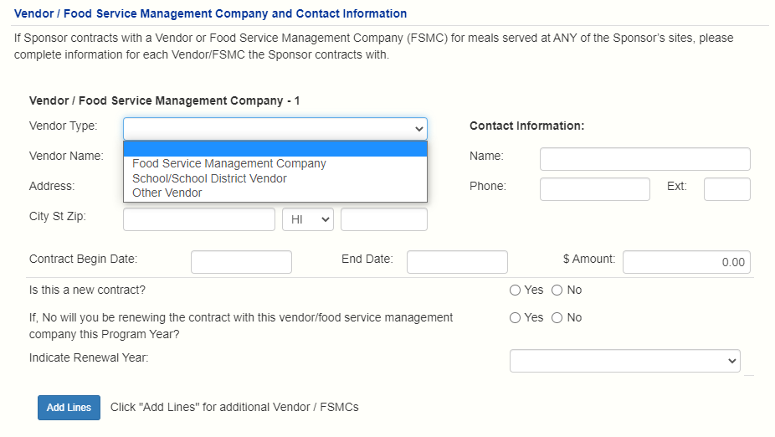
Sample Sponsor Application
Notes:
We are going to take a few minutes to go over some of the areas where we commonly find errors on the Sponsor Application.
This slide shows the Vendor/Food Service Management Company section:
If you have a contract to purchase meals from a vendor or food service management company, enter the information in this section.
For ‘Vendor Type’, make the appropriate selection from the drop down menu:
Food Service Management Company
School/School District Vendor (in other words, another SFA)
Other Vendor
Enter the rest of the information for the vendor.
For ‘$ Amount’, enter the total amount that you anticipate paying for the entire school year.
Then, answer the questions in this section:
Is this a new contract? (select ‘Yes’ if it is a new contract OR select ‘No’ if it is a renewal contract). If ‘Yes’ is selected, proceed to the next section.
If you answered no, answer the question, will you be renewing the contract with this vendor/FSMC this year? (select ‘Yes’ or ‘No’).
For a renewal contract, select the renewal year from the drop down menu (for example, if this is the first year that you are renewing the vended contract, select ‘Year 1’).
If your SFA contracts with more than one vendor for meals, <CLICK> click the “Add Lines” button so you can enter the information for your additional vendor.

Slide 16
Sample Sponsor Application
USDA Eligibility Manual for School Meals, July 2017: https://fns-prod.azureedge.us/sites/default/files/cn/SP36_CACFP15_SFSP11-2017a1.pdf
Notes:
NOTE: check if this question is #27 or #28 in production
For the Verification Method Section, currently, all SFAs that accept free and reduced price applications are using the Standard Method (verify 3% of applications).
If your SFA is interested in the Alternate Methods, please refer to the USDA Eligibility Manual for School Meals. The manual describes the Alternate Methods and the criteria for being able to qualify to use the Alternate Methods. If you think your SFA qualifies for one of the Alternate Methods, your SFA will need to submit documentation to HCNP to demonstrate this.

Slide 17
Sample Sponsor Application
Notes:
NOTE: check numbering in production
Meal Price Information Chart: remember to enter ‘0’ for any meals that you do not serve.
For example, this SFA does not have any preschoolers. Therefore, ‘0’ must be entered for preschool.
If ‘0’ is not entered, you will see an error message for this section.

Slide 18
Sponsor Application
Verify existing information and make any changes
Add information that is not carried over
Certify the information that is not carried over
Certify the information (check the Certification Statement checkbox) and submit the Sponsor Application
If any errors are identified, correct all errors and resubmit
Notes:
To complete the Sponsor Application, verify the existing information that was carried over from the previous school year and make any necessary updates.
Review all of the information on the application to make sure everything is correct. If there are staff that are listed on the application who no longer work at your SFA, please make the necessary updates so HCNP’s directory is updated.
Enter the information that is not carried over from the previous year that is still current.
When the Sponsor Application is complete, certify the information by checking the checkbox and submit the Sponsor Application. If any errors are identified, correct all of the errors and resubmit. Once all errors have been corrected, the status of the Sponsor Application should be ‘Pending Submission’.
Next, we will discuss the second part of the renewal application, the Site Application.

Slide 19
Add Site Application
ABCDE School (1234-5)
123 ABCDE Elementary School
456 ABCDE Middle School
Notes:
After you have completed the Sponsor Application, return to the “Applications” tab and add the Site Application by clicking on the plus button.

Slide 20
Site Application
Most information from the previous year’s approved Site Application will carry over
Contact Information
Program Participation Information (NSLP, SBP, FFVP)
Accountability Information
Information not carried over:
Program Participation (ASP, SSO)
Food Safety Inspection Information
Notes:
Most of the information from the previous year’s approved Site Application will carry over, such as:
Contact Information,
NSLP, SBP, and FFVP sections, AND
Accountability Information.
Make sure everything is still current. If not, make the necessary updates.
Some of the information that is not carried over from the previous year include:
Afterschool Snack Program and Seamless Summer Option sections, and
Food Safety Inspection Information.

Slide 21
Sample Site Application
Notes:
This slide shows part of the General Information section of the Site Application.
We will review some of the common mistakes that are made:
For question #16, Campus Type: Closed Campus means students are not allowed to leave campus during the school day to buy lunch. Open Campus means students are allowed to leave campus during the school day to buy lunch.
For question #20: Are meals served in locations other than the regular dining areas? In other words, are meals counted in multiple locations at your school? Examples include, but are not limited to, classrooms, kiosks, and the gym.
On this slide, this school serves meals in the cafeteria and also serves meals in one preschool classroom. For this school, the answer to question #20 would be “Yes” and for question #21, the school would enter “1” for the one preschool classroom as the other location where meals are counted. If the answer is yes to question #20, your SFA must complete the offline form called, “On-Campus Meal Service and Counting Locations.” We will show you where all of the offline forms are located later in this presentation.
For question #22: Does this site regularly serve meals to students off campus? This does not include occasional field trips. An example of meals being served to students off campus on a regular basis include a school has groups of students that go to another location every day for a Farm to School program where meals are served and counted. If your school answers “Yes” to question #22, enter the number of off campus locations in #23. The Off-Campus Meal Service and Counting Locations form will need to be completed.

Slide 22
Sample Site Application
Residential Child Care Institutions (RCCIs) ONLY:
Answer #24-25
Notes:
For questions #24-25: Licensing information must be entered for RCCIs only (RCCIs are Residential Child Care Institutions). Therefore, if you are a school, do NOT enter any licensing information because this does not apply to you.
For RCCIs, email a copy of the current license to the NSLP Team as part of your renewal application.

Slide 23
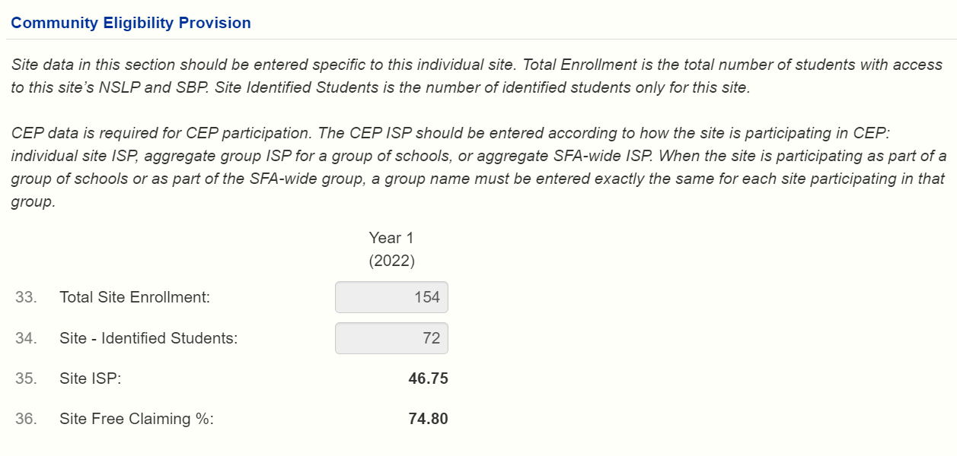
Sample Site Application
Do NOT complete the CEP section
(2026)
Notes:
NOTE: need to check whether or not CEP is in the site app in production. It is removed in UAT.
For the CEP section, do NOT complete this section. The NSLP Specialist will enter your school’s CEP information if your school plans on participating in CEP in the upcoming school year.
It is important to note that SFAs that are participating in CEP will see warning messages under the CEP section. The warning messages in this section will not prevent your application from being submitted. Therefore, you may disregard the warning messages in the CEP section.

Slide 24
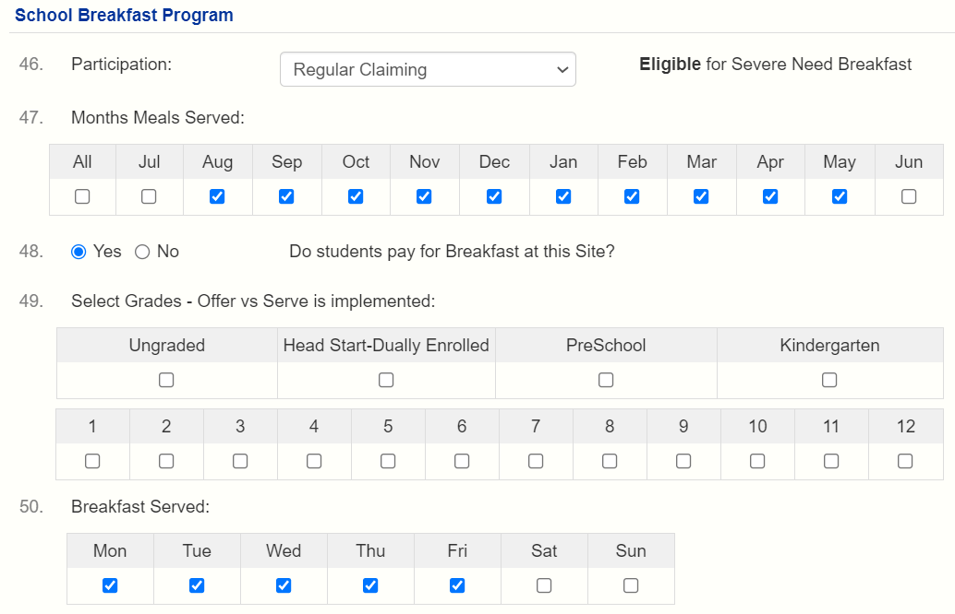
Sample Site Application
Notes:
For the National School Lunch and School Breakfast Program sections, the information that was entered in your approved application last school year will be carried over to the new school year. Review the sections carefully and make any necessary updates.
Here are a few reminders:
For questions #41 and #46: Indicate your participation in NSLP and/or SBP.
Indicate the type of participation:
Regular Claiming OR
Provision 2 or Provision 3 OR
Community Eligibility Provision OR
Not Participating
For questions #42 and #47: Indicate the months when meals will be served. This is important because this enables your SFA to submit your claim for reimbursement. For example, if your school starts in August, but August is not checked, you will not be able to submit an August claim. If this happens, you will need to revise the Site Application.
For questions #44 and #49: If your site does Offer vs Serve (OVS), select the grade levels that implement Offer vs Serve. This information is used during an Administrative Review when we are observing meal service and are identifying whether or not the meals are reimbursable. Therefore, it is very important to make sure the information on the application is correct.

Slide 25
Notes:
For the Afterschool Snack Program section, the information in this section is not carried over from the previous school year.
Complete question #55 by indicating if the site is Participating or Not Participating in the Afterschool Snack Program.
If the site is participating in the Afterschool Snack Program, complete the rest of the section.
Let’s take a few minutes to discuss site eligibility for question #60. <CLICK>
For regular claiming schools, eligibility is based on the most current October data. If your school has at least 50% free and reduced price eligibility, select the second option, Area Eligible, Site free and reduced eligibility 50% or greater. If your school does not have at least 50% free and reduced price eligibility, but is in the attendance area of a school that has at least 50% free and reduced price eligibility, the school is considered area eligible. Select the third option, Area Eligible, Attendance Area free and reduced eligibility 50% or greater. Then, complete questions #61 and #62 to show which school is being used for area eligibility. If your school does not have at least 50% free and reduced price eligibility and is not in the attendance area of a school with at least 50% free and reduced price eligibility, select the first option, Not Area Eligible, site free and reduced eligibility less than 50%.
For CEP schools, if your school is in year one of your CEP cycle, eligibility is based on the most current October data. If your school is in year two through four of the CEP cycle, then the site free claiming % is used to establish area eligibility.
For question #63, list the program name. If there is more than one program that is participating in the Afterschool Snack Program, list all program names.
For question #64, the afterschool care program must include education or enrichment activities. Examples include homework assistance, tutoring, drama activities, and arts and crafts programs. Organized interscholastic programs or community-level competitive sports are not eligible to participate.
If more than one program is listed in question #63, clearly identify the education or enrichment activities for each program.
Just a reminder, if any acronyms are used, please spell out the acronyms.

Slide 26
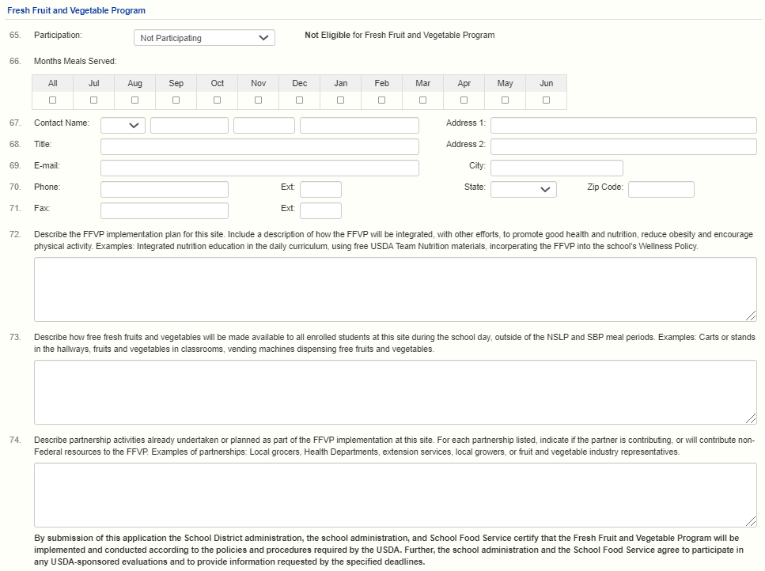
For #72-74, include “2025-26” in each box to indicate updates were made.
If not sure what to enter at this time, enter “2025-26:TBD”.
Notes:
UPDATED – DONE
For the schools that submitted SY 25-26 Fresh Fruit and Vegetable Program (FFVP) applications: The FFVP section may have information that has carried over from the previous school year. Please update any school or contact information as needed. Information should match what was submitted on the FFVP application, but the default FFVP contact would be the school Principal. For question #66, please check all the months when FFVP could be served. If a month is not checked and an FFVP claim is submitted for that month, an error message will appear and block the claim until the month has been checked off. For questions #72-74, be sure to include the school year “2025-26:” in each box to indicate that the FFVP section has been updated for SY 25-26. If you are unsure of what information to enter for the school at this time, enter “2025-26: TBD” for To Be Determined.
Prior to commencing FFVP service in the new school year, schools will need to submit updated FFVP service information (e.g. planned days of service, grade levels to be served, time of service, etc.)

Slide 27
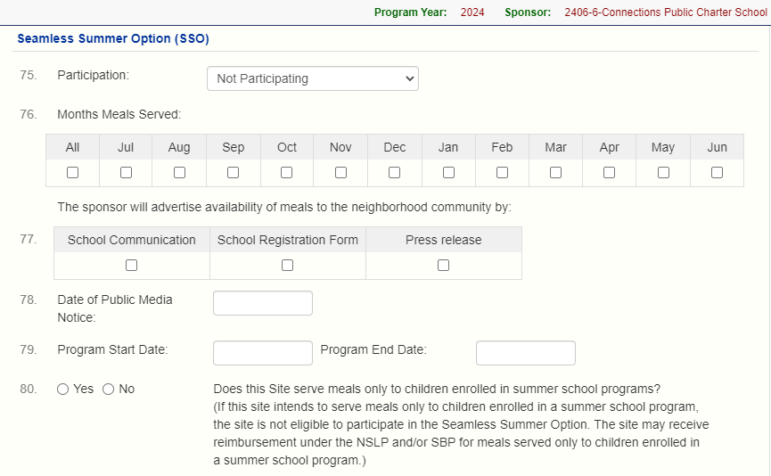
2026
1234-5-ABCDE School
This is July 2025
This is June 2026.
For SSO in June 2025:
revise the Site Application in Program Year 2025
Notes:
UPDATED –DONE
Next, is the Seamless Summer Option (SSO) section. Seamless Summer Option (SSO) information is not carried over from the previous school year.
Complete question #75 by indicating if the site is Participating or Not Participating in SSO for summer 2025.
For SFAs that have informed HCNP that their school(s) will be operating SSO during summer 2025 and have been advised by the NSLP Team to proceed with completing site application(s), please complete this section.
Just a reminder, we are in Program Year 2026. This means that for question #76, July is July 2025 and June is June 2026. Select the months that meals will be served under the SSO during summer 2025.
If your school is operating SSO in June 2025, complete the SSO section in your site application for Program Year 2025.
For questions #77 and #78: Specify how and when the availability of free meals to children was communicated to the families and community and proceed with completing the rest of the section.

Slide 28
2020
2021
2022
2023
2024
Notes:
For question #82, answer this question if the site is operating as an open site or restricted open site. If the site is not operating as an open or restricted open site, skip this question.
When answering question #82, if you answer yes, that the site has at least 50% free and reduced price eligibility, proceed to question #83.
If you answer no, one option is you may use a previous year’s eligibility if this site was previously approved to participate in SSO. To request approval for this option, select the school year in the chart of question #82. The year selected must be at least 50%.
If this option does not apply, or you would like to use a school in the attendance area instead to establish area eligibility, proceed to answer questions #83 and #83B.
If the site is operating as a restricted open site, provide a detailed explanation in question #83D on why attendance is being restricted . Do not only list the explanation, for safety reasons. This is not considered a detailed explanation and the site application will not be approved with this reason.

Slide 29
Notes:
If the site is operating as a closed enrolled site, complete question #84 and indicate the appropriate selection for site eligibility.
For question #84J explain why the site is operating as a closed enrolled site instead of an open site. Provide a detailed explanation. Simply listing for safety reasons is not a detailed explanation and the site application will not be approved.

Slide 30
Notes:
Complete the Seamless Summer Meal Service section.
Up to two meals may be served under SSO, such as breakfast and lunch, lunch and one snack, breakfast and one snack, or one snack and supper.
As a reminder, for meal service times, schools should provide sufficient time to give all students adequate time to be served and to eat their meals. Therefore, the minimum meal service times for open and restricted open sites is one and a half hours per meal service. For closed enrolled sites, the minimum for breakfast, lunch, and supper is 25 minutes each, and snack is 15 minutes.

Slide 31
Notes:
NEW (made new recording)-DONE:
If the site is participating in SSO, proceed with completing the Non-Congregate Meal Service Operation section.
If your site is "NOT" participating in S S O, do "NOT" complete the Non-Congregate Meal Service Operation section.
For SSO sites, question #92 is required, “Do you plan to provide non-congregate meals at this site?”
If “Both” is selected, this means that the site plans on serving both congregate and non-congregate meals under SSO.
If “Yes” or “Both” is selected for question #92, proceed with answering the questions in the section.
If “No” is selected for question #92, the remaining questions do not need to be answered in this section.
This section must be completed if your site would like to request HCNP’s approval to provide non-congregate meals under SSO. As questions are answered, you may notice that some of the questions below it may not be required. For example, if the site will not be providing multiple days of meals, the three questions under that question will not be required.
Please keep in mind that additional information will be requested by HCNP if your SFA plans on serving non-congregate meals.

Slide 32
Notes:
NEW – made recording
Some of the answers in the Non-Congregate Meal Service Operation section have tooltips to help provide clarification. To see the tooltips, hover your cursor over the answer options as shown on the slide.
For example, you can see that a tooltip appears when you hover your cursor over “Both” for question #92.
If “Yes” or “Both” is selected for question #92, proceed with answering the questions in the section.
If “No” is selected for question #92, the remaining questions do not need to be answered in this section.
This section must be completed if your site would like to request HCNP’s approval to provide non-congregate meals under SSO.
As questions are answered, you may notice that some of the questions below it may not be required. For example, if the site will not be providing multiple days of meals, the next three questions will not be required.
After you have completed this section, HCNP will request for additional information from your SFA if your SFA plans on serving non-congregate meals.

Slide 33
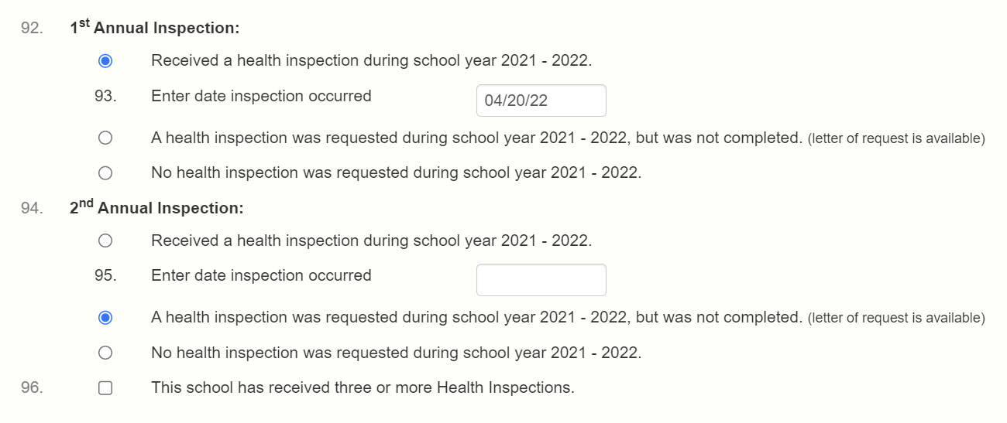
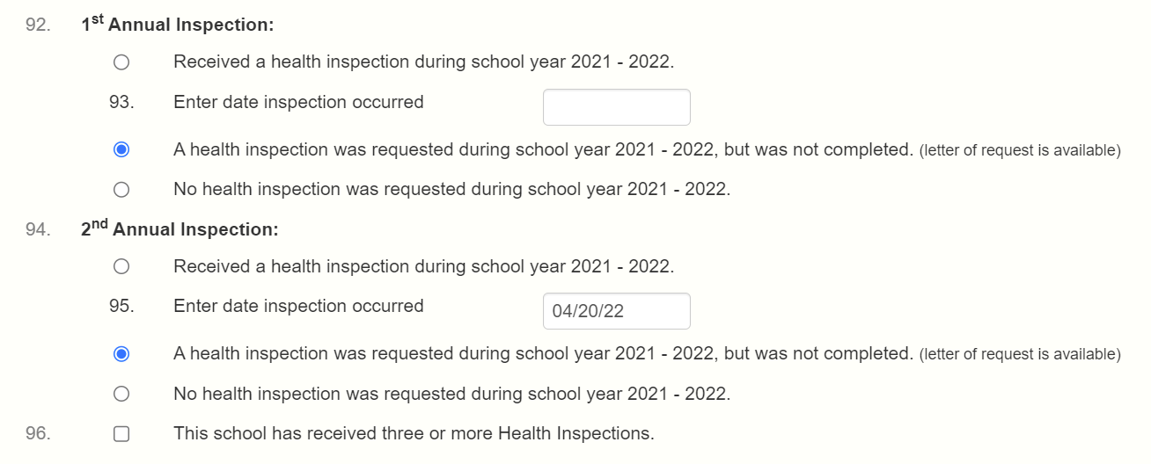
93.
2023 - 2024.
94.
04/15/2025
2023 - 2024, but
2023 - 2024.
95.
2023 - 2024.
96.
CORRECT
2023 - 2024, but
2023 - 2024.
97.
93.
2023 - 2024.
94.
2023 - 2024, but
2023 - 2024.
95.
2023 - 2024.
96.
04/15/2025
WRONG
2023 - 2024, but
2023 - 2024.
97.
Notes:
UPDATED - DONE:
Under the Food Safety Inspection section, enter the dates of the inspections that the site received in SY 24-25.
SFAs continue to complete this section incorrectly. This slide shows an example of the correct way and the wrong way to complete this section. In this example, a school requested to be inspected twice but only received one inspection on April 15, 2025.
The top half of the slide shows the correct way to enter this data. The school received their first inspection on April 15, 2025 and requested for the second inspection but did not receive it.
The bottom half of the slide shows what NOT to do. It is not correct to say that the school did not receive the first inspection but received the second one. If your school received only one inspection, it is considered your first inspection regardless of when it was during the school year.
Please make sure the food safety inspection section is completed correctly.

Slide 34
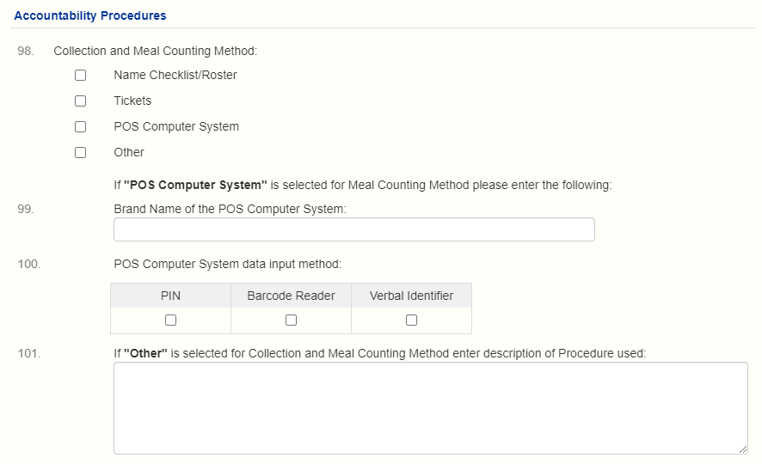
Notes:
The information under Accountability Procedures is carried over from the previous school year.
Double check that all of the information is correct and applies to this school year.

Slide 35
Notes:
UPDATED-DONE:
For question #102 Student Payments, remember to select ‘Non-Pricing’ if the site is:
Implementing CEP or Provision 2, or
An RCCI with no day students.
For question #103 Point of Service, this is asking how meals are counted. If meals are counted at the end of the line, select End of Line. End of line means an adult is at the end of the serving line checking whether or not the student has a reimbursable meal and is doing the meal counting.
If meals are not counted at the end of the line, select Exception. Then, proceed with either selecting question #104 if meals are counted as described, or complete question #105 and explain how meals are counted.

Slide 36
Site Application
Verify existing information and make any changes
Add information that is not carried over
Certify (check the Certification Statement checkbox) and submit application
If any errors are identified, correct errors and resubmit
Notes:
When completing the Site Application,
Verify the information that is carried over and make any necessary updates.
Add information that is not carried over.
When the Site Application is complete, certify the information by checking the checkbox and submit the Site Application.
If any errors are identified, correct the errors and resubmit. Once all errors have been corrected, the status should be ‘Pending Submission’.
Next, we are going to talk about the third part of the renewal application, the Off-line Forms.

Slide 37
Off-line Forms
Off-line forms must be submitted to HCNP as part of the renewal application
Upload off-line forms by clicking the upload button
Forms marked with the red check mark are REQUIRED
Notes:
Off-line forms are part of the renewal application. Therefore, your SFA must complete all required off-line forms. Remember to submit the off-line forms by uploading the forms into HCNP Systems using the upload button, which is very similar to including an attachment to an email.
The required off-line forms are marked with a red check mark. However, there are a few more forms that will not have a red check mark that will also need to be completed.

Slide 38
Off-line Forms
Single Agreement
Must be signed and submitted if your SFA had a change in SFA leadership within the last school year
Fresh Fruit and Vegetable Program Application
Must upload if participating in FFVP
Off-Campus Meal Service and Counting Locations
Must upload if ‘Yes’ to question #22 on site application
Notes:
UPDATED – DONE
This slide shows other offline forms that are also required, even if there is no red check mark next to it.
First, the Single Agreement. The Single Agreement will not have a red check mark but must be signed only if your SFA has had a change in SFA leadership within the last school year. For the purpose of this agreement, SFA leadership includes the Superintendent, Board Chairman, Director, Administrator, and/or Food Service Director. Please read the document carefully. The Single Agreement will be accepted electronically. Therefore, you do not need to mail two hard copies. Please upload the ENTIRE agreement into HCNP Systems; not just the signature page.
Second, the Fresh Fruit and Vegetable Program Application. If your SFA has any sites that will be participating in FFVP, upload the FFVP application(s).
Third, the Off-Campus Meal Service and Counting Locations form. If your SFA has any sites that answered ‘Yes’ to question #22 on the site application, upload the completed Off-Campus Meal Service and Counting Locations form.

Slide 39
ABCDE School (1234-5)
Notes:
The off-line forms are located on the “Checklist” tab, as shown on this slide. Before we discuss the off-line forms, let’s look at the top right section of this slide.
You can see that the Sponsor Application and the two Site Applications for this SFA are in Pending Submission status. <CLICK> This means the SFA has completed "two" of the three parts of the renewal application.
Now let’s look at the off-line forms. Below the Sponsor and Site Applications, there is a section called “Off-line Forms Description” that lists the different off-line forms.
For this SFA, there are five off-line forms that have a red check mark. <CLICK>The SFA must complete and upload the forms with a red check mark. The red check mark appears based on the information entered on the Sponsor Application and Site Applications. Most of the off-line forms have a downloadable form to complete under the “Downloads” column. The other off-line forms without a downloadable form means your SFA must submit the documentation that you have to HCNP.
For example, the SFA on this slide receives vended meals. There is a red check mark next to Vended Meals Contract. Therefore, the SFA must submit their executed Vended Meals Contract. There is no PDF icon next to the “Vended Meals Contract” because this is a document between the SFA and the vendor.

Slide 40
ABCDE School (1234-5)
Notes:
UPDATED- DONE
As we mentioned in one of the previous slides, there are other forms that must be submitted even if there is no red checkmark: <CLICK>
SFAs must submit the Single Agreement only if your SFA has had a change in SFA leadership within the last school year. (This is the first off-line form listed),
Second, if your school is participating in FFVP in school year 25-26, upload your completed FFVP application (which is off-line form #14). For SFAs with more than one school participating in FFVP, multiple applications must be combined into a single file attachment to upload.
Third, if your SFA answered ‘Yes’ to question #22 on the site application, the SFA must upload the completed Off-Campus Meal Service and Counting Locations form (this is off-line form #15).
To upload the off-line forms, look at the “Action” column on the right. <CLICK> Click on the blue upload button to upload the completed off-line forms. Uploading the off-line form is similar to adding an attachment to an email.

Slide 41
06/01/2025
06/01/2025
Notes:
UPDATED-DONE:
After you have selected the Off-line form file to upload, the date will be recorded under the Date Sent and Date Received columns. Under the Action column, you have the option to view the file you have opened and/or delete the file if you uploaded the wrong file.
As a friendly reminder, upload the entire document into the renewal application, not just the page with the signature. It is unacceptable to only submit the signature page without the rest of the document.
An important note about the Free and Reduced Price Meal Policy Statement, please include any addendums to specify changes made to this policy statement. For example, if your SFA uses a web-based free and reduced price application in addition to using HCNP’s prototype free and reduced price paper application, please submit an addendum to the Free and Reduced Price Meal Policy Statement.

Slide 42
Final Steps
At the bottom of the Checklist tab, you should see “Submit to the State for Approval”
Click to submit your renewal application to the State for approval
Check that your application is in “Pending Approval” status
Notes:
After all of the required forms have been uploaded, click the button on the bottom to “Submit all forms to the State for Approval”.
After clicking the button, the application should be in Pending Approval status. It is very important to make sure your application says “Pending Approval”. Let’s take a look at what this looks like.

Slide 43
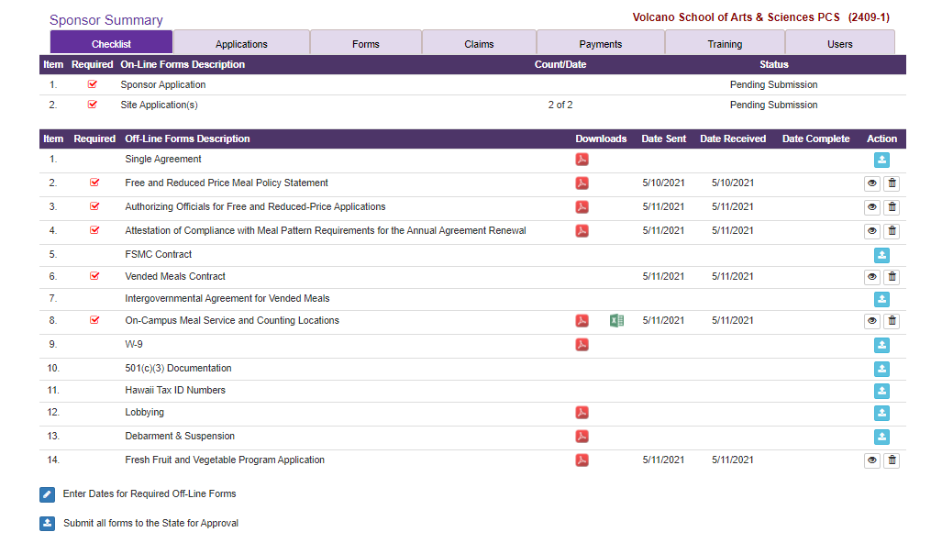
ABCDE School (1234-5)
06/01/2025
06/01/2025
06/01/2025
06/01/2025
06/01/2025
06/01/2025
06/01/2025
06/01/2025
06/01/2025
06/01/2025
06/01/2025
06/01/2025
06/01/2025
06/01/2025
Remember to do this last step
Notes:
This slide shows the Sponsor and Site Applications for this SFA are in Pending Submission status and the required offline forms have been uploaded, including the Single Agreement, and FFVP Application. This SFA completed all of the three parts of the renewal application and is now ready to submit it to HCNP.
To submit the renewal application, go to the bottom and click on the blue button to ‘Submit all forms to the State for Approval’.
Every year, many SFAs forget to do this last step. If this step is not completed, your application will remain in Pending Submission status and the NSLP Team will not review your application.
If you think you are ready to submit your renewal application but do not see the blue submit button, this means you have not completed all of the necessary steps. Double check that the Sponsor and Site Applications are in Pending Submission status and that all of the required off-line forms have been uploaded.

Slide 44
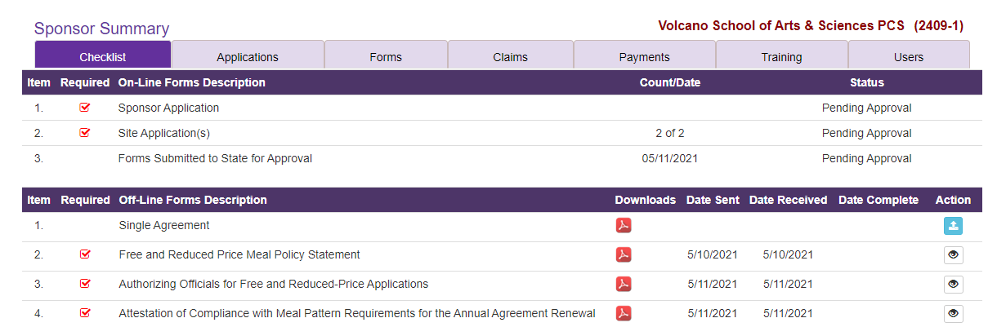
Pending Approval Status
ABCDE School (1234-5)
ABCDE School (1234-5)
05/01/2025
06/07/2023
06/01/2025
06/01/2025
06/01/2025
06/01/2025
06/01/2025
06/01/2025
Make sure the status is PENDING APPROVAL
Notes:
After submitting the application, double check that the status is in “Pending Approval” status. The NSLP Specialist will only review applications that are in Pending Approval status.

Slide 45
Approval Process
NSLP Specialist will review the Sponsor Application, Site Application(s), and Off-line forms
Specialist will either approve the renewal or send forms back to the SFA for correction
SFA must make all corrections and resubmit the application
The application is approved when the status is ‘Approved’
Notes:
Once the application is in Pending Approval status:
- The NSLP Specialist will review the Sponsor Application, Site Applications, and Off-line forms.
- The Specialist will either approve the renewal application or send forms back to the SFA for correction.
- The SFA must make all corrections and resubmit the application.
The application is approved when the status is “Approved”.

Slide 46
Deadline
SY 25-26 Renewal Application:
MONDAY, JUNE 30, 2025
Notes:
NEED TO UPDATE:
Be sure to mark your calendar! The SY 25-26 Renewal Application is due by Monday, June 30, 2025.

Slide 47
Reminders
Three parts to the renewal application: Sponsor Application, Site Application(s), and Offline forms
Make sure all information is accurate and up to date
Complete and upload all offline forms with the red check mark
Complete and submit the Single Agreement – applies to ALL SFAs
If applicable, upload the FFVP application(s) and completed Off-Campus Meal Service and Counting Locations form
Make sure the status is in Pending Approval
Deadline: Monday, June 30, 2025
Notes:
We went over a lot of information during this presentation. We want to highlight some important things to remember when completing the renewal application:
There are three parts to the renewal application: the Sponsor Application, the Site Application(s), and the Offline forms.
Make sure all information is accurate and up to date.
For the offline form, complete and upload all offline forms with the red check mark.
There will be some offline forms that must be completed, even if there is no red check mark. For example, ALL SFAs must complete and submit the Single Agreement even if there is no red check mark.
If your SFA is participating in the Fresh Fruit and Vegetable Program, upload the FFVP application(s), even if there is no red check mark.
If your SFA answered ‘Yes’ to question #22 on the site application, upload the completed Off-Campus Meal Service and Counting Locations form, even if there is no red check mark.
After you have completed and submitted the renewal application, double check that the status of the renewal application is in Pending Approval status. If it is not in Pending Approval status, the renewal application has not been submitted and the NSLP Specialist will not review or approve your SFA’s application.

Slide 48
Please take the Renewal Application Training Quiz
Go to: https://forms.gle/GaLcAXoA9xntRwGw8
Code word: HCNP Systems
Notes:
NEED TO UPDATE - DONE:
Please remember to complete the Renewal Application Training quiz after viewing this presentation.
The link to take the Renewal Application Training quiz is available in the description box that is displayed below this video. For your convenience, you can copy and paste the link into your web browser to access the training quiz.
You will need to enter the code word that is shown on this slide to access the quiz.
You must score at least 80% to receive a certificate for your professional standards training hours. If you do not score at least 80% on your first try, you may re-take the quiz.

Slide 49
Notes:
On behalf of the HCNP team, we want to say “thank you!” for all of your hard work and dedication in feeding Hawaii’s Keiki! Children’s access to nutritious meals could not have happened without your tireless efforts.

Slide 50
Questions
NSLP Team:
rachel.itano@k12.hi.us and kasey.kawamoto@k12.hi.us
(808) 587-3600
Notes:
If you have any questions about completing the renewal application, feel free to contact the NSLP Team at Hawaii Child Nutrition Programs.

Slide 51
In accordance with federal civil rights law and U.S. Department of Agriculture (USDA) civil rights regulations and policies, this institution is prohibited from discriminating on the basis of race, color, national origin, sex (including gender identity and sexual orientation), disability, age, or reprisal or retaliation for prior civil rights activity.
Program information may be made available in languages other than English. Persons with disabilities who require alternative means of communication to obtain program information (e.g., Braille, large print, audiotape, American Sign Language), should contact the responsible state or local agency that administers the program or USDA’s TARGET Center at (202) 720-2600 (voice and TTY) or contact USDA through the Federal Relay Service at (800) 877-8339.
To file a program discrimination complaint, a Complainant should complete a Form AD-3027, USDA Program Discrimination Complaint Form which can be obtained online at: https://www.usda.gov/sites/default/files/documents/USDA-OASCR%20P-Complaint-Form-0508-0002-508-11-28-17Fax2Mail.pdf, from any USDA office, by calling (866) 632-9992, or by writing a letter addressed to USDA. The letter must contain the complainant’s name, address, telephone number, and a written description of the alleged discriminatory action in sufficient detail to inform the Assistant Secretary for Civil Rights (ASCR) about the nature and date of an alleged civil rights violation. The completed AD-3027 form or letter must be submitted to USDA by:
mail: U.S. Department of Agriculture Office of the Assistant Secretary for Civil Rights 1400 Independence Avenue, SW Washington, D.C. 20250-9410; or
fax: (833) 256-1665 or (202) 690-7442; or
email: program.intake@usda.gov
This institution is an equal opportunity provider.

