Slide 1
FNS-742 Verification Collection Report
RCCI and CEP Schools
SY 2020-21

Slide 2
FNS-742 – What is it?
The FNS-742, also known as the Verification Collection Report, is an annual report submitted to the USDA
It is a report that explains the results of verification for each participating SFA, and must be completed by ALL SFAs, including Community Eligibility Provision (CEP) Schools and Residential Child Care Institutions (RCCI)
As an SFA, you are responsible for completing the report and submitting it to HCNP for processing and forwarding

Slide 3
FNS-742 in HCNP Systems
Log into HCNP Systems
http://www.cnpweb.org/hawaii/Login
Go to the Forms tab
Click the + symbol for the Verification Report (circled in red above)

Slide 4
Section 1 – Sites and Students
CEP SFAs: 1-1A: Total Number of Schools/Sites and 1-1B: Total Number of Students (red boxes)
RCCIs ONLY: DO NOT complete 1-1A or 1-1B. Instead, complete lines 1-2A, 1-2B, 1-2bA, and 1-2bB (yellow boxes)
These numbers must be reflective of the last operating day of October

Slide 5
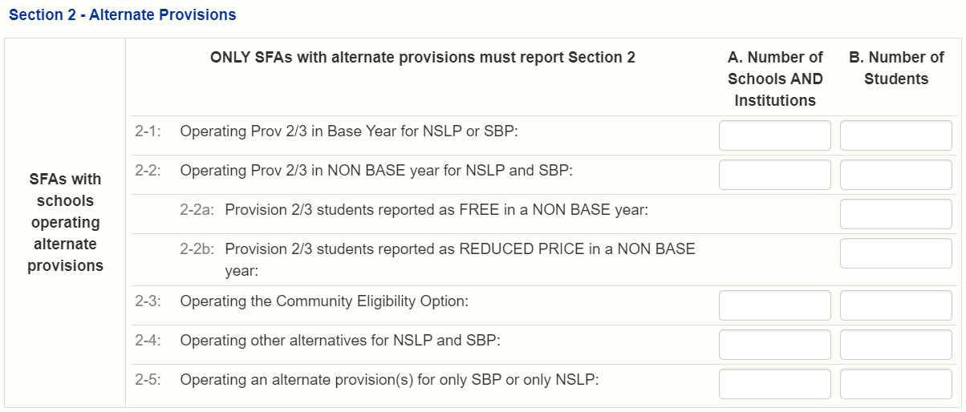
Section 2 – Alternate Provisions
CEP SFAs: complete both 2-3A and 2-3B (red boxes) entering the same numbers entered in Section 1
RCCIs: skip Section 2 and proceed to Section 3

Slide 6
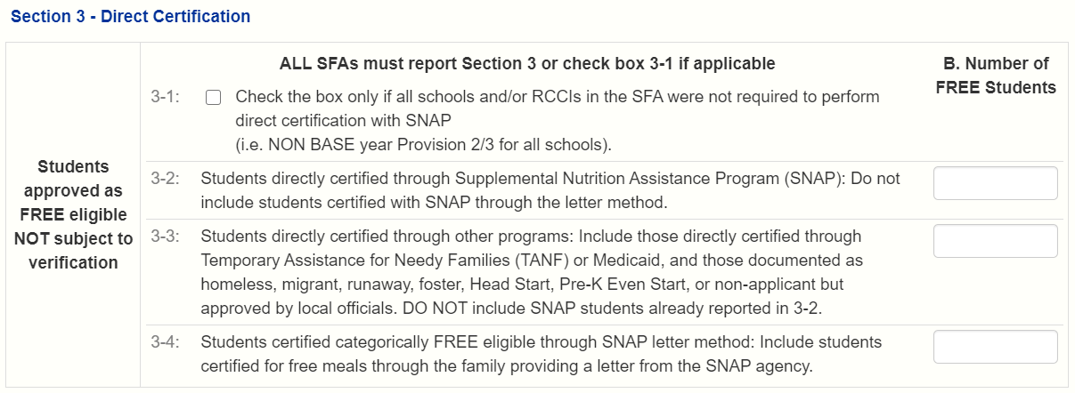
Section 3 – Direct Certification
RCCIs and CEP SFAs – check box 3-1, skip Section 4, and proceed to Section 5

Slide 7
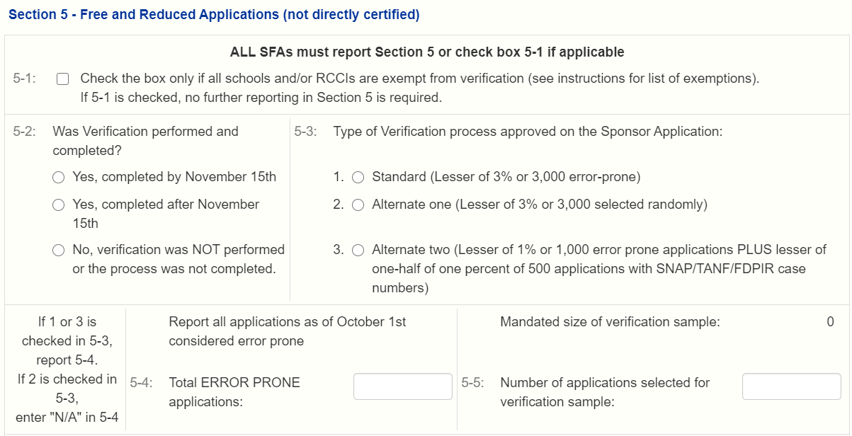
Section 5 – Free and Reduced Applications (not directly certified)
After skipping Section 4, both RCCIs and CEP SFAs will check Box 5-1. No further action is required in Section 5, proceed to Section 6

Slide 8
Section 6 – Verification for Cause / Certification
Before signing and submitting form, both RCCIs and CEP SFAs must write “N/A” in VC-1. Do not include quotations, write exactly as N/A

Slide 9
Section 6 – Verification for Cause / Certification
Complete the report by entering your information in 6-1 and check Box 6-2.
Save the report and exit from it. You should then see the Verification Report’s status listed as ‘Pending Approval’. HCNP will review for accuracy and let you know if changes are needed.

Slide 10
Non-Discrimination Statement

