Slide 1


Civil Rights and
Child Nutrition Programs
(revised 9/2022) by
Notes:
Introduction: Pass out handouts and sign in
Hello everyone thank you very much for attending our annual training. Today we are going to review Civil Rights Compliance in the Child and Adult Care Food Program. The propose of this training is to assure that all your staff understand and can recognize discrimination, Civil Rights complaints, and procedures.

Slide 2
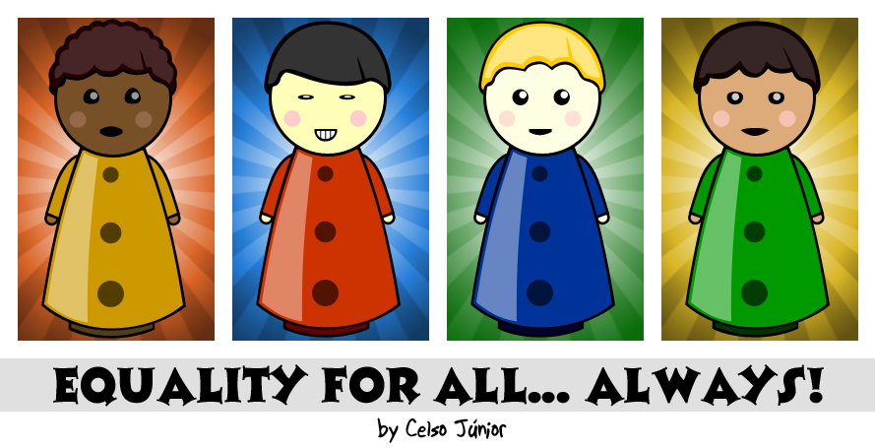
What are
Civil Rights?

Slide 3
Civil rights are the rights of individuals to receive equal treatment (and to be free from unfair treatment or "discrimination") in a number of settings; including education and employment.

Slide 4

Civil Rights and Child Nutrition Programs
Benefits of Child Nutrition Programs (CNP) must be available to all eligible people in a nondiscriminatory manner.
All Institutions participating in a Child and Adult Care Food Program (CACFP) and receiving federal $$ must implement civil rights requirements.
Notes:
Read all slide

Slide 5
History of Civil Rights Laws
Title VI of Civil Rights Act of 1964- Prohibits discrimination on the basis of race, color and national origin.
Title IX of Education Amendment of 1972- Prohibits discrimination on the basis of sex.
Section 504 of Rehabilitation Act of 1973- Disability
Age Discrimination Act of 1975- Prohibits discrimination on the basis of age.
Civil Rights Restoration Act of 1987- Recipients of federal funds must comply with civil rights laws in all areas, not just programs receiving federal funding.
Notes:
These are the important Civil Rights Laws

Slide 6


What is Discrimination?

Slide 7

Discrimination is the unjust or prejudicial treatment of different categories of people or things, especially on the grounds of race, color, age, sex, national origin, or disability.
Notes:
Read slide
Preventing discrimination is a key component of civil rights training. Discrimination complaints are defined as, “Any complaint filed by persons (non-employee), organizations or companies who, based on being a member of a protected class, allege discrimination in a program or activity conducted or assisted.”

Slide 8

Discrimination
The 4
“D”s
When an individual or group of individuals are:
Delayed in receiving benefits or services others receive
Denied benefits or services others receive
Treated Differently than others to their disadvantage
Given Disparate treatment for something which does not seem discriminatory, but has a discriminatory impact.
Notes:
1.) These are the 4 D’s when determining discrimination
1.) Read slide

Slide 9


Discrimination Examples
Refusing enrollment based on disability
Failure to provide reasonable accommodation
Serving meals at a time, place, or in a manner that is discriminatory
Failing to provide non-English materials
Notes:
A few examples of potential discrimination may be: refusing a person’s enrollment in a program based on disability, failure to provide reasonable accommodation to disabled individuals, serving meals at a time, place, or in a manner that is discriminatory, or failing to provide materials that give non-English speaking persons full and equal opportunity to receive benefits.
Child Nutrition Programs often take place in low income neighborhoods, where, due to economic disadvantage, children and parents have extraneous circumstances to overcome in regard to their food security. Civil rights are in place to protect children and families from being discriminated against while participating in USDA funded food programs.

Slide 10
Areas of Compliance
Annual Training
Assurances
Public Notification System
Data Collection
Reasonable Accommodation of Persons with Disabilities
Limited English Proficiency
Customer Service
Conflict Resolution
Complaint Procedure
Compliance Review
Resolution of Noncompliance

Slide 11
CACFP Meal Compliance
CACFP meal benefit forms (MBF) must be distributed and processed in a nondiscriminatory manner.
Meal benefit forms must accessible to all.
Distribution of MBF’s must be done in a way that does not discriminate within the six protected classes.
Does meal service allow equal participation regardless of race, color, sex, age, national origin, or disability?
Notes:
Read all slide

Slide 12
Civil Rights Training
All staff should:
Receive training on compliance annually
Be able to identify complaints
Handle complaints in accordance with procedures
Understand basic right of individual to file complaint
Notes:
Identify

Slide 13

CNPs have six
“Protected Classes”
Race
Color
Sex (including gender identity and sexual orientation)
Age
National Origin
Disability
Notes:
The class of religion is not a protected class in the Child Nutrition Program

Slide 14

Assurances
To qualify for Federal assistance, the Institution must provide written assurance that CNP will operate in compliance with all nondiscrimination laws, regulations, instructions, policies, and guidelines.
Covered in “Agreement Between the Institution and the Department of Education, Hawaii Child Nutrition Programs”
Notes:
1.) Read Slide
2.) The Institution’s agreement defines your compliance.

Slide 15

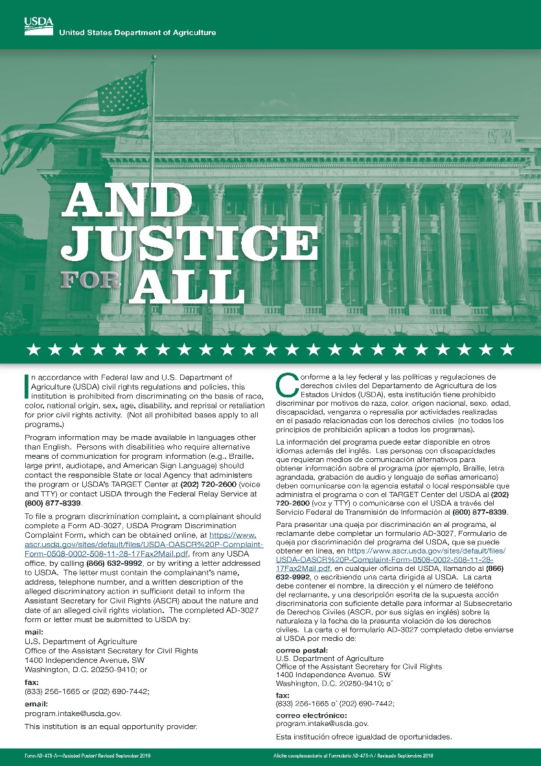
“And Justice For All”
Poster must be displayed in prominent areas where participants and potential participants will be able to view it.
Notes:
15
You can place the poster in the meal service area, school lobby, or in the Main Office. It has to be visible to the children, teachers, and parents. We do have posters in our office for your Institution so let me know your needs. You also need to check to see that you have the current poster. Failure to post current poster will be a finding during a review. 1999 revised

Slide 16

Nondiscrimination Statement Long Version (part 1)
In accordance with federal civil rights law and U.S. Department of Agriculture (USDA) civil rights regulations and policies, this institution is prohibited from discriminating on the basis of race, color, national origin, sex (including gender identity and sexual orientation), disability, age, or reprisal or retaliation for prior civil rights activity.

Slide 17
Nondiscrimination Statement Long Version (part 2)
Program information may be made available in languages other than English. Persons with disabilities who require alternative means of communication to obtain program information (e.g., Braille, large print, audiotape, American Sign Language), should contact the responsible state or local agency that administers the program or USDA’s TARGET Center at (202) 720-2600 (voice and TTY) or contact USDA through the Federal Relay Service at (800) 877-8339.

Slide 18
Nondiscrimination Statement Long Version (part 3)
To file a program discrimination complaint, a Complainant should complete a Form AD-3027, USDA Program Discrimination Complaint Form which can be obtained online at: https://www.usda.gov/sites/default/files/documents/USDA-OASCR%20P-Complaint-Form-0508-0002-508-11-28-17Fax2Mail.pdf

Slide 19
Nondiscrimination Statement Long Version (part 4)
Call (866) 632-9992, or Write a letter addressed to USDA. The letter must contain the complainant’s name, address, telephone number, and a written description of the alleged discriminatory action in sufficient detail to inform the Assistant Secretary for Civil Rights (ASCR) about the nature and date of an alleged civil rights violation. The completed AD-3027 form or letter must be submitted to USDA by:

Slide 20
Nondiscrimination Statement Long Version (part 5)
mail:
U.S. Department of Agriculture
Office of the Assistant Secretary for Civil Rights
1400 Independence Avenue, SW
Washington, D.C. 20250-9410; or
fax:
(833) 256-1665 or (202) 690-7442; or
email:
program.intake@usda.gov
This institution is an equal opportunity provider.

Slide 21



Nondiscrimination Statement Short Version
“This institution is an equal opportunity provider.”
Use short version on all documents pertaining to CACFP where space is limited.
Long version is preferred when there is allowable space. ie. Family Handbooks

Slide 22
Materials requiring nondiscrimination statement include:
Meal Benefit Forms
Menus
Employee Handbook
Newsletters
Flyers
Websites
Brochures
Advertisement
Notes:
1.) Here are some of the materials that you can included the nondiscrimination statement on.

Slide 23

Public Notification
All sites must provide materials in appropriate translations concerning availability and nutritional benefits of meals in CNPs.
USDA NSLP translations website http://www.fns.usda.gov/cacfp/meal-benefit-income-eligibility
All CNPs must display 11x17 “And Justice For All” nondiscrimination poster in a prominent place.
Notes:
1.) Read slide
2.) You can find translations of the Free and Reduced Policy and Procedures on the USDA website.

Slide 24
Public Notification (continued)
CNPs must make program information available to the public upon request.
  Free & Reduced Price Press Release
Upon initial visit, parents must be given specific program information pertinent to receipt of benefits through CNPs.
  Meal Benefit Form
Nondiscrimination statement and a procedure for filing a complaint must be readily available to households participating in program.
Notes:
Read slide

Slide 25


Data Collection and Maintenance
Ensure that racial/ethnic data are collected annually and maintained on file for 3 years + current year for each site
Two Categories shall be used when collecting and reporting race and ethnicity
Notes:
1.) Read Slide
2.) Data collection can be addressed in application process, Students enrollment forms, etc. This data is collected for the purpose of nondiscrimination procedures.

Slide 26
Data Collection and Maintenance
1.) Ethnicity-
Hispanic/Latino
    A person of Cuban, Mexican, Puerto Rican, South or Central American, or other Spanish culture or origin - regardless of race
or
Non-Hispanic/Non-Latino
Notes:
Sponsors may develop a system of data collection specific for their individual organization.
Data documentation must be kept for three years plus the current year per USDA or longer if required by your agency. When obtaining data, both ethnicity and race need to be recorded for each participant.
Ethnicity refers to the question: “Is a person Hispanic or Latino or Not Hispanic or Latino?” Participants can choose from either category.

Slide 27

Data Collection and Maintenance
2. Racial Categories
Black or African American – A person having origins in any of the black racial groups of Africa
White - A person having origins in any of the original peoples of Europe, the Middle East, or North America
Asian - A person having origins in any of the peoples of the Far East, Southeast Asia, or the Indian subcontinent, including: Cambodia, China, India, Japan, Korea, Malaysia, Pakistan, the Philippine Islands, Thailand, and Vietnam
Notes:
Race refers to specific country of origin of the program participant. Racial categories include:
Black or African American – A person having origins in any of the black racial groups of Africa.
White - A person having origins in any of the original peoples of Europe, the Middle East, or North America.
Asian - A person having origins in any of the peoples of the Far East, Southeast Asia, or the Indian subcontinent, including: Cambodia, China, India, Japan, Korea, Malaysia, Pakistan, the Philippine Islands, Thailand, and Vietnam.
(racial categories continue on next slide)
Native Hawaiian or Other Pacific Islander - A person having origins in any of the original peoples of Hawaii, Guam, Samoa, or other Pacific Islands.
American Indian or Alaskan Native - A person having origins in any of the original peoples of North America (including Central America) who maintains tribal affiliation or community attachment.
Please make sure that all program participants are documented by both Ethnicity and Race. Data is used to help determine areas of potential need and help prevent any discrimination of the participant or a group of participants.

Slide 28
Data Collection and Maintenance
2. Racial Categories
Native Hawaiian or Other Pacific Islander - A person having origins in any of the original peoples of Hawaii, Guam, Samoa, or other Pacific Islands
American Indian or Alaskan Native - A person having origins in any of the original peoples of North America (including Central America) who maintains tribal affiliation or community attachment
Notes:
Native Hawaiian or Other Pacific Islander - A person having origins in any of the original peoples of Hawaii, Guam, Samoa, or other Pacific Islands.
American Indian or Alaskan Native - A person having origins in any of the original peoples of North America (including Central America) who maintains tribal affiliation or community attachment.
Please make sure that all program participants are documented by both Ethnicity and Race. Data is used to help determine areas of potential need and help prevent any discrimination of the participant or a group of participants.

Slide 29
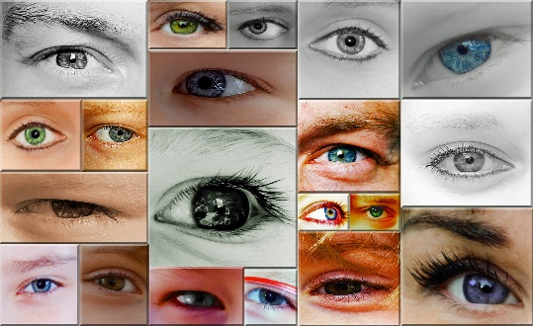

Data Collection and Maintenance
(continued)
Complete Civil Rights Ethnic Data Report annually by October 31.
Parents are asked to voluntarily identify racial/ethnic group of children on MBF.
Visual identification MAY NOT be used by Institution to determine a child’s racial/ethnic category.
Notes:
Sponsors are required to report ethnicity and race of all program participants annually. The preferred method of data collection, according to Food and Nutrition Service, is self identity. For example, a parent checks an ethnicity or race box on their enrollment form. In the case that no self identification is made, a visual identification should be documented.
Please remember you CANNOT ask a child his or her race or ethnicity.
State agencies require annual reporting on the ethnic and racial data of participants. Each Child Nutrition Program area has a data collection form specific to their program posted on the hcnp website, http://hcnp.hawaii.gov .

Slide 30

Limited English Proficiency
If a significant number or proportion of eligible population needs service or information in a language other than English to be informed of or to participate, the institution shall take reasonable steps to provide appropriate language translations to such persons.

Slide 31
Limited English Proficiency (continued)
Consider ….
Number of Limited English Proficiency individuals participating in CNP
Frequency of contact
Nature and importance of Program
Resources available

Slide 32

Limited English Proficiency (continued)
Enrollment statements
Meal Benefit Forms
Menus
Informational brochures
Letters to families and notifications
Nondiscrimination statement
Free Translations – see http://www.freetranslation.com
Notes:
Some of the documents that may need to be translated.

Slide 33
Reasonable Accommodation of
Persons with Disabilities
Disability: physical or mental impairment which substantially limits one or more of an individual’s major life activities, has a record of such an impairment, or is regarded as having such an impairment
Disabilities are defined based on Section 504 of the Rehabilitation Act/Americans with Disabilities Act and Part B of Individuals with Disabilities Education Act (IDEA)
  Examples: Orthopedic, visual, speech, hearing impairments; cerebral palsy; epilepsy; muscular dystrophy; multiple sclerosis; cancer; heart disease; food anaphylaxis (severe food allergy); metabolic diseases (such as diabetes)

Slide 34

Expanded Definition of Disability
Revises “Substantially Limits”
  Need not prevent, or severely / significantly restrict a major life activity
  Individualized assessment
  Without regard to ameliorative effects of mitigating measures
  May include an impairment that is episodic or in remission if it would substantially limit a major life activity when active
Notes:
New language makes it very clear that what constitutes “substantially limits” is a low threshold.
Point 1 – a condition does not need to prevent or significantly severely restrict a major life activity to qualify. Questions on “how severe a disability is” are not important, not as relevant to the discussion.
Point 2 – It requires an individualized assessment.
Point 3 - The assessment must be made without considering the effects of measures that might mitigate or improve the condition. So, for example, glasses might correct the vision impairment, but for persons deciding whether someone is disabled you would consider their sight without glasses.
Point 4 -- The intent is to make this a threshold question whether you have a disability a very simple and low standard for people to meet and to shift the focus of the analysis to what is required to give them equal access. And so someone who might have a disability that is in remission, there would be no need to argue about whether they had a disability, instead you would talk about what was necessary while they were in remission, which might be much less than while the condition was active.

Slide 35
Expanded Definition of Disability
Major Life Activities
Seeing, hearing
Walking
Speaking, learning, reading
Eating
Breathing
New Category of Major Life Activities
Major Bodily Functions
Digestive
Immune system
Respiratory
Circulatory
Neurological / Brain
Notes:
Digestion and immune response – often very common to the kind of conditions that arise in the meal modification context.

Slide 36

What is the center’s responsibility to participants with disabilities?
Provide facilities for participants with disabilities
  Examples: accessible parking lots, entrances and exits, halls, elevators, restrooms, service animals, alternative arrangements for service
Provide appropriate information in alternative formats for persons with disabilities
  Example: Braille program materials, sign language interpreters
Provide food substitutions for students with disabilities when documented in writing by a licensed physician or State licensed health care professional.
Notes:
Read slide
2)USDA has special rules that applies to milk substitution for children with medical of special dietary needs.
For a student with a disability, the school can omit or substitute fluid milk based on the written statement form a licensed physician. The meal may consist of only four components and a beverage from home, if prescribed by a licensed physician.
For a student who does not have a disability, under Offer vs Serve, a meal without fluid milk can be reimbursable. If there is no Offer vs Serve, a reimbursable meal must include milk or an acceptable milk substitute provided by the school. If the school does not offer an acceptable milk substitute for those without disabilities, the student has to take the fluid milk for the meal to be reimbursable.

Slide 37
Special Dietary Needs: Medical Statement Form
DISABILITY
Sponsors are required to make substitutions for participants with food allergies deemed as disabilities
A disability may only be determined and signed by a licensed physician (M.D. or D.O.), physician assistant, nurse practitioner, or dentist
Signed form must also indicate appropriate substitutions
INTOLERANCE
Sponsors have the option to make substitutions for participants with food intolerances not deemed as a disability by a recognized medical provider
Intolerance recommendations may be determined and signed in a similar manner.
Signed form must also indicate appropriate substitutions
Notes:
Special Dietary Needs.
The difference between what is considered a disability and what is a food intolerance or sensitivity is outlined in USDA sponsored Child Nutrition Programs. Per USDA, the determination is ultimately based on documentation by a recognized or licensed medical authority within the state, since only recognized medical authorities may determine and sign a medical statement form. In the state of Hawaii, a disability may only be determined and signed by the following recognized medical authorities: licensed physician (Medical Doctor or Doctor of Osteopathy), physician assistant, nurse practitioner, dentist. Sponsors are required to make substitutions for appropriately documented medical disabilities and must keep all documentation in regards to disabilities, foods to be omitted, and menu substitutions. School food service must never revise or change a written prescription or diet order. Diet orders do not need to be renewed on a yearly basis, however, they should be up to date to reflect the current medical and/or nutritional needs of the participant.
Meals that do not meet Program meal pattern requirements are not eligible for reimbursement unless supported by a medical statement.
A food intolerance or food sensitivity may be documented and signed by the same medical professionals however, the Sponsors have the option to substitute for intolerances or sensitivities. It is NOT a requirement.
Medical information must be kept confidential. Information should only be shared with staff that needs to know to provide for the health, safety, and well-being of the student.

Slide 38
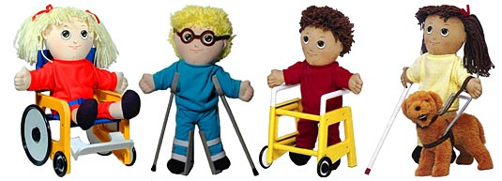
Customer Service
All participants must be allowed equal opportunities to participate in CN programs regardless of race, color, national origin, sex, age, disability
All participants must be treated in the same manner
(i.e. seating arrangements, serving lines, services and facilities, assignment of eating periods, methods of selection for meal benefit approval and verification processes)

Slide 39

Conflict Resolution
USDA recommends using an Alternative Dispute Resolution (ADR) program
  ADR: use of a neutral third party (usually a person acting as a facilitator) to resolve informally a complaint of discrimination through use of various techniques

Slide 40



Recognizing
a
Civil Rights Complaint

Slide 41

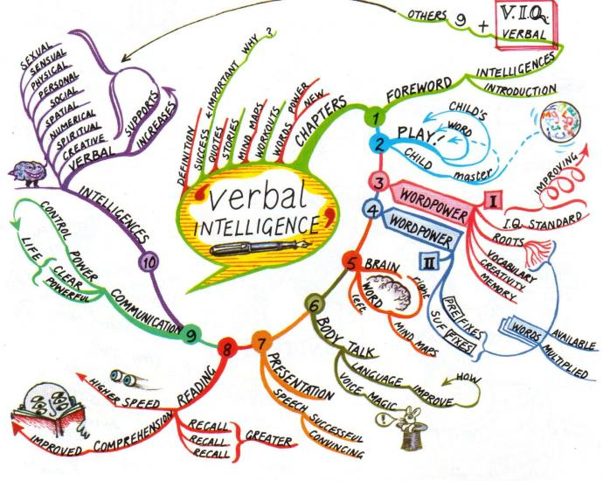


Unequal Treatment
Verbal
In writing
Observed

Slide 42
Handling a Complaint
CACFP Civil Rights Official enters complaint on log.
Complainant completes Civil Rights Complaint Form
Resolve at the site level.
Submit complaint report to HCNP within 5 working days.
Notes:
42
1.) These are some samples of how to handle a complaint
2.) Read slide
3.) There should be one SFA official in charge of Civil Rights complaints and procedures. This person will log all complaints in CNP Civil Rights Procedure Manual.

Slide 43

How soon does a complaint need to be filed?
Complainant has up to 180 days from alleged incident to file a complaint.
Notes:
1.) Read Slide

Slide 44
Civil Rights Complaint Procedure
Civil Rights complaint received by Institution
(verbal or written)
Document Civil Rights Complaint in the Compliant Log
Institution gives complainant Civil Rights Complaint Form to be Completed or
The Institution assists complaint with Complaint Form
All Completed Civil Rights Complaint Forms Received MUST be Reviewed Immediately.by the Institution,
Institution forwards Civil Rights Complaint Form to HCNP within 5 working days of RECIEPT
.
Notes:
This is an example of how the Civil Rights complaint procedures are to be gathered, documented and forwarded- in this order.
There should be one Institution official in charge of Civil Rights complaints and procedures. This person will log all complaints in CNP Civil Rights Procedure Manual.

Slide 45
Civil Rights Complaint Log
Must be dated
Keep for current plus three years, even if no complaints have been received
Notes:
1.) All complaints must be logged and kept for 3 years plus the current year even if there are no complaints. If the state requires more you must follow the state request. Three years is only a mandate by the USDA.

Slide 46
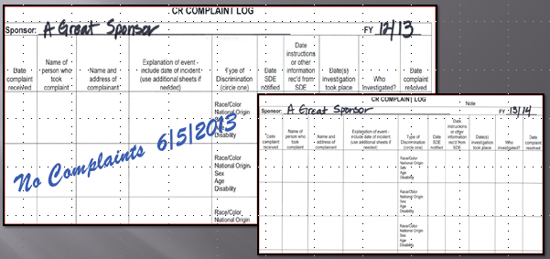
SAMPLE Civil Rights Complaint Log
.
Notes:
1.) If no complaints – document and keep with records for the appropriate timeframe (3 years + current year)

Slide 47
Civil Rights Complaint Form
CR Complaint Form must be readily available at all sites for all staff.
Make every attempt to help complainant complete CR Complaint Form.
If the household cannot fill out the complaint form, the center staff is responsible to assist the family to complete the document.
Notes:
The Civil Right complaint form must be easily accessible for all Staff.

Slide 48
CNP Civil Rights Procedure Manual
Sections for
  1) Institution CR complaint procedure
  2) CR complaint forms and log (make copies).
  4) FNS Instructions 113-1
  5) Training forms – Sign-in sheet, agenda, etc.
Civil Rights Coordinating Official must sign complaint log.
Notes:
48
1.) When creating a Civil Rights Procedure Manual you can you this reference for organization proposes. This Manual must be implemented in all programs.
2.) Read slide/ show CNP Civil Rights Procedure Manual
3.).) All Civil Rights information is confidential information and must be in a locked area.

Slide 49

Compliance Review Purpose
To ensure that CNPs are in compliance with Civil Rights Requirements
Notes:
When we review your program we want to insure the you are following the Civil Rights Requirements.

Slide 50
Noncompliance
There are NO “minor” or “major” categories of noncompliance. All instances of non-compliance are considered equally.
  No matter the level or severity of noncompliance, it must be reported and it must be corrected.

Slide 51
Examples of Noncompliance
Denying an individual or household the opportunity to apply for FNS program benefits or services on the basis of race, color, sex, age, national origin, or disability
Providing FNS program services or benefits in a dissimilar manner on the basis of race, color, sex, age, national origin, or disability
  Example: Serving lunch to an African American child but serving a snack/modified meal to an Asian American child

Slide 52
Examples of Noncompliance
Selecting FNS program sites or facilities in a manner that denies an individual access to FNS program benefits, assistance, or services on the basis of the six protected classes (race, color, national origin, etc.)
  Example: Serving meals on site to toddlers and preschoolers. Parents of infants must bring in formula and food for their infant.

Slide 53
Resolution of Noncompliance
If noncompliance is indicated, a corrective action plan must be implemented immediately to achieve voluntary compliance within 30 days
Corrective Action Plan: a plan describing the agency’s actions to be taken to resolve noncompliance with civil rights requirements

Slide 54
Common Review Findings
And Justice for All poster is not visible where families and the general public can read it
Nondiscrimination statement is missing from CNP documents
Civil Rights File is not complete
  Log, complaint process, training sign-in sheet

Slide 55
Civil Rights “Must Do List”
Offer all CNPs in a nondiscriminatory manner so that all students have equal access to CACFP meals.
Complete Civil Rights Ethnic Data Report annually by October 31.
Train staff annually on Civil Rights compliance.
Implement Complaint Procedure.
Notes:
Read all slides

Slide 56
Civil Rights “Must Do List” (continued)
Make available CNP Civil Rights procedures and forms.
Prominently display the “And Justice for All” poster.
Place nondiscrimination statement on all printed CNP materials available to public including Web site.

Slide 57

Thank You

