Slide 1
Production Records
June 2019

Slide 2
Overview
Why production records are important
Role of production records in the Administrative Review
Two-step process for completing production records
Notes:
Read slide.

Slide 3
What is a Production Record?
A required daily document that records all reimbursable meals prepared and served daily
National School Lunch Program, School Breakfast Program, Afterschool Snack Program, Seamless Summer Option
Notes:
What is a production record? It is a daily document that records all reimbursable meals planned, prepared, and served through the school nutrition programs.
Production records are REQUIRED for all school nutrition programs including NSLP, SBP, ASP, and SSO.

Slide 4
HCNP Template
Notes:
This is the revised HCNP production record template.
A successful production record achieves two things:
Gives the staff information
- What foods and recipes to use
- What quantities to prepare
- What amounts to portion
Enables staff to document information
- Actual quantities prepared
- Total meals served
- Leftovers

Slide 5
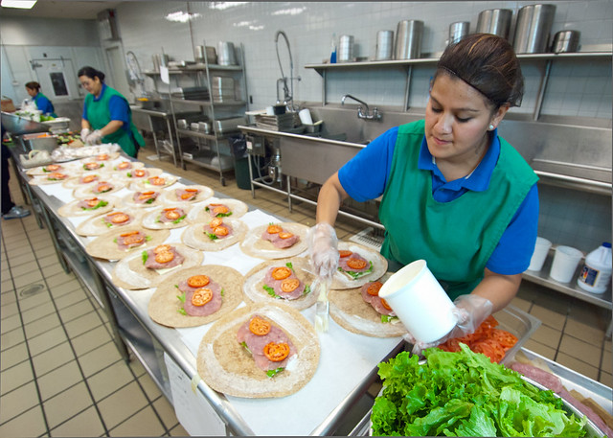
Production Records
Reviewed
during AR
Demonstrate compliance with meal pattern requirements
Identify information needed for the nutrient analysis
Notes:
Production records must be completed because they demonstrate compliance with the meal pattern requirements. Remember, production records are reviewed during the Administrative Review. Why?
Production records help to support the meals claimed for reimbursement were reimbursable. Reviewers evaluate production records to ensure the daily and weekly meal pattern requirements were met.
Production records also identify information needed for a nutrient analysis to demonstrate your meals are compliant with the dietary specifications (calories, saturated fat, sodium, trans fat).

Slide 6
Reminder…
No Production Records = FISCAL ACTION
Notes:
If you fail to maintain completed records or have records that go missing, this will result in fiscal action. Again, production records are your proof that you served reimbursable meals to your students. Without the supporting documentation, reimbursement will be taken back.
Remember, turnover in staff is not an excuse to not have production records. Production records must be done daily!
ASK: How long must you keep your records for? Records must be maintained for at least 3 years plus the current year. (DOE is 6 years plus the current year).

Slide 7
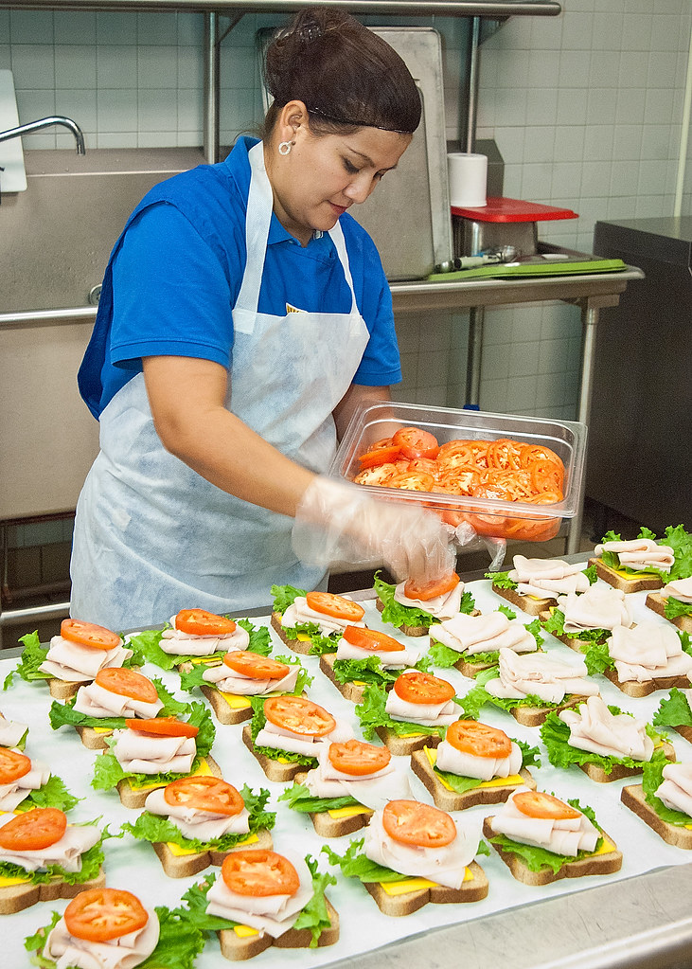
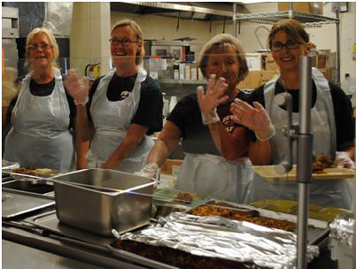
Production Records
Menu Development
Production
Service
Communication tool
Notes:
Production records serve as a communication tool
From menu development to production to meal service.
Your menu planner creates the cycle menu. This guy is so excited that he made a cycle menu that meets the meal pattern requirements. Once the cycle menu is finalized, production record templates are made that reflect the cycle menu.
The production staff use the production records to know what they need to prepare for that meal.
The food service staff use the production record to determine what to serve and how much to serve on the serving line.

Slide 8
Production Records
Provide historical information
Forecast trends
Identify student preferences
Plan future menus
Notes:
Production records provide historical information that is useful to help:
Forecast trends
Identify student preferences
Plan future menus
Use past production records to help predict the number of portions to plan for a future meal service. This is helpful so that you can reduce your likelihood of food shortages or food waste due to over production.
Past production records help you identify menu items with high or low customer acceptance. Are you making too much of a certain entrée? Is there an item that your students are not interested in – maybe you should consider changing it to something else. Is there an item that your students get excited about – maybe this is something you can serve several times on the cycle menu.

Slide 9
Supporting Materials
Cycle menu
Standardized recipes
Child Nutrition (CN) Labels
Product Formulation Statements
Exhibit A
Food Buying Guide
Food Buying Guide Calculator
Notes:
In order to correctly complete your production records, you will need to refer to some supporting documentation, such as:
Cycle menu (using the information on your cycle menu to create production record templates for your entire cycle)
Standardized recipes (standardized recipes state how that item credits towards the meal pattern requirements)
CN labels & Product Formulation Statements (includes information on how to credit the product towards the meal pattern requirements)
Exhibit A (identifies how to credit your grain items)
Food Buying Guide & Food Buying Guide Calculator (helps you to determine how much of an item you need to prepare and purchase)

Slide 10
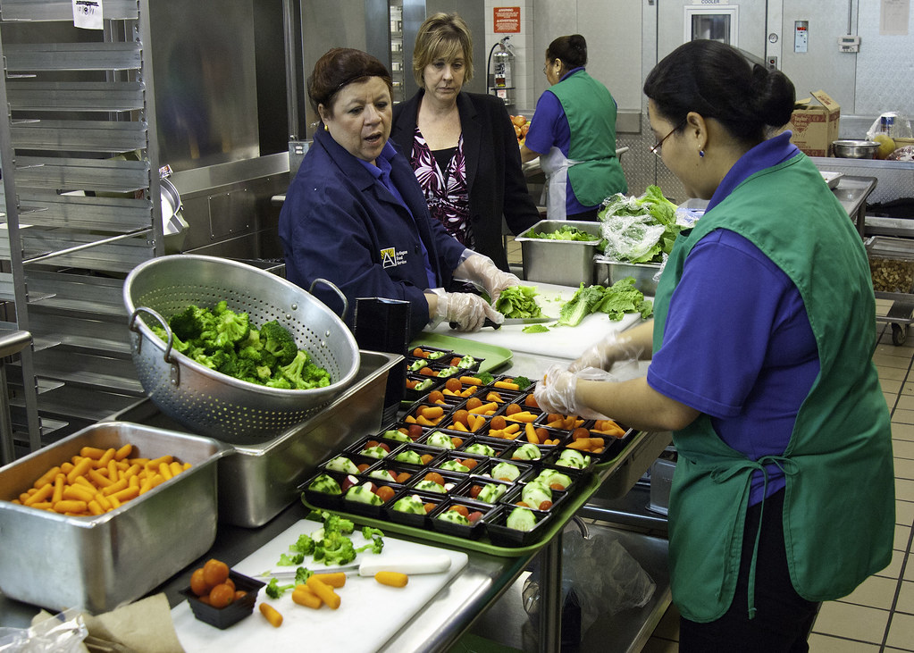
When to Complete Production Records?
Prior to production
Plan ahead!
Day of service
Notes:
When do you complete production records?
Prior to production (this can be days or weeks in advance). You can pre-type the items that are constant, such as:
School name
Menu
Grade Groups
Planned # of meals
Menu items
Portion sizes
Meal Pattern Contribution, etc.
Day of service. Staff complete the remaining parts of the production record during production and immediately after meal service:
Substitutions
Amount prepared
Food temperatures, times, initials
# of meals served
Amount leftover, etc.
Remember, at the end of the meal service, the manager must review the production record, verify the information is accurate and complete, and sign/date the bottom of the form. File this document for future reference.

Slide 11
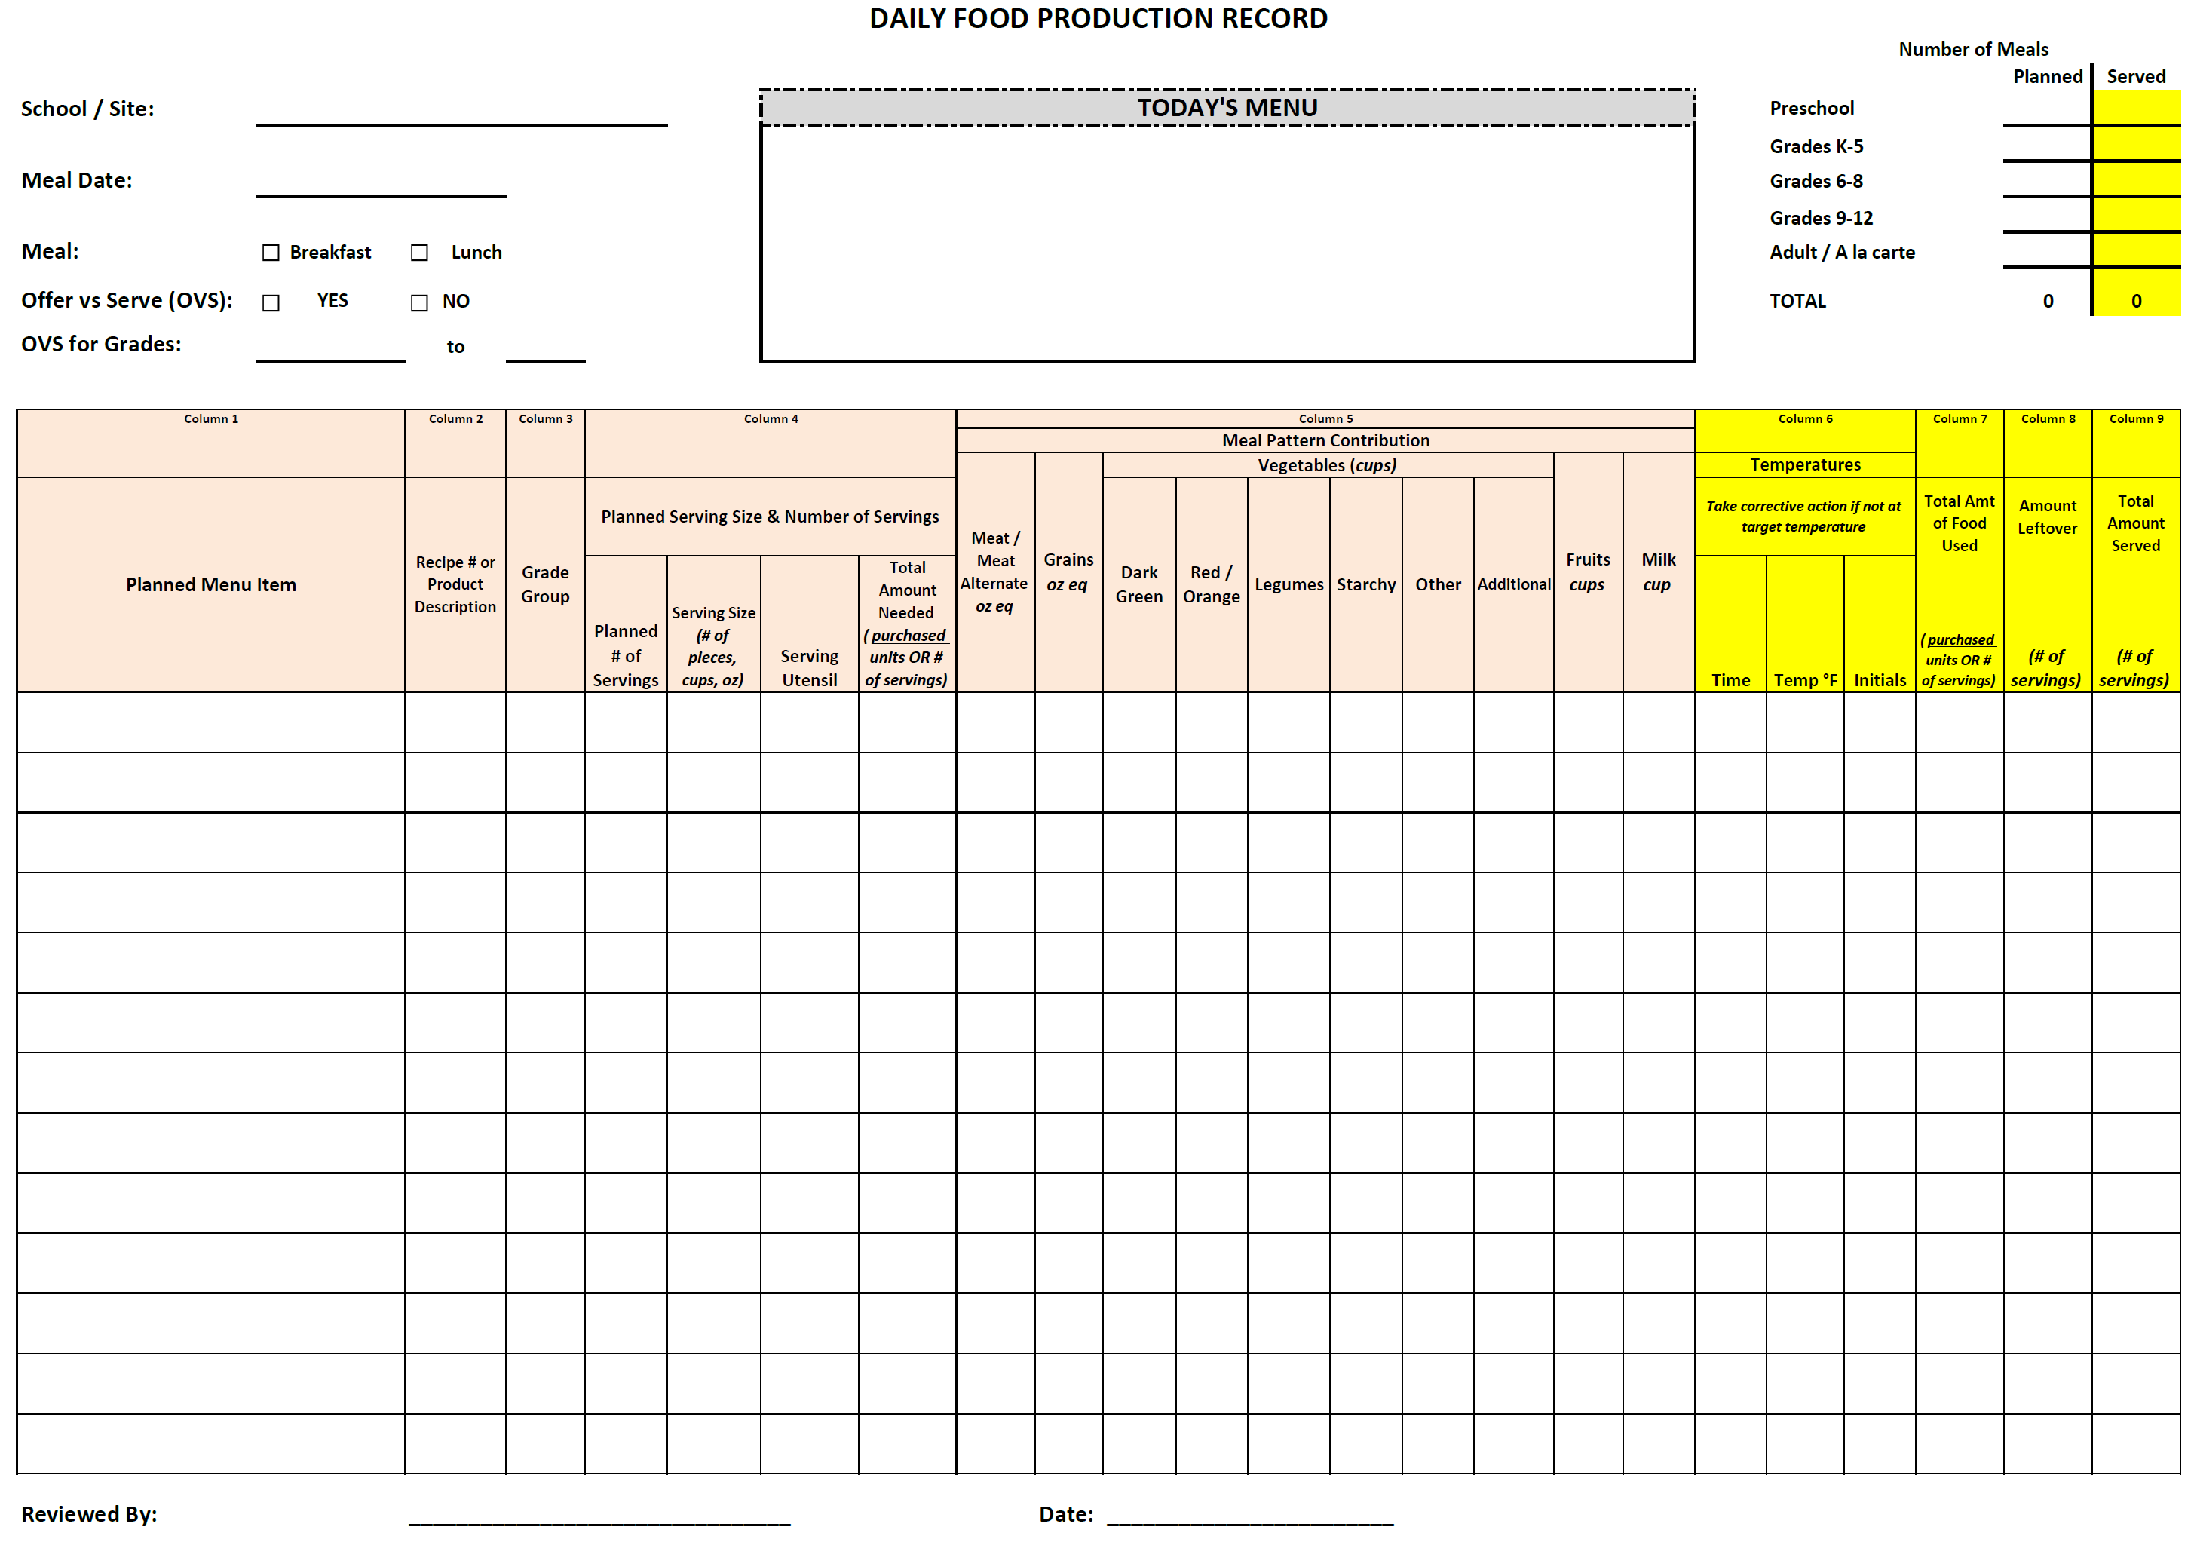
Complete Prior to Production
Notes:
Once your cycle menu is completed and has been verified that it meets the meal pattern requirements, you can make production record templates.
Complete all of the circled areas before the day of service.

Slide 12
Complete During Meal Preparation
Notes:
During meal preparation, the food service staff need to complete the circled areas.

Slide 13
Complete After Meal Service
Notes:
Immediately after meal service, complete the circled areas.

Slide 14
Activity
Notes:
It’s time for an activity!
Take out the Production Record Activity handout (____________), blank production record template, and the HCNP Menu Planning Activity that you did earlier today.
You may work together with the person sitting next to you.

Slide 15
Activity

Slide 16
Activity

Slide 17
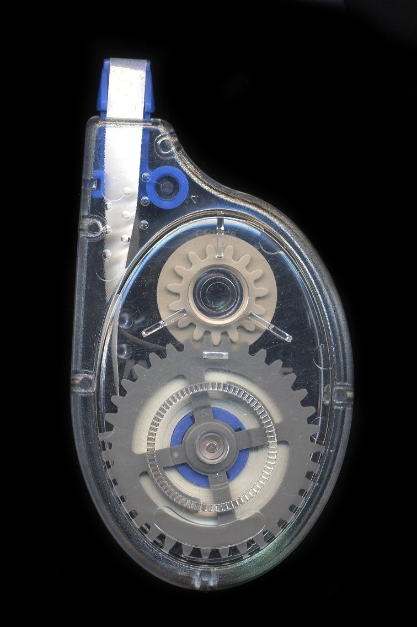
Substitutions
Record any substitutions made to the planned menu
Mark one line through the original menu item and write in the substitution
Complete the rest of the production record for the new item
Notes:
Read slide.
Emphasize – DO NOT use white out!
Also, DO NOT use post-its to document what you served. Write directly on the production record.

Slide 18
Special Circumstances
Document the reason for a drastic change in amount of meals planned and served
Examples:
Grade 5 went on a field trip (100 students out)
Chicken pox outbreak (40 students out)
Notes:
Remember to document any reason why there is a drastic change in the amount of meals that were planned/served.
For example, grade 5 went on a field trip or chicken pox outbreak.
This information is important when you look back at these production records. Documenting this kind of information will help you to understand why there was a big change in production/participation so you can plan accordingly when serving this meal again in the future to ensure enough food is prepared.

Slide 19
Do Production Records Daily
Notes:
Completing production records is a team effort (menu planner, kitchen manager, production staff). Make sure the production records a FULLY completed on a DAILY basis.
It is so easy to get behind – so DO NOT let this happen. Every day, make sure you spend 5-10 minutes to review the production records before leaving for the day. If something is incomplete/inaccurate, make sure your staff completes it immediately.

Slide 20
Questions?

Slide 21
In accordance with federal civil rights law and U.S. Department of Agriculture (USDA) civil rights regulations and policies, the USDA, its Agencies, offices, and employees, and institutions participating in or administering USDA programs are prohibited from discriminating based on race, color, national origin, sex, disability, age, or reprisal or retaliation for prior civil rights activity in any program or activity conducted or funded by USDA.
Persons with disabilities who require alternative means of communication for program information (e.g., Braille, large print, audiotape, American Sign Language), should contact the Agency (state or local) where they applied for benefits. Individuals who are deaf, hard of hearing or have speech disabilities may contact USDA through the Federal Relay Service at (800) 877-8339. Additionally, program information may be made available in languages other than English.
To file a program complaint of discrimination, complete the USDA Program Discrimination Complaint Form, (AD-3027) found online at: How to File a Complaint, and at any USDA office, or write a letter addressed to USDA and provide in the letter all of the information requested in the form. To request a copy of the complaint form, call (866) 632-9992. Submit your completed form or letter to USDA by:
mail: U.S. Department of Agriculture Office of the Assistant Secretary for Civil Rights 1400 Independence Avenue, SW Washington, D.C. 20250-9410;
fax: (202) 690-7442; or
email: program.intake@usda.gov.
This institution is an equal opportunity provider.

