Slide 1
Free & Reduced Price Meal Applications
June 2019

Slide 2
Purpose of Applications
Documentation required for student to receive free or reduced benefits
Identified Students (Direct Certifications, Migrant, Homeless, etc.)
Meal Applications
Without documentation, student must pay for meals
Notes:
Why are there meal applications? The requirement is that you must have documentation in order to give any student a meal benefit. This can be either through the Direct Certification system or a meal application. Without documentation, a student must pay for meals.

Slide 3
Certification & Benefit Issuance – A Critical Area (PS 1)
Per SP 09-2018: USDA research finds > 1 in 5 applicants certified incorrectly
Errors in the Certification and Benefit Issuance process are considered a Performance Standard 1 violation
Potential for Fiscal Action!
Notes:
Certification and benefit issuance is considered a ‘Critical Area’ by the USDA (Performance Standard 1) – meaning fiscal action is tied to findings in this area!

Slide 4
Direct Certifications (DC)
As soon as July 1, 2019, check the DC list in HCNP_S and complete matches
Print and mail DC letters to households
Notes:
One of the quickest and most efficient ways to reduce the number of meal applications you will have to process is to check the direct certification list in HCNP Systems after July 1, 2019 and send out the Direct Certification notices to the households. Students that are Directly Certified do not need to have an application (if submitted) processed – they will be certified to receive free meals. A letter informing the household of their direct certification and free status must be sent.

Slide 5
Free and Reduced Price Application - Prototype
The USDA has not revised SY 2018-19 Application
DO NOT use last year’s application
SY 2019-20 version will be made available on HCNP website July 1, 2019
No requirement to use HCNP’s version
USDA strongly recommends prototype
Notes:
The SY 2019-20 version of the Free and Reduced Price Application Prototype is available on HCNP web. The only change to this years application is the school year listed at the top.
DO NOT use applications for SY 2018-19 for SY 2019-20 – discard all old applications.
The use of HCNP’s prototype application is NOT required. However, if you choose to create your own application, you will need to make sure it contains all of the necessary information.

Slide 6
SP 09-2018
Web-based prototype released by USDA in 2016
Does not ‘mimic’ paper applications
Contains integrity features that ensure completeness & accuracy
USDA encouraging use of online application to decrease error
Check if your POS is capable
Potential to reach more families
Notes:
The USDA released SP 09-2018 in March – ‘Reducing School Meal Certification Error through Improved Online Application Design’

Slide 7
Application Materials
2019-20 Application for Free and Reduced Price School Meals
‘How to Apply for Free and Reduced Price School Meals’
‘Frequently Asked Questions About Free and Reduced Price School Meals
To be sent out to SFAs via email and posted on HCNP website
Notes:
SFAs should have these forms sent to all households at or near the beginning of the school year (July 1). All forms will be made available on HCNP website.

Slide 8
Application Materials
Notice to households of Approval/Denial of Benefits
Sharing Information with Other Programs
Sharing Information with Medicaid/CHIP
Notes:
These forms are included in your packet and are available on HCNP website.
The ‘sharing information’ forms ask households for permission to share info provided on F&R apps to agencies such as CHIP so that they may contact households that have a child or children that may qualify for additional need-based programs.

Slide 9
Step 1: Press Release
Every SFA required to send press release annually (start of SY)
Local news media, unemployment office, major employers in school area that are initiating large layoffs within school area
Don’t pay to publish
Keep copy on file for HCNP to review during Administrative Review
Template available on HCNP Website
Notes:
Each SFA required to send a press release.

Slide 10
Step 2: Application Packet
Free and Reduced Price Application
If using HCNP Prototype, ensure school name is on front of application
Instructions and Frequently Asked Questions Forms
If using HCNP forms, fill in blanks with appropriate information
Print copies for every student enrolled at each school
Application, Instructions, FAQs
Notes:
Remember, while you don’t have to use HCNP prototype application and forms, it is highly encouraged as it will increase efficiency.

Slide 11
Step 3: Sending to Households
School year begins July 1st
Send application packet near beginning of school year to allow time to process
Best practices for making materials available:
Send home with each student on first day of school
Mail to household (email as an alternative)
Put in registration/enrollment packet
Put with school newsletter, if applicable
Post on school website, if applicable
Notes:
The intent is to ensure all households are able to successfully submit an application. Keep in mind they may require translated applications, which you as a sponsor are required to provide under Civil Rights statutes.

Slide 12
Remember, you CANNOT require any child or household to submit an application. However, they must be aware that they have the right to do so, at any time during the school year.
Notes:
Households are also able to submit additional applications at any time during the school year. For example if their income or number of household members changes, their eligibility
may change as well, allowing them an opportunity to receive better benefits.

Slide 13
A Word on Confidentiality
Please use caution when handling applications – they contain sensitive and confidential information
Name, address, household size, income, ethnicity/race, etc.
A student’s eligibility must never be publicized or made accessible to unauthorized individuals

Slide 14
Step 4: Processing Applications
Date stamp applications when they are returned to school
Application must be processed within 10 operating days of receipt
Check applications for completeness
Remember: the sooner you process and certify an application, the sooner that student receives the benefit they are entitled to
Notes:
Applications should NOT be processed if they are not completed in full – we will discuss what that means in the following slides.

Slide 15
Incomplete Applications
Number of household members does not equal number of names on application
Frequency of income is missing
Missing SNAP/TANF number (when #2 was checked ‘yes’)
SNAP/TANF number is questionable
No adult signature
No SS# and ‘none’ box is not checked
Notes:
Remember, there is no ‘temporarily approved’ application status. The application is either complete and able to be processed or is incomplete and further information from the household must be obtained.

Slide 16
Indication of ‘No Income’
Application instructions state how a household should report income
If a household member(s) does not have income, they should mark ‘zero’ in income field
Leaving income field blank is indicative of ‘no income’
An application with a blank income field is considered complete and can be processed
Suspicious applications – Verify for Cause (October)
Notes:
Application instructions should be clear in requesting that household members with no income should put ‘zero’ in income field.
Although an application may be missing income information, it is still considered complete, and processed as though the income is zero. If school officials have information that the income was intentionally misreported, the school is obligated to verify that application for cause in October (in addition to mandated number of verified applications).

Slide 17
Income Eligibility Guidelines
Not available to general public
Ensure you are using SY 2019-20 guidelines
Conversion factors are on bottom back of HCNP prototype application
If application indicates multiple income frequencies:
Convert to annual income then make determination
Notes:
IEG’s not intended to be made publicly available – this will help decrease temptation of misreporting income
An AR finding HCNP has seen is SFAs using the previous years IEG’s – this may lead to incorrect benefit certification, which can then lead to fiscal action during an AR.
When multiple income frequencies → convert to annual to make determination based on income/household size

Slide 18
Finish Processing the Application
Complete bottom portion of back page (FOR SCHOOL USE ONLY)
Determining official signs, dates, and designates eligibility
Confirming official checks the application, signs and dates the form

Slide 19
Notice of Approval or Denial
ALL households must be notified of their eligibility status
Make two copies of the letter:
Send the original to the household
Keep a copy on file at school
A letter template is available for use on HCNP’s website
Notes:
Households must always be notified of their status after the application is process (either free via income, reduced price, or denied aka paid)

Slide 20
Discontinuing Benefits
Per CFR 245.6(c)(2) – student’s eligibility from previous SY carries over for up to 30 operating days of new school year
At end of 30 operating days, benefits must be stopped if:
An application for current SY has not been submitted
The child has been determined to be ineligible based on new application

Slide 21
Carryover Period
30 OPERATING days
Notification not required, but highly encouraged
Within 10 days of receiving new application, make determination and notify household
Encourage households to reapply PRIOR to conclusion of Carryover Period
Notes:
Returning students are eligible to receive previous school year’s status for up to 30 operating days in the new school year, or until a new eligibility determination is made, whichever comes
First. Carryover applies to eligibility established through a household application or direct certification.
Operating Day: defined as any day in which reimbursable meals or milk are provided by a school or another program sponsor.
Notification that the carryover period is ending is not required, but is encouraged to let households know that they need to re-submit an application if they wish to continue receiving
benefits in the new school year.
Once new application is received, process and notify household within 10 operating days.

Slide 22
Denied Applications
Notice of Adverse Action: 10 calendar days written notice prior to change
Notice cannot be through phone only – must be written
Contents of Notice:
Change in benefits
Reasons
Right to Appeal
May reapply at any time
Notes:
All currently certified households for whom benefits are to be reduced or terminated must be given 10 calendar days’ written notice of the change prior to the date the change will go
into effect. Note: adverse action cannot be through telephone only – written notice must be sent.

Slide 23
Helpful Tips
Keep a separate log with a tally of the answers to the ethnicity/race questions
This will be useful for completing the Ethnic Data Report
Identify error prone applications
Add a check mark, use post-its, etc.
MUCH easier when verification rolls around in October
Notes:
Remember, error prone applications are those that fall within the $1200/year or $100/month of income guideline cut-offs for free or reduced price meals. For example, for SY 2018-19, the cut-off income for a family of 3 to receive reduced price meals is $44,215 annually. So if the income reported on an application with a household of 3 is within $1200 plus/minus of that cutoff, that application should be marked as ‘error prone’
The HCNP prototype application has ethnicity/race questions on the backside of the form – this is an excellent method for collecting data used on the Ethnic Data Report that is required annually.
We will discuss what a master list is on the next few slides.

Slide 24
Master List
Per 7 CFR 210.18 – Each SFA must have a system for issuing benefits and updating each student’s eligibility status
This is what is referred to as the Master List
Consists of name of each student enrolled (updated continually throughout the year), including meal status, changes, start and end dates
Separate from meal counting system and POS
Helpful in completing edit checks

Slide 25
Master List - example
Notes:
A Master List (excel file) is available for use on HCNP’s website.
Remember – a Master List is only useful if it is updated regularly, including enrollment changes, status changes, and dates those changes occur.

Slide 26
Second Review of Applications
Criteria
10% or greater error
HCNP discretion
Completed before eligibility determinations made
Still adhere to 10 operating day requirement
Requirement to review all applications a second time
Ensures certification accuracy
Upholds program integrity
Notes:
HCNP discretion: If you are a new SFA, or have had a large turnover in food service personnel at your SFA, HCNP may decide to require your SFA to complete a Second (Independent)
Review of Applications

Slide 27
Reminders
Only ONE application per household is needed
You cannot require a household to submit an application
If a household qualifies for benefits, but refuses, a statement of refusal (in writing) must be obtained – ensure signed and dated
Households have right to re-apply during the year
All approvals are good for the entire school year, plus 30 day carryover
Verification – may cause change in status

Slide 28
Activity: Certifying Applications

Slide 29
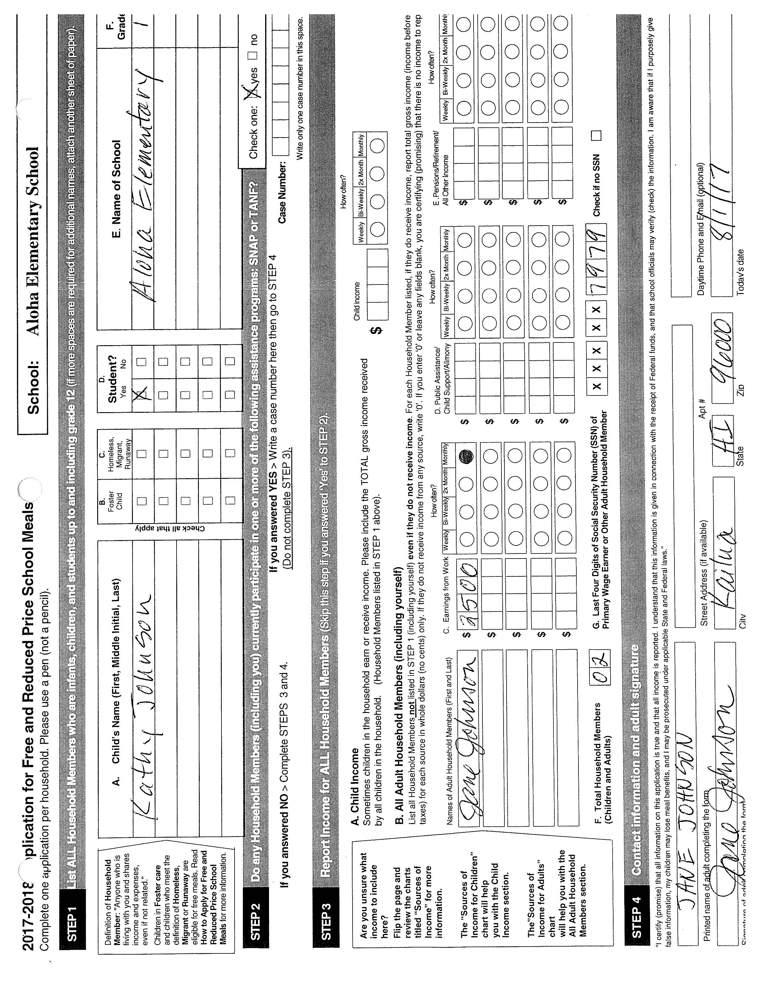
2019-2020
Notes:
Ensure Application is Complete: Contains adult signature, social security number. Remember, an application can still be considered complete without income reported (this application does have an income)
Step 1 – No Issues
Step 2 – Checked ‘yes’, but did not provide a case number. School should check DC list to see if child has been matched through either SNAP or TANF
Step 3 – Application contains an income and frequency, as well as an SSN
Step 4 – Application has contains adult signature
If child is matched on DC list, child should be certified as free and direct certification letter should be sent home to household. If child is NOT on DC list, certify application based on info provided.
Monthly income: $2500 Household size: 2 Benefit: Reduced

Slide 30
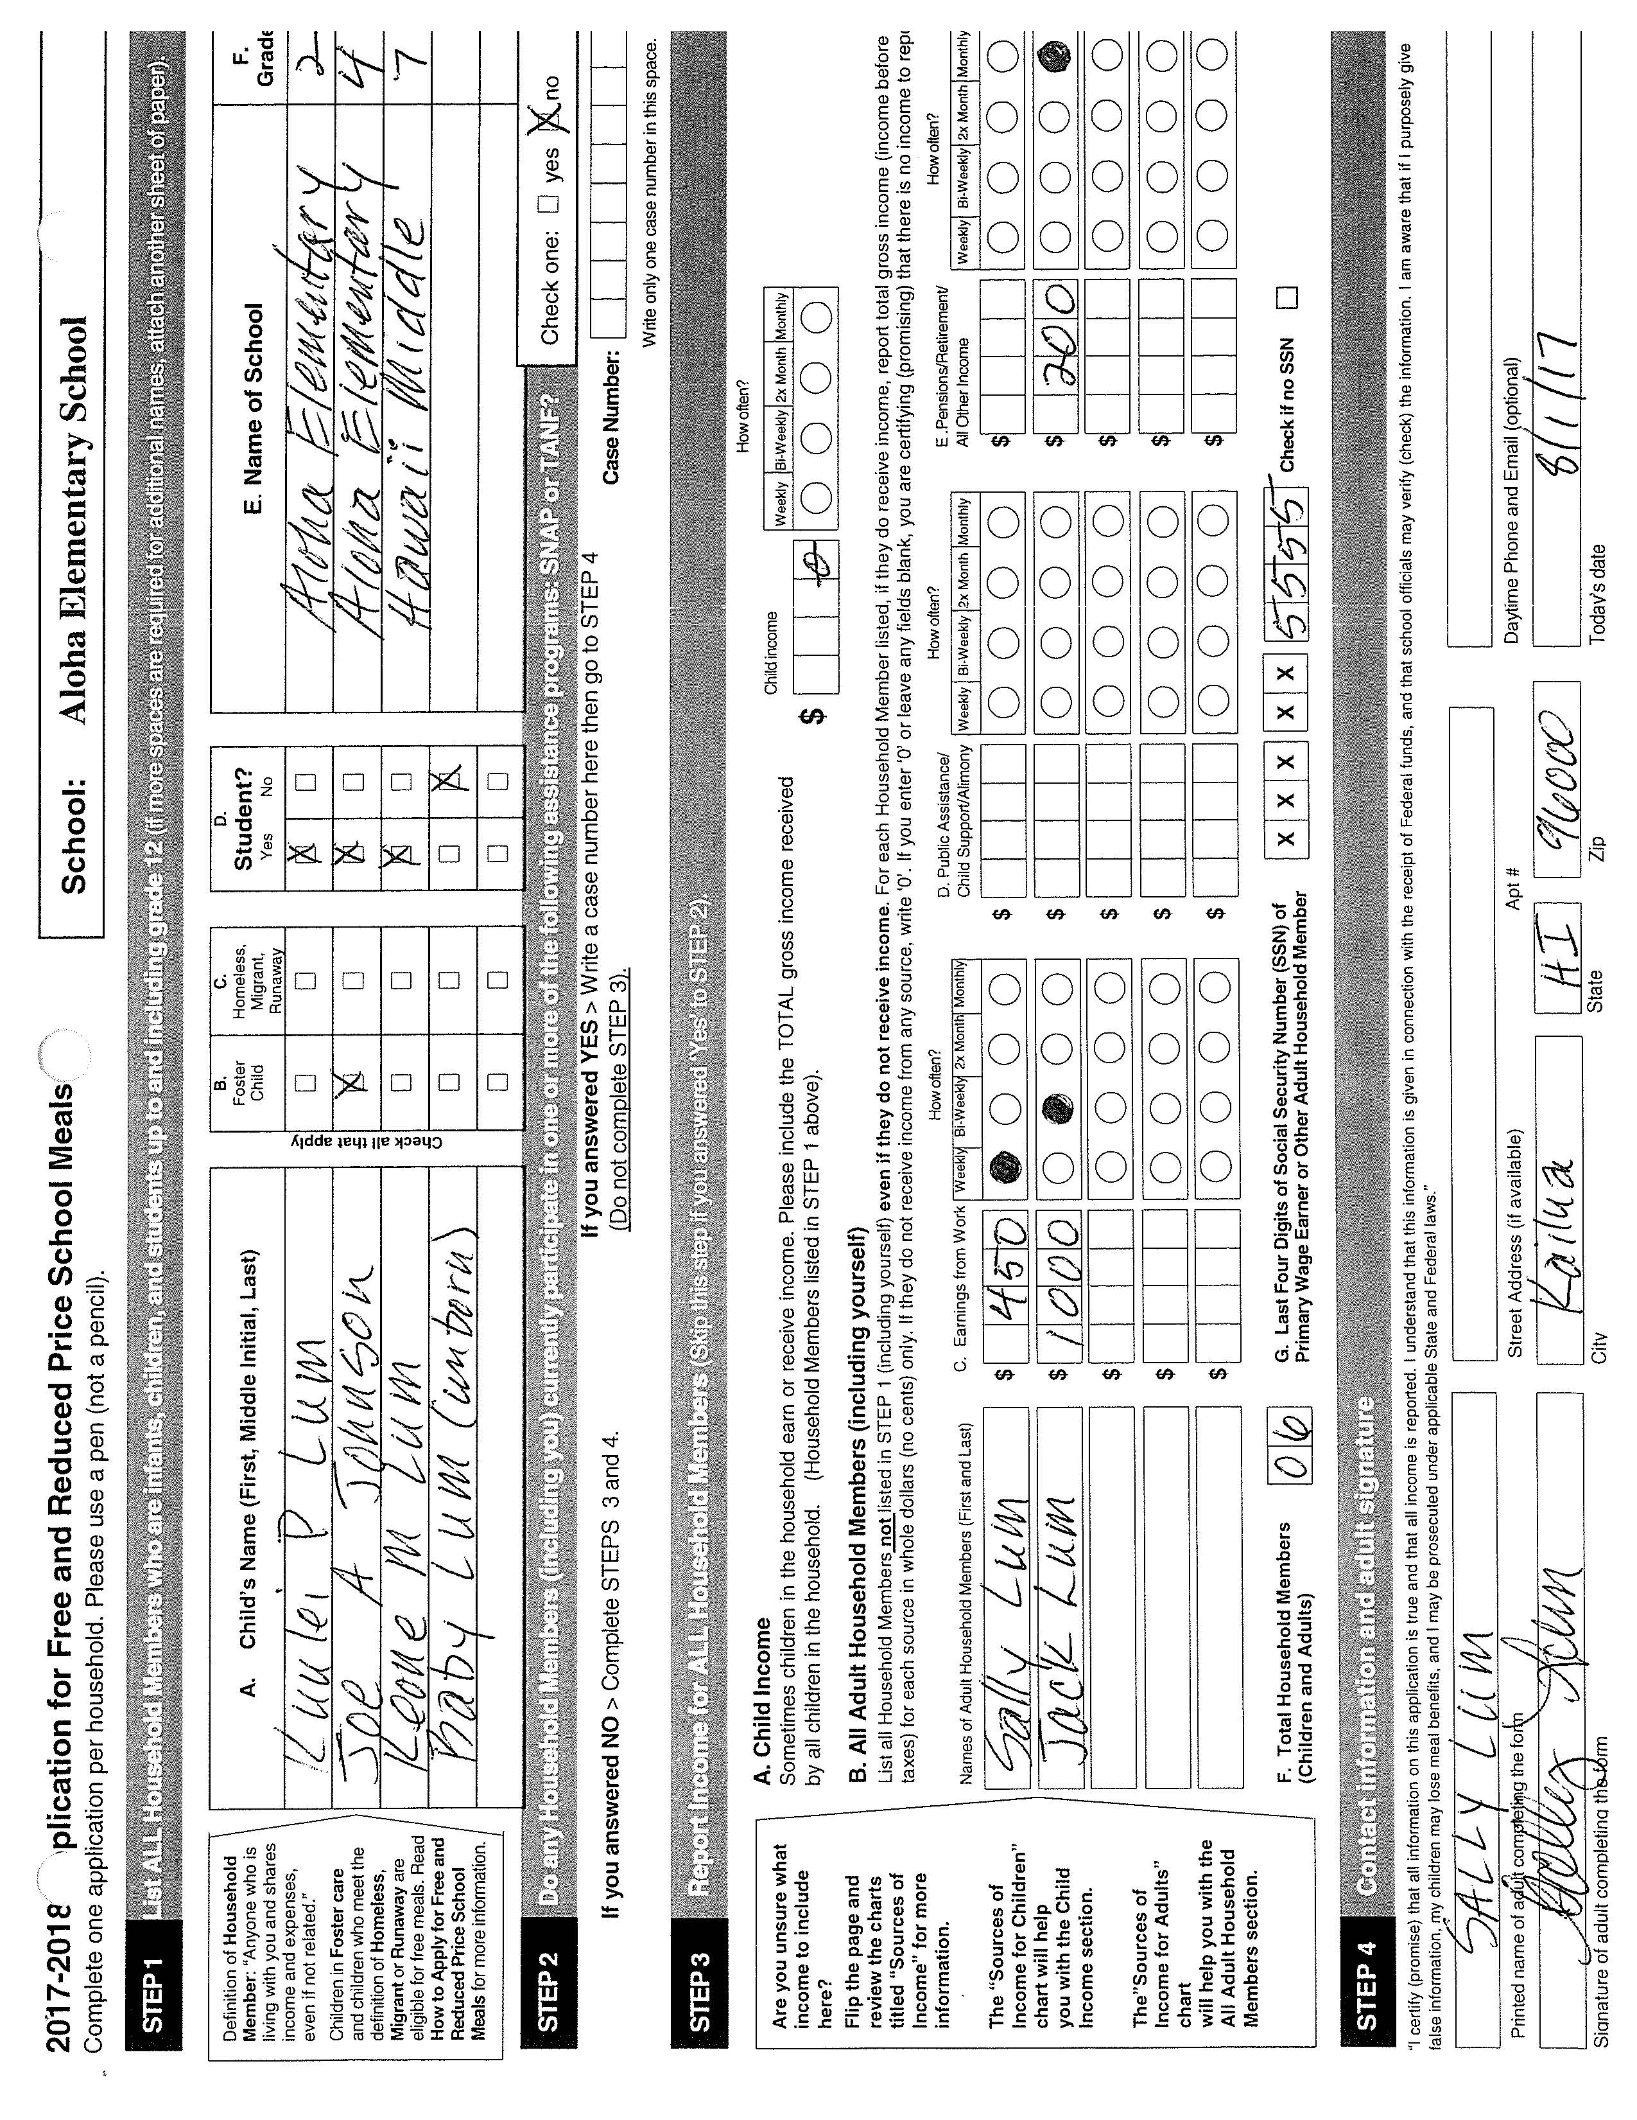
2019-2020
Notes:
Ensure Application is Complete: Contains adult signature, social security number. Remember, an application can still be considered complete without income reported (this application does have an income)
Step 1 – ‘Baby Lum (unborn)’ – cannot count an unborn child as a household member
One student (Joe) is a foster child – student should be given free meals; however, this benefit does NOT extend to other children in household
Step 2 – No Issues
Step 3 – Application contains an income and frequency, as well as an SSN. However, total household members may be incorrectly reported (Line F). SFA should contact the household to confirm if ‘Baby Lum’ is indeed still unborn. Because income is reported for multiple household members, and multiple frequencies, convert all income to annual to determine benefit eligibility
Step 4 – Application contains adult signature
Annual income: $51,800 Household size: 6 (until confirmation received on status of ‘Baby Lum’) Benefit: Reduced (whether household is 6 or 5)

Slide 31
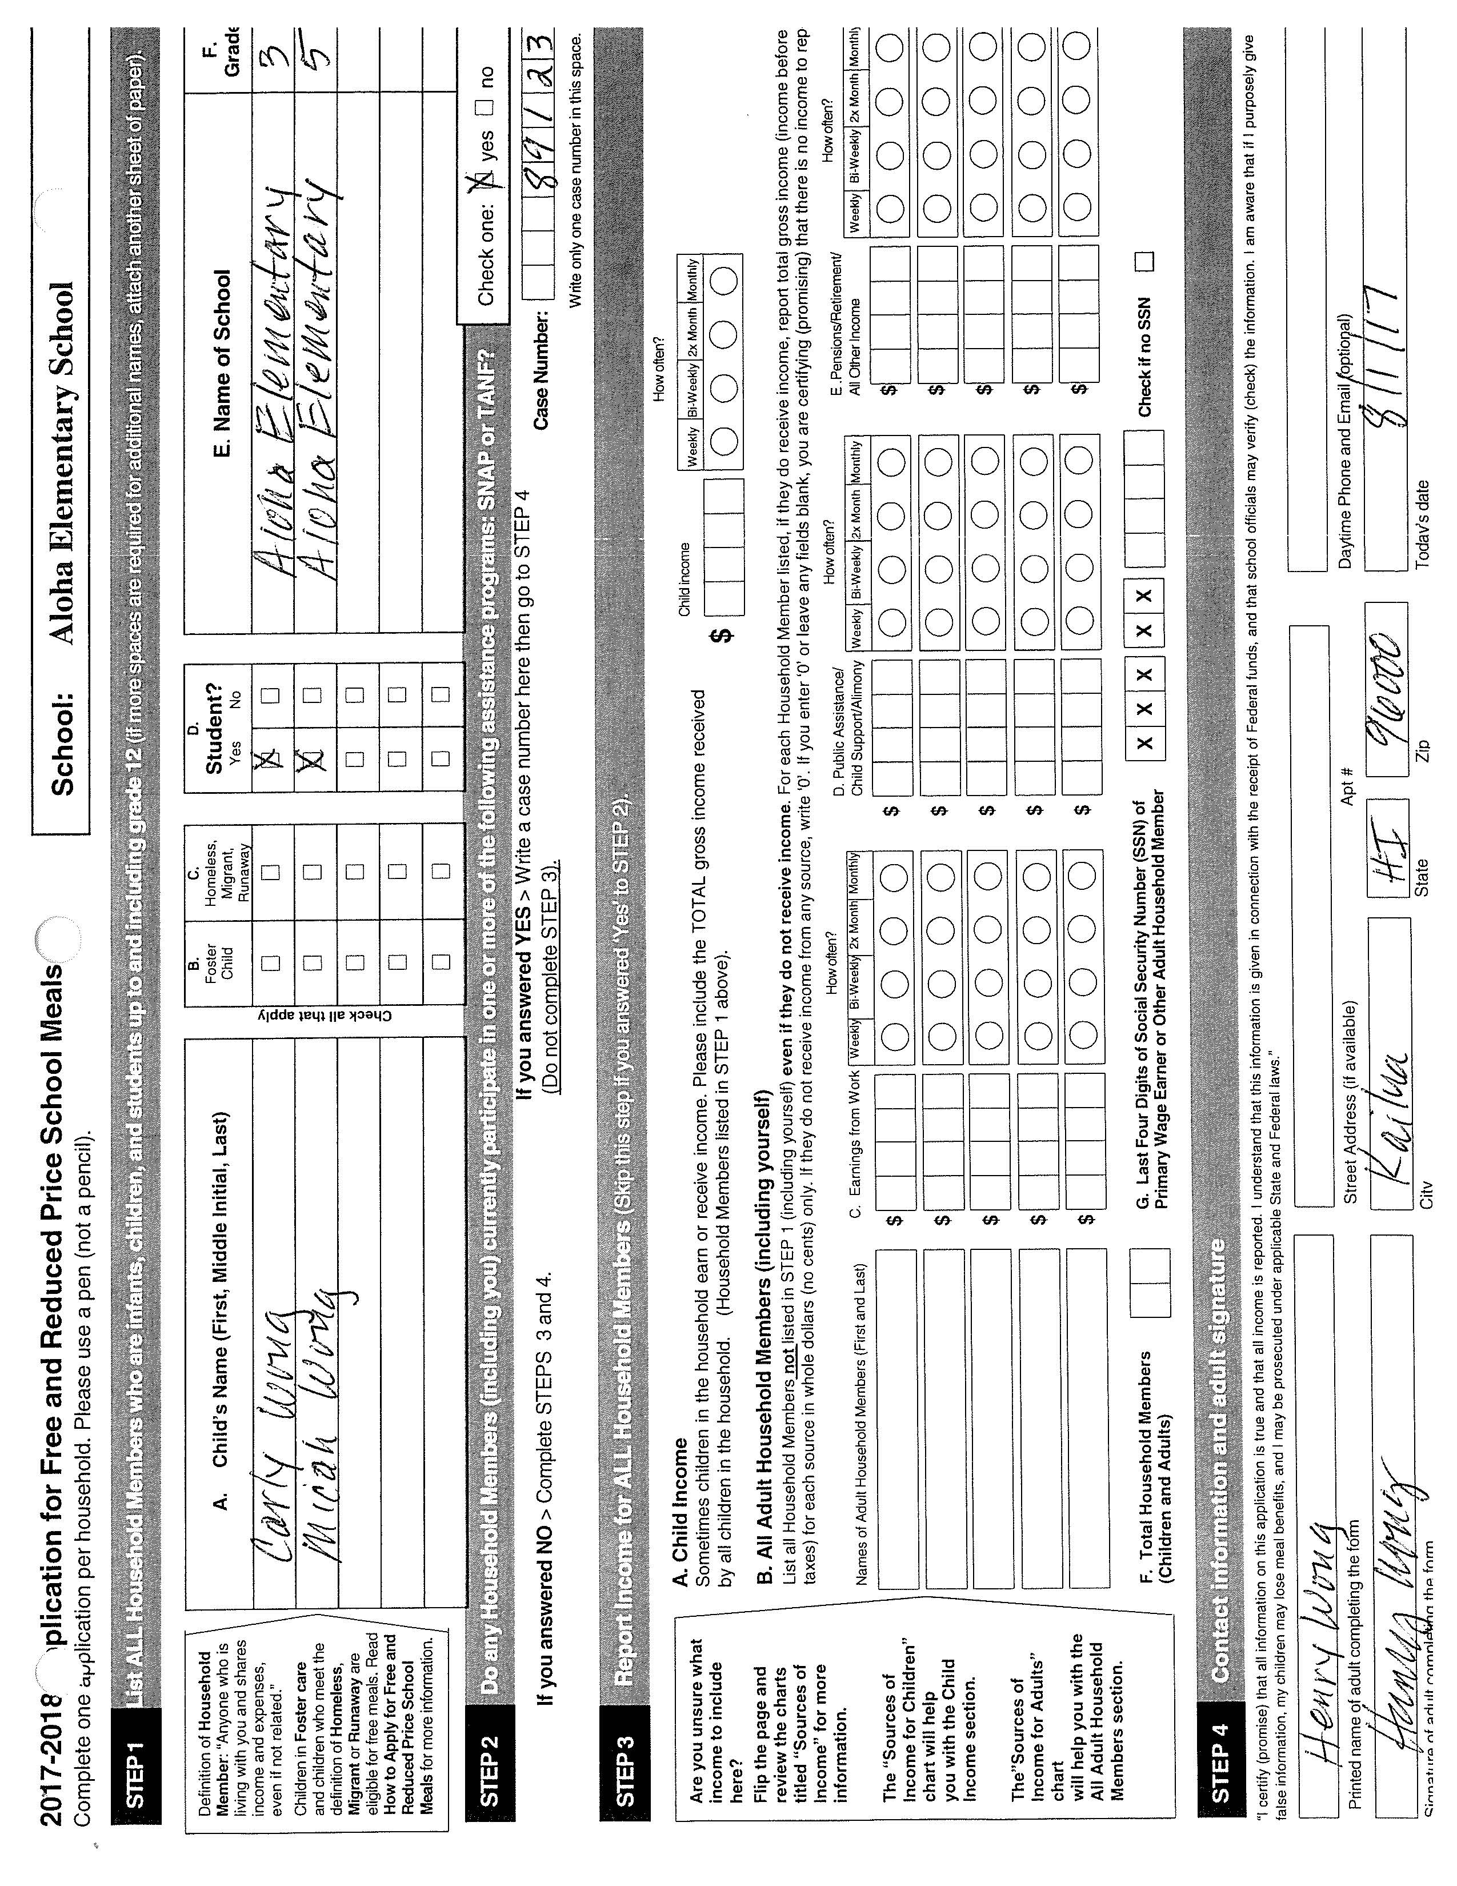
2019-2020
Notes:
Ensure Application is Complete: Contains adult signature, social security number (omit in this case since case number provided and Step 3 not completed). Remember, an application can still be considered complete without income reported
Step 1 – No Issues
Step 2 – Checked ‘yes’, but SNAP or TANF number appears questionable. School should check DC list on HCNP Systems to check if student has been matched
Step 3 – No Adult household members, yet application was signed by Henry Wong; Application is missing SSN and ‘no SSN’ box is not checked
Step 4 – Application has adult signature
If child is matched on DC list, child should be certified as free and direct certification letter should be sent home to household. If child is NOT on DC list, contact the household to clarify case number to make eligibility certification. If household provides number and it is authentic, child should be certified as free by categorical eligibility.

Slide 32
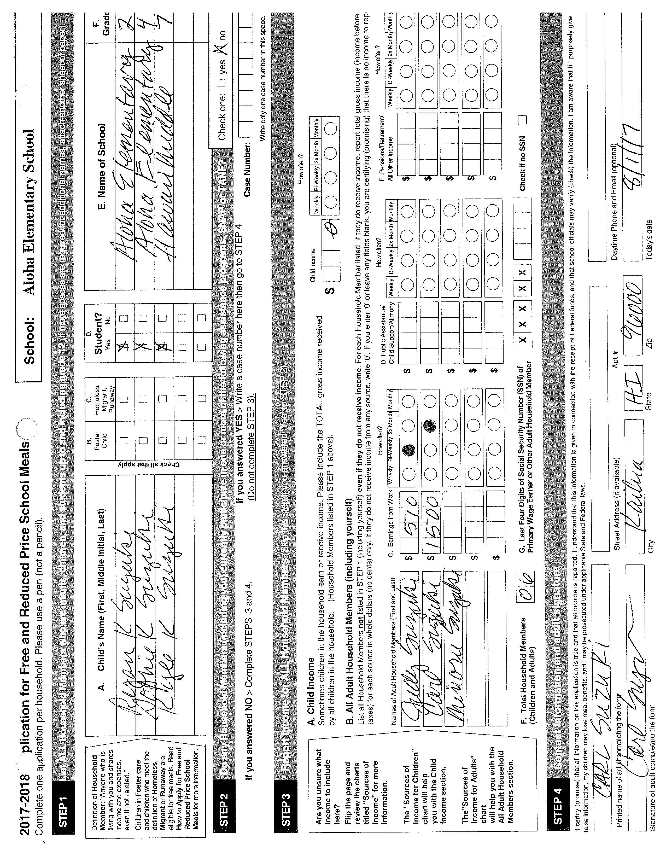
2019-2020
Notes:
Ensure Application is Complete: Contains adult signature, social security number (this application does not have a social security number; therefore, application is considered incomplete and should be returned to household, with a request for a completed app). Remember, an application can still be considered complete without income reported
Step 1 – No Issues
Step 2 – No Issues
Step 3 – Income information for ‘Minoru’ is missing – income for this individual is assumed to be zero, and the application may still be certified.
Step 4 – Application contains adult signature
Annual income: $49,260 Household size: 6 Benefit: Free This application is also error prone (within $1200 of annual income for free meals). Certify the application and mark as ‘error prone’ for verification purposes

Slide 33
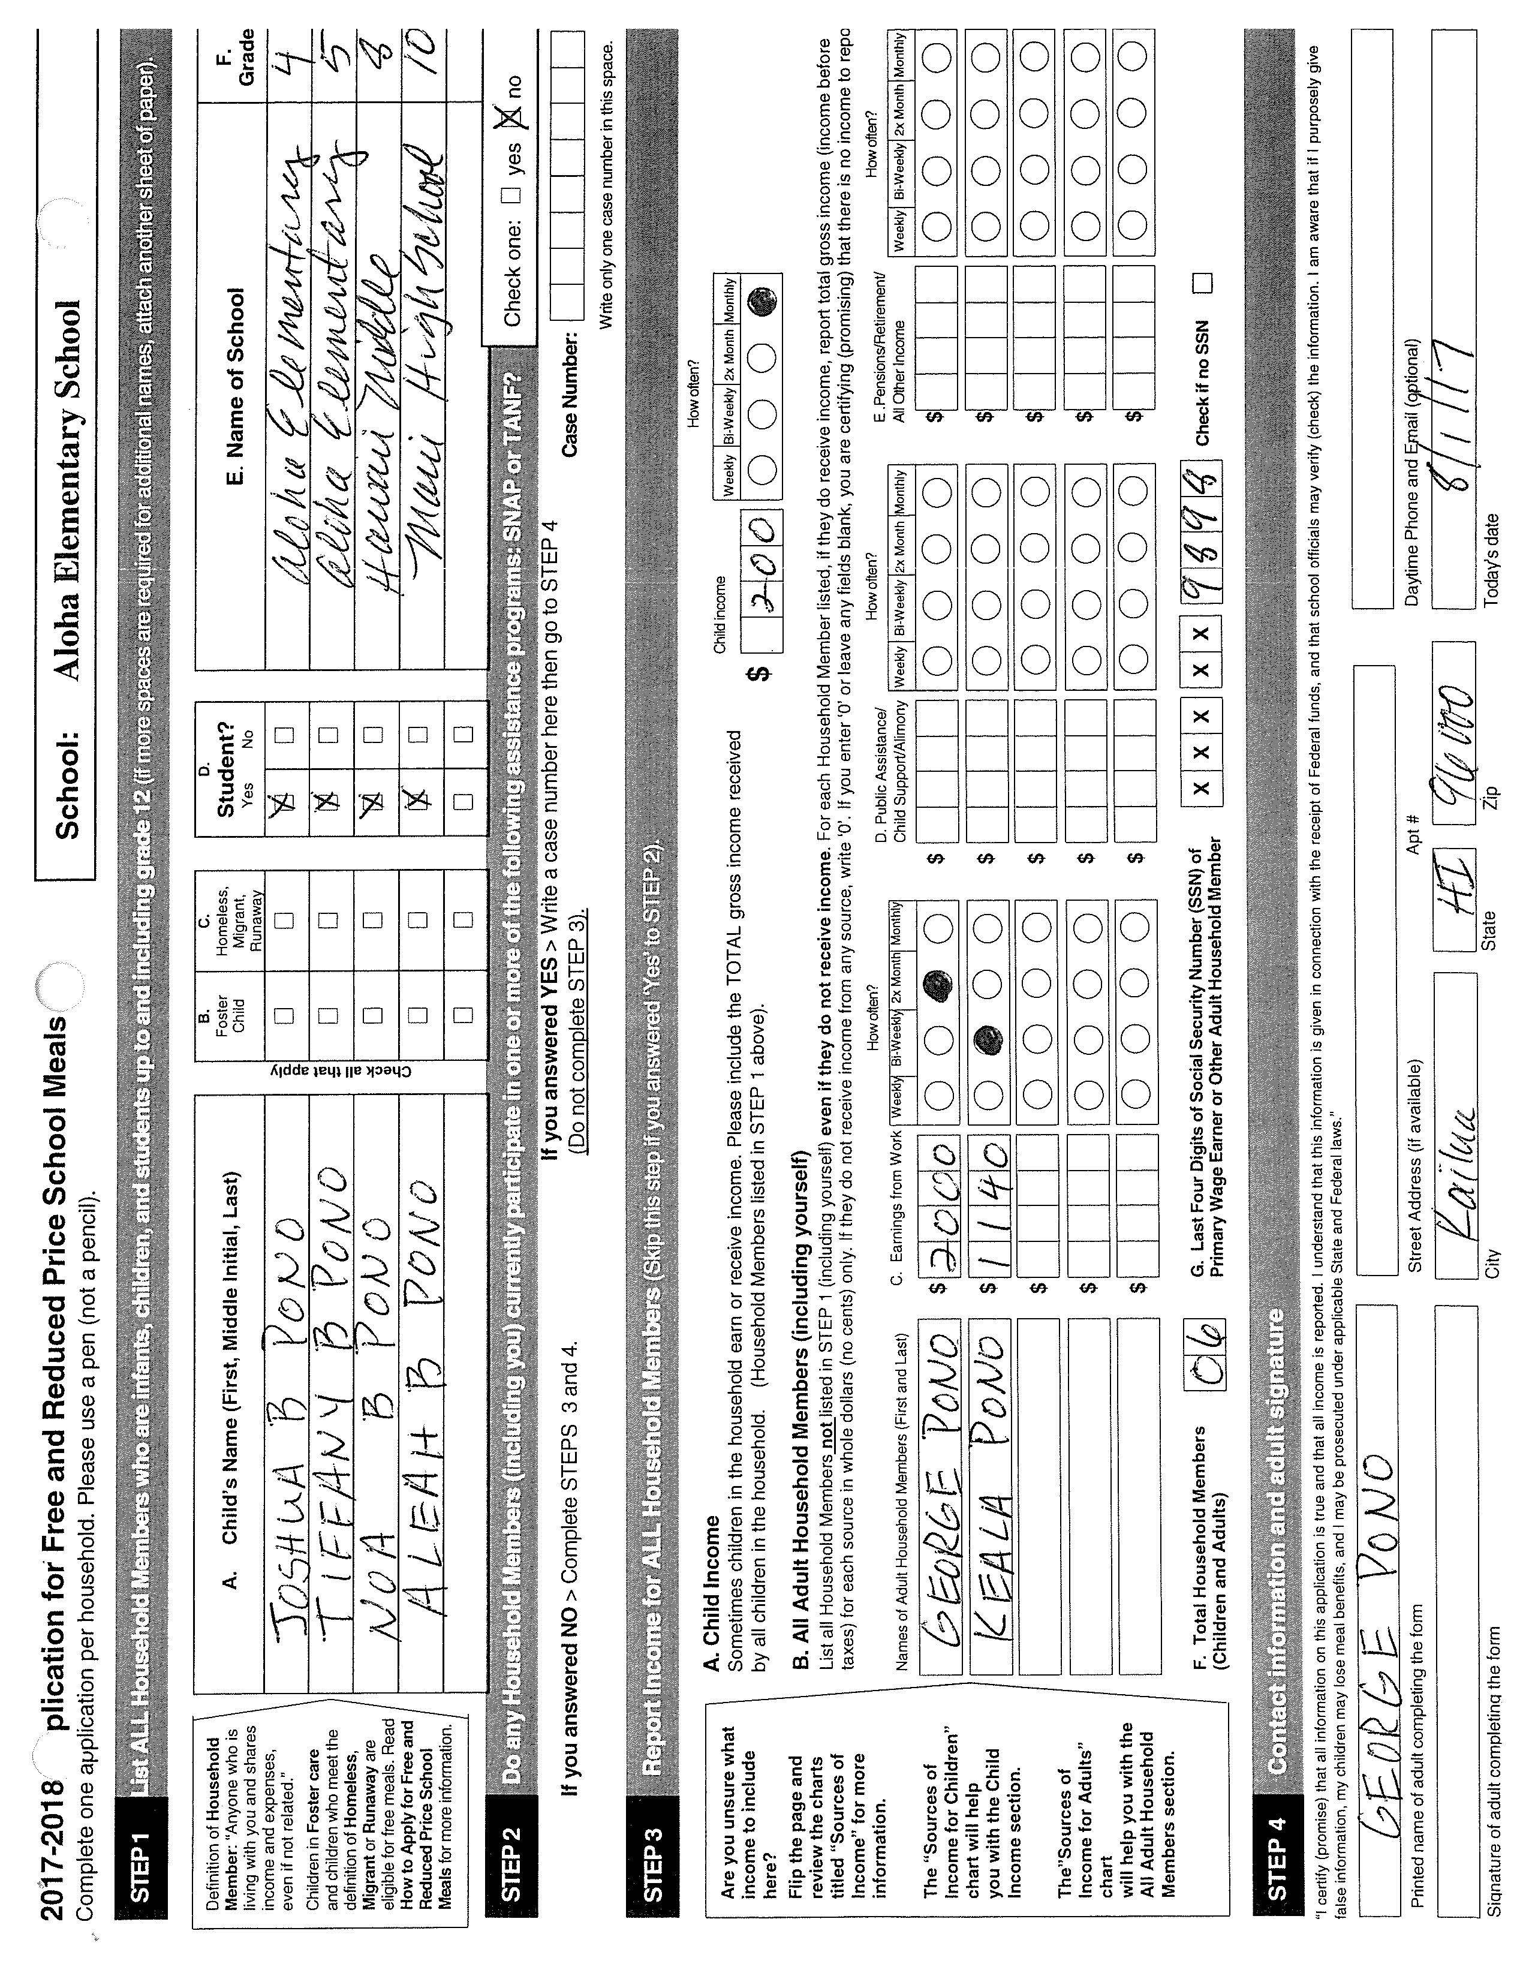
2019-2020
Notes:
Ensure Application is Complete: Contains adult signature, social security number. Remember, an application can still be considered complete without income reported (this application does have an income)
This application is missing an adult signature – it is therefore incomplete and cannot be certified; household should be contacted to obtain signature. Benefit is denied until complete application is received.

Slide 34
Resources
The ‘Eligibility Manual for School Meals – Determining and Verifying Eligibility’
Most current version: revised June 29, 2017
USDA Policies
SP 28-2017 – Prototype Applications
SP 09-2018 – Web-based Applications
Notes:
The Eligibility Manual contains a wealth of information regarding F&R Applications, including verification, certification requirements (approval/denial), and FAQs
USDA Policies are a great resource for more information. A few of the key policies regarding the F&R Applications are listed here.

Slide 35
Non-Discrimination Statement
In accordance with federal civil rights law and U.S. Department of Agriculture (USDA) civil rights regulations and policies, the USDA, its Agencies, offices, and employees, and institutions participating in or administering USDA programs are prohibited from discriminating based on race, color, national origin, sex, disability, age, or reprisal or retaliation for prior civil rights activity in any program or activity conducted or funded by USDA.
Persons with disabilities who require alternative means of communication for program information (e.g., Braille, large print, audiotape, American Sign Language), should contact the Agency (state or local) where they applied for benefits. Individuals who are deaf, hard of hearing or have speech disabilities may contact USDA through the Federal Relay Service at (800) 877-8339. Additionally, program information may be made available in languages other than English.
To file a program complaint of discrimination, complete the USDA Program Discrimination Complaint Form, (AD-3027) found online at: How to File a Complaint, and at any USDA office, or write a letter addressed to USDA and provide in the letter all of the information requested in the form. To request a copy of the complaint form, call (866) 632-9992. Submit your completed form or letter to USDA by:
mail: U.S. Department of Agriculture Office of the Assistant Secretary for Civil Rights 1400 Independence Avenue, SW Washington, D.C. 20250-9410;
fax: (202) 690-7442; or
email: program.intake@usda.gov.
This institution is an equal opportunity provider.

