Slide 1
FNS 742
RCCI and CEP Schools
SY 2019-20

Slide 2
FNS 742 – What is it?
The FNS 742, also known as the Verification Collection Report, is an annual report submitted to the USDA
It is a report that explains the results of verification for each participating SFA, and must be completed by all SFAs, including CEP (Community Eligibility Provision) Schools and RCCI’s
As an SFA, you are responsible for completing the report and submitting it to HCNP for processing and forwarding

Slide 3
Section 1 – Sites and Students
CEP Schools: 1-1 A: Total Number of Schools/Sites and 1-1 B: Total Number of Students (red boxes)
RCCI’s ONLY: DO NOT complete 1-1 A or 1-1 B. Instead, complete lines 1-2b A and 1-2b B (yellow boxes)
These numbers must be reflective of the last operating day of October (October 31, 2019) Tip: Use your October Survey to get these numbers

Slide 4
Section 2 – Alternate Provisions
SFAs that are CEP must complete both 2-3A and 2-3B (red boxes) entering the same numbers entered in Section 1
RCCI’s: you may skip Section 2 and proceed to Section 3

Slide 5
Section 3 – Direct Certification
RCCI’s and CEP SFA’s – check box 3-1, skip Section 4 and proceed to Section 5

Slide 6
Section 5 – Free and Reduced Applications (not directly certified)
After skipping Section 4, both RCCI’s and CEP SFA’s will Check Box 5-1. No further action is required in Section 5, proceed to Section 6

Slide 7
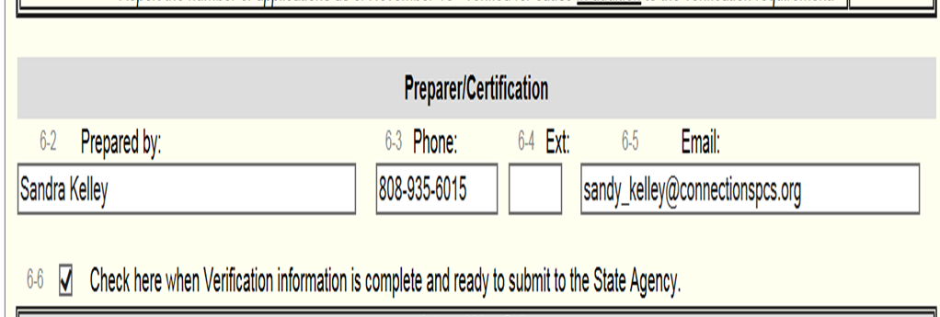
Section 6 – Verification for Cause / Certification
Before signing and submitting form, both RCCI’s and CEP SFA’s must write ‘N/A’ in the Verification for Cause Box. Do not include quotations, write exactly as N/A
Complete the report by filling in fields 6-2, 6-3, 6-5, and checking Box 6-6.
Save the report and exit from it. You should then see the Verification Report’s status listed as ‘Pending Approval’. HCNP will review for accuracy and let you know if changes are needed.

Slide 8
Non-Discrimination Statement
In accordance with federal civil rights law and U.S. Department of Agriculture (USDA) civil rights regulations and policies, the USDA, its Agencies, offices, and employees, and institutions participating in or administering USDA programs are prohibited from discriminating based on race, color, national origin, sex, disability, age, or reprisal or retaliation for prior civil rights activity in any program or activity conducted or funded by USDA.
Persons with disabilities who require alternative means of communication for program information (e.g., Braille, large print, audiotape, American Sign Language), should contact the Agency (state or local) where they applied for benefits. Individuals who are deaf, hard of hearing or have speech disabilities may contact USDA through the Federal Relay Service at (800) 877-8339. Additionally, program information may be made available in languages other than English.
To file a program complaint of discrimination, complete the USDA Program Discrimination Complaint Form, (AD-3027) found online at: How to File a Complaint, and at any USDA office, or write a letter addressed to USDA and provide in the letter all of the information requested in the form. To request a copy of the complaint form, call (866) 632-9992. Submit your completed form or letter to USDA by:
mail: U.S. Department of Agriculture Office of the Assistant Secretary for Civil Rights 1400 Independence Avenue, SW Washington, D.C. 20250-9410;
fax: (202) 690-7442; or
email: program.intake@usda.gov.
This institution is an equal opportunity provider.

