Slide 1
Paid Lunch Equity PART 4 Increasing lunch price & contributing non federal source
Hawaii Child Nutrition Programs
SY 2020-2021
Notes:
This power point is focused on an SFA’s decision to increase their lunch price and contribute non federal funds to meet the PLE requirements.

Slide 2
NEW USDA PAID LUNCH EQUITY TOOL GUIDELINES
Consistent with the terms of the Act, policy memorandum SP 12-2018 Paid Lunch Equity: Guidance for School Year 2018-19 provides notice that any SFA with a positive or zero balance in its nonprofit school food service account as of January 31, 2020, is exempt from PLE requirements found at 7 CFR 210.14(e) for school year (SY) 2019-20. SFAs that had a negative balance in the nonprofit school food service account as of January 31, 2020 must follow PLE requirements when establishing their prices for paid lunches in SY 2020-21.
Notes:
Consistent with the terms of the Act, policy memorandum SP 12-2018 Paid Lunch Equity: Guidance for School Year 2018-19 provides notice that any SFA with a positive or zero balance in its nonprofit school food service account as of January 31, 2020, is exempt from PLE requirements found at 7 CFR 210.14(e) for school year (SY) 2019-2020. SFAs that had a negative balance in the nonprofit school food service account as of January 31, 2020 must follow PLE requirements when establishing their prices for paid lunches in SY 2020-21.

Slide 3
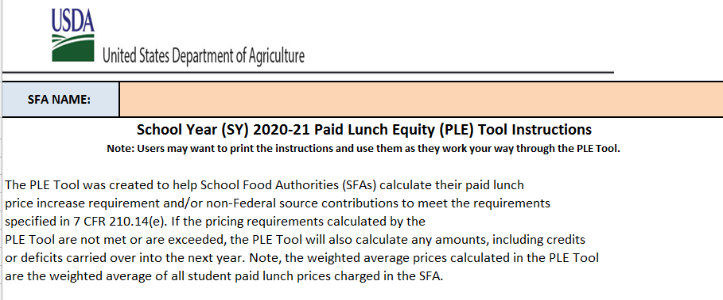
PLE INSTRUCTIONS TAB
Notes:
Lets begin on the instructions tab. It is advised that everyone review the PLE instructions before starting on the PLE Tool. After you had a chance to take a look at the instructions, we will move on to the unrounded requirement finder tab.

Slide 4
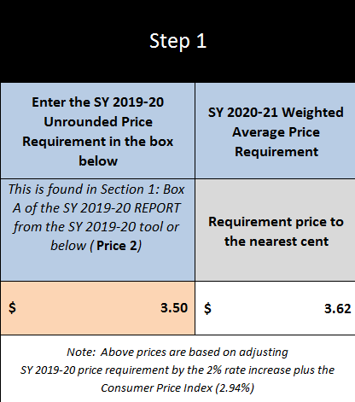
UNROUNDED REQUIREMENT FINDER TAB
Notes:
If you have SY 2019-2020 unrounded price requirement, enter it in the orange box.
This information is found in last year (SY2019-20) PLE tool, on the SY 2019-2020 Report tab in Box A. In this situation, the SY 2020-2021 weighted average price requirement is $3.62. The SFA’s unrounded price requirement is $3.50 (see green arrow).
As we can see, the SY 2020-2021 Average Price Requirement of $3.62 exceeds the SY 2019-2020 unrounded price requirement. To meet the PLE requirements, this SFA decided to increase the paid lunch prices and contribute nonfederal funds.
Next click on the to SY 20-21 Split Calculator tab.

Slide 5
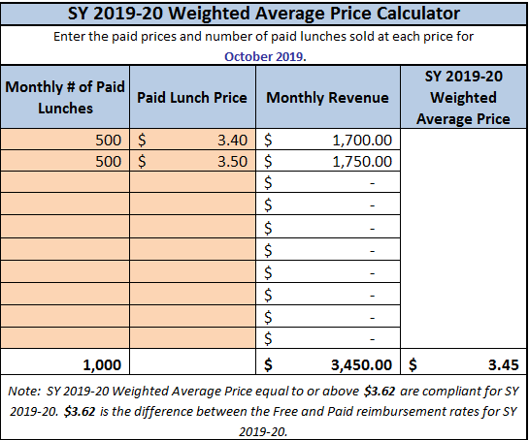
SY 20-21 SPLIT CALCULATOR TAB
Notes:
To calculate the SY 2020-2021 Weighted Average Price Calculator:
First enter the October 2019 paid lunch total (see the green arrow) which in this example is 500 for elementary and 500 for high school
Then enter the price of the paid lunch (see blue arrow) $3.40 elementary and $3.50 high school.
Enter each student paid lunch price (including all schools- elementary, middle, and high school.
After the quantity of paid lunch and price of paid lunches were entered we see this SFA’s SY 2019-2020 Weighted Average Price was $3.45 (see red arrow)
In this situation because the SFA’s SY 2019-2020 weighted average price of $3.45 is less then the SY 2020-2021 weighted average price of $3.62. The SFA needs to increase its paid lunch price by $0.17 to meet the PLE requirement or contribute nonfederal funds.
Now lets assume this SFA wants to increase it lunch prices by $0.10 instead of $0.17 for the upcoming school year, so the SFA must contribute Non Federal Funds to the nonprofit school food service account.

Slide 6
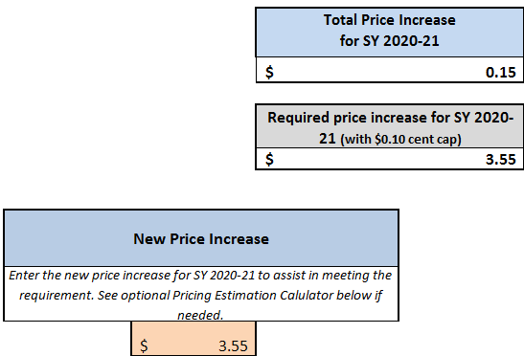
SY 20-21 SPLIT CALCULATOR TAB
Notes:
Enter the new price increase in the orange box.
Instead of increasing the price by $0.15, this SFA wants to increase it lunch prices by $0.10, so the new price is $3.55.

Slide 7
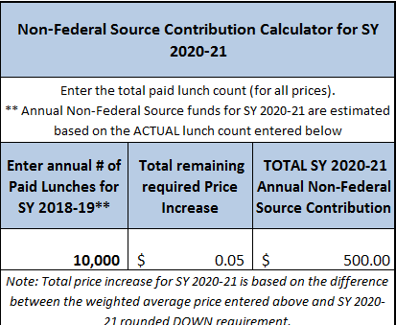
SY 20-21 SPLIT CALCULATOR TAB
Notes:
Enter the paid lunch total meals for SY 2018-2019. This SFA sold 10,000 paid lunches (see green arrow).
The difference between the recommended USDA price increase of $0.15 and SFA elected price increase of $0.10 is $0.05 (see blue arrow)
The total SY 2020-2021 Non-Federal Source Contribution is $500.00

Slide 8
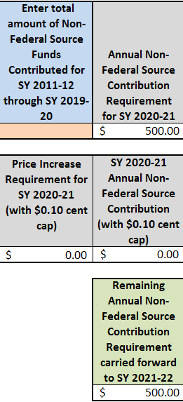
SY 20-21 SPLIT CALCULATOR TAB
Notes:
If you scroll down a little, you will see a box that says, “Enter total amount of Non-Federal Source Funds Contributed for SY 2011-2012 through SY 2019-2020 (see green arrow). Now before you fill in this box, take a moment to consider, may SFAs are under the mistaken impression that any funds they contribute into the nonprofit food service account should be entered in this box, and that is incorrect. There are many reason SFAs transfer funds to the nonprofit food service account. For the purpose of the PLE tool, we are only looking at the nonfederal funds that were specifically used to satisfy the PLE requirement. For this power point let’s assume at this specific time that this SFA did not contributed any nonfederal source funds for PLE. The SFA must contribute $500.00 from a non-federal source the PLE requirement (see blue arrow).
Once completed, click on the SY 2020-2021 Report tab.

Slide 9
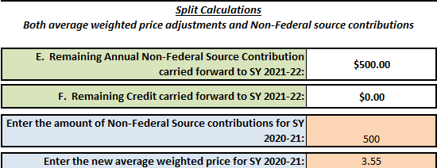
SY 20-21 REPORT TAB
Notes:
SFAs inform the state agency how they will meet the paid lunch equity requirement. They do that by selecting one of the five options from the pull down menu (see green arrow). Because this SFA has chosen to adjust their lunch price and contribute non-federal funds, they will select “Both” (see green arrow).
Scroll down to the Split Calculations.
Here is where we will enter the amount of money the SFA will contribute to the nonprofit school food service account (see blue arrow)
From the previous slide, we know the amount is $500.00.
Enter the new average weighted price for SY 2020-2021 of $3.55 (see purple arrow).
Next save a copy for your file. Then submit a copy of the PLE tool to HCNP. Include documentation (example, student handbook or menu) which identifies the paid lunch prices for SY2020-2021 and identify when the general funds will be transferred into the nonprofit school food service account.

Slide 10
QUESTIONS?
Contact:
Shaynee Moreno
Email: Shaynee.Moreno@k12.hi.us
Notes:
Please contact Shaynee Moreno at the Hawaii Child Nutrition Programs if you have questions.

Slide 11
Nondiscrimination Statement
In accordance with Federal civil rights law and U.S. Department of Agriculture (USDA) civil rights regulations and policies, the USDA, its Agencies, offices, and employees, and institutions participating in or administering USDA programs are prohibited from discriminating based on race, color, national origin, sex, disability, age, or reprisal or retaliation for prior civil rights activity in any program or activity conducted or funded by USDA.
Persons with disabilities who require alternative means of communication for program information (e.g. Braille, large print, audiotape, American Sign Language, etc.), should contact the Agency (State or local) where they applied for benefits. Individuals who are deaf, hard of hearing or have speech disabilities may contact USDA through the Federal Relay Service at (800) 877-8339. Additionally, program information may be made available in languages other than English.
To file a program complaint of discrimination, complete the USDA Program Discrimination Complaint Form, (AD-3027) found online at: How to File a Complaint, and at any USDA office, or write a letter addressed to USDA and provide in the letter all of the information requested in the form. To request a copy of the complaint form, call (866) 632-9992. Submit your completed form or letter to USDA by:
1) mail: U.S. Department of Agriculture
Office of the Assistant Secretary for Civil Rights
1400 Independence Avenue, SW
Washington, D.C. 20250-9410;
2) fax: (202) 690-7442; or
3) email: program.intake@usda.gov
This institution is an equal opportunity provider.
Notes:
This institution is an equal opportunity provider.

