Slide 1
Paid Lunch Equity PART 2 Contributing Non Federal source fund
Hawaii Child Nutrition Programs
SY 2020-2021
Notes:
This presentation will focus on helping those SFAs that have decided to contribute non federal source funds to meet the PLE requirement.

Slide 2
NEW USDA PAID LUNCH EQUITY TOOL GUIDELINES
Consistent with the terms of the Act, policy memorandum SP 12-2018 Paid Lunch Equity: Guidance for School Year 2018-19 provides notice that any SFA with a positive or zero balance in its nonprofit school food service account as of January 31, 2020, is exempt from PLE requirements found at 7 CFR 210.14(e) for school year (SY) 2019-20. SFAs that had a negative balance in the nonprofit school food service account as of January 31, 2020 must follow PLE requirements when establishing their prices for paid lunches in SY 2020-21.
Notes:
Consistent with the terms of the Act, policy memorandum SP 12-2018 Paid Lunch Equity: Guidance for School Year 2018-19 provides notice that any SFA with a positive or zero balance in its nonprofit school food service account as of January 31, 2020, is exempt from PLE requirements found at 7 CFR 210.14(e) for school year (SY) 2019-2020. SFAs that had a negative balance in the nonprofit school food service account as of January 31, 2020 must follow PLE requirements when establishing their prices for paid lunches in SY 2020-21.

Slide 3
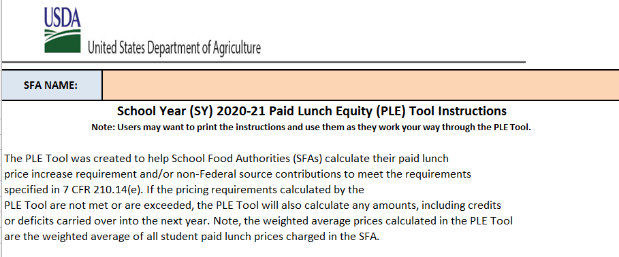
PLE INSTRUCTIONS TAB
Notes:
Lets begin on the instructions tab. It is advised that everyone review the PLE instructions before starting on the PLE Tool. After you had a chance to take a look at the instructions, we will move on to the unrounded requirement finder tab.

Slide 4
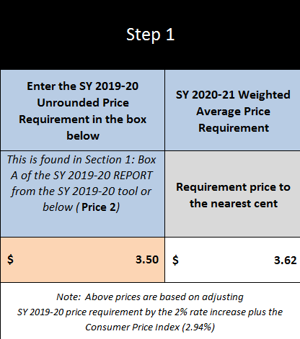
UNROUNDED REQUIREMENT FINDER TAB
Notes:
If you have SY2019-2020 unrounded price requirement, enter it in the orange box.
This information is found in last year (SY2019-20) PLE tool, on the SY 2019-2020 Report tab in Box A. In this situation, the SY 2020-2021 weighted average price requirement is $3.62. The SFA’s unrounded price requirement is $3.50 (see green arrow). If your SY 2019-2020 unrounded price requirement is lower than the SY 2020-2021 weighted average price requirement, then please click on the SY2020-2021 Price Calculator Tab.

Slide 5
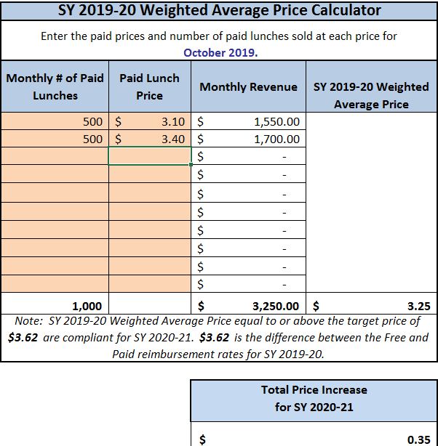
SY 2019-2020 PRICE CALCULATOR
Notes:
To calculate the SY 2019-2020 Weighted Average Price Calculator:
First enter the October 2019 paid lunch total (see the green arrow) which in this example is 500 for elementary and 500 for high school
Then enter the price of the paid lunch (see blue arrow) $3.10 elementary and $3.40 high school.
Enter each student paid lunch price (including all schools- elementary, middle, and high school.
After the quantity of paid lunch and price of paid lunches were entered we see this SFA’s SY 2019-2020 Weighted Average Price was $3.25 (see red arrow)
In this situation because the SFA’s SY 2019-2020 weighted average price of $3.25 is less then the SY 2020-2021 weighted average price of $3.62. The SFA needs to increase its paid lunch price by $0.35 (see purple arrow) to meet the PLE requirement or contribute nonfederal funds. Now lets assume this SFA does not want to increase it lunch prices for the upcoming school year, so the SFA must contribute Non Federal Funds to the nonprofit school food service account.
Next click on the SY 20-21 Non Federal Calculator tab.

Slide 6
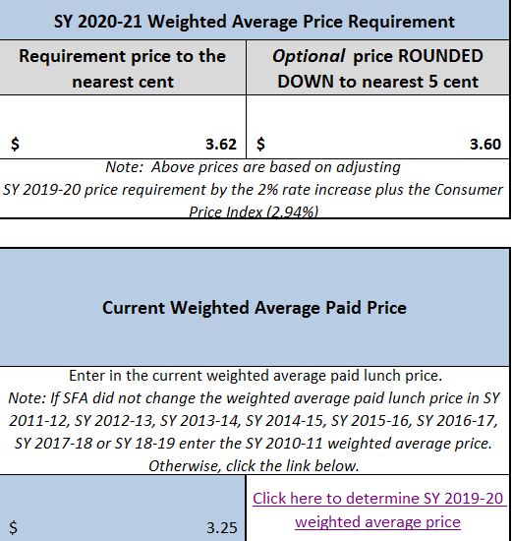
SY 20-21 NONFEDERAL CALCULATOR
Notes:
On the top section of this tab we can see:
the SFA weighted average price $3.25 (see green arrow)
the SY 2020-2021 weighted average price requirement $3.62 (see blue arrow)
the optional price $3.60 rounded down to the nearest 5 cents (see purple arrow)

Slide 7
Different Scenario of Non-Federal Source Contribution Requirement
1) SFA contributed for SY2011-2012 through SY219-2020 is less than required Non-Federal Source Contribution Requirement for SY2020-21
2) SFA contributed for SY2011-2012 through SY219-2020 is more than required Non-Federal Source Contribution Requirement for SY2020-21
3) SFA contributed for SY2011-2012 through SY219-2020 is zero
Notes:
Using the information from the previous slides:
The SFA’s unrounded price requirement is $3.50, while the weighted average requirement is $3.62
We will focus on 3 different scenarios.
1) SFA contributed for SY2011-2012 through SY219-2020 is less than required Non-Federal Source Contribution Requirement for SY2020-21
2) SFA contributed for SY2011-2012 through SY219-2020 is more than required Non-Federal Source Contribution Requirement for SY2020-21
3) SFA contributed for SY2011-2012 through SY219-2020 is zero

Slide 8
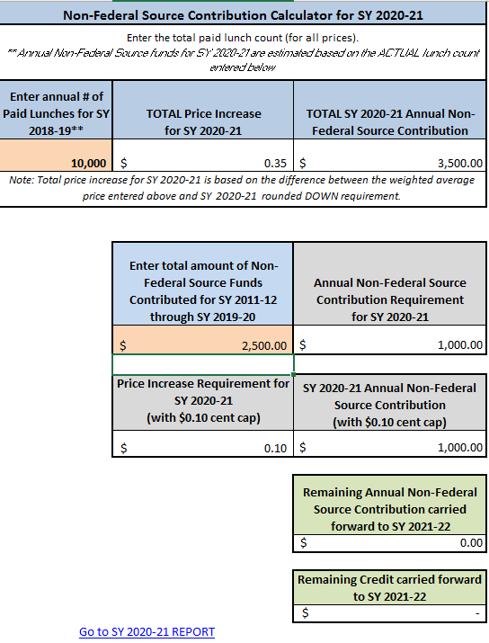
SY 20-21 NONFEDERAL CALCULATOR Scenario 1
Notes:
Scenario 1:
On the bottom section of this tab, enter the annual number of paid lunches for SY 2019-2020. In this situation the total paid lunches for SY 2019-2020 were 10,000 (see green arrow)
If we take the 10,000 paid lunches multiplied by the “total price increase for SY 2020-2021” of $0.35 (Price Calculator Tab), we see that this SFA must contribute $3,500.00 (see blue arrow) from a non-federal source to the nonprofit school food service account to meet the PLE requirements.
If you scroll down a little, you will see a box that says, “Enter total amount of Non-Federal Source Funds Contributed for SY 2011-2012 through SY 2017-2018. Now before you fill in this box, take a moment to consider, may SFAs are under the mistaken impression that any funds they contribute into the nonprofit food service account should be entered in this box, and that is incorrect. There are many reason SFAs transfer funds to the nonprofit food service account. For the purpose of the PLE tool, we are only looking at the nonfederal funds that were specifically used to satisfy the PLE requirement. For this power point let’s assume at this specific time that this SFA contributed $2,500.00 (see purple arrow) for PLE in previous schools years. This is $1.000.00 less than is required amount and the SFA has to contribute $1,000.00.

Slide 9
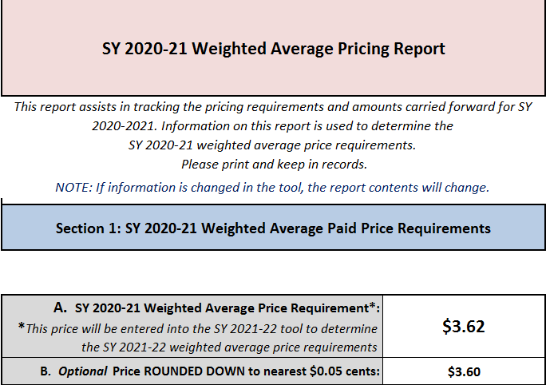
SY 2020-2021 REPORT TAB SECTION 1 Scenario 1
Notes:
IMPORTANT
This reports assists in tracking the price requirements and amounts carried forward for SY 2020-2021. Information on this report is used to determine the SY 2020-2021 weighted average price requirement. Please print and keep in records.

Slide 10
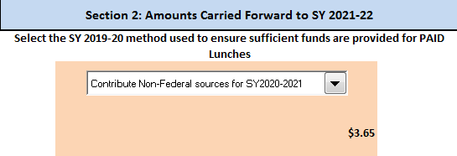
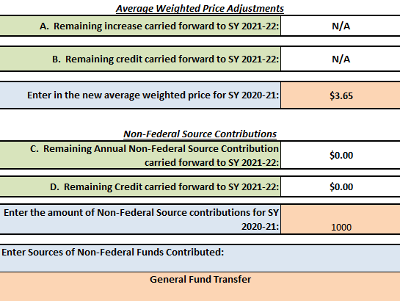
SY 2020-2021 REPORT TAB SECTION 2 Scenario 1
Notes:
SFAs inform the department how they will meet the paid lunch equity requirement. They do that by selecting one of the five options from the pull down menu (see green arrow). Because this SFA has chosen not to adjust their lunch price they will select “Contribute Non-Federal Sources for SY 2020-2021” (see green arrow).
Scroll down to the Non-Federal Source Contribution.
Here is where we will enter the amount of money the SFA will contribute to the nonprofit school food service account (see blue arrow)
From the previous slide, we know the amount is $1,000.00.
Next the tool will ask you where the nonfederal funds are coming from. We want to make sure the funds are coming from an allowable source.
In this instance, the SFA is contributing funds from its “General funds” (see purple arrow).
Next save a copy for your file. Then submit a copy of the PLE tool to HCNP. Include documentation (example, student handbook or menu) which identifies the paid lunch prices for SY 2020-2021 and identify when the general funds will be transferred into the nonprofit school food service account.

Slide 11
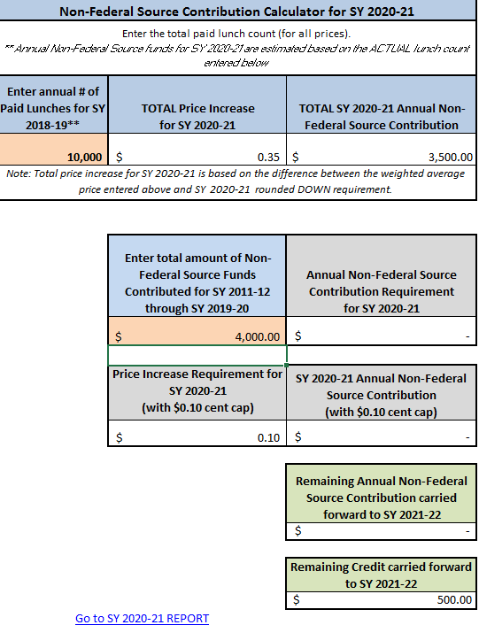
SY 20-21 NONFEDERAL CALCULATOR Scenario 2
Notes:
Scenario 2:
On the bottom section of this tab, enter the annual number of paid lunches for SY 2019-2020. In this situation the total paid lunches for SY 2019-2020 were 10,000 (see green arrow)
If we take the 10,000 paid lunches times the “total price increase for SY 2020-2021” of $0.35 (Price Calculator Tab), we see that this SFA must contribute $3,500.00 (see blue arrow) from a non federal source to the nonprofit school food service account to meet the PLE requirements.
If you scroll down a little, you will see a box that says, “Enter total amount of Non-Federal Source Funds Contributed for SY 2011-2012 through SY 2017-2018. Now before you fill in this box, take a moment to consider, may SFAs are under the mistaken impression that any funds they contribute into the nonprofit food service account should be entered in this box, and that is incorrect. There are many reason SFAs transfer funds to the nonprofit food service account. For the purpose of the PLE tool, we are only looking at the nonfederal funds that were specifically used to satisfy the PLE requirement. For this power point let’s assume at this specific time that this SFA contributed $4,00.00 (see purple arrow) for PLE in previous schools years. This is $500.00 more than is required and the SFA does not have to contribute any funds this year.
The remaining $500.00 would be carried forward to SY 2021-2022 (see red arrow).

Slide 12
SY 2020-2021 REPORT TAB SECTION 1 Scenario 2
Notes:
IMPORTANT
This reports assists in tracking the price requirements and amounts carried forward for SY 2020-2021. Information on this report is used to determine the SY 2020-2021 weighted average price requirement. Please print and keep in records.

Slide 13
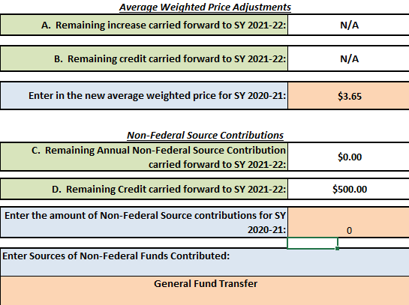
SY 2020-2021 REPORT TAB SECTION 2 Scenario 2
Notes:
SFAs inform the department how they will meet the paid lunch equity requirement. They do that by selecting one of the five options from the pull down menu (see green arrow). Because this SFA has chosen not to adjust their lunch price they will select “Contribute Non-Federal Sources for SY 2020-2021” (see green arrow).
Scroll down to the Non-Federal Source Contribution.
Here is where we will enter the amount of money the SFA will contribute to the nonprofit school food service account (see blue arrow). From the previous slide, we know the amount is $0.
Because the SFA contribution for SY2011-2012 through SY219-2020 is more than required Non-Federal Source Contribution Requirement for SY2020-21.
Next, the tool will show the Remaining Credit carried forward to SY 2021-22 is $500 (see purple arrow).
Finally, save a copy for your file. Then submit a copy of the PLE tool to HCNP. Include documentation (example, student handbook or menu) which identifies the paid lunch prices for SY 2020-2021 and identify when the general funds will be transferred into the nonprofit school food service account.

Slide 14
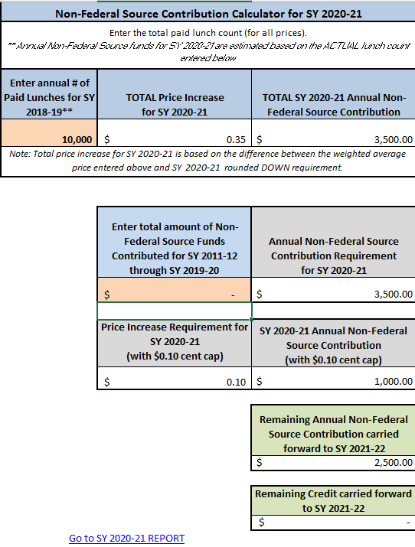
SY 20-21 NONFEDERAL CALCULATOR Scenario 3
Notes:
Scenario 3:
On the bottom section of this tab, enter the annual number of paid lunches for SY 2019-2020. In this situation the total paid lunches for SY 2019-2020 were 10,000 (see green arrow)
If we take the 10,000 paid lunches times the “total price increase for SY 2020-2021” of $0.35 (Price Calculator Tab), we see that this SFA must contribute $3,500.00 (see blue arrow) from a non federal source to the nonprofit school food service account to meet the PLE requirements.
If you scroll down a little, you will see a box that says, “Enter total amount of Non-Federal Source Funds Contributed for SY 2011-2012 through SY 2017-2018. Now before you fill in this box, take a moment to consider, may SFAs are under the mistaken impression that any funds they contribute into the nonprofit food service account should be entered in this box, and that is incorrect. There are many reason SFAs transfer funds to the nonprofit food service account. For the purpose of the PLE tool, we are only looking at the nonfederal funds that were specifically used to satisfy the PLE requirement. For this power point let’s assume at this specific time that this SFA contributed $0 (see purple arrow) for PLE in previous schools years. The SFA can elect to raise it lunch prices by $0.10 and $1,000 of the Annual Non-Federal Source Contribution would be met. The remaining $2,500 balance is the amount the SFA must contribute to the non-profit food service account. Or the SFA can elect to contribute the $3,500 and not increase the lunch cost.
In this next power point, the SFA did not contribute any funds from SY 2011-2012 through SY 2017-2018. In this instance the SFA has elected not to increase its lunch prices and make a $3,500 contribution to satisfy the PLE requirement.
Now click on the SY 2020-2021 Report.

Slide 15
SY 2020-2021 REPORT TAB SECTION 1 Scenario 3
Notes:
IMPORTANT
This reports assists in tracking the price requirements and amounts carried forward for SY 2020-2021. Information on this report is used to determine the SY 2020-2021 weighted average price requirement. Please print and keep in records.

Slide 16
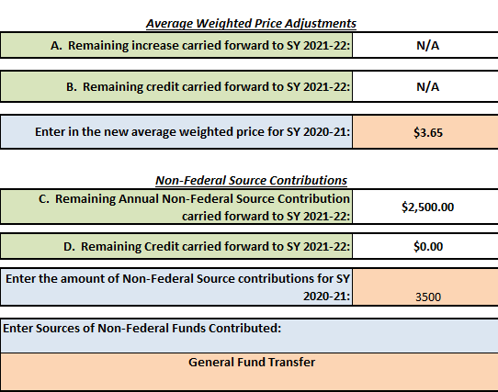
SY 2020-21 REPORT TAB SECTION 2 Scenario 3
Notes:
SFAs inform the department how they will meet the paid lunch equity requirement. They do that by selecting one of the five options from the pull down menu (see green arrow). Because this SFA has chosen not to adjust their lunch price they will select “Contribute Non-Federal Sources for SY 2020-2021” (see green arrow).
Scroll down to the Non-Federal Source Contribution.
Here is where we will enter the amount of money the SFA will contribute to the nonprofit school food service account (see blue arrow). From the previous slide, we know the amount is $3,500.
Because the SFA contribution for SY2011-2012 through SY219-2020 is more than required Non-Federal Source Contribution Requirement for SY2020-21.
Next, the tool will ask you where the nonfederal funds are coming from. We want to make sure the funds are coming from an allowable source.
In this instance, the SFA is contributing funds from its “General funds” (see purple arrow).
Finally, save a copy for your file. Then submit a copy of the PLE tool to HCNP. Include documentation (example, student handbook or menu) which identifies the paid lunch prices for SY 2020-2021 and identify when the general funds will be transferred into the nonprofit school food service account.

Slide 17
QUESTIONS?
Contact:
Shaynee Moreno
Email: Shaynee.Moreno@k12.hi.us
Notes:
Please contact Shaynee Moreno at the Hawaii Child Nutrition Programs if you have questions.

Slide 18
Nondiscrimination Statement
In accordance with Federal civil rights law and U.S. Department of Agriculture (USDA) civil rights regulations and policies, the USDA, its Agencies, offices, and employees, and institutions participating in or administering USDA programs are prohibited from discriminating based on race, color, national origin, sex, disability, age, or reprisal or retaliation for prior civil rights activity in any program or activity conducted or funded by USDA.
Persons with disabilities who require alternative means of communication for program information (e.g. Braille, large print, audiotape, American Sign Language, etc.), should contact the Agency (State or local) where they applied for benefits. Individuals who are deaf, hard of hearing or have speech disabilities may contact USDA through the Federal Relay Service at (800) 877-8339. Additionally, program information may be made available in languages other than English.
To file a program complaint of discrimination, complete the USDA Program Discrimination Complaint Form, (AD-3027) found online at: How to File a Complaint, and at any USDA office, or write a letter addressed to USDA and provide in the letter all of the information requested in the form. To request a copy of the complaint form, call (866) 632-9992. Submit your completed form or letter to USDA by:
1) mail: U.S. Department of Agriculture
Office of the Assistant Secretary for Civil Rights
1400 Independence Avenue, SW
Washington, D.C. 20250-9410;
2) fax: (202) 690-7442; or
3) email: program.intake@usda.gov
This institution is an equal opportunity provider.
Notes:
This institution is an equal opportunity provider.

