Slide 1
Paid Lunch Equity PART 3 price increase
Hawaii Child Nutrition Programs
SY 2020-2021
Notes:
This presentation will focus on helping those SFAs that have decided to increase the lunch prices to meet the PLE requirement.

Slide 2
NEW USDA PAID LUNCH EQUITY TOOL GUIDELINES
Consistent with the terms of the Act, policy memorandum SP 12-2018 Paid Lunch Equity: Guidance for School Year 2018-19 provides notice that any SFA with a positive or zero balance in its nonprofit school food service account as of January 31, 2020, is exempt from PLE requirements found at 7 CFR 210.14(e) for school year (SY) 2019-20. SFAs that had a negative balance in the nonprofit school food service account as of January 31, 2020 must follow PLE requirements when establishing their prices for paid lunches in SY 2020-21.
Notes:
Consistent with the terms of the Act, policy memorandum SP 12-2018 Paid Lunch Equity: Guidance for School Year 2018-19 provides notice that any SFA with a positive or zero balance in its nonprofit school food service account as of January 31, 2020, is exempt from PLE requirements found at 7 CFR 210.14(e) for school year (SY) 2019-2020. SFAs that had a negative balance in the nonprofit school food service account as of January 31, 2020 must follow PLE requirements when establishing their prices for paid lunches in SY 2020-21.

Slide 3
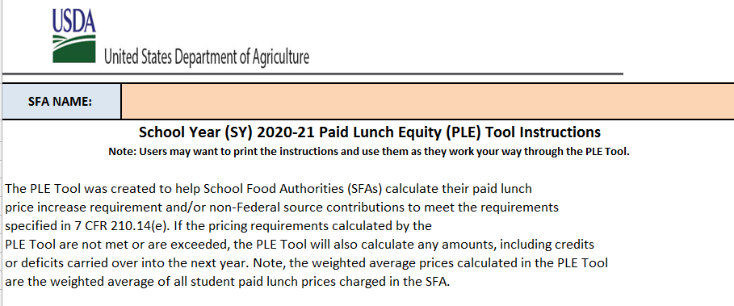
PLE INSTRUCTIONS TAB
Notes:
Lets begin on the instructions tab. It is advised that everyone review the PLE instructions before starting on the PLE Tool. After you had a chance to take a look at the instructions, we will move on to the unrounded requirement finder tab.

Slide 4
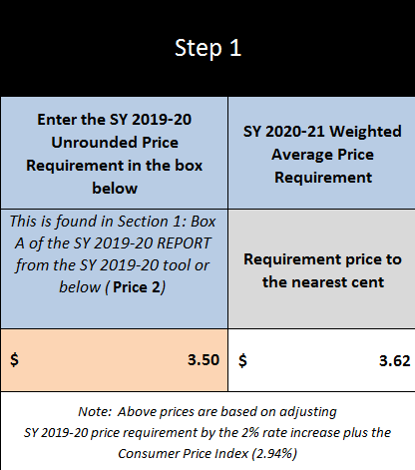
UNROUNDED REQUIREMENT FINDER TAB
Notes:
If you have SY2019-2020 unrounded price requirement, enter it in the orange box.
This information is found in last year (SY2019-20) PLE tool, on the SY 2019-2020 Report tab in Box A.
In this situation, the SY 2020-2021 weighted average price requirement is $3.62. The SFA’s unrounded price requirement is $3.50 (see green arrow). If your SY 2019-2020 unrounded price requirement is lower than the SY 2020-2021 weighted average price requirement, then please click on the SY2020-2021 Price Calculator Tab.

Slide 5
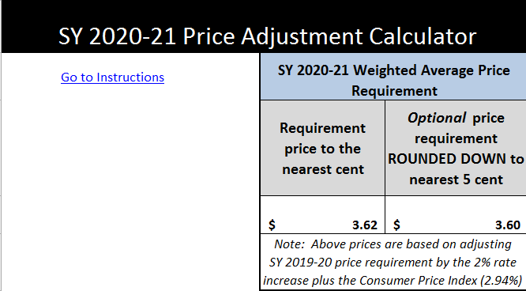
SY 20-21 PRICE CALCULATOR TAB
Notes:
At the top of the SY 20-21 Price Calculator, it shows the SY 2020-2021 Weighted Average Price:
Requirement price to the nearest cent of $3.62
Optional price requirement rounded down to the nearest 5 cents of $3.60
By USDA policy, SFAs have the option of either raising the prices to the full weighted average price $3.62 or using the optional rounded down price of $3.60. Please remember if a SFA chooses to use the round down price of $3.60, next year unrounded requirement price will be $3.60 and the SFA might have to increase its lunch prices next school year.

Slide 6
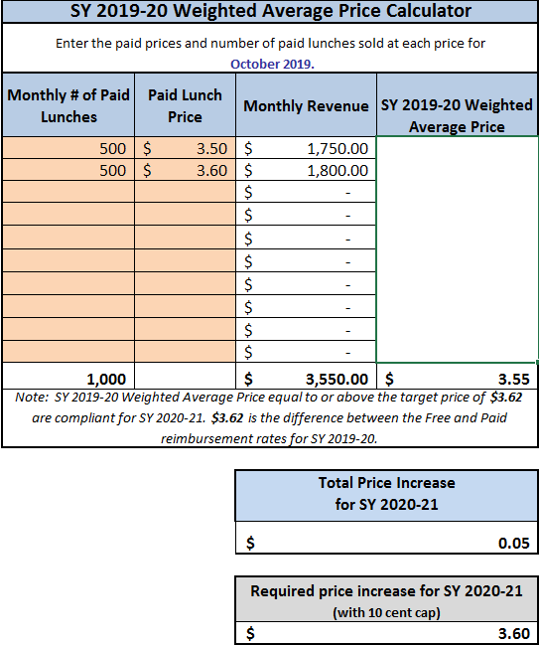
SY 2019-2020 PRICE CALCULATOR
Notes:
To calculate the SY 2019-2020 Weighted Average Price Calculator:
First enter the October 2019 paid lunch total (see the green arrow) which in this example is 500 for elementary and 500 for high school
Then enter the price of the paid lunch (see blue arrow) $3.50 elementary and $3.60 high school.
Enter each student paid lunch price (including all schools- elementary, middle, and high school.
After the quantity of paid lunch and price of paid lunches were entered we see this SFA’s SY 2019-2020 Weighted Average Price was $3.55 (see red arrow)
In this situation the SFA’s SY 2019-2020 weighted average price of $3.55 is less then the SY 2020-2021 weighted average price of $3.62.
To meet the SY 2020-2021 full weighted average price requirement of $3.62, the SFA would increase it lunch price by $0.07.
If the SFA chooses to raise it meet the optional price requirement of $3.60, then the SFA could increase its paid lunch price by $0.05.
Now lets assume this SFA will increase it lunch prices for the upcoming school year.
Please take a look at the Gray box (see yellow arrow)- “Required price increase for SY 2020-2021. This box can cause a lot of confusion for SFAs. They think this box refers to them and they are unable to raise their lunch prices over the amount in the box. In actuality this box is for USDA, according to USDA policy, USDA and state agency can only require that SFA increase their weighted average to 10 cents per year. But SFAs can only their own, voluntarily increase their prices.
Next scroll down to the bottom of the PLE Tool, and you will see “Step 3 (Optional but very helpful.)
Next click on the SY 20-21 Non Federal Calculator tab.

Slide 7
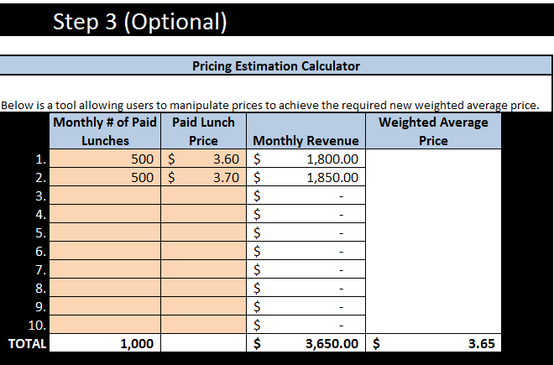
SY 20-21 PRICE CALCULATOR TAB
Notes:
At the bottom of this SY 20-21 Price Calculator tab is a pricing estimation calculator that will assist the SFA(s) with the calculation of charging different prices to meet the price requirements. First start by coping the monthly # of paid lunches in the SY 2020-2021 Weighted Average Price Calculator (middle section of this page) to the Pricing Estimation Calculator. Next in the “Next in the Paid Lunch Price” enter different lunch prices. There will be many combination of price increases that could equal or exceed the Weighted Average Price $3.62. The SFA does not have to do an equal price increase for the different grade levels. Example, it could choose to increase the elementary price or the high school price or both.
The SFA will then choose which price is right for its school. In this example, the new SY 2020-2021 lunch price is $3.60 Elementary School and $3.70 High School and the weighted average is $3.65 (see red circle).
Next click on the SY 2020-2021 REPORT tab

Slide 8
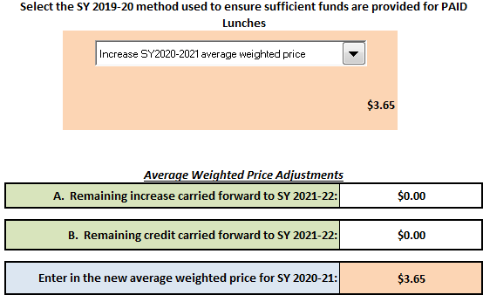
SY 2020-2021 REPORT TAB
Notes:
SFAs inform the state agency how they will meet the paid lunch equity requirement. They do that by selecting one of the five options from the pull down menu (see green arrow). Because this SFA has chosen to adjust their lunch price they will select “Increase SY 2020-2021 average weighted price” (see green arrow).
In the peach cell under the Average Weighted Price Adjustment enter the new average weighted price for SY 2020-2021 (see blue arrow). From the previous slide the new average weighted price for SY 2020-2021 was $3.65.
Next save a copy for your file. Then submit a copy of the PLE tool to HCNP. Include documentation (example, student handbook or menu) which identifies the paid lunch prices for SY 2020-2021

Slide 9
QUESTIONS?
Contact:
Shaynee Moreno
Email: Shaynee.Moreno@k12.hi.us
Notes:
Please contact Shaynee Moreno at the Hawaii Child Nutrition Programs if you have questions.

Slide 10
Nondiscrimination Statement
In accordance with Federal civil rights law and U.S. Department of Agriculture (USDA) civil rights regulations and policies, the USDA, its Agencies, offices, and employees, and institutions participating in or administering USDA programs are prohibited from discriminating based on race, color, national origin, sex, disability, age, or reprisal or retaliation for prior civil rights activity in any program or activity conducted or funded by USDA.
Persons with disabilities who require alternative means of communication for program information (e.g. Braille, large print, audiotape, American Sign Language, etc.), should contact the Agency (State or local) where they applied for benefits. Individuals who are deaf, hard of hearing or have speech disabilities may contact USDA through the Federal Relay Service at (800) 877-8339. Additionally, program information may be made available in languages other than English.
To file a program complaint of discrimination, complete the USDA Program Discrimintion Complaint Form, (AD-3027) found online at:
http://www.ascr.usda.gov/complaint_filing_cust.html, and at any USDA office, or write a letter addressed to USDA and provide in the letter all of the information requested in the form. To request a copy of the complaint form, call (866) 632-9992. Submit your completed form or letter to USDA by:
1) mail: U.S. Department of Agriculture
Office of the Assistant Secretary for Civil Rights
1400 Independence Avenue, SW
Washington, D.C. 20250-9410;
2) fax: (202) 690-7442; or
3) email: program.intake@usda.gov
This institution is an equal opportunity provider.
Notes:
This institution is an equal opportunity provider.

