Slide 1
FNS-742 Verification Collection Report
SFAs with Meal Applications
SY 2020-21

Slide 2
FNS-742 – What is it?
The FNS-742, also known as the Verification Collection Report, is an annual report submitted to the USDA
It is a report that explains the results of verification for each participating SFA, and must be completed by ALL SFAs, including Community Eligibility Provision (CEP) Schools and Residential Child Care Institutions (RCCI)
As an SFA, you are responsible for completing the report and submitting it to HCNP for processing and forwarding

Slide 3
Gather Your Verification Forms
Forms V-7a, V-7b, and V-7c
Slides will indicate when to refer to your forms so you can enter the information into the FNS-742

Slide 4
FNS-742 in HCNP Systems
Log into HCNP Systems
http://www.cnpweb.org/hawaii/Login
Go to the Forms tab
Click the + symbol for the Verification Report (circled in red above)

Slide 5
Section 1 – Sites and Students
In Box 1-1A, enter the total number of schools/sites in your SFA (red box)
In Box 1-1B, enter the total number of students in your SFA (yellow box)
These numbers must be reflective of the last operating day of October.

Slide 6
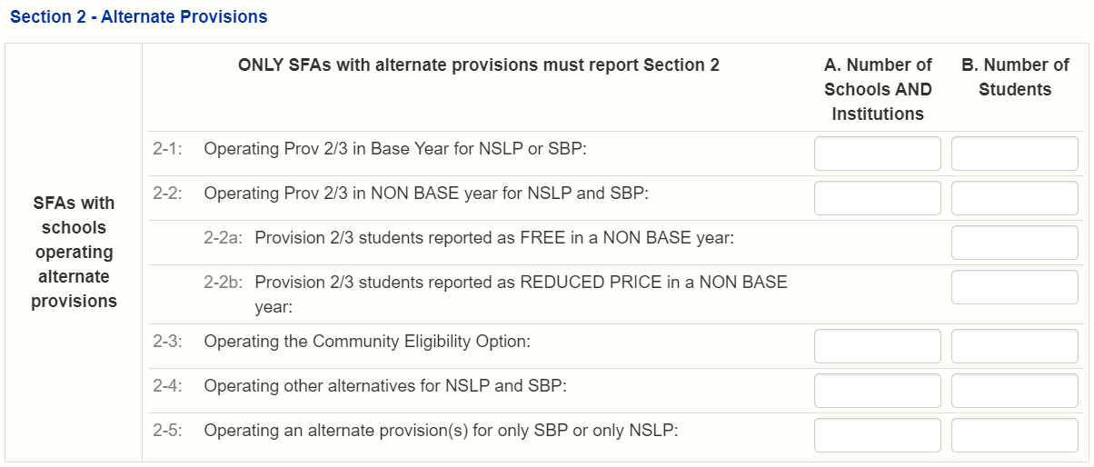
Section 2 – Alternate Provisions (Provision 2)
Complete this section only if you have schools/sites in your SFA that participate in alternate provisions. This slide explains what to do if your SFA has any Provision 2 schools (BAS YEAR). Enter the number of schools/sites operating Provision 2 in box 2-1A (red box) and the total number of students in those schools/sites in box 2-1B (yellow box)
If all of the schools/sites in your SFA accept applications, skip this section and proceed to Section 3

Slide 7
Section 2 – Alternate Provisions (CEP)
This slide explains what to do if your SFA participates in CEP (Community Eligibility Provision). Enter the number of schools/sites operating CEP in box 2-3A (red box) and the total number of students in those schools/sites in box 2-3B (yellow box)
If all of the schools/sites in your SFA accept applications, skip this section and proceed to Section 3

Slide 8
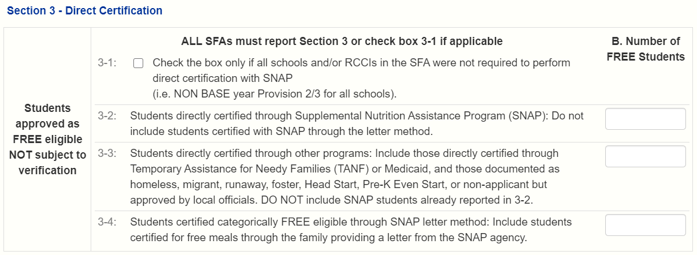
Section 3 – Direct Certification
Refer to
Form V-7b
In Box 3-2B (red box), enter the number of students in your SFA directly certified to receive free meals via SNAP
In Box 3-3B (yellow box), enter the number of students directly certified to receive free meals through any method other than SNAP (e.g. TANF, Foster Child, etc.)
These numbers are again reflective of the last operating day of October
Enter 0 for 3-4B because this does not apply to Hawaii

Slide 9
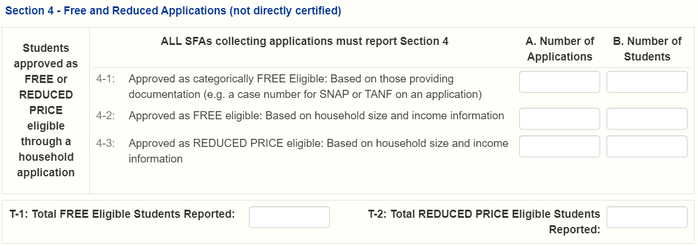
Section 4 – Free and Reduced Applications (not directly certified)
Refer to Forms V-7a and V-7b
Box 4-1A (red box)– enter the total number of applications (as of the start of Verification, October 1) that were approved as Categorically Free (e.g. the application had a SNAP case number)
Box 4-1B (yellow box) – enter the total number of students that were listed on the applications in Box 4-1A

Slide 10
Section 4 – Free and Reduced Applications (not directly certified)
Refer to Forms V-7a and V-7b
Box 4-2A (red box) – enter the total number of applications approved as Free (as of the start of Verification, October 1), based on household size and income
Box 4-2B (yellow box) – enter the total number of students that were listed on the applications in Box 4-2A

Slide 11
Section 4 – Free and Reduced Applications (not directly certified)
Refer to Forms V-7a and V-7b
In Box 4-3A (red box), enter the total number of applications approved as reduced price (as of the start of Verification, October 1) based on household size and income
In Box 4-3B (yellow box), enter the total number of students that were listed on the applications in Box 4-3A

Slide 12
Section 4 – Free and Reduced Applications (not directly certified)
Refer to Form V-7b
In Box T-1 (red box), enter the total number of students eligible for free meals based on applications and direct certification. This is the SUM of Boxes (3-2B), (3-3B), (3-4B), (4-1B), (4-2B), and (2-2aB, if applicable)
In Box T-2 (yellow box), enter the total number of students eligible for reduced price meals based on applications. This number comes from Boxes (4-3B) and (2-2bB, if applicable)

Slide 13
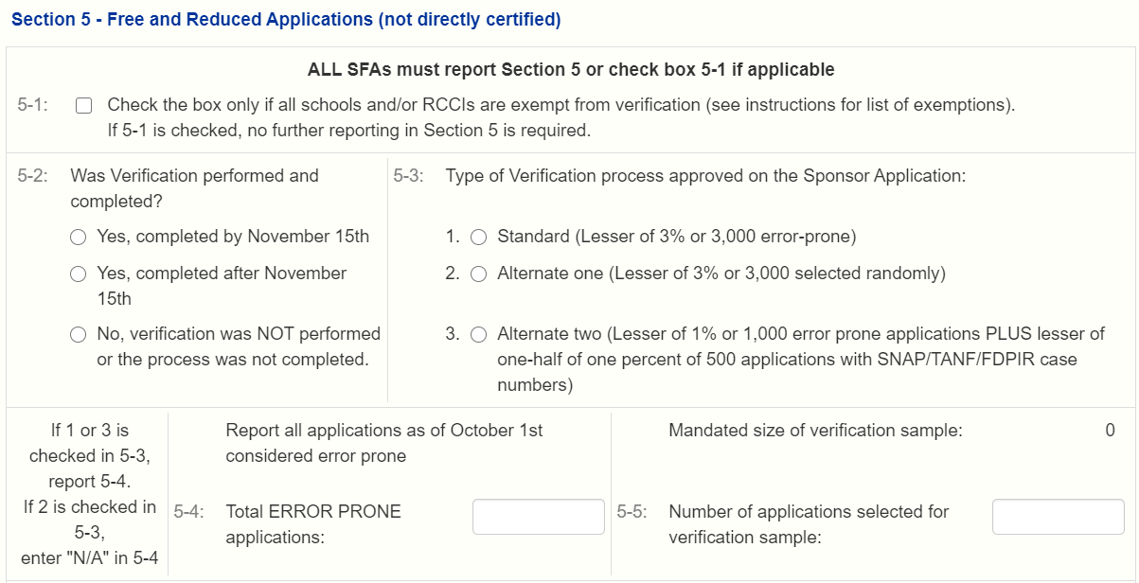
Section 5 – Free and Reduced Price Applications (not directly certified)
Refer to Form V-7a
Answer the question in Field 5-2
In 5-3, select the verification process that was used. All SFAs should have used the Standard Method.

Slide 14
Section 5 – Free and Reduced Price Applications (not directly certified)
Refer to Form V-7a
In Box 5-4 (red box), enter the total number of Error Prone applications you had on file as of the beginning of Verification (Oct. 1)
In Box 5-5 (yellow box), enter the total number of applications your SFA selected to be verified
Note: the number you enter in Box 5-5 must match the auto-generated number above it (‘Mandated size of verification sample’)

Slide 15
Section 5 – Free and Reduced Price Applications (not directly certified)
Direct Verification = using records from public agencies (e.g. Department of Human Services) to verify program participation.
Typically not done in Hawaii. If you think your SFA conducted Direct Verification for any app(s), enter the appropriate numbers in Box 5-7A (number of applications) and 5-7B (number of students)
For most SFAs, Direct Verification is not conducted, so please check Box 5-6. Box 5-7A and 5-7B will therefore be left blank.

Slide 16
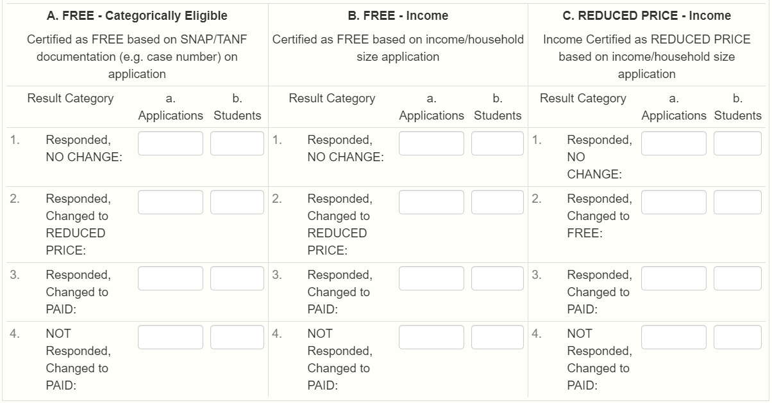
Section 5 – Free and Reduced Price Applications (not directly certified)
Refer to Form V-7c
Enter the results of verification in Section 5-8
Every application your SFA verified must be listed here, in the appropriate box
The total number of applications in this section must match the number entered in Box 5-5
Proceed to next slide for further instructions with this section

Slide 17
Section 5 – Free and Reduced Price Applications (not directly certified)
Refer to Form V-7c
Box A – “Categorically Free” applications (i.e. case number on application) – based on verification result (#1, #2, #3, or #4), enter number of applications in Column a (red boxes), and the number of students in Column b (yellow boxes)
Do the same for Box B (Free - Income) and Box C (Reduced Price - Income)

Slide 18
Section 6 – Verification for Cause / Certification
Refer to Form V-7c
Enter the number of applications your SFA verified for cause. If your SFA did not verify any for cause, enter ‘N/A’ (without quotes)

Slide 19
Section 6 – Verification for Cause / Certification
Final step: Complete all fields (red boxes), then check Box 6-2.
Save the report and exit from it. You should then see the Verification Report’s status listed as ‘Pending Approval’. HCNP will review for accuracy and let you know if changes are needed.

Slide 20
Non-Discrimination Statement

