Slide 1
Accommodating Disabilities in the School Meal Programs

Slide 2
Objectives
Familiarize with Federal regulations
The Medical Statement
Meal Modifications for Special Diets & Meeting the Meal Pattern
The Responsibility of the SFA in Accommodating Disabilities
Understanding Procedural Standards
Notes:
Objectives for this presentation:
-Familiarize with some of the Federal regs that form the basis for how we accommodate disabilities for school meals
-Understand requirements for the medical statement
-Discuss reasonable meal modifications for students with special dietary needs
-Understand the role you, the SFA, has in accommodating these needs and in meeting Fed regulations and
-Understand the participant’s right to procedural safeguards and to file complaint

Slide 3
Accommodating Special Needs in School Meals Program
Provide nutritious meals and snacks to all participating children
Ensure children with disabilities have an equal opportunity to benefits
2010: 2.8 million school-aged children with disabilities
Make reasonable modifications to accommodate children with disabilities
At no extra charge
Notes:
The aim of USDA School Meals Program is to provide all participating children, regardless of background, with the nutritious meals and snacks they need to be healthy
This includes ensuring children with disabilities have an equal opportunity to participate in these benefits (including NSLP, SBP, FFVP ASP)
Why is it important? According to the US Census Bureau, in 2010, ~2.8 million school-aged children were reported to have a disability
Not only do we have a moral obligation to address this need, but Federal regulations require SFAs to make reasonable modification to meals to accommodate children with disabilities.

Slide 4
Laws & Regulations
The Rehabilitation Act of 1973
Individuals with Disabilities Education Act (IDEA)
Americans with Disabilities Act (ADA)
USDA nondiscrimination regulation (7 CFR 15b)
Memorandum SP 59-2016
Notes:
These are the main Laws & Regulations that form the basis for accommodating special diets
I won’t discuss them in-depth, but sharing this to illustrate the guiding principles behind the requirements for accommodating special diets.

Slide 5
What’s Considered a “Disability”?
“Any person who has a physical or mental impairment which substantially limits one or more major life activities, has a record of such an impairment, or is regarded as having such an impairment.”
“Major life activities” = self-care, manual tasks, seeing, hearing, eating, walking, breathing, learning, reading, concentrating, thinking, communicating
Includes “major bodily functions”
immune system, normal cell growth, digestive, bowel, bladder, neurological, respiratory, circulatory, endocrine, reproductive functions
Does not need to be life threatening
Regardless if taking medication or other mitigating measures
Notes:
We touched upon disabilities earlier, but as a review…
The term “disability” is defined by:
Section 504 of the Rehabilitation Act of 1973
Americans w/Disabilities Act (ADA) of 1990
Departmental Regulations at 7 CFR part 15b
“Major life activities” includes, but is not limited to… (read slide)
Major life activities also includes “major bodily functions” of the immune system, cell growth, bowel, bladder, neurological, respiratory, circulatory, endocrine, reproductive fx
The condition doesn’t have to be life threatening: allergy doesn’t need to cause anaphylaxis to be considered a disability. It is enough that it limits a major life activity.
An impairment may be considered a disability even if medication or another mitigating measure may reduce the impact on the impairment. For example: A child may be able to control an allergic reaction with medication, however that should not be a consideration in determining whether the allergy is a disability.

Slide 6
What is Considered a Disability? (continued)
Most physical and mental impairments will constitute a disability
DON’T: focus on weighing medical evidence against the legal standard
DO: ensure equal opportunity to access the program
Notes:
After the passage of the ADA Act, most physical and mental impairments will constitute a disability
Therefore, effort should NOT be spent on weighing medical evidence vs legal standards to determine of the condition is severe enough to qualify as a disability
The emphasis SHOULD be on ensuring equal opportunity to all participating children to benefit from the program

Slide 7
Situation #1
A school food service professional assumes a child’s condition is not a disability because it is not listed under “categories of disease and conditions” in the ADA Amendments Act.
Is this assumption correct?
Notes:
No.
As noted in the law, the “categories of diseases and conditions” are not meant to be all-inclusive. Therefore, more conditions will meet the definition of disability than are listed in the ADA. Each situation must be considered on a case-by-case basis.

Slide 8
Medical Statement
Signature of a “State licensed healthcare professional”
authorized to write medical prescriptions under State law
(physician, physician assistant, nurse practitioner)
http://pvl.ehawaii.gov/pvlsearch/app to verify licensure in Hawaii
Don’t need medical statement if the request can be honored while remaining within the meal pattern
Meals that don’t meet the meal pattern = NOT eligible for reimbursement
(unless supported by a medical statement)
Notes:
Program regs require SFAs to provide modifications for children with disabilities on a case-by-case basis when requests are supported by a written statement from a State licensed healthcare professional
In this case, a “State licensed healthcare professional” is someone who is authorized to write medical prescriptions under State law (physician, nurse practitioner)
-May visit link to verify State licensure for prescription-writing privileges
-A Registered Dietitian Nutritionist (RD or RDN) may assist in implementing meal modifications, as appropriate, but the medical statement must be signed by one of the professionals listed above.
A medical statement is not required if the request can be honored without stepping outside of the meal pattern
If you can honor the request and stay within the meal pattern, you don’t need a medical statement and the meal will still be reimbursable
If you cannot honor a request within the meal pattern, a medical statement is required
Bottom line: if the meal is not within the meal pattern, and there’s no supporting medical statement, the meal is not reimbursable.

Slide 9
What Should Be Included in the Medical Statement?
Description of the impairment
Must be sufficient enough to understand how it restricts the diet
Explanation of what must be done to accommodate the child
The food(s) to be omitted and recommended alternatives
Special Diets Medical Statement Form: http://hcnp.hawaii.gov/overview/nslp/
Notes:
The medical statement must include:
-A description of the impairment and how it restricts the child’s diet
-An explanation of what must be done to accommodate the disability
-A list of food(s) to be omitted, and recommended substitutes for those foods
The statement should not, and must not state the actual diagnosis. It just has to describe how the child’s diet is restricted.
A Medical Statement form for Special Diets is posted on our website for your use.

Slide 10
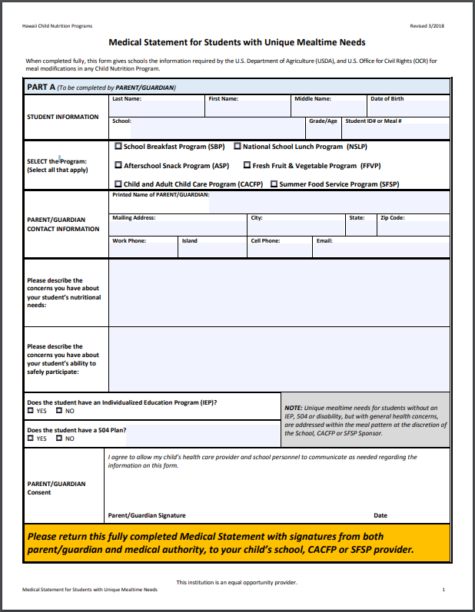
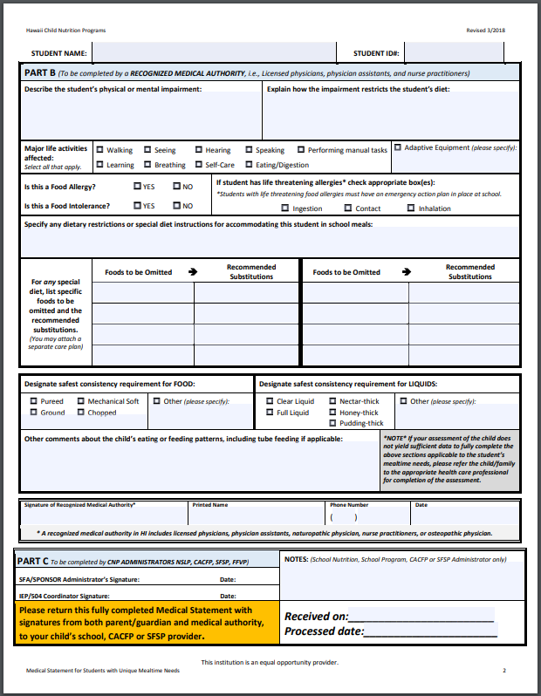
http://hcnp.hawaii.gov/overview/nslp/
Under Program Resources -> Special Diets Medical Statement Form
Notes:
Notice second page of the form doesn’t request a diagnosis, just description of the impairment and how it affects their diet; also asks “Foods to be Omitted” and “Recommended Substitutions”
Needs to be signed by the licensed healthcare professional with prescription writing privileges
Be sure to document received and processed dates

Slide 11
What if the Statement is Unclear?
IMMEDIATELY contact the child’s parent / guardian
Request an amended medical statement
Provide the meal modification anyway
Follow the parts that are clear
Document all communication!!!
This includes verbal communication
Notes:
Collaboration with the student’s family is important, especially when the medical statement is unclear
An example of an unclear medical statement could be: child is allergic to nuts. You may want to gain clarification on: what type of nut? How severe? Does the student need to be assigned to a designated seat in the cafeteria?
Immediately contact the family for guidance and request an amended medical statement
Waiting on clarification is not an acceptable excuse to delay the special diet: could be construed as discrimination (delayed services), and may have serious implications for the child’s health and well-being.
-provide the meal modification anyway, and follow the parts of the medical statement that are clear to the greatest extent possible
Document all communication, including verbal communication
-Keep documentation on file
The primary goal is to feed a special needs child as soon and safely as possible, but maintaining good documentation also protects your SFA from complaints and miscommunication.
Even after receiving the updated medical statement, I recommend documenting any communication with the parent that includes important information regarding the special meals.
Since we’re talking about documentation, this is the perfect segue into…

Slide 12
How Often Must the Medical Statement be Updated?
No regularly-scheduled requirement
Statement on file must reflect current dietary needs
OK to request updated medical statements
Consider the burden to parent/guardian
Notes:
It is not required that SFAs obtain medical statements on a regular basis
However, when an SFA receives updated medical information, the statement on file MUST reflect the student’s current dietary needs
-No need to request a new statement unless you feel it’s necessary to an updated version
SFAs may require updates as necessary to meet their responsibilities, but please be considerate of the burden it could create for parents/guardians.

Slide 13
Situation #2
A child required a modification outside the Program meal pattern for her food allergy in the previous school year.
Must the SFA obtain an updated medical statement at the start of the next school year?
However, medical statements on file must reflect current dietary needs.

Slide 14
Records Management
Must keep copies of medical statements when breaking the meal pattern
Recommendation: retain records even when medical statement was not required (i.e. the meal modification was still within the meal pattern)
Maintain confidentiality
May NOT request medical records related to child’s disability
Notes:
Maintaining records isn’t just a recommendation, but it’s something that will be reviewed during an AR because it may have affect your reimbursement
SFAs must retain copies of medical statements when making modifications outside of the regular meal pattern in order to receive reimbursement
The SFA must employ a method of recordkeeping that permits the State Agency to review it.
Although it is not required, we strongly recommend that you maintain documentation of the child’s disability even when a medical statement was not required (i.e. the meal modification was still within the meal pattern)
-Again, this protects the child and the SFA. Ensures everyone is on the same page that a child has some kind of adversity to food.
Of course, maintain confidentiality when documenting and maintaining files (especially since these are medical-related records)
The SFA may NOT request medical charts/records related to the child’s disability
-your main concern is obtaining the medical statement to receive Federal reimbursement for the modified meal, not doing a medical assessment

Slide 15
Meal Service Modifications
“a change or alteration in policies, practices, and/or procedures to accommodate a disability that ensures children with disabilities have equal opportunity to participate in, or benefit from, a program”
Review on a case-by-case basis
ex: age and maturity of the child
Specific request vs reasonable modification
Generic is OK, unless the brand name is medically necessary
OK to replace one fruit with another fruit
Notes:
A meal modification involves any type of change or alteration to accommodate a disability
We’ll review some different meal modification examples here and in the next few slides
First of all, requests for a meal modificaiton should reviewed on a case-by-case basis: every student is different, and there is no “cookie cutter” solution
-For example, one such factor that you’d review on a case-by-case basis would be the age and maturity of the child
-Younger children may need more assistance w/selecting and eating their meals
-Older children may be able to take greater level of responsibility for their dietary decisions
The SFA doesn’t have to honor specific requests, but must at least offer a reasonable modification to accommodate the disability
-For example, if a child is allergic to one ingredient that is in a specific brand name, the SFA may provide a generic brand instead as long as it doesn’t contain the specific allergen
-Another example could be if a child is allergic to a specific fruit such as pineapple, you can offer a different fruit instead.
-If it’s a vegetable, though, should sub it with a safe vegetable within the same subcategory.

Slide 16
Meal Service Modifications: Special Seating Arrangements
“Integrated setting appropriate to the person’s needs”
Able to participate with other children to maximum extent
Must NOT segregate children with disabilities
NEVER simultaneously use a separate table to punish children for misconduct
Separate table may be appropriate if:
Extensive assistance required during mealtimes
Severe food allergy
Collaborate with the family first
Other children allowed join (with precautions)
Notes:
Regs state that children who receive Program benefits (such as NSLP), “should be provided in the most integrated setting appropriate to the person’s needs”
The school must ensure that children with disabilities are able to participate along with children without disabilities to the maximum extent appropriate
The school can NOT segregate children with disabilities on the basis of convenience
And it is NEVER appropriate to simultaneously use a separate table to punish children for bad behavior
A separate table may be appropriate in unique cases such as:
-The child requires extensive feeing assistance from an aide and requires more space during mealtime
-The child has a severe food allergy and requires a designated table that has been cleaned according to food safety guidelines, or in an area away from the cafeteria where they can safely consume their meal without risk of cross-contamination from the allergen
Prior to developing special seating arrangements, collaborate with the child’s family and if reasonable, the healthcare professional who signed the medical statement, to determine if this type of seating arrangement is truly necessary.
If special seating is used, other children should be permitted to join the child with the food allergy, provided they do not bring the potentially dangerous food(s) with them.

Slide 17
Meal Service Modifications: Accessibility
SFAs/LEAs are responsible for:
the accessibility of food service areas
ensuring the provision of food service aides, as needed
No additional School Meal Program reimbursement is available
Nonprofit food service account may be used for:
Adaptive feeding equipment
Aides
Notes:
Recipients may provide aides or use other methods to serve food to disabled students, however SFAs and LEAs are responsible for the accessibility of food service areas and ensuring the provision of food service aides to assist in preparing and serving meal accommodations.
No additional School Meal Program is available, however additional costs for adaptive feeding equipment or aides are considered allowable costs for the nonprofit school foodservice account

Slide 18
Meal Service Modifications: Other Scenarios
Tracking Dietary Intake
Diabetics must track carbohydrate intake
Develop a cycle menu for the child?
Portion Sizes
Must provide larger or smaller portion sizes if specifically prescribed in the medical statement
No additional reimbursement for providing extra food
Notes:
Some children may need to have their dietary intake tracked
-For example: diabetes meets the definition of “disability,” and the doctor might prescribe meal substitutions and tracking carbohydrate intake
-One suggestion could be to create a cycle menu (with the help of the parent/guardian/student, dietitian) to alleviate the workload of frequently calculating carbohydrate content of foods.
You may also have to make modifications to portion sizes
-If the medical statement prescribes larger or smaller portions for the student, it must be honored at no additional cost
-There is no additional reimbursement for providing extra food

Slide 19
Can a Requested Modification Be Declined?
Declining a request is RARE, unless:
Fundamentally alters the nature of the Program (must provide evidence)
Collaborated with all parties first
Procedural Safeguards Process
Consult with HCNP before declining
Must NEVER say: “this is outside of our school policy”
If an SFA declines a request, must ensure that the child’s parent/guardian understands the Procedural Safeguards process
Most disabilities can be managed within meal pattern requirements
Offer a well-planned variety of nutritious food
Notes:
Declining a modification request is rare, and only acceptable if the SFA can prove that:
-the change would fundamentally alter the nature of the nutrition Program
Example: a child with a disability eats their lunch at home everyday. Is this reimbursable?
-No. NSLP (and SBP) meals are intended to be served and consumed on school grounds with limited exceptions (school-sponsored field trips)
-Providing NSLP meals outside of school on a regular basis would fundamentally alter the nature of the program.
-If you decline a request, it must be documented that you tried to work with the family on an agreeable modification
-SFA must ensure the parent/guardian understands their rights under the Procedural Safeguards process
-Please consult with HCNP before declining a meal modification request
SFAs must never say “this is outside our school policy”
-Again, the regulations state that SFAs have an obligation to provide reasonable accommodations
Unfortunately, there will likely always be some degree of burden in providing meal modifications
However, rest assured that most special diet requests can be managed within the meal pattern without significant modifications
-well-planned variety of nutritious food

Slide 20
Can OVS Be Used to Accommodate a Meal Modification?
NO!
Child must have the opportunity to select all required food components for the meal
ex: a child who has a gluten intolerance must have a choice of a bread/grain item that is gluten free
Notes:
No, OVS may not be used to accommodate a meal modification
Schools operating OVS must ensure children with disabilities have the same opportunity to select all required meal components for the meal
For example, a child who has Celiac disease or a gluten intolerance must have a choice of a grain/bread item that is gluten-free
The SFA may not use OVS to eliminate a specific food component for a child with a disability

Slide 21
Accommodating Requests Without Disability
Accommodations NOT required for children without a disability
Religious preferences, vegetarianism, low-carbohydrate diet
If the SFA chooses to provide a modification for a child without a disability:
Must be consistent with the meal pattern to be reimbursable
Must honor all students with the same request
Notes:
SFAs are NOT required to accommodate meal modification requests for children who do not have a disability
-These include requests based on lifestyle/religious preferences (vegetarianism, low-carb diet)
If the meal is not in compliance with the meal pattern requirements and you do not have a medical statement, it is considered non-reimbursable and fiscal action may occur if this is found during an Administrative Review.
Also, if you choose to honor these types of meal modifications, you have to honor all students with the same request. You cannot pick and choose who you will accommodate.

Slide 22
Situation #3
A child with autism is very sensitive to food textures, and will only eat foods with a smooth texture.
Is the child’s condition considered a disability, and if so, must the school food service make a modification for the child?
Notes:
Yes.
According to the ADA, any physical or mental impairment impacting the “major life activity” of eating is considered a disability. Some children with autism have sensory sensitivities and prefer food of a certain texture or color. They may require the same foods every day and need to maintain a regular routine. If a child’s autism impacts their ability to consume Program meals, the SFA must provide a reasonable modification.

Slide 23
Situation #4
A child’s parents have requested that the school prepare a strict vegetarian diet for their child based on a statement from a “nutrition advisor” who is not a licensed physician.
Must the school comply with this request?
Notes:
Medical statements must be signed by a licensed healthcare provider. Also, SFAs are not obligated to honor food preferences without a medical statement of disability.

Slide 24
Reimbursement
Based on eligibility for free, reduced price or paid meals, regardless of the modification
No additional reimbursement for extra costs
Does not have to meet the meal pattern if:
Supported by a medical statement
Meets the nutritional needs of the child
Waiting for a medical statement?
Do not delay providing the meal modification
Document, document, document!
Notes:
Reimbursement for modified meals is based on the rate of the child’s eligibility for free, reduced price, or paid meals regardless of the modification
The SFA will not receive additional reimbursement to cover the extra costs sometimes associated with providing a reasonable modification.
-However, you may use funds from the non-profit school food service account, the general fund, or special education funds (if specified in the child’s IEP – individualized education program)
Meal modifications do not have to meet the meal pattern in order to be claimed for reimbursement if it is supported by a medical statement
Sometimes a meal modification is requested but the parent hasn’t been able to submit the medical statement yet
-Again, must not delay meeting meal modification requests. Provide to the greatest extent possible.
-Document all communication w/the family, including the date when the SFA first learned of the child’s need, following up w/the family to immediately provide a medical statement, to actual receipt of the medical statement.

Slide 25
Procedural Safeguards
Required to provide information on requesting a modification
Must inform parents of procedural rights:
Filing grievances
Receiving prompt and equitable resolution of the grievance
Request and participate in an impartial hearing
Be represented by counsel at the hearing
Examine the record
Be informed of the final decision and a procedure for review
(i.e., right to appeal)
Notes:
Procedural safeguards require SFAs/LEAs to provide notice and information to parents/guardians regarding how to request a reasonable modification
Their procedural rights are listed above:
-Filing a grievance if they believe a violation has occurred regarding their request for a reasonable modification
-That they will receive prompt and equitable resolution of the grievance,
-That they may request and participate in an impartial hearing to resolve their grievance,
-They may be represented by counsel at the hearing
-They may examine the record, and
-Receive notice of the final decision and a procedure for review (i.e. right to appeal the decision)

Slide 26
Section 504 / ADA Coordinator & Team
SFAs/LEAs with 15+ employees must designate a Section 504/ADA Coordinator
May be responsible for addressing disability accommodations for the whole school
Team approach
Food service, school admin, teachers, medical/support staff, parents
Collaborative way to share information throughout the school
May help protect children outside the cafeteria
Notes:
SFAs/LEAs employing 15+ individuals must ensure that their Procedural Safeguards process provides for a prompt and fair resolution of grievances
To do this, at least one person must be designated to coordinate disability compliance requirements. The title would be Section 504/ADA Coordinator.
-The 504/ADA Coordinator doesn’t have to be a food service employee. Often times, this person may be responsible for addressing disability-related issues for the whole school, however the Section 504/ADA Coordinator must ensure that food service professionals understand the process for handling meal modification requests.
SFAs are strongly encouraged to develop a Section 504/ADA Team that may include school food service professionals, administrators, teachers, medical/support personnel (including therapists, allergists), parents/guardians, special education staff
-Encourages a “team approach” for sharing information throughout the school, and may help protect children when food is served outside the cafeteria

Slide 27
Situation #5
A school wishes to serve meals to children with disabilities in an area separate from the cafeteria where the majority of school children eat.
May the school establish a separate facility for these children?
Notes:
No.
Schools must provide all meal services in the most integrated setting appropriate to the needs of the disabled child. It may appropriate to designate a separate table for children with severe allergies like the previous example, however, to require children to dine in an area other than the cafeteria would be inappropriate, unless stated in the medical statement.

Slide 28
Discontinuing a Meal Modification
Written documentation from healthcare provider NOT required…
BUT
It is highly recommended that documentation is maintained when ending a meal modification
Request a signed statement from the parent/guardian
“If it’s not documented, it was not done.”
Notes:
What happens if a meal modification needs to be discontinued?
Written documentation from a State licensed healthcare professional is not required when discontinuing a medical order for meal modification
HOWEVER, USDA and HCNP highly recommend some form of documentation when ending a meal modification
Could be something as simple as asking the child’s parent or guardian to sign a statement indicating their child no longer needs a meal accommodation
This protects the SFA from any miscommunication or accusations of improperly serving a meal

Slide 29
Situation #6
A child who previously required a meal modification outside the Program meal pattern no longer requires modified meals.
Must the SFA obtain an amended medical statement prior to ending the child’s meal modification?
However, it is recommended that some form of documentation be on file to indicate the child no longer needs the meal modification.
Notes:
No. However, FNS recommends that SFAs maintain documentation of ending the meal modification. May even want to ask child’s parent/guardian to sign a statement indicating that their child no longer needs a meal modification to document closure.

Slide 30
Food Allergies
An immune system reaction to a component of a food, at times, producing a life-threatening response
Can range from relatively mild to severe (anaphylaxis)
Considered a “disability”
Does not need to be life-threatening or cause anaphylaxis
Common food allergens:
Peanuts | Soy
Milk | Tree Nuts (almonds, pecans, walnuts)
Eggs | Fish
Wheat | Shellfish
Notes:
Food allergies may be the most common nutrition program-related disability you’ll encounter. It’s important to understand that all food allergies qualify as a disability, and that they don’t have to be life-threatening to be considered a disability.
No food item offered to the child may contain traces of allergens that might trigger an allergic reaction
-This entails a detailed review of the food label/specifications
-It is the responsibility of SFA to obtain adequate information if it is not provided on the product (contact the supplier/manufacturer)
-Suggest providing advance notice to parents (menus), so they may review and ask questions regarding potential concerns
Remember that the SFA is required to provide the child with a safe environment to consume their meal, even if it requires special accommodations
Also proper storage, preparation, and cleaning techniques must be employed to prevent cross contamination from allergens
Schools should also make sure all children understand the importance of not sharing food with others to prevent food allergy emergencies

Slide 31
Food Intolerances
An abnormal response to a component of food that does not involve an immune system reaction
Not typically a disability
Only if it substantially limits a major life activity
SFAs may, but is not required to, make food substitution
Follow prescribed substitutions if made by the licensed physician
Notes:
Unlike a food allergy, a food intolerance does not involve an immune system reaction
Some food intolerances may be considered a disability if it substantially limits a major life activity
-Example: digestion (major bodily function) is impaired due to gluten intolerance
-if it is not considered a disability that limits a major life activity, the SFA may make food substitutions at their discretion

Slide 32
Food Safety to Prevent Allergic Reactions
Follow HACCP principles and follow SFA’s Food Safety Plan
Develop a Food Allergy Action Plan, including:
Cleaning & sanitizing food surfaces
Personal hygiene
Preventing cross contamination
Serving food properly
Notes:
SFAs are responsible for educating all food service staff on the potential severity of even a very small amount of exposure to a food allergen and the role of proper food handling and sanitation.
Remind them that food allergies can be life threatening, and therefore following food safety principles is important.
The Institute for Child Nutrition (ICN) shares a lot of good information on food safety principles and even has SOPs for handling food safely for food allergies. It may be helpful to include these in your school’s food safety plan.

Slide 33
Situation #7
The “regular” menu item for lunch is whole grain-rich pasta with cheese and vegetable toppings.
Must the school food service prepare whole grain-rich pasta with lactose-free cheese and vegetable toppings for a child with lactose intolerance?
Notes:
No. In a disability situation, the meal modification or meal item substituted does not need to mirror the menu item offered each day. The SFA’s responsibility is to serve the child a safe meal that accommodates their disability, not to mirror the Program meal served that day. In the example used in this question, the SFA would not be required to serve a whole grain-rich pasta dish, and could instead serve a different meal that meets the child’s modification request, such as a sandwich with whole grain-rich bread.

Slide 34
USDA Policy on Universal Exclusion
Universal exclusions of specific food(s) is not an FNS policy
May be appropriate depending on the circumstances
At the discretion of SFA
Notes:
The USDA doesn’t encourage “school-wide” ban on any food or food groups, but it may be necessary given the severity of the allergy
It is up to the SFA to decide
If imposing a school wide ban of foods, make sure it is adequately communicated to students and families.

Slide 35
Recap
Must make food substitutions or modifications for students with disabilities at no extra charge.
Substitutions and modifications based on medical statement provided by state licensed health care professional.
Modifications that do not follow the meal pattern must be accompanied by a medical statement to be considered reimbursable.
Notes:
Just to recap the main points about special diets:
SFAs must make food substitutions for students with disabilities at no extra charge.
The modification should be based on a the medical statement, which is only acceptable if signed by a licensed healthcare professional.
The meal pattern still applies, so if you have to step outside of a meal pattern to honor a meal substitution, it must be accompanied by a medical statement to be reimbursable.

Slide 36
Recap
Document, document, document!!! Retain records.
Ensure that the medical statement reflects the current dietary needs of the child.
Request for the statement to be updated as needed.
Know the Procedural Safeguards process and how to contact the 504 Coordinator.
Notes:
Documentation is key! Remember that all records must be kept on file for 3 years plus the current year (6 years plus the current for DOE)
Make sure that the medical statement that your SFA has on file reflects the child’s current needs, and request that the parent/guardian obtain an updated statement only when needed.
Know who your school’s 504 coordinator is and know the procedural safeguards to protect your SFA from discrimination complaints.

Slide 37
Questions?

Slide 38
Nondiscrimination Statement
In accordance with Federal civil rights law and U.S. Department of Agriculture (USDA) civil rights regulations and policies, the USDA, its Agencies, offices, and employees, and institutions participating in or administering USDA programs are prohibited from discriminating based on race, color, national origin, sex, disability, age, or reprisal or retaliation for prior civil rights activity in any program or activity conducted or funded by USDA.
Persons with disabilities who require alternative means of communication for program information (e.g. Braille, large print, audiotape, American Sign Language, etc.), should contact the Agency (State or local) where they applied for benefits. Individuals who are deaf, hard of hearing or have speech disabilities may contact USDA through the Federal Relay Service at (800) 877-8339. Additionally, program information may be made available in languages other than English.
To file a program complaint of discrimination, complete the USDA Program Discrimination Complaint Form, (AD-3027) found online at: http://www.ascr.usda.gov/complaint_filing_cust.html, and at any USDA office, or write a letter addressed to USDA and provide in the letter all of the information requested in the form. To request a copy of the complaint form, call (866) 632-9992. Submit your completed form or letter to USDA by:
mail: U.S. Department of Agriculture Office of the Assistant Secretary for Civil Rights 1400 Independence Avenue, SW Washington, D.C. 20250-9410;
(2) fax: (202) 690-7442; or
(3) email: program.intake@usda.gov.
This institution is an equal opportunity provider.

