Slide 1
Offer vs Serve (OVS)

Slide 2
Why Offer vs Serve (OVS)?
Allows students to decline some food items
Decreases food waste
Allows students to choose what they want to eat
Notes:
Goals of OVS
Allow students to decline some food items and empowers them to make some choices with regards to their meals
Reduce food waste: may prepare less of the least popular items and more of the more popular items

Slide 3
Offer vs Serve
OVS is…
not required for grades K-8
required for grades 9-12 (LUNCH)
not an option for Pre-K
not required for field trips.*
*SP 57-2014 p. 7 (Prepackaged Meals – if these meals are offered as part of field trips, OVS is not required, even at the senior high level.)
Notes:
OVS is optional for K-8
OVS is required for grades 9-12 at lunchtime
-need State agency approved exemption to not do OVS
-optional for 9-12 at breakfast
OVS is not allowed for Pre-K
OVS is not required for field trips

Slide 4
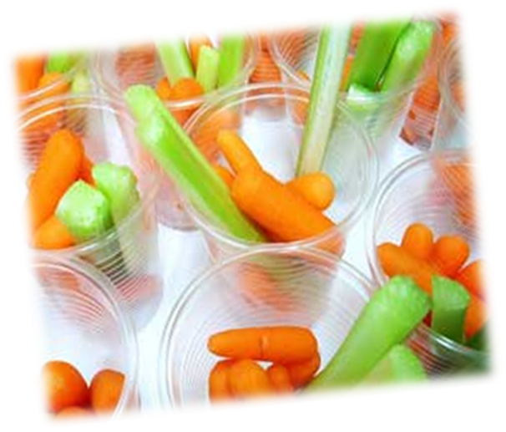
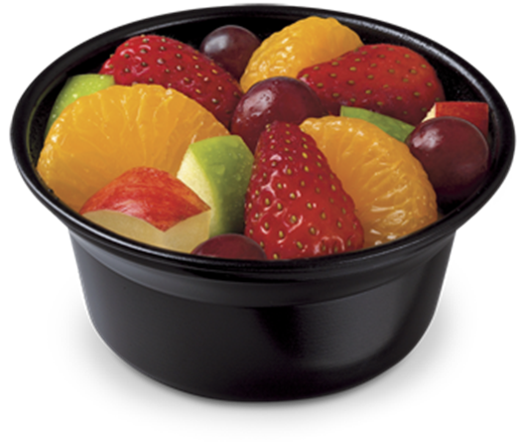
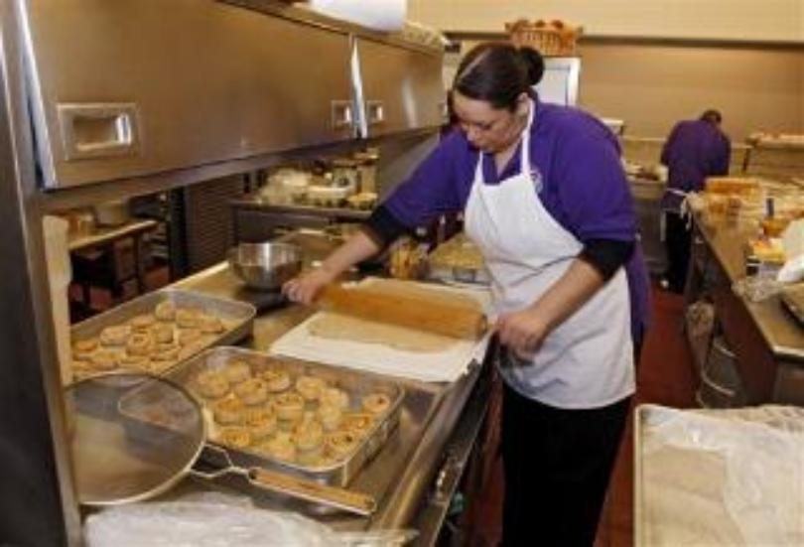
Offer vs Serve Basics…
Full component portions must be offered at each meal
Production records to back it up
May prepare less of the least popular choice, and more of the more popular choice
Must choose at least ½ cup either fruit or vegetable, or fruit/vegetable combined
Notes:
We’ll review OVS at breakfast and lunch separately, but here are some general rules for OVS that apply to both meal services
First, enough food must be prepared to supply full component portions at each meal.
-This should be supported on your production records, meaning that your production records accurately show that enough food was prepared and served for the number of meals claimed that day
May prepare less of the least popular items, and more of the most popular items
-This should reduce your food waste, allow for better forecasting, and ultimately lower food costs
For both breakfast and lunch, at least ½ cup of either fruit or vegetable must be chosen, or a combination of both (i.e. a ¼ cup each)

Slide 5
Offering Choices ≠ OVS
4 different cereals offered, student told to choose 1 ≠ OVS
Offer ½ cup portion of three different fruits, student told to choose “up to two”
This is considered OVS
May offer more than the minimum requirement, if desired
Notes:
Offering a variety of choices within a food component/item is not the same as OVS
-For example: if you offer 4 different cereal varieties at breakfast, but instruct the student to pick one, this is NOT OVS
-since the student can only “pick one”, technically only 1 grain item is being offered even though they have a variety to choose from
On the other hand, let’s say your SFA offers ½ cup portions of three different fruits (apple, orange, strawberries), and the student is instructed to choose “up to two”
-this is considered OVS, because it provided the student with options within the meal component and showed
Offering more than the minimum requirement is at the manager’s discretion (ex: offer four ½ cup servings of fruit, and allow the student to choose 3-4 servings to total more than the minimum requirement for fruit)
-as long as it doesn’t exceed the dietary specs

Slide 6
Offer vs Serve –
Breakfast
Notes:
We’ll start by reviewing Breakfast OVS

Slide 7
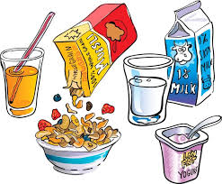
Offer vs Serve -- Breakfast Meal Components
Fruit
Grains
Milk
Notes:
If you recall what you’ve already learned about the meal pattern, you know that there are 3 meal components for breakfast.
Again, breakfast OVS is optional for all grade levels except Pre-K, where it is not allowed unless co-mingled with older grades.

Slide 8
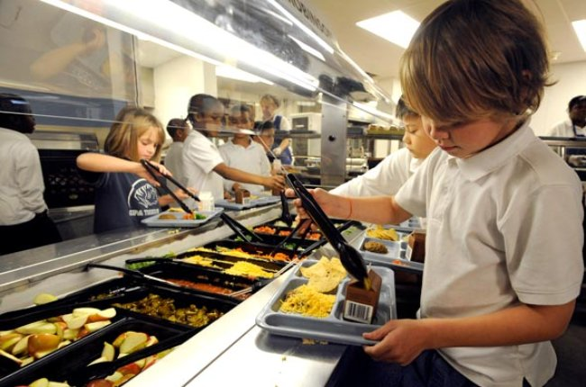
Offer vs Serve -- Breakfast
K-12 grade levels – OPTIONAL
Pre-K – NO OVS
Must offer all 3 Breakfast meal components
Must offer 4 food items
Must select 3 out of the 4 food items
Must take at least ½ cup either fruit or vegetable, or fruit/vegetable combined
Notes:
The rules for Breakfast OVS are (read slide)
Meal pattern rules still apply
-veg can sub for fruit but not within the first 2 cups per week
-M/MA can count towards grains but only after daily minimum grain requirement is met

Slide 9
Breakfast OVS Exercises
Notes:
Let’s warm up to this whole OVS concept by practicing identification of a reimbursable breakfast under OVS (since lunch is a little more detailed)

Slide 10
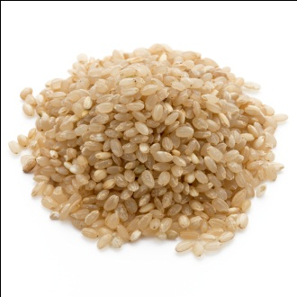
K-12 OVS Breakfast #1
Brown Rice
1 oz eq Grain
Scrambled Egg
2 oz eq M/MA
Milk
1 cup Milk
NOT REIMBURSABLE!
Missing ½ cup Fruit

Slide 11
K-12 OVS Breakfast #2
Yogurt
1 oz eq M/MA
WW Toast
1 oz eq Grain
Fresh Orange
½ cup Fruit
REIMBURSABLE!!!
Notes:
Got 3 different components, one of which is ½ cup fruit

Slide 12
K-12 OVS Breakfast #3
Breakfast Sandwich
WW English Muffin
1.75 oz eq Grain
Egg + Cheese
2 oz M/MA
100% Orange Juice
½ cup Fruit
REIMBURSABLE!!!
Notes:
Again, we have 3 meal components, one of which is ½ cup fruit

Slide 13
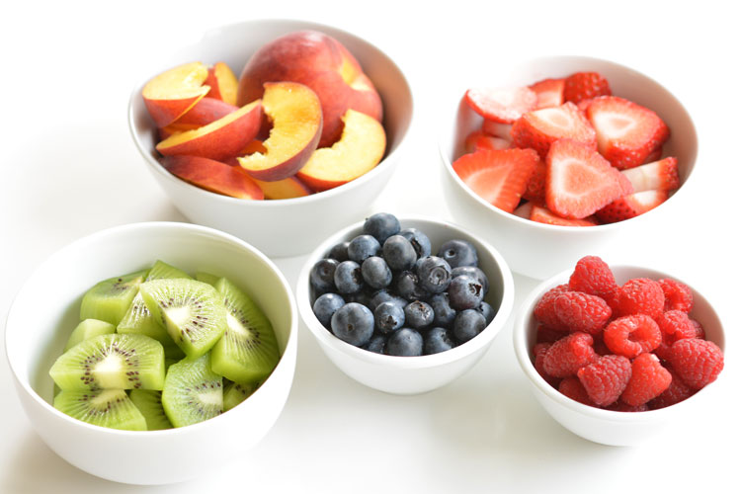
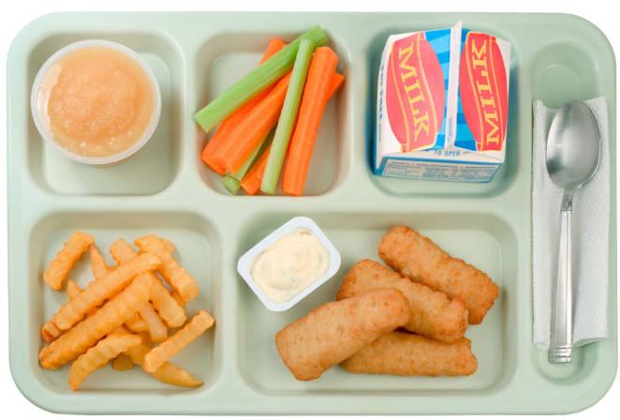
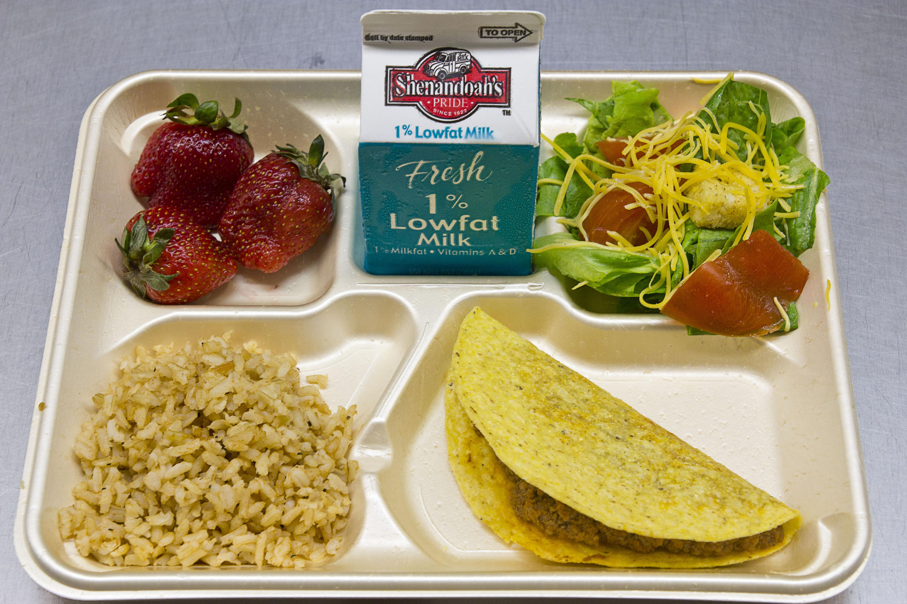
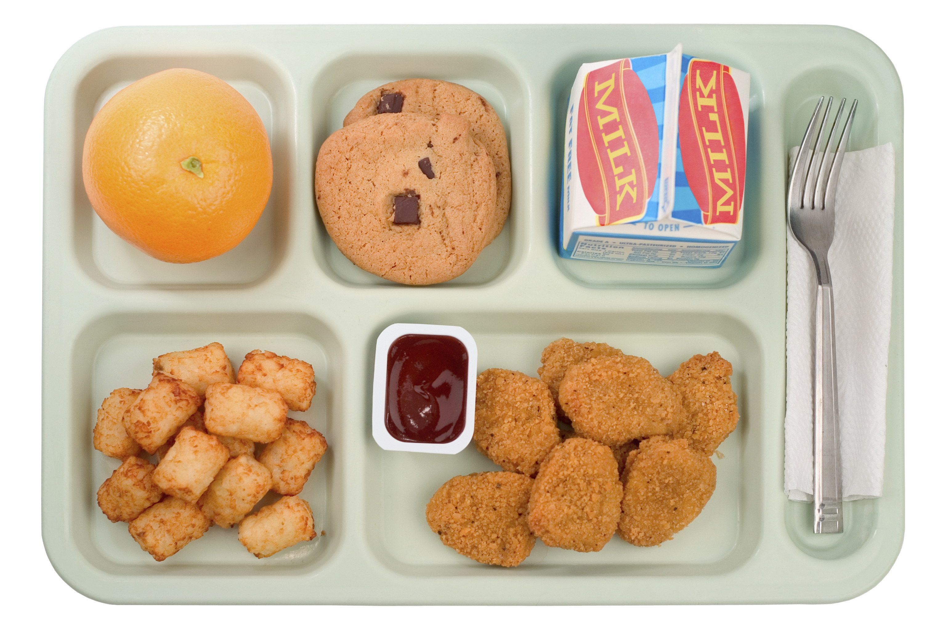
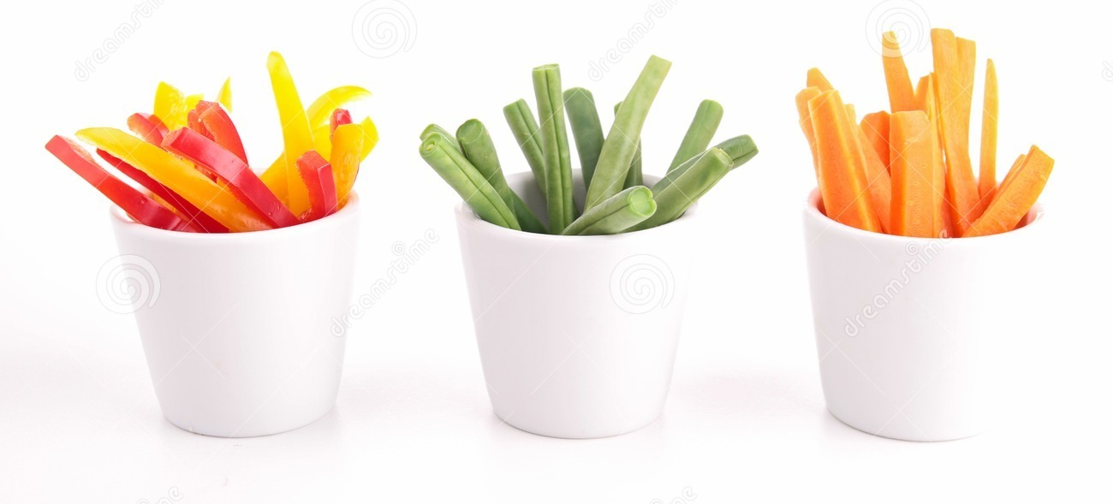
Offer vs Serve –
Lunch

Slide 14
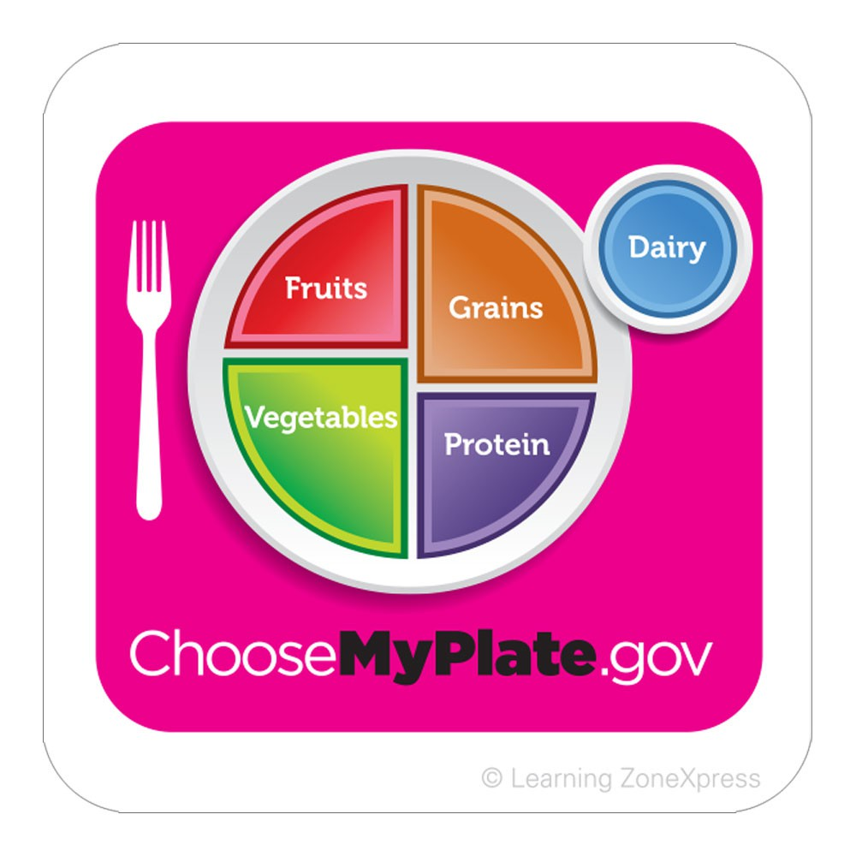
Review: Meal Components & Food Items
One of the five food groups that comprise a reimbursable lunch:
Meat / Meat Alternate (M/MA)
Fruits (F)
Vegetables (V)
Grains (G)
Fluid Milk (M)
Food Item: a specific food offered within the five food components
Notes:
Just a review of the 5 different meal components at lunchtime
Reminder: a food item is a specific food offered within the five food components
-It’s possible to have more than one component within one food item
Example: Hamburger on bun
-1 food item
-2 food components: M/MA (hamburger patty), Grain (bun)

Slide 15
Offer vs Serve – Lunch
Must offer all 5 components, 2 may be declined
Must choose at least ½ cup either fruit or vegetable, or fruit/vegetable combined
If 3 components selected, and one is ½ cup fruit or vegetable, the other 2 components must be full servings
No requirement on vegetable subgroups in OVS
But must have the opportunity to select throughout the week
Notes:
Under OVS, all students, at any grade level, must select 3 of 5 food components, AND one of those choices must be at least ½ cup fruit or veg, or a total of ½ F/V combined
-Meal is not reimbursable if student does not take at least ½ cup fruit or veg
If the student selects 3 components, and one is at least ½ cup fruit or vegetable, the other two components must be taken in full servings
For vegetables, there is no requirement that the student choose each subgroup, however they must be provided with the opportunity to select an adequate amount from each subgroup over the week

Slide 16
If a K-8 Student Selects…
½ cup Vegetable
(partial portion)
½ cup Fruit
(full portion)
1 cup Milk
(partial portion)
Notes:
This is a schematic to illustrate full versus partial portions on OVS
If a student in grades K-8 selects ½ cup of vegetable (a partial portion since the daily veg requirement is ¾ cup), a ½ cup fruit (the full portion) and a full portion of one other component (example: Milk) the
meal is reimbursable.
Ask: Would this same meal be reimbursable for a high school student?

Slide 17
If a 9 - 12 Student Selects…
½ cup Vegetable
(partial portion)
½ cup Fruit
(partial portion)
1 cup Milk
(full portion)
1 cup Fruit
(full portion)
Notes:
If a student selects the same components in the same amounts as the previous example for K-8, it is NOT a reimbursable meal
If the 9-12 student chooses ½ cup vegetable, the next two components must be the full portion sizes (1c fruit, 1c milk)
Remember, the daily fruit and vegetable requirements for 9-12 is 1 cup each

Slide 18
Reimbursable Lunch Meal? Quick Checklist
Are there at least 3 food components?
If Yes, is one a fruit or a vegetable?
If Yes, is it at least ½ cup?
If you can answer “Yes” to all three questions, then the meal is reimbursable!

Slide 19
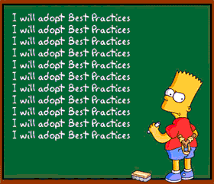
Let’s Practice Lunch OVS

Slide 20
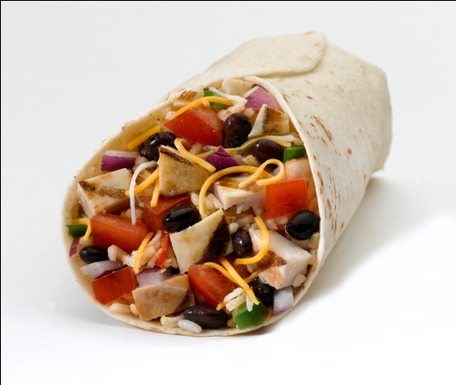
K – 8 OVS Lunch #1
Grilled Chicken Wrap
2 oz eq M/MA
WW Tortilla
2 oz Grains
Tomatoes & Beans (in wrap)
1/4 cup Red/Orange Vegetables
1/4 cup Legumes Vegetables
REIMBURSABLE!
Notes:
We have 3 different food components
One is a vegetable
The vegetable is ½ cup
The M/MA and grains exceeds the daily requirement for K-8

Slide 21
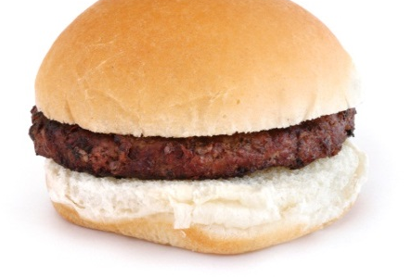
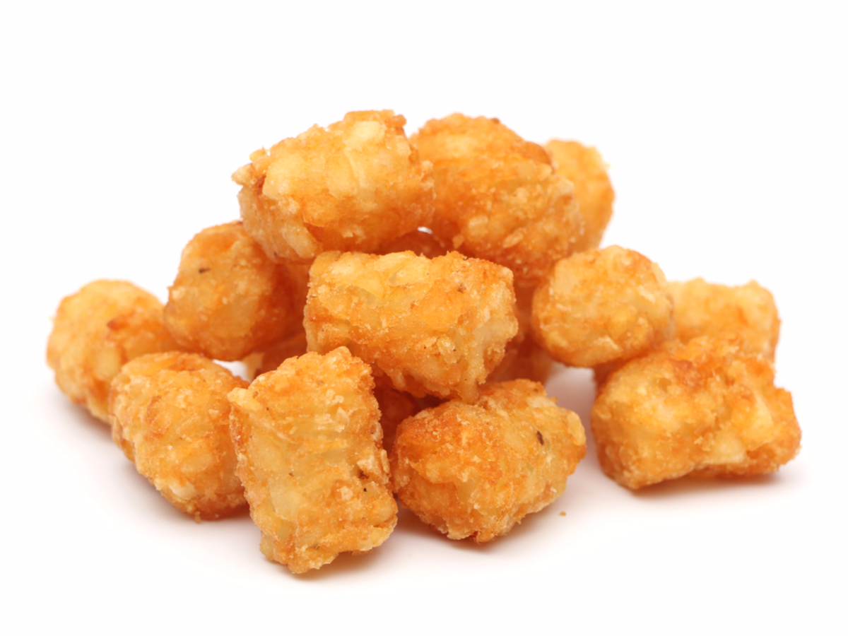
K – 8 OVS Lunch #2
Hamburger on Whole Wheat Bun
2 oz M/MA
1.5 oz Grains
Potato Tator Tots
½ cup Starchy Vegetable
Orange Wedges
½ cup Fruit
Milk
1 cup Milk
REIMBURSABLE!
Notes:
Here we have all 5 components, including a fruit and a vegetable (1/2 cup each)
The M/MA, grains, and milk meet the daily requirements for K-8

Slide 22
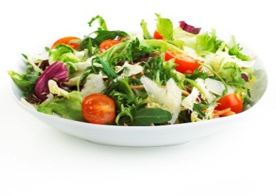
K – 8 OVS Lunch #3
Tossed Salad
½ cup Dark Green Vegetable
½ cup Red/Orange Vegetable
Sliced Strawberries
½ cup Fruit
Celery Sticks
½ cup Red/Orange Vegetable
NOT REIMBURSABLE
*only two meal components selected
Notes:
Only 2 components selected (fruit & veg). Must choose at least 3 different meal components to be reimbursable.

Slide 23
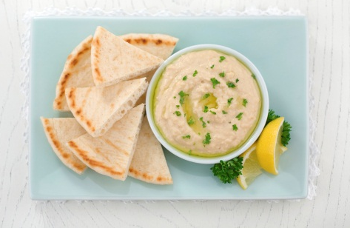
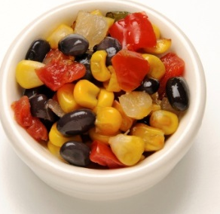
K – 8 OVS Lunch #4
Hummus
2 oz M/MA
WW Pita Bread
1 oz eq Grain
Black Bean Salsa
½ cup Legumes Vegetable
¼ cup Other Vegetable
REIMBURSABLE!
Notes:
3 meal components (M/MA, grains, vegetable)
One is a vegetable, and more than ½ cup was taken (3/4 cup)

Slide 24
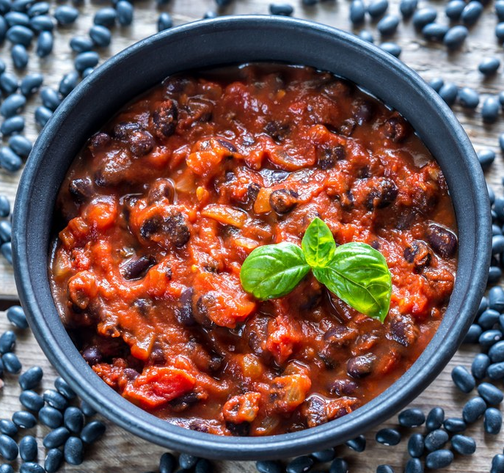
K – 8 OVS Lunch #5
NOT REIMBURSABLE
Vegetarian Chili
2 oz M/MA (beans)
¼ Red/Orange Vegetable (tomato sauce)
Brown Rice
1 oz eq Grains
Milk
1 cup Milk
Notes:
4 meal components
One is a vegetable, but it’s less than ½ cup, so not enough
Remember: if counting beans as a M/MA, can’t count it as a vegetable. Even if we counted the beans as a vegetable, the meal still wouldn’t be reimbursable because not enough meal components.

Slide 25
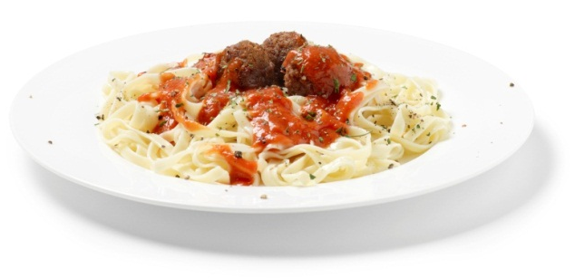
9-12 OVS Lunch #1
WW Spaghetti w/Meatballs
2 oz M/MA
1 oz eq Grain
¼ cup Red/Orange Vegetable
Whole Grain Roll
1 oz eq Grain
Milk
1 cup Milk
NOT REIMBURSABLE
Notes:
Let’s practice identifiying OVS for grades 9-12
Here, we have 4 meal components
We have a vegetable, but it’s less than ½ cup

Slide 26
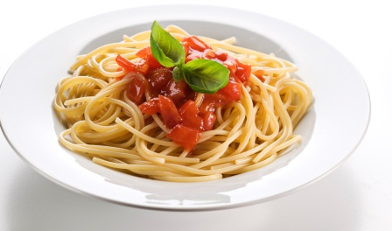
9 – 12 OVS Lunch #2
WW Spaghetti w/Marinara Sauce
1 oz eq Grain
¼ cup Red/Orange Vegetable
Broccoli
¾ cup Dark Green Vegetable
Fresh Orange
½ cup Fruit
NOT REIMBURSABLE
Notes:
Let’s try again with this spaghetti meal…
Includes 3 meal components, including a fruit and a vegetable
We have ½ cup fruit, 1 cup vegetable (meets the daily requirement)
However, the grain is not the full portion for grades 9-12
-minimum daily requirement for grain is 2 oz

Slide 27
9-12 OVS Lunch #3
WW Spaghetti w/Meatballs
2 oz eq M/MA
1 oz eq Grain
¼ cup Red/Orange Vegetables
Broccoli
¾ cup Dark Green Vegetable
Fresh Grapes
½ cup Fruit
Milk
1 cup Milk
REIMBURSABLE!!!
Notes:
Let’s try one more time with the spaghetti…
5 meal components, but the grain is still insufficient (1 oz out of 2 oz required)
½ cup fruit
Vegetable meets the requirement (1 cup)
Milk meets the requirement
M/M meets the requirement

Slide 28
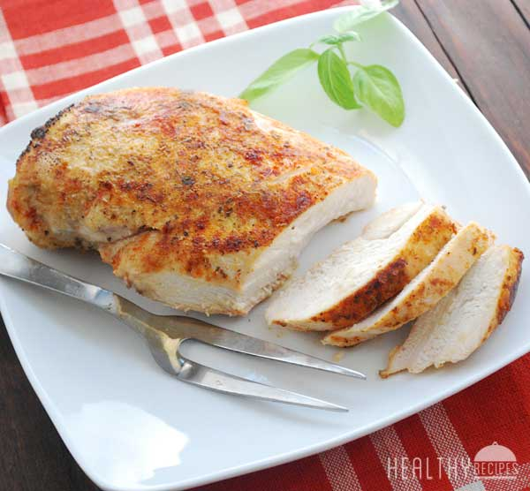
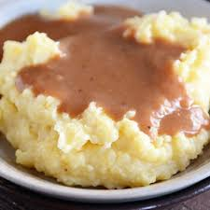
9-12 OVS Lunch #4
Baked Chicken
2 oz M/MA
Mashed Potatoes w/Gravy
½ cup Starchy Vegetable
Steamed Broccoli
½ cup Dark Green Vegetable
NOT REIMBURSABLE
Notes:
Not reimbursable: there are only 2 meal components here
Note: mashed potato is NOT a grain, it’s a starchy vegetable

Slide 29
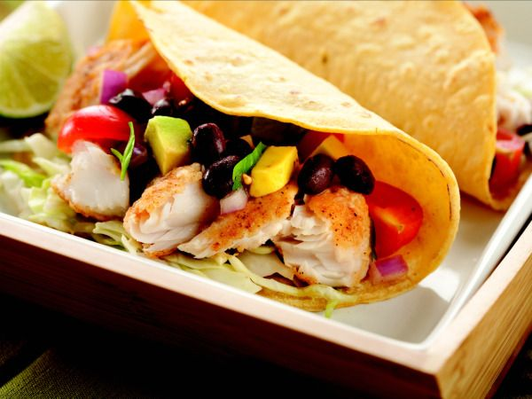
9-12 OVS Lunch #5
Fish Taco
2 oz M/MA
¼ cup Red/Orange Vegetables
¼ cup Legumes Vegetable
¼ cup Dark Green Vegetable
Fresh Apple
½ cup Fruit
Milk
1 cup Milk
REIMBURSABLE!!!
Notes:
We have 4 meal components
½ cup fruit, ¾ cup vegetable
M/MA meets the daily requirement
Milk meets the daily requirement

Slide 30
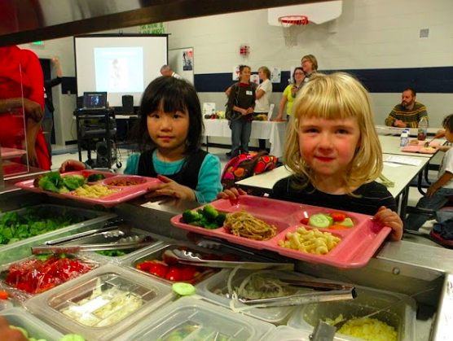
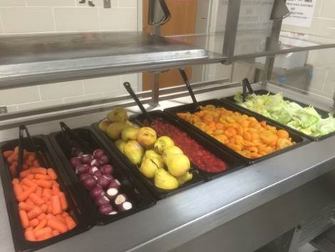
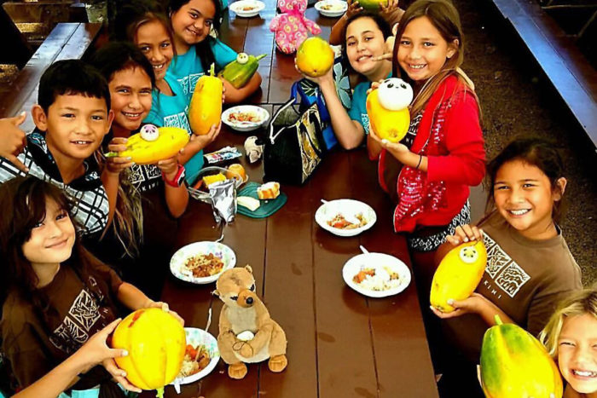
What We’re Looking For…
Offering enough food on all reimbursable meal serving lines
Signage posted
Students selecting enough components/items to make a reimbursable meal
Notes:
These are the things that we look for during an AR with regards to OVS:
Must offer enough for each student to take the full required amount of each component
We’ll discuss signage on the next slide
Students are selecting enough components/items to make a reimbursable meal

Slide 31
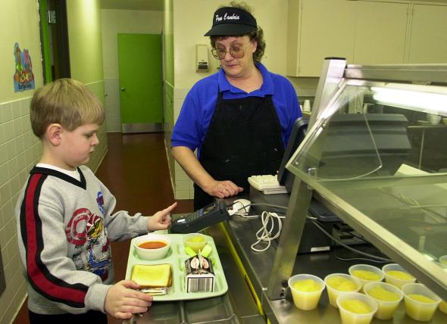
What We’re Looking For…
Train meal clerks, servers on OVS requirements
Food service staff accurately judging quantities on self-serve bars
Food service staff at the POS are trained and can recognize a reimbursable meal
Notes:
SFAs must train their meal clerks/servers on OVS requirements so that they can accurately judge quantities, portion sizes and what constitutes a reimbursable meal
Remember to document this training to help meet Professional Standards requirements

Slide 32
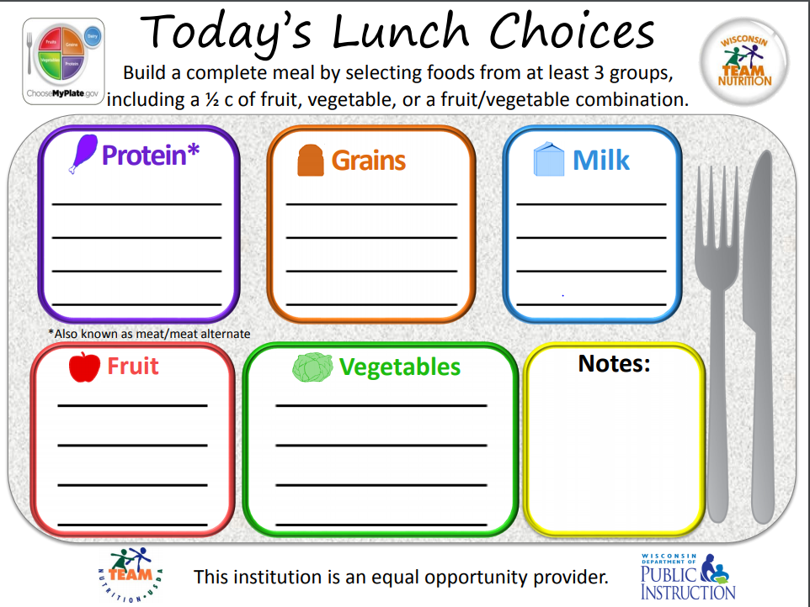
Signage
Signage and menus should provide clear information about allowable choices
Notes:
Signage must be placed in a location that is visible and near or at the beginning of the service line, and must show what constitutes a reimbursable meal
The sign on the left was provided by HCNP: illustrates the different meal components, and advises the student to choose from at least three and include ½ cup fruit or vegetable
We recently received guidance from USDA: preferable signage would lay out each item that falls into each meal component for that particular day, to make it even clearer for the student to choose a reimbursable meal.
-You can do this by using a dry erase board or laminating a sign and writing/erasing the menu items on it daily
-Or, can type out each daily menu in advance, post it on the corresponding day, and save in a file to re-post when the cycle week comes up again
Signage not required for field trips, breakfast in the classrooms, or other venues where signage may be problematic, but other methods should be used to inform students of their choices.

Slide 33
Questions
This institution is an equal opportunity provider.

