Slide 1
Preschool Meal Pattern

Slide 2
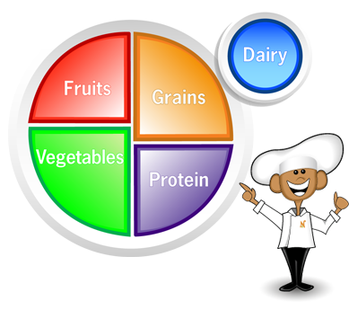
What is a Reimbursable Meal?
Follows all of the federal requirements to be claimed for reimbursement.
Contains all of the required meal components and specified quantities and meets the dietary specifications
Notes:
Let’s start with “What is a Reimbursable Meal?”
A reimbursable meal follows all of the USDA requirements to be claimed for reimbursement. It consists of all of the required components and specified quantities and meets the dietary specifications.

Slide 3
Why is this Important?
SFAs receive federal dollars for every reimbursable meal
Free
Reduced Price
Paid
Notes:
Why is it important to understand the meal pattern requirements?
SFAs receive money from the federal government for every reimbursable meal served to students. Reimbursement is not only received for free and reduced price meals but paid meals, too.
It is the SFA’s responsibility to make sure meals claimed for reimbursement are reimbursable. This includes those who receive vended meals - DO NOT assume your vendor is meeting the meal pattern requirements. Check that your vendor is meeting the requirements. Do not wait until you are reviewed to do this.

Slide 4
Pay Attention
Fiscal action is taken when:
A meal component is missing
School runs out of a food item during the meal service period
Ex: School runs out of apple wedges during the middle of meal service so 25 students do not have the opportunity to have any fruit with their meal.
Repeat meal pattern findings
Notes:
During an Administrative Review, nonreimbursable meals is a Performance Standard 2 violation. Fiscal action (reimbursement is taken back):
A meal component is missing
You run out of a food item during meal service and it is not replenished
Ex: Run out of apples during meal service so 25 students do not have the opportunity to have any fruit with their meal.
3. Repeat meal pattern findings include:
Milk type
Vegetable subgroups
Food quantities
Whole grain-rich foods
Dietary specifications
What is a repeat finding – A finding found during the current AR was also found during a previous AR.
Ex: During the last AR, the beans requirement was not met. Now, during the current AR, the red/orange vegetable requirement is not being met. This is a repeat finding of the vegetable subgroup requirement.

Slide 5
Preschool Meal Pattern

Slide 6
Overview
PRESCHOOL
Last revisions started October 1, 2017
Reflects Child & Adult Care Food Program (CACFP) meal pattern for infants and children, ages 1-5 years old
Notes:
Last set of revisions for the Pre-K meal pattern went into effect last October, no big changes this year
Pre-K meal pattern reflects the CACFP meal patter for infants & children, age 1-5
For this presentation, the slides contain the requirements for children ages 3-5. If you have students who are younger than the age of 3, please refer to the handouts in your packet for the requirements for infants.

Slide 7
Preschool Meal Pattern
Fruit and vegetables are separate components
Juice limit: fruit juice or vegetable juice is limited to one meal per day
Offer vs Serve is NOT allowed for children under 5 years old
Frying is NOT allowed as a way of preparing foods on-site
Notes:
Here’s a basic overview of the Pre-K meal pattern
Many things are different than the meal pattern for older grades, however fruits and vegetables are still separate components.
The other things on this slide are different:
Juice is limited to one meal per day
OVS is not allowed for Pre-K
Frying on-site is not an allowed food prep method

Slide 8
Preschool – Breakfast Meal Pattern
Must serve ALL three components for a
reimbursable meal
Notes:
This is the breakfast meal pattern for Pre-K
As with the older grades, there are three components. All three must be taken to make a reimbursable meal.
The minimum daily quantities are less than the older grades.

Slide 9
Preschool – Lunch Meal Pattern
Notes:
This is the lunch meal pattern for Pre-K
Ask: What is the daily M/MA for K-8?
The minimum daily M/MA requirement for K-8 is 1 oz. Notice that Pre-K needs are more.
Now let’s take a look at the individual meal components for Pre-K…

Slide 10
Milk
PRESCHOOL
Flavored milk cannot be served to preschoolers
Notes:
Reminder: chocolate / flavored milk must NOT be served to preschoolers, unless they are comingled with other grades (will discuss later)

Slide 11
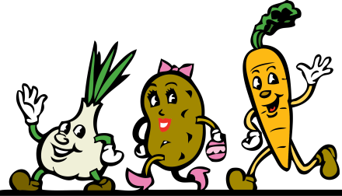
Vegetables
PRESCHOOL
May be used to meet the entire fruit component
Must serve 2 different kinds of vegetables
No vegetable subgroups
Allowable:
Milk
Chicken sandwich
Broccoli
Carrots
Not Allowable:
Milk
Chicken sandwich
Broccoli (2 servings)
Notes:
Vegetables may be used to meet the entire fruit component
-Therefore, the SFA may choose to serve two vegetables at lunch instead of 1 serving fruit + 1 serving vegetable
-The substituting vegetable must be at least the same serving size as the fruit it replaced
-Must be 2 different types of vegetables
In the example here, it would be OK to sub 1 serving of fruit with carrots, but it is not OK to serve an extra serving of broccoli to substitute for the serving of fruit.
There are no vegetable sub-groups for Pre-K, so the two veggies don’t have to be from two different sub groups

Slide 12
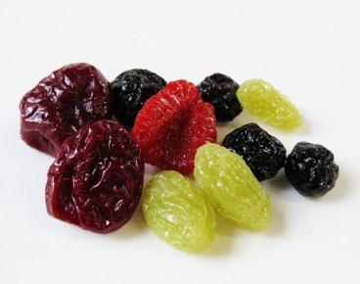
Fruit
PRESCHOOL
May serve full-strength juice
Juice (fruit or vegetable) is limited to one meal, including snack, per day
Dried fruit is credited at twice the volume served
¼ cup of dried fruit = ½ cup fruit
Notes:
Full strength juice is allowed, but limited to only once per day
May NOT serve 2 fruit servings to substitute for a serving of vegetables
Reminder that that dried fruit is credited at twice the volume served

Slide 13
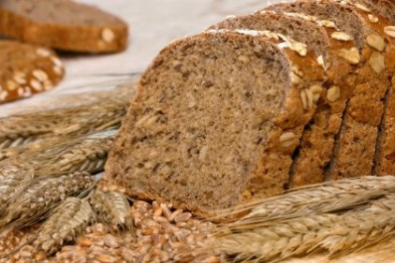
Grains
PRESCHOOL
All grains must be made with enriched or whole grain meal or flour
At least one serving of grains per day must be whole grain-rich:
Contains 100% whole grains, OR
Contains at least 50% whole grains and the remaining grains are enriched
Notes:
The definition of WG-rich still applies, however for Pre-K the requirement is at least one serving of grains per day must be WG-rich

Slide 14
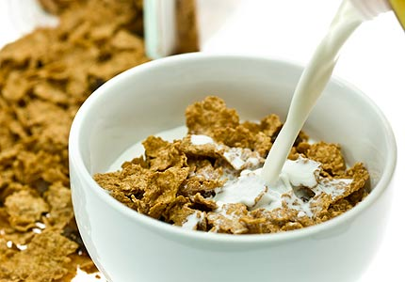
Grains
PRESCHOOL
Grain-based desserts DO NOT count towards the grains component
Oz eq are used to determine the amount of creditable grains (starting October 1, 2019)
Breakfast cereals must contain no more than 6 grams of sugar per dry ounce
Notes:
Grain-based desserts do not count towards the grain component: goal is to promote healthy eating patterns, and therefore reduce consumption of added sugars and saturated fats
-Graham crackers and animal crackers are exempt and not considered a grain-based dessert
Starting October 2019, grains in the infant and preschool meal patterns will be credited using oz equivalents instead of “servings”
-An oz equivalent is slightly heavier than a “serving” of grains and will meet the minimum quantity for grains
-Many of you may already be doing this, which is great! If you haven’t already started, switching to oz eq for grains is required by October 2019
There is a limitation on the sugar content in cereals for Pre-K
-Cereals cannot contain more than 6 grams of sugar per ounce

Slide 15
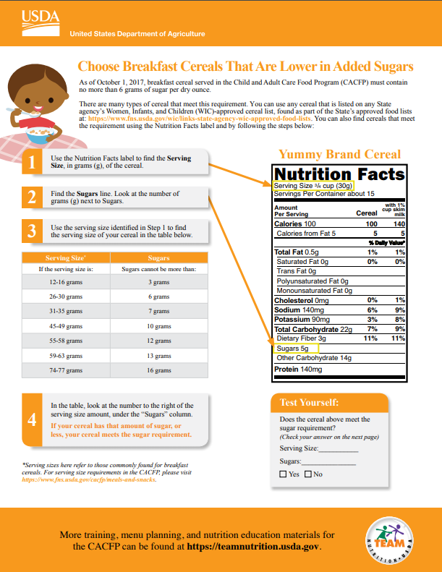
“Choose Breakfast Cereals That Are Lower in Added Sugars”
Notes:
Included in your packet is a handout to help you determine if the sugar content in your cereal is within the limitation

Slide 16
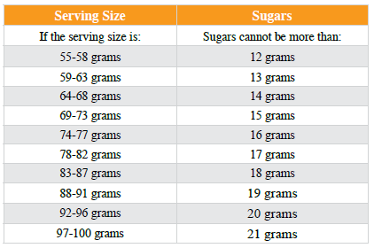
Grains Mini Activity
This cereal can be served to preschoolers
Notes:
Ask: Using the nutrition facts label on the slide, can this cereal be served to preschoolers?
According to the label, one serving is 55 grams, which contains 11 grams of sugar. When you use the chart to the right, it says that a serving size of 55 grams cannot have more than 12 grams of sugar. Therefore, yes, this cereal can be served to preschoolers.

Slide 17
Meat / Meat Alternate
May be served in place of the entire grains component at BREAKFAST
Maximum of 3 times a week
Yogurt must contain no more than 23 grams of sugar per 6 ounces
Notes:
For Pre-K, the M/MA component may be served in place of grains at breakfast up to 3x per week
Yogurt cannot contain more than 23 grams of sugar per 6 ounces

Slide 18
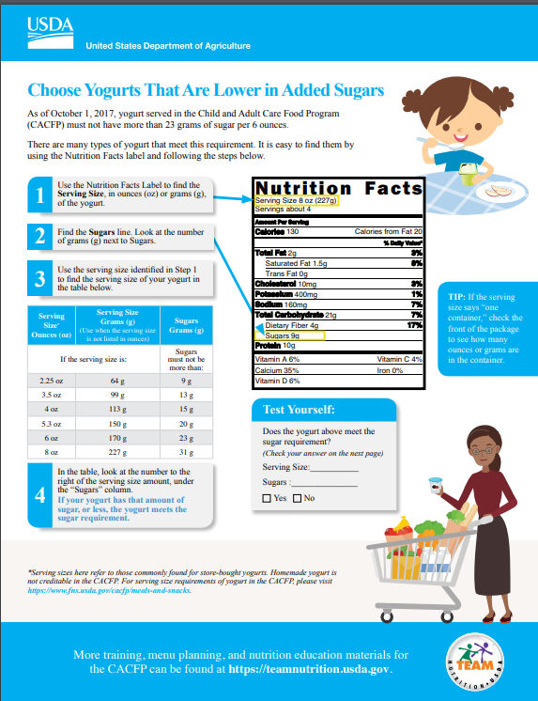
“Choose Yogurts That Are Lower in Added Sugars”
Notes:
Included is your packet is another handout to help you determine if the yogurt you are serving is under the sugar limit

Slide 19
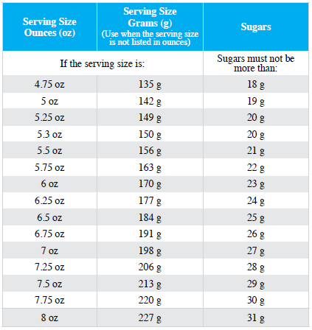
Yogurt Mini Activity
This yogurt cannot be served to preschoolers
Notes:
Ask: Using the nutrition facts label on the slide, can this yogurt be served to preschoolers?
According to the label, one serving is 150 grams, which contains 22 grams of sugar. When you use the chart to the right, it says that a serving size of 150 grams cannot have more than 20 grams of sugar. Therefore, no, this yogurt cannot be served to preschoolers.

Slide 20
Flexibility for Co-Mingled Preschool Meals
Preschoolers and K-5 students served in the same area at the same time
SFA’s choice:
Follow grade-appropriate meal pattern
Serve the K-5 meal pattern to both groups
Notes:
Comingling is when Pre-K students are served at the same time and location as older grades, which makes it difficult for the SFA to correctly count, claim, and serve the appropriate meal pattern to each child.
-For example: pre-K and K-5 students arrive to school on the same school bus and enter the cafeteria for breakfast at the same time.
Although the SDA strongly encourages schools to attempt to find ways to serve grade-appropriate meals to preschoolers and K-5 students to best meet the child’s nutritional needs, SP37-2017 does allow some flexibilities for these SFAs who serve preschoolers and K-5 students in the same service area at the same time
When comingling students, the SFA has the choice to either serve the K-5 meal pattern for both Pre-K and K-5, or implement ways to follow the grade-appropriate meal pattern, such as serving breakfast in the classroom, or staggering meal service for the two age groups.
Any questions on the preschool meal pattern?

Slide 21
Questions
This institution is an equal opportunity provider.

