Slide 1
Helping Hawaii Eat Healthier
NSLP PROCUREMENT TRAINING

Slide 2
HCNP and community partners work together to assure Hawaii’s children have access to healthy meals.

Slide 3
National School Lunch Program (NSLP)
USDA FNS
(Funded by Tax Payer $$$)
State Agency
HCNP
Charter
Schools
Independent
Schools
HIDOE
School Food Service Branch
256 (98%) Schools
3
Notes:
3
Overview of how the federal meal program works. USDA set rules for participation. If you do everything properly, we will partially reimburse you for your expenses. Locally, the State Agency makes sure we’re all doing what we’re suppose to do. In Hawaii, there are 48 School Food Authorities, as you can see, the DOE is the largest.

Slide 4
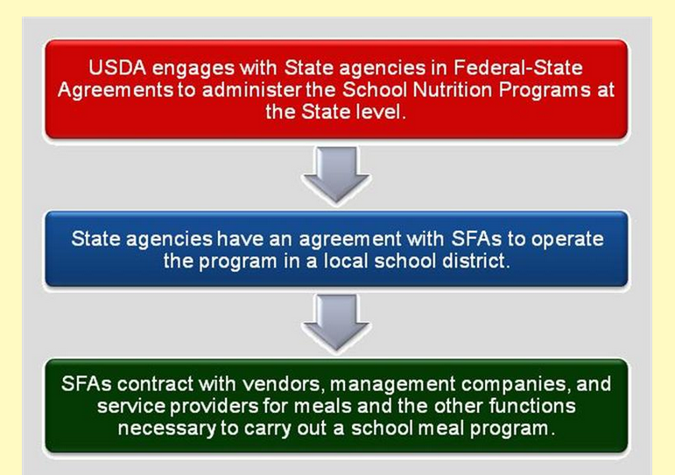
RESPONSIBILITY for assuring procurement compliance is “passed down” from one level to the next through agreements and contracts.

Slide 5
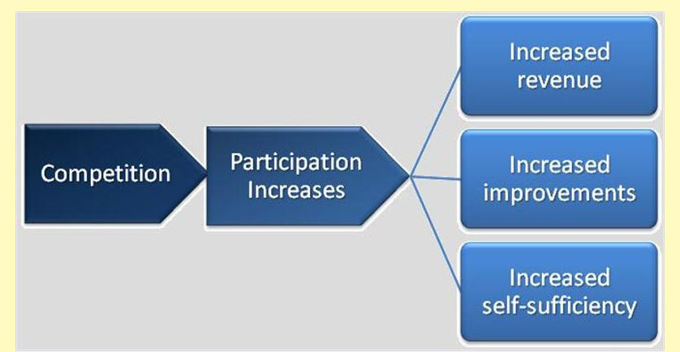
Competitive purchasing could improve meal quality, which can increase participation. Increased revenue improves the NSLP program overall and decreases need for school’s general funds.
Notes:
Through better procurement, SFAs can get better quality meals..
When SFAs offer better meals to students, participation increases.
When participation increases, SFAs have more revenue (through both students’ payment and meal reimbusement), and will have more funds to improve the overall NSLP. With more revenue, SFAs can make NSLP more cost effective and self-sufficient and will rely less on the schools’ general funds.

Slide 6
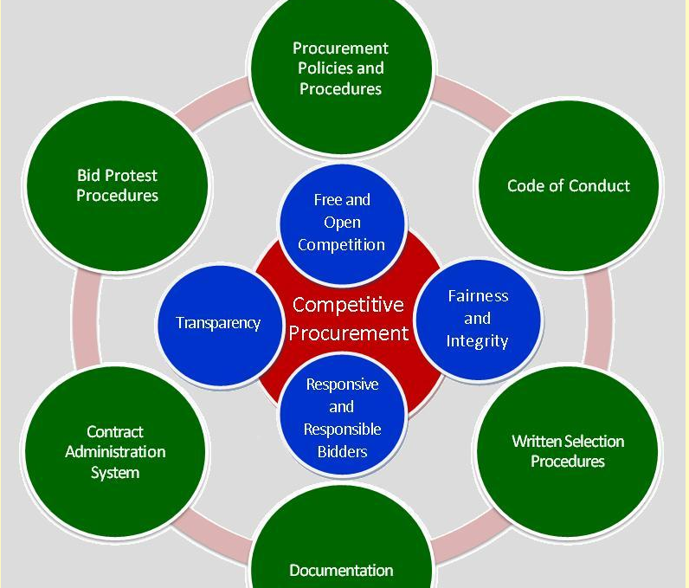
Elements of Competitive Procurement

Slide 7
HCNP will conduct Procurement Reviews every three years in conjunction with a school or organization’s
tri-annual Administrative Review.

Slide 8
SFAs must have a Procurement Plan
A procurement plan is a detailed description of an SFA’s procurement process that demonstrates that they procure in a manner that is consistent with federal, state, and local law and regulation. The plan must
demonstrate that the procurement process allows for fair competition for all products.

Slide 9
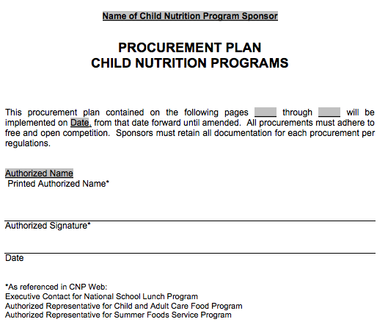

Slide 10
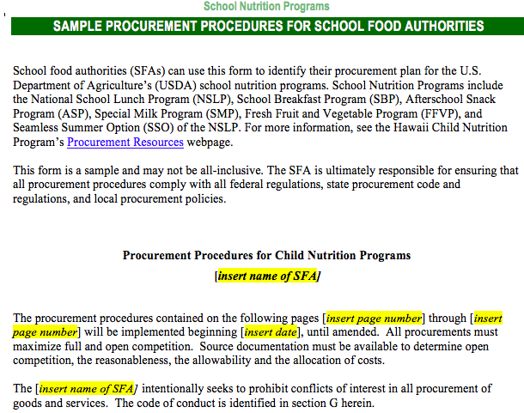

Slide 11
Written Procurement Procedures:
Ensure purchases are made in compliance with federal, state, and local rules.
Provide purchasing staff with a guide on proper procuring which will help prevent unallowable purchases.

Slide 12
HCNP Prototype Procurement Plan
Includes a Code of Conduct section.
All SFA’s must have a written Code of Conduct.
Protects employees from engaging in unethical and unallowable behavior
Provides disciplinary actions for violations
Protects SFA’s reputation

Slide 13
Code of Conduct must have consequences if rules are violated.
Examples of disciplinary actions are:
Verbal warning
Written warning
Fines
Suspension or Termination
Police/Legal Action

Slide 14
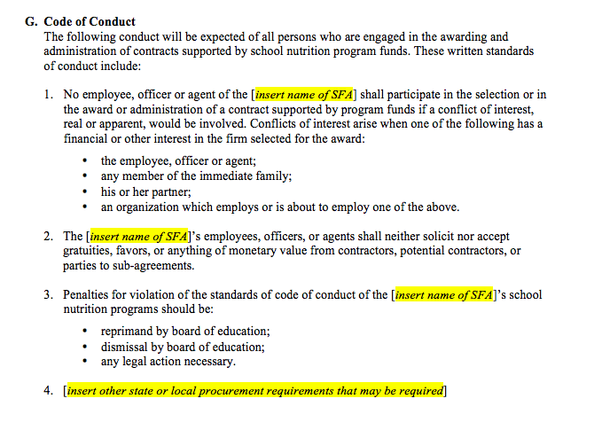

Slide 15
Conflicts of Interest
No employee should be involved in the procurement process if they have a conflict of interest – real or perceived.
REAL: Professional judgment is compromised because of a financial personal benefit.
PERCEIVED:A reasonable person would think that the professional’s judgment is likely to be compromised.
The Newspaper/Stink Test

Slide 16
Can a SFA Receive Gifts?
Yes, but it must be clearly defined in the SFA’s Code of Conduct.

Slide 17
WHAT DO HAWAII SCHOOLS PROCURE?
VENDED MEALS (8) | SELF-OPS (13) PURCHASE FOOD, GOODS & SERVICES | MEALS FROM ANOTHER SFA (4) | CONTRACTS WITH FSMC (4)
Connections Ka ‘Umeke Ka’eo Ka’ohao PCS Kamalani PCS Ka Waihona PCS Malama Honua National Guard YC Voyager | Bobby Benson Child & Family Ser. HAAS DOE – SFSB Ka’u Learning Aca. Kualapu’u PCS Ke Kula Niihau Kona Pacific PCS Laupahoehoe Na Wai Ola PCS St. Catherine Sch. Windward Nazarene Volcano SAS | Ke Ana La’ahana Kua o ka La Nawahiokalani’opu’u Waimea PCS | Kamaile St. Joseph? University Lab Waialae Elem.

Slide 18
Procurement Principles and Regulations

Slide 19
What Is Procurement?
Procurement
Principles
Procurement is the purchasing of
goods and services. The procurement process involves:
Planning
Drafting Specifications
Advertising the Procurement
Awarding a Contract
Managing the Contract
Notes:
Procurement is the purchasing of goods and services.
The procurement process begins with planning. Which goods or services do you need? How much do you need? When do you need them? This is a great time to gather information from prospective vendors and to conduct research.
After determining your needs, document them in detail and create specifications.
Then, provide specifications to responders who might be able to fulfill your needs.
Document the responses.
Award/Document a contract to one of the responders to provide the needed goods and services.
Manage the contract to ensure that everything is provided according to your specifications.
Remember, An SFAs that practices these key steps will be in good shape when its time for Local Agency Procurement Reviews.

Slide 20
Four Guiding Principles
Buy American – Buy Hawaii
Knowledge of Federal, State, Local Regulations
Full and Open Competition
Responsive and Responsible Vendors
Notes:
These four USDA procurement principles guide the procurement process and ensure that taxpayer money is only used to procure the best products or services at the lowest possible prices.
The Buy American – Hawaii Provision requires schools to purchase domestically grown and processed foods “to the maximum extent practicable.” For processed products, 51% of ingredients must be Hawaii grown and the product must be processed in Hawaii. Reference: §7 CFR 210.21(d), Memo SP 38-2017
There are two exceptions:
Product is not produced in sufficient quantities in the Hawaii,
Competitive bids reveal that the cost of a Hawaii product is significantly higher than a domestic or foreign product.
Exceptions to the purchase of domestic foods must be documented as well as the domestic food alternatives considered. The documentation must be maintained for review by the State agency during procurement reviews.
The most important principle of a sound procurement is competition. Competition helps ensure that taxpayer dollars are used efficiently and effectively.
The regulations use the term “full and open competition,” which essentially means that all potential suppliers be on a level playing field. For more information, see 2 CFR 200.319.
(Using local as a product spec can LIMIT competition. This training is designed to help you target local without overly restricting competition. Reference: §2 CFR 200.319, Memo SP_18 – 2011 Procurement Geographic Preference Q&As.)

Slide 21
1
The Buy American Provision
The National School Lunch Act requires SFAs to purchase domestically grown and
processed foods to the maximum
extent practicable.
Buy American = Buy Hawaii

Slide 22
Buy Hawaii – Decision Tree
Is product produced in Hawaii (> 51% Hawaii product) or grown in Hawaii?
NO
YES
Is price per unit significantly higher for Hawaii product?
Buy product from anywhere
NO
YES
Must buy product from Hawaii
Consider an alternative product or buy product from anywhere

Slide 23
Buy American: Things to Remember!
Must have Buy American clause in all solicitations and contracts
Must buy HI if cost effective or in sufficient quantities. Document if you don’t.
Must monitor vendor. Document everything.

Slide 24
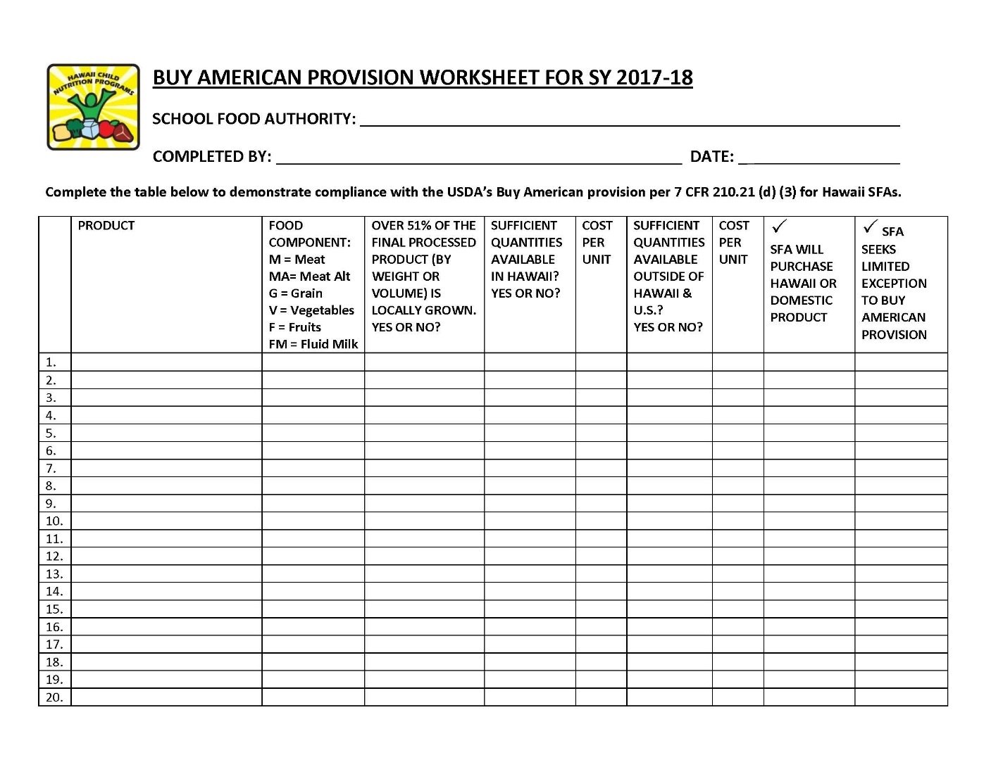

Slide 25
2
State and Local Procurement Policies
Schools must be aware of procurement requirements at the federal, state and local levels and are responsible for complying with ALL levels of regulations.
In some cases, state and federal regulations may be in conflict with each other.

Slide 26
State Procurement Policies
State Small Purchase Threshold is $100,000
DOE Small Purchase Threshold is $25,000
Charter and private schools will need to ask their Board of Directors to establish a Small Purchase Threshold and identify the authorized personnel empowered to sign contracts.

Slide 27
3
Competition
Competition is essential to ensure the best cost and quality of goods and services.

Slide 28
Why is Competition Important?
Price!
In a competitive procurement environment:
Sellers may accept a smaller margin of return on a given sale rather than make no sale at all.
Schools may receive more goods or services at a lower price than in a non-competitive environment.

Slide 29
Why is Competition Important?
Quality!
In a competitive environment:
Businesses seek to differentiate themselves in terms of quality and innovation.
Each procurement offers an opportunity to consider new and/or higher quality products and services.

Slide 30
Competition Killers
Do not…
Place unreasonable requirements on firms;
Require unnecessary experience;
Give noncompetitive awards to consultants or vendors;
Have organizational conflicts of interest;
Specify only brand name products;
Make arbitrary decisions in the procurement process;
Write bid specifications that are too narrow and limit competition;
Allow potential contractors to write or otherwise influence bid specifications; or,
Provide insufficient time for vendors to submit bids.
Use local as a product specification.

Slide 31
4
Responsive and Responsible
Awards must be made to vendors that are responsive and responsible.
Responsive means that the vendor submits a bid that conforms to all terms of the solicitation.
Responsible means that the vendor is capable of performing successfully under the terms of the contract.

Slide 32
Procurement Methods

Slide 33
§200.320
Methods of procurement
Micro-purchase – not services
Small purchase
Invitation for Bids
Request for Bids
Single/Sole Source
Emergency Procurement
Notes:
We won’t talk much about noncompetitive proposals today, but there are times when procurement through solicitation of a proposal from only one source and many be used when:
-Item available from one source
-Public exigency or emergency – delay not permitted
-Authorized by FNS or State agency due to written request
-After solicitation from a number of sources, competition is deemed inadequate

Slide 34
Procurement Methods
Requirements | Micro-purchase | Small purchase | Invitation for Bids | Request for Proposals
Value | ≤3,500 | ≤$150,000 | >$150,000 | >$150,000
Use | One-time purchases React to quickly changing markets or urgent needs | Purchases >$3,500 and ≤ local, state, and federal small purchase threshold | Purchases ≤ local, state, and federal small purchase threshold Complete, adequate, & realistic specification available Contract can be awarded on price | Purchases ≤ local, state, and federal small purchase threshold Considerations other than price; price is still primary
Miscellaneous | Reasonable price (no competitive quotes) Equitable distribution among qualified suppliers | No overly restrictive requirements 3 bids and a buy | No overly restrictive requirements | No overly restrictive requirements Clear evaluation criteria
Written Specifications | Best Price | √ | √ | √
Public Notification |  |  | √ | √
Contract Management | √ | √ | √ | √
Documentation | √ | √ | √ | √

Slide 35
Micro-purchasing for food and supplies < $3,500: No solicitation, no cost comparisons necessary
For one-time food & supplies purchases valued between 0-$3,500. No solicitation or cost comparisons are necessary. Rotate all food and supply purchases between grocery or warehouse stores, etc. Total annual expenditures at each store should be somewhat equal. Not to be used for equipment or services.

Slide 36
Procurement Methods for goods & services
≤ Small Purchase Threshold >
(Federal Threshold = $150,000)
Informal
Formal
Small Purchase
(Requires price quotes from at least 3 bidders)
Sealed Bids (IFBs) & Competitive Proposals (RFPs)
(Requires public advertising)

Slide 37
Small Purchase Procedures for goods & services
Use it when:
The estimated amount of your purchase falls below your small purchase threshold. Small purchases require that schools:
Acquire bids from ideally three responsible and responsive vendors;
Develop written specifications; and,
Document all bids.

Slide 38
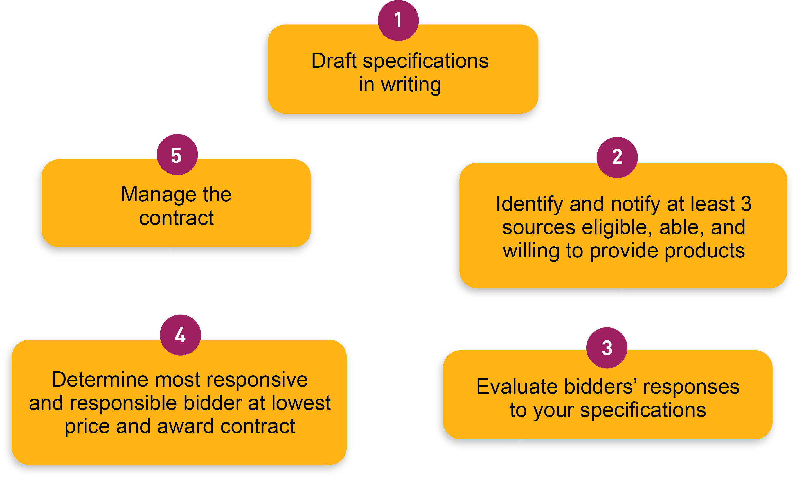
The Informal Procurement Process

Slide 39
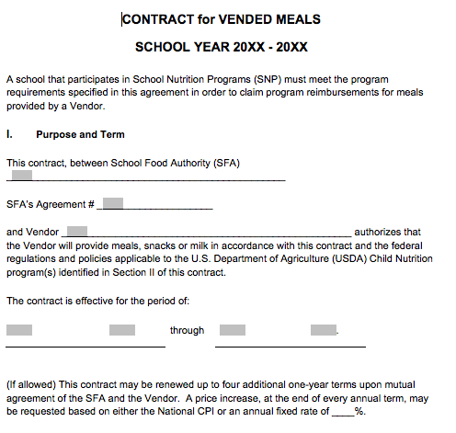

Slide 40
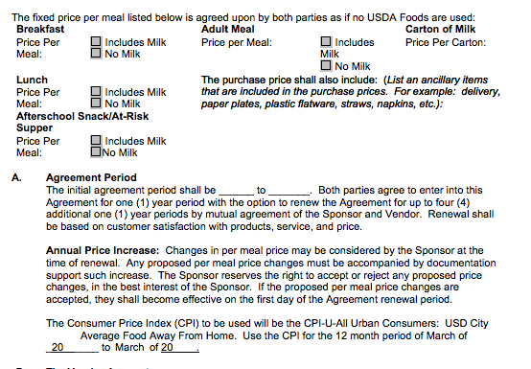

Slide 41
Other important clauses…
✔
✔

Slide 42
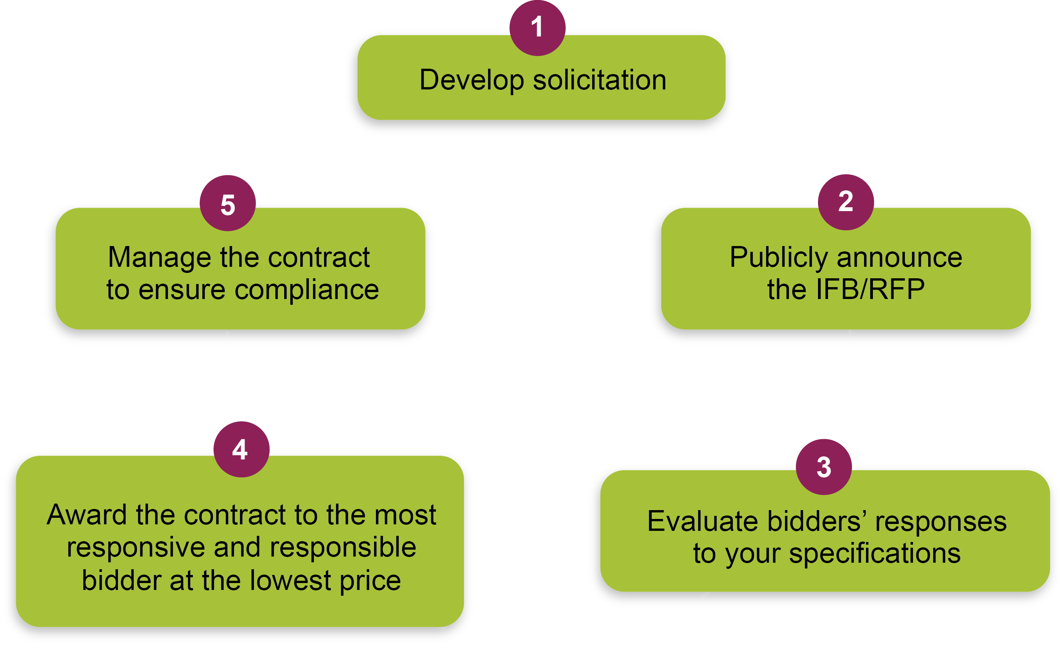
The Formal Procurement Process for FSMC and Contracts > $150,000

Slide 43
Competitive Sealed Bidding
Procurement by competitive sealed bidding is done by issuing an invitation for bid (IFB).
Use it when:
A complete, adequate, and realistic specification is available.
The contract can be awarded on the basis of price.

Slide 44
Invitation for Bid (IFB)
Contract Type
Introduction/Scope
General Descriptions of Goods and Services (AKA Specifications)
Timelines and Procedures
Technical Requirements

Slide 45
Competitive Proposals (RFP)
Procurement by competitive proposal is done by issuing a request for proposal (RFP).
Use it when:
Conditions aren’t appropriate for a sealed bid.
Price won’t necessarily be the sole basis for the award.
Price must still be weighted the highest % of total

Slide 46
Request for Proposals (RFP)
Contract Type
Introduction/Scope
General Descriptions of Goods and Services (AKA Specifications)
Timelines and Procedures
Technical Requirements
Evaluation Criteria

Slide 47
7-Step Procurement Process
Menu/Recipes Developed
Forecasting Conducted - Assess Current Inventory. Maximize use of USDA Foods. Determine Needs.
Specifications Written and Solicited to Potential Vendors
Contracts Awarded
Proposals Received
Contracts Managed
Vendor is reliable. Meets delivery and product specifications. Follows substitution rules.
Vendors Evaluated
Responsiveness
Reliability
Responsible

Slide 48
Quiz:
Procurement Basics

Slide 49
If a vendor cannot meet a school’s specifications or requirements, is the vendor responsive?

Slide 50
Is documentation required for informal procurements?

Slide 51
Can a school award a contract if only one bid was received?

Slide 52
Can a school require a vendor to provide references?

Slide 53
Can a school require a specific brand name product?

Slide 54
Can a vendor request that a school change specifications or solicitation language after the solicitation has gone out?

Slide 55
Can a school award a contract to a local vendor without conducting a procurement?

Slide 56
Should schools always use the formal procurement method when making a purchase over $150,000?

Slide 57
Are there other rules besides federal regulations that schools must follow?

Slide 58
Must schools always award to the lowest bidder?

Slide 59
Is price the only consideration in an IFB?

Slide 60
Do you know the difference between an IFB and an RFP?

Slide 61
Local Procurement Guide
Available at: http://go.usa.gov/KAFH
or on the Procuring Local Foods page of the USDA Farm to School website: http://www.fns.usda.gov/farmtoschool/procuring-local-foods

Slide 62
Questions!
This institution is an equal opportunity provider.

