Slide 1
Paid Lunch Equity PART 2 Contributing Non Federal source fund
Hawaii Child Nutrition Programs
SY 2017-2018
Notes:
Aloha everyone,
This power point is focused on an School Food Authority’s (SFA) decision to contribute non federal funds to meet the Paid Lunch Equity (PLE) requirements.

Slide 2
PLE Instructions tab
Notes:
We begin on the instructions tab. I would advise everyone to review the PLE instructions before starting on the PLE Tool. After you had a chance to take a look at the instruction, we will move on to the unrounded requirement finder tab.

Slide 3
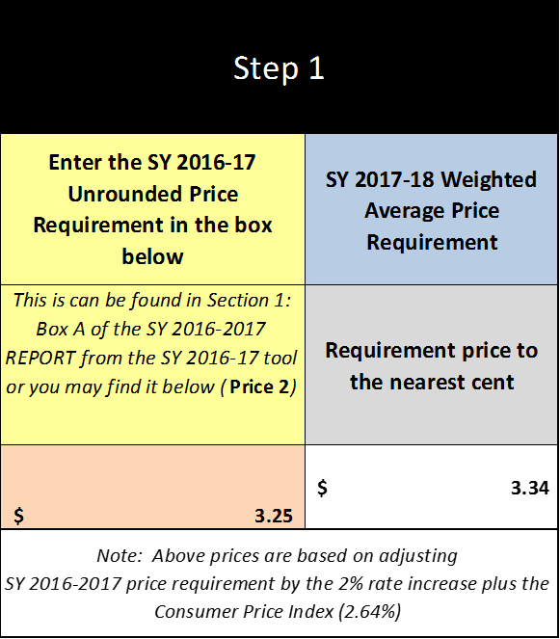
UNROUNDED REQUIREMENT FINDER TAB
Notes:
Please enter SY2016-2017 unrounded price requirement, in the orange box.
This information is found in last year PLE tool, on the SY 2016-2017 Report tab in Box A.
In this situation, the SY 2017-2018 weighted average price requirement is $3.34. The SFA’s unrounded price requirement is $3.25 (see green arrow). Since this SFA has decided to use a Non Federal Funds contribution to meet the PLE requirement, we will have to know this SFA’s SY16-17 average weighted price. To accomplish this, we will click on SY 17-18 NonFederal Calculator tab.

Slide 4
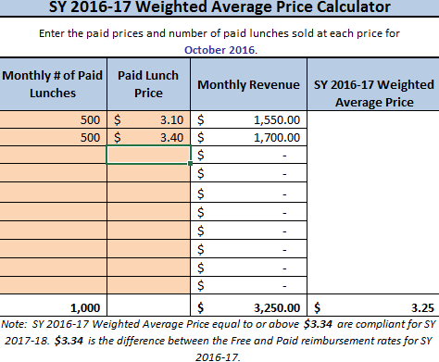
SY 17-18 PRICE CALCULATOR tab
Notes:
To calculate the SY2016-2017 Weighted Average Price we will complete the following steps:
First enter the October 2016 paid lunch total (see the green arrow).
In this example there were 500 paid lunches for the elementary and 500 paid lunches for the middle school.
Then enter the prices of the paid lunches (see blue arrow).
The elementary paid lunch price was $3.10 and the middle school paid lunch price was $3.40.
Enter each student paid lunch price (including all schools- elementary, middle, and high school.
After the quantity and price of paid lunches were entered we see this SFA’s SY2016-2017 Weighted Average Price was $3.25 (see red arrow)
In this situation because the SFA’s SY2016-2017 weighted average price of $3.25 is less then the SY2017-2018 required weighted average price of $3.34. The SFA needs to increase its paid lunch price by $0.09 to meet the PLE requirement or contribute nonfederal funds. Now lets assume this SFA does not want to increase it lunch prices for the upcoming school year, so the SFA must contribute Non Federal Funds to the nonprofit school food service account.
Next click on the SY 17-18 Non Federal Calculator tab.

Slide 5
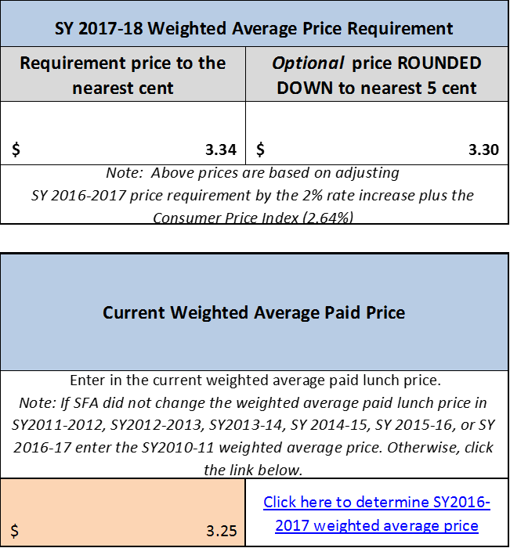
SY 17-18 Non Federal calculator tab
Notes:
In this section of the Non Federal Calculator tab we can see:
the SFA weighted average price $3.25 (see green arrow)
the SY2017-2018 weighted average price requirement $3.34 (see blue arrow)
The optional rounded down price is $3.30 (see purple arrow). By USDA policy, SFAs have the option of either raising the prices to the full weighted average price $3.34 or using the optional rounded down price of $3.30. Please remember if a SFA chooses to use the round down price of $3.30, next year unrounded requirement price will be $3.30 and the SFA might have to increase its lunch prices next school year.
The next 2 slides will have 2 scenarios to demonstrate how this SFA calculates is Non Federal Funds Contribution.

Slide 6
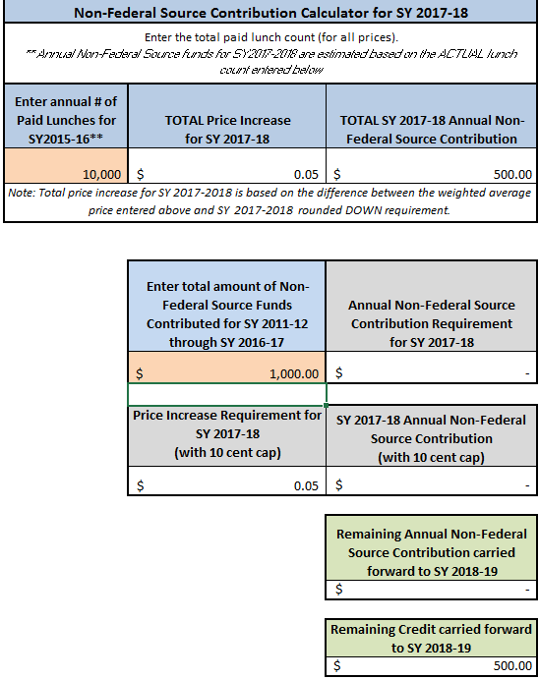
Sy 17-18 nonfederal calculator tab
Notes:
Scenario 1
In the orange section of this tab, enter the annual number of paid lunches for SY2015-2016. In this example there were 10,000 total paid lunches (see green arrow).
If we take the 10,000 paid lunches times the “total price increase for SY 2017-2018” for $0.05, we see that this SFA must contribute $500.00 from a non federal source to the nonprofit school food service account to meet the PLE requirements.
If you scroll down a little, you will see a box that says, “Enter total amount of Non-Federal Source Funds Contributed for SY 2011-2012 through SY2016-2017. Now before you fill in this box, take a moment to consider, may SFAs are under the mistaken impression that any funds they contribute into the nonprofit school food service account should be entered in this box, and that is incorrect. There are many reason SFAs transfer funds to the nonprofit school food service account. For the purpose of the PLE tool, we are only looking at the nonfederal funds that were specifically used to satisfy the PLE requirement. For this scenario let’s assume at this specific time that this SFA contributed $1,000.00 for this specific time period. Since the SFA has already contributed $1,000.00, which is $500.00 more than is required, the SFA does not have to contribute any funds this year.
The remaining $500.00 would be carried forward to SY 2018-2019 (see purple arrow).

Slide 7
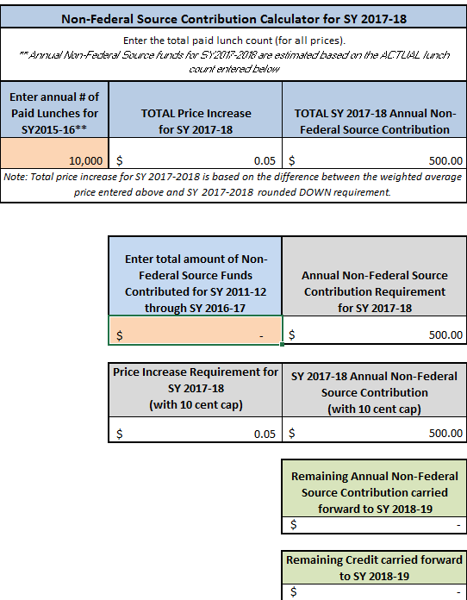
Sy 17-18 nonfederal calculator tab
Notes:
Scenario 2
In scenario 2 please enter the annual number of paid lunches for SY 2015-2016 in the orange box. In this example we are using 10,000 paid lunches. The required SY 17-18 non federal contribution is $500.00 (see green arrow).
In scenario 2, the SFA did not contribute any funds from SY 2011-2012 through SY 2016-2017. In this instance the SFA is required to make $500.00 contribution to the nonprofit school food service to satisfy the PLE requirement.
Now click on the SY 2017-2018 Report tab.

Slide 8
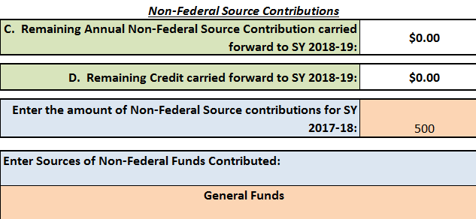
SY 2017-2018 Report tab
Notes:
The SY 2017-2018 Report tab is used for SFAs to inform the department how they will meet the paid lunch equity requirement. They do this by selecting one of the five options from the drop down menu (see green arrow). Because this SFA has chosen not to adjust their lunch price but is required to make a nonfederal contribution they will select “Contribute Non-Federal Sources for SY2017-2018” (see green arrow).
Scroll down to the Non-Federal Source Contribution.
Here is where we will enter the amount of money the SFA will contribute to the nonprofit school food service account (see blue arrow)
From the previous slide, we know the amount is $500.00.
Next the tool will ask you where the nonfederal funds are coming from. We want to make sure the funds are coming from an allowable source.
In this instance, the SFA is contributing monies from its “General funds” (see purple arrow).
Next print and save a copy for your file. Then submit a copy of the PLE tool to HCNP. Include documentation (example, student handbook or menu) which identifies the paid lunch prices for SY2017-2018 and identify when the general funds will be transferred into the nonprofit school food service account.

Slide 9
Questions?
Contact:
Shaynee Moreno or Derek Vidinha
Email: Shaynee_Moreno@notes.k12.hi.us
Derek_Vidinha@notes.k12.hi.us
Notes:
Please contact Shaynee Moreno or Derek Vidinha at the Hawaii Child Nutrition Programs if you have questions.

Slide 10
Nondiscrimination Statement
In accordance with Federal civil rights law and U.S. Department of Agriculture (USDA) civil rights regulations and policies, the USDA, its Agencies, offices, and employees, and institutions participating in or administering USDA programs are prohibited from discriminating based on race, color, national origin, sex, disability, age, or reprisal or retaliation for prior civil rights activity in any program or activity conducted or funded by USDA.
Persons with disabilities who require alternative means of communication for program information (e.g. Braille, large print, audiotape, American Sign Language, etc.), should contact the Agency (State or local) where they applied for benefits. Individuals who are deaf, hard of hearing or have speech disabilities may contact USDA through the Federal Relay Service at (800) 877-8339. Additionally, program information may be made available in languages other than English.
To file a program complaint of discrimination, complete the USDA Program Discrimintion Complaint Form, (AD-3027) found online at:
http://www.ascr.usda.gov/complaint_filing_cust.html, and at any USDA office, or write a letter addressed to USDA and provide in the letter all of the information requested in the form. To request a copy of the complaint form, call (866) 632-9992. Submit your completed form or letter to USDA by:
1) mail: U.S. Department of Agriculture
Office of the Assistant Secretary for Civil Rights
1400 Independence Avenue, SW
Washington, D.C. 20250-9410;
2) fax: (202) 690-7442; or
3) email: program.intake@usda.gov
This institution is an equal opportunity provider.
Notes:
This institution is an equal opportunity provider.

