Slide 1

Paid Lunch Equity
PART 1
AT OR ABOVE EQUITY
Hawaii Child Nutrition Programs
SY 2017-2018
Notes:
Aloha, my name is Shaynee Moreno and I will train on the Paid Lunch Equity (PLE)
This power point is focused on an School Food Authority's (SFA) weighted average price from the current school year when it equals or exceeds the weighted average price for the upcoming school year.

Slide 2
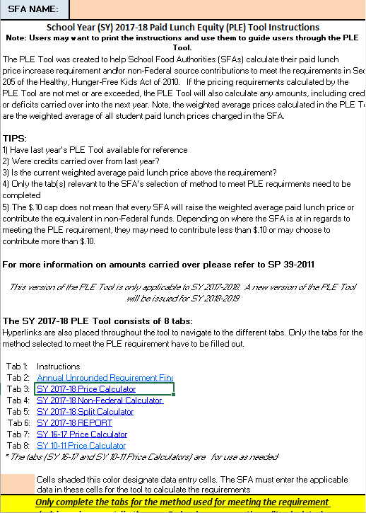
PLE Instructions tab
Notes:
We begin on the instructions tab. Please review the PLE instructions before starting on the PLE Tool. After you had a chance to take a look at the instruction, we will move on to the unrounded requirement finder tab.

Slide 3
Unrounded requirement finder tab
Notes:
If not do not have SY2016-2017 unrounded price requirement, then you would have to complete the Annual Unrounded Requirement Finder.
Let’s assume that most of you have last year’s PLE tool.
Next click on SY 2017-2018 Price Calculator tab

Slide 4
2 Scenarios
Unrounded price requirement is greater then the SY2017-2018 weighted average price
Unrounded price requirement is less than the SY 2017-2018 weighted average price
Notes:
Today we will discuss 2 scenarios for PLE Tool when the SFA’s weighted average price is “At or above equity.”
Unrounded price requirement is greater then the SY2017-2018 weighted average price
Unrounded price requirement is less than the SY 2017-2018 weighted average price

Slide 5
Unrounded requirement finder tab
Notes:
Scenario 1
If you have SY2016-2017 unrounded price requirement, enter it in the orange box. (see green arrow)
This information is found in last years PLE tool, on the SY 2016-2017 Report tab in Box A.
If your SY 2016-2017 Unrounded price requirement is equal to or greater then the SY2017-2018 average price requirement, a new cell will pop up and state, “ Proceed to the Report Tab” (see blue arrow).
If you see this box, click on SY 2017-2018 Report tab.

Slide 6
SY 2017-2018 REPORT TAB
Notes:
In the top section of the SY 2017-2018 Report, it reminds the SFA to keep the SY2016-2017 average weighted price to be used in next year’s PLE tool (see yellow arrow).

Slide 7
SY 2017-2018 REPORT TAB
Notes:
On this tab, SFAs inform the department how they will meet the paid lunch equity requirement. They do that by selecting one of the five options from the pull down menu (see green arrow).
This SFA will not be adjusting their lunch price because their current average weight price of $3.50 exceeds the required weighted average price of $3.34, they will select “At or above Equity.” Once the SFA selects this option a new box appears and the SFA enters the SY 2016-2017 average weighted price (see blue arrow).
Finally, in the Average Weighted Price Adjustment the SFA must enter the new average weighted price for SY2017-2018 (see purple arrow).
Next print and save a copy for your file. Then submit a copy of the PLE tool to HCNP. Include documentation (example, student handbook or menu) which identifies the paid lunch prices for SY2017-2018.

Slide 8
Unrounded requirement finder tab
Notes:
Sceneraio 2
If you have SY2016-2017 unrounded price requirement, enter it in the orange box.
This information is found in last year (SY2016-2017) PLE tool, on the SY 2016-2017 Report tab in Box A. If your SY 2016-2017 unrounded price requirement is lower than the SY 2017-2018 weighted average price requirement, then please click on the SY2017-2018 Price Calculator Tab.

Slide 9
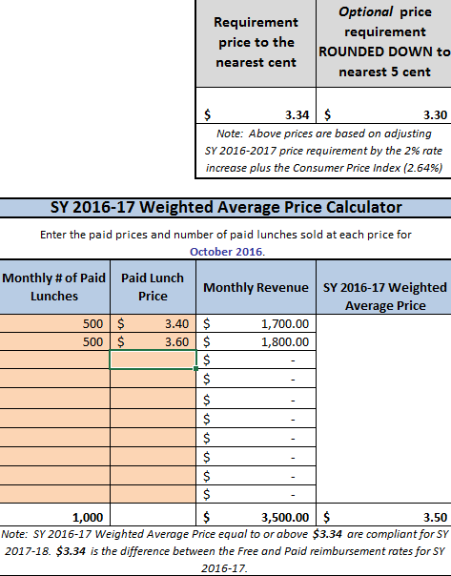
SY 17-18 PRICE CALCULATOR TAB
Notes:
Since the unrounded price requirement $3.30 was less than SY 2017-2018 weighted average price requirement of $3.34 (see purple arrow), we will have to calculate the SY2016-2017 Weighted Average Price.
First enter the October 2016 paid lunch total (see the green arrow). In this example there were 500 paid lunches for elementary and 500 paid lunches for the middle school
Then enter the price of the paid lunch (see blue arrow).The elementary paid lunch price was $3.40 and the middle school paid lunch price was $3.60.
Enter each student paid lunch price (including all schools- elementary, middle, and high school.
After the quantity and price of paid lunches were entered we see this SFA’s SY2016-2017 Weighted Average Price was $3.50 (see red arrow)
In this situation because the SFA’s SY2016-2017 weighted average price of $3.50 was greater then the SY2017-2018 weighted average price of $3.34. The SFA does not need to increase its paid lunch price and does not need to contribute non federal funds. The SFA can if it so chooses to raise its prices or keeps its current average price the way it is. Now lets assume this SFA has chosen to keep it current weighted average price $3.50 for the upcoming school year.
Then the SFA would click on: SY2017-2018 Report tab

Slide 10
SY 2017-2018 REPORT TAB
Notes:
Remember this tab is used to inform the department how SFA will meet the paid lunch equity requirement. They do that by selecting one of the five options from the pull down menu (see green arrow).
This SFA will not be adjusting their price because their current average weight price of $3.50 exceeds the required weighted average price of $3.34, they will select “At or above Equity.”
Once the SFA selects this option a new box appears and the SFA enters the SY 2016-2017 average weighted price (see blue arrow).
Finally, in the Average Weighted Price Adjustment the SFA must enter the new average weighted price for SY2017-2018 (see purple arrow).
Next print and save a copy for your file. Then submit a copy of the PLE tool to HCNP. Include documentation (example, student handbook or lunch menu) which identifies the paid lunch prices for SY2017-2018.

Slide 11

Questions?
Contact:
Shaynee Moreno or Derek Vidinha
Email: Shaynee_Moreno@notes.k12.hi.us
Derek_Vidinha@notes.k12.hi.us
Notes:
Please contact Shaynee Moreno or Derek Vidinha at the Hawaii Child Nutrition Programs if you have questions.

Slide 12
Nondiscrimination Statement
In accordance with Federal civil rights law and U.S. Department of Agriculture (USDA) civil rights regulations and policies, the USDA, its Agencies, offices, and employees, and institutions participating in or administering USDA programs are prohibited from discriminating based on race, color, national origin, sex, disability, age, or reprisal or retaliation for prior civil rights activity in any program or activity conducted or funded by USDA.
Persons with disabilities who require alternative means of communication for program information (e.g. Braille, large print, audiotape, American Sign Language, etc.), should contact the Agency (State or local) where they applied for benefits. Individuals who are deaf, hard of hearing or have speech disabilities may contact USDA through the Federal Relay Service at (800) 877-8339. Additionally, program information may be made available in languages other than English.
To file a program complaint of discrimination, complete the USDA Program Discrimintion Complaint Form, (AD-3027) found online at:
http://www.ascr.usda.gov/complaint_filing_cust.html, and at any USDA office, or write a letter addressed to USDA and provide in the letter all of the information requested in the form. To request a copy of the complaint form, call (866) 632-9992. Submit your completed form or letter to USDA by:
1) mail: U.S. Department of Agriculture
Office of the Assistant Secretary for Civil Rights
1400 Independence Avenue, SW
Washington, D.C. 20250-9410;
2) fax: (202) 690-7442; or
3) email: program.intake@usda.gov
This institution is an equal opportunity provider.
Notes:
This institution is an equal opportunity provider.

