Slide 1
Preparing for the Administrative Review
September 26, 2017
Adapted from:
State of Washington OSPI Child Nutrition Services

Slide 2
SY 17-18 Administrative Reviews
Child and Family Service
Connections PCS
Hawaii Academy of Arts & Sciences PCS
Hookakoo Schools
Kamalani Academy
Ka Umeke PCS
Ka Waihona PCS
Ke Ana Laahana PCS
Ke Kula O Nawahiokalaniopuu Iki PCS
Kua O Ka La PCS
Malama Honua PCS
Na Wai Ola PCS
St. Joseph School
Volcano School of Arts & Sciences
Waialae Elementary PCS
Notes:
Here are the SFAs that will be reviewed this school year.
Even if your SFA is not listed, it is important that you still pay attention so you know how to prepare for the AR and what changes to make now to be in compliance.
Reviews will take place anywhere between November to March.

Slide 3
Overview
Purpose of the Administrative Review (AR)
Areas of the AR – Critical and General
Other Federal Program Reviews
AR Process
Notes:
Read slide.
Note: The Procurement Review is done at the same time as the AR.

Slide 4
AR CYCLE 1
SY 13-14
AR CYCLE 2
SY 16-17
SY 14-15
SY 15-16
SY 17-18
SY 18-19
Finding
Repeat Finding
Notes:
The Healthy, Hunger-Free Kids Act of 2010 requires an Administrative Review to be conducted every three years. All SFAs were reviewed under the first three year review cycle between SY 13-14 through SY 15-16. SY 17-18 is year 2 of a new three year cycle.
During this presentation, we will talk about repeat findings. When a finding found during AR Cycle 1 is found again in AR Cycle 2, it is considered a repeat finding.

Slide 5
Administrative Review
Purpose of the Administrative Review:
Ensure USDA Program Requirements are being met
Provide an opportunity for individualized Technical Assistance
Notes:
The purpose of the AR is to monitor and ensure SFAs are meeting USDA program requirements and that meals claimed are eligible for reimbursement. A large part of the purpose of the AR is to provide technical assistance in areas where program requirements are not being met and provide direction for corrective action to bring programs into compliance. We want SFAs to operate successful programs and serve nutritious meals to students in Hawaii.

Slide 6
Administrative Review
What happens during a review?
What are you looking for?
How do I prepare?
What documents will be looked at?
What happens if you find something wrong?
How long will you be here?
What schools will you visit?
Which staff will you talk to?
Notes:
We know you have lots of questions and perhaps even concerns when you have an AR.
The purpose of today’s presentation is to share with you what to expect, how to prepare, and to answer any questions you may have.
We want you to be prepared and to know what to expect.

Slide 7
Administrative Review
School Meals Administrative Review
Critical Areas
General Areas
Other Federal Program Reviews
Notes:
There are three overall parts to an Administrative Review: Critical Areas, General Areas, and Other Federal Program Reviews.
First, let’s take a peek at the critical areas. (next slide)

Slide 8
Administrative Review
Critical Areas
Meal Access and Reimbursement
Nutritional Quality and Meal Pattern
Meal Components
Dietary Specifications and Nutrient Analysis
Offer vs Serve
Certification and Benefit Issuance
Verification
Meal Counting and Claiming
Notes:
Under the critical areas, there is Performance Standard 1 - Meal Access and Reimbursement and Performance Standard 2 – Nutritional Quality and Meal Pattern.
PERFORMANCE STANDARD 1 – Meal Access and Reimbursement:
All free, reduced-price, and paid lunches claimed for reimbursement are served only to children eligible for free, reduced-price, and paid lunches respectively; and are counted, recorded, consolidated, and reported through a system that consistently yields correct claims.
This includes Certification and Benefit Issuance, Verification, and Meal Counting and Claiming.
PERFORMANCE STANDARD 2 – Nutritional Quality and Meal Pattern:
Reimbursable lunches must meet the meal requirements in 7 CFR 210.10, as applicable to the age/grade group reviewed. Reimbursable breakfasts must meet the meal requirements in 7 CFR 220.8, as applicable to the age/grade group reviewed.
This includes Meal Components, Dietary Specifications and Nutrient Analysis, and Offer vs Serve.

Slide 9
Administrative Review
General Areas
Resource Management
General Program Compliance
Indirect Costs
Maintenance of Non-Profit Food Service Account
Paid Lunch Equity
Revenue from Nonprogram Food
Procurement
Notes:
Now, let’s look at the general areas. The general areas cover all of the other program areas not tied to your reimbursement. They are still important though. There are specific program regulations for each area. Topics include resource management (financial management) of the program and general program compliance.
Resource Management includes:
Indirect Costs
Maintenance of the Non-profit Food Service Account
Paid Lunch Equity
Revenue from Nonprogram Food
Procurement

Slide 10
Administrative Review
General Areas
Resource Management
General Program Compliance
Civil Rights
On-Site Monitoring
Local Wellness Policy
Smart Snacks
Reporting and Recordkeeping
Food Safety
Water
SBP and SFSP Outreach
Professional Standards
Meal Charge Policy
Notes:
The areas of general program compliance are:
On-site Monitoring
Civil Rights
Smart Snacks
Wellness Policy
Food Safety
Reporting and Recordkeeping
Breakfast and Summer Outreach
Water
Professional Standards
Meal Charge Policy

Slide 11
Administrative Review
Other Federal Program Reviews
Afterschool Snack Program (ASP)
Fresh Fruit and Vegetable Program (FFVP)
Seamless Summer Option (SSO)
Notes:
The last part of the review is the review of other Federal programs – Afterschool Snack Program, Fresh Fruit and Vegetable Program, and Seamless Summer Option.

Slide 12
Administrative Review - Steps
Off-Site Assessment Tool sent
2) Complete and submit Off-site Assessment Tool
3) Announcement letter
4) Specialist communicates details of visit
5) On- site Review
6) Complete and submit all Corrective Action
7) Review is closed (final letter)
Notes:
The steps listed on this slide represent the Administrative Review order of events.
Read slide.
Now we are going to talk about each step in more detail. First, the Off-site Assessment Tool.

Slide 13
Step 1. Off-Site Assessment Tool
Gives broad overview of the SFA’s systems and procedures
Off-Site Assessment
Identifies which site(s) will be reviewed and which is high risk
Provides framework for General Areas & Resource Management
Allows for earlier Technical Assistance and Corrective Action
Notes:
The Off-site Assessment Tool is a lengthy questionnaire designed to be completed by the SFA (Administrator, NSLP Coordinator, Business Manager and other staff as applicable).
The Off-site Assessment Tool gives HCNP a broad overview of the SFA’s systems and procedures prior to the on-site visit.
It helps us to identify the sites that will be reviewed and which are considered high risk.
It also provides the framework for the general areas and resource management sections.
The Off-site Assessment Tool helps HCNP identify any areas that require technical assistance and corrective action.

Slide 14
Step 1. Off-Site Assessment Tool
Upload docs
IMPORTANT TIPS:
Start early
Answer all questions
Submit requested documentation
Notes:
New for this school year is that the SFA will complete the Off-site Assessment questions online. This is a screen shot of what it looks like online. More information on how to login and access this section will be forthcoming.
Last year’s Off-site Assessment Tool was in a Word Document and was 30 pages long. START EARLY. There are a lot of questions that need to be answered.
Consider dividing the questions by assigning certain sections to be completed by the person responsible for that area. For example, the Resource Management section could be given to your Business Manager. The information on this tool provides the background information needed to effectively prepare for the AR.
Read each question carefully. Many questions have multiple parts/questions (parts a. and b. or it may specify “If the answer is yes, explain in the comments section”). Answer each question and each part of the question.
The tool is part of the AR - the Program Specialist may assign corrective action to the SFA based on answers to the questions. Answer the questions so that it represents what your SFA is doing. This will give the Program Specialist an idea of how the SFA is operating the program and provide technical assistance/advise on how to correct any issues to be in compliance before the on-site review.
There are questions that specify to submit documentation/tools to HCNP. Submit all requested documents with your completed Off-site Assessment Tool. Upload documents into HCNP Systems using the blue folder icon (on the right).
IMPORTANT: Please keep in mind that USDA has not released the new AR materials for SY 17-18. This means that there may be changes or additional Off-site Assessment questions that need to be answered once the new AR materials are released. HCNP will notify the SFAs if this happens.

Slide 15
Step 2. Complete / Submit Off-Site Assessment Tool
Off-Site Assessment Tool sent
2) Complete and submit Off-site Assessment Tool
3) Announcement letter
4) Specialist communicates details of visit
5) On- site Review
6) Complete and submit all Corrective Action
7) Review is closed (final letter)
Notes:
The next step of he AR process is to make sure the Off-site Assessment Tool is complete (all questions are answered) and submit it to HCNP along with the requested documentation.

Slide 16
Step 2. Complete / Submit Off-Site Assessment Tool
Submit by the specified due date
Do not wait until the last minute – the tool is LONG
Contact HCNP with any questions
Submit documentation/tools specified in the Off-site Assessment Tool
Off-site Assessment Tool not submitted by due date?
Comprehensive Resource Management Review
More time on-site
Notes:
Complete and submit the Off-site Assessment Tool by the specified due date.
Do not wait until the last minute to work on the tool – there are numerous questions!
Contact HCNP if you have any questions or are not sure what the question is asking.
Submit the documentation/tools as specified by the Off-site Assessment Tool questions.
Examples:
Application approval/denial letter sent to households
Press Release
3. LWP & Assessment. Expectation is that the LWP is updated, implemented, and assessed.
If you have not already submitted the following to HCNP, you must submit:
- Completed PLE tool for SY 17-18 AND meal pricing documentation
If the Off-site Assessment Tool is not submitted by the due date:
A comprehensive resource management review will be done which means the reviewers will be on-site longer.

Slide 17
Step 3. Announcement Letter
Off-Site Assessment Tool sent
2) Complete and submit Off-site Assessment Tool
3) Announcement letter
Sites
Menu Documentation
4) Specialist communicates details of visit
5) On- site Review
6) Complete and submit all Corrective Action
7) Review is closed (final letter)
Notes:
An announcement letter is sent by email to the Administrator with a copy to the NSLP Coordinator about a month before the on-site review.
There are a lot of details in the announcement letter so please read it carefully.
The letter provides the dates of the onsite review, a brief explanation of the purpose of the review, and the review period that we will focus on.
For SFAs with more than one site, the letter specifies which site(s) is selected for review.
It is also specified in the letter about how many reviewers will be onsite. Please provide adequate workspace for the reviewers.
The letter also identifies the documents that are to be ready and available for HCNP at the entrance conference. Please pay careful attention to the list. It is lengthy but the documents are all necessary. DO NOT wait until the reviewers arrive to ask what documents are needed.
If you have any questions about how to organize the documents, please contact your Program Specialist directly.

Slide 18
Number of Sites to Review
Step 3. Announcement Letter
# of Sites in SFA | # of Sites to Review
1 – 5 | 1
6 – 10 | 2
11 – 20 | 3
21 – 40 | 4
41 – 60 | 6
61 – 80 | 8
81 – 100 | 10
101 or More | 12*
* 12 plus 5% of # of schools over 100.
Review all sites with free ADP of ≥ 100 and free participation factor of ≥ 100%
Notes:
This table shows how HCNP determines the number of schools that will be selected for review.
For SFSB, with 260 sites, HCNP would review 20 schools.
HCNP must select all sites with free ADP of at least 100 and a free participation factor of at least 100%.

Slide 19
Selection Criteria for Additional Sites
Step 3. Announcement Letter
Elementary schools with free ADP of ≥ 100 and free participation factor of ≥ 97%
Combination schools with free ADP of ≥ 100 and free participation factor ≥ 87%
Secondary schools with free ADP of ≥ 100 and free participation factor ≥ 77%
Notes:
When selecting additional sites to review, HCNP must select sites that meet the criteria listed on this slide.
Notes:
Elementary = preschool-8
Secondary = 9-12
Combination = combination of elementary and secondary
Calculate the Free Participation
Calculate the free average daily participation (ADP) by dividing the number free claimed by the number of serving days. Round the ADP to the nearest whole number, using standard rounding procedures (i.e. if less than 5 round down, if 5 or more round up).
Calculate the percent free participation by dividing the free ADP by the highest number of free eligible. Round to three (3) decimal places and multiply the result by 100.

Slide 20
State Agency Criteria for Additional Sites
Step 3. Announcement Letter
May include but is not limited to the following:
Low participation
High participation
Recommendations from Food Service Director
Schools with previous findings
Manager or school not reviewed by HCNP
Schools with complaints
Schools with mix of age/grade groups
Schools with alternate points of service
Schools participating in other programs (FFVP, ASP, SSO)
Notes:
If after using the criteria on the previous slides does not result in the minimum number of sites that must be reviewed, HCNP may use State Agency criteria.
This includes, but is not limited to the those listed on this slide. Read slide

Slide 21
Step 3. Announcement Letter
Time periods that will be reviewed
Day of Review
Date of on-site visit
Ex: November 6, 2017
Review Period
Typically the month PRIOR to the on-site visit (the month of the most recent claim submitted prior to on-site visit)
Prior School Year
Most recently completed school year
Ex: SY 16-17 for ARs conducted in SY 17-18
Ex: October 2017
Notes:
Here are some important time periods to keep in mind with regards to the Administrative Review.
Day of Review – this is the date of the on-site visit
Ex: November 6, 2017
Review Period – month prior to the on-site visit, unless otherwise noted
Ex: If the day of review is on November 6, 2017, the review period is October 2017 if the October claim was submitted by November 6.
If the October claim was not submitted by the day of review, the review period goes back to September 2017.
Important: submit your claim on time. The further back we review, more funds may be taken back if there are findings in the critical areas.
Prior School Year – most recently completed school year.
Ex: For reviews conducted in SY 17-18, the prior school year would be SY 16-17.
Resource Management (fiscal) – documentation is reviewed from the prior fiscal year.

Slide 22
Step 3. Menu Documentation
Review Menus
To determine compliance with meal pattern requirements
Announcement Letter specifies the one week (from the review period) of menu documentation to submit
Documentation includes, but is not limited to:
Completed production records
Calendar menu
Child Nutrition Labels
Recipes
What if we find errors?
The entire month is reviewed
Notes:
CLICK The menu documentation is reviewed to determine compliance with meal pattern requirements.
CLICK SFAs must provide menu documentation for all meals served for the one week specified in the Announcement Letter for the site(s) selected for review. The one week selected for review is from the Review Period which, as we previously mentioned, is the month prior to the onsite visit or the month that the most recent claim has been submitted. (focus on meals served during the ‘Review Period’)
CLICK You must provide completed production records for the one week specified – it is ok if the production records are dirty, we want them straight from the kitchen.
You must provide all product documentation showing meal pattern contribution; this includes CN labels or manufacturer specifications for processed food items. Remember, any M/MA or product not found in the FBG needs a CN label, Product Formulation Statement, and/or Recipes! We must see that meal pattern contribution has been documented correctly.
Menus will be evaluated for each program offered at the site selected for review. Therefore, if the sites selected for review also offer the Afterschool Snack Program, menu documentation must be submitted for review as well.
CLICK What if we find errors? If errors are determined during the review of documentation from the selected week of review, the review will expand to include the entire month of review.
CLICK This means that menu documentation (production records, labels, recipes, etc.) will need to be submitted for the entire month! This is why it’s important that you check your menus now to determine compliance with the meal pattern requirements.
Next, we will talk about the best way to organize your menu documentation.

Slide 23
Step 3. Menu Documentation
Please organize all supporting documentation and production records IN ORDER BY DAY
Monday Menu: Chicken Nuggets with Whole Grain Roll, Steamed Broccoli, Carrots, Apple Slices & Milk
Folder/Binder should contain:
Monday’s completed production record
Product documentation including:
CN label/Manufacturer Specification for Chicken Nuggets
Label/Product Formulation Statement/Recipe for Roll
Recipes or product documentation necessary to validate crediting for fruits & vegetables
Notes:
CLICK Please organize all of your menu documentation in order by day. We want to make sure we have all of the information we need and to be able to find things fast. Everything should match the menu and be self-explanatory.
CLICK Let’s look at an example. Monday’s menu includes Chicken nuggets, a roll, broccoli, carrots, apples and milk. Please organize your documentation in a folder/binder. The organization of your associated documents should match this menu. So.. CLICK
We should have:
CLICK Monday’s production record
CLICK Associated Product Documentation for the chicken nuggets, such as a CN Label from the box or Manufacturer specification, and a label or product formulation statement or recipe for the Whole-Grain Roll.
Next we would also need to see any associated recipes or product documentation necessary to validate crediting for fruits & vegetables.
Each page after this one should follow suit: Tuesday’s Menu, Tuesday’s Production Record, Tuesday’s Product Documentation
If you serve the same whole grain roll twice during the week selected for review, you only need to submit the product documentation once. For example, if you serve the same roll on Monday and Thursday, you could have a page that says refer to Monday, October 17, 2016 for Whole Grain Roll documentation). Another good place to use this method would be for Milk. It’s OK to only include the milk label or other repeat items just once. Unless a NEW product appears on your production record, we only need to validate the product and serving size one time.

Slide 24
Administrative Review - Steps
Off-Site Assessment Tool sent
2) Complete and submit Off-site Assessment Tool
3) Announcement letter
4) Specialist communicates details of visit
5) On- site Review
6) Complete and submit all Corrective Action
7) Review is closed (final letter)
Notes:
Although we send the announcement letter, there are so many more details to be communicated.
The Program Specialist will communicate with you as the review approaches to obtain more information regarding the onsite visit and to answer any questions that you may have. This may take place by phone or email.
Since the Program Specialist is out multiple times during the year reviewing other SFAs, please be patient with communication and please also be prompt in your responses. Our goal is good communication and a well organized review. Let’s take a closer look at some of the details.

Slide 25
Step 4. Specialist Communicates Details of Visit
Meal service times:
Breakfast
Lunch
Fresh Fruit and Vegetable Program
Afterschool Snack Program
Office/school hours
Vended meals – verify time of meal preparation to visit vendor
Special instructions to find the school
Parking – specify where reviewers may park
Coordinate time of entrance conference
Notes:
The Program Specialist will call the NSLP Coordinator to obtain additional information in preparation for the onsite review.
Please have the following information available:
Meal service times for breakfast, lunch, FFVP, afterschool snack
Office/school hours – so reviewers know how to plan their day
Vended meals – time the vendor prepares meals. Reviewers will visit the vendor to observe meal preparation. It is the SFA’s responsibility to inform your vendor when and what time the reviewers will be onsite at their kitchen.
Any special instructions on how to find your SFA/school. If you are aware of Mapquest or Google Maps giving the wrong directions, please let us know.
Parking – specify where reviewers may park.
Coordinate a time to meet for the entrance conference. We will explain in more detail what the entrance conference is in a few minutes.

Slide 26
Administrative Review - Steps
1) Off-Site Assessment Tool sent
2) Complete and submit Off-site Assessment Tool
3) Announcement letter
4) Specialist communicates details of visit
5) On- site Review
Entrance Conference
Meal Access and Reimbursement
Meal Observations / Meal Pattern
General Areas
Exit Conference
6) Complete and submit all Corrective Action
7) Review is closed (final letter)
Notes:
Once the review team arrives, the onsite review is conducted. This starts with an entrance conference.
During the onsite review, reviewers will look at meal access and reimbursement (meal applications, meal counts, claim for the review period).
Meal service is observed and the general areas will be reviewed for compliance.
An exit conference will be scheduled during the onsite visit. The exit conference takes place on the last day of the review and presents the findings from the review.

Slide 27
Step 5. On-Site Review
Entrance Conference
Provide an AR overview
Relevant SFA staff (e.g., Administrator, NSLP Coordinator, Manager, Business Manager)
15-30 minutes
Arranged prior to the AR
Purpose
Who Should Attend
How Long
What Time
Notes:
The purpose of the entrance conference is to introduce staff and provide an overview of the review.
Typically, the Administrator, NSLP Coordinator, Food Service Manager, and Business Manager attend the entrance conference. Any other relevant staff may also attend such as the Determining/Verifying Officials.
The meeting generally lasts between 15-30 minutes.
The program specialist will arrange with the SFA a time to meet for the entrance conference before arriving on site. Please arrange a space that will accommodate everyone that is attending the entrance conference.
Have all documents organized and ready when the reviewers arrive onsite. This is very important. If you have any questions on what needs to be gathered, you must contact your Program Specialist before the onsite review.

Slide 28
Step 5. On-Site Review
Meal Access and Reimbursement:
Certification and Benefit Issuance
Verification
Meal Counting and Claiming
Common Finding:
Applications were not approved correctly
Notes:
During the onsite review, we will review the certification and benefit issuance of the students in your SFA. In other words, we will review the approval/denial of the F/R applications and validate that students have been assigned the correct eligibility status.
If you have less than 100 students certified for F/R meals, we will review documentation for all of the students.
For SFAs with more than 100 F/R students, we’ll review a sample of students approved for free and reduced price benefits.
A common finding is that applications were not approved correctly:
Calculation errors
Not converting multiple income frequencies to annual income
SSN portion was not completed
Number of names listed on the application does not match the number listed for “Total Household Members”
Counting an unborn child as a household member

Slide 29
Step 5. On-Site Review
Certification and Benefit Issuance
Provide benefit issuance document for all schools in the SFA
Benefit issuance document must be from the POS system
Directly used in meal count system to deliver benefit to children
Do not group by benefit status
No duplicate names
Spreadsheet
Notes:
In order for HCNP to determine the number of students to review and which students to review, the SFA will need to provide the benefit issuance document for all schools in the SFA.
The benefit issuance document must be from the POS system:
Directly used in the meal counting system to deliver the benefit to children
Not grouped by benefit status
No duplicate names
Spreadsheet (Excel) – for SFSB

Slide 30
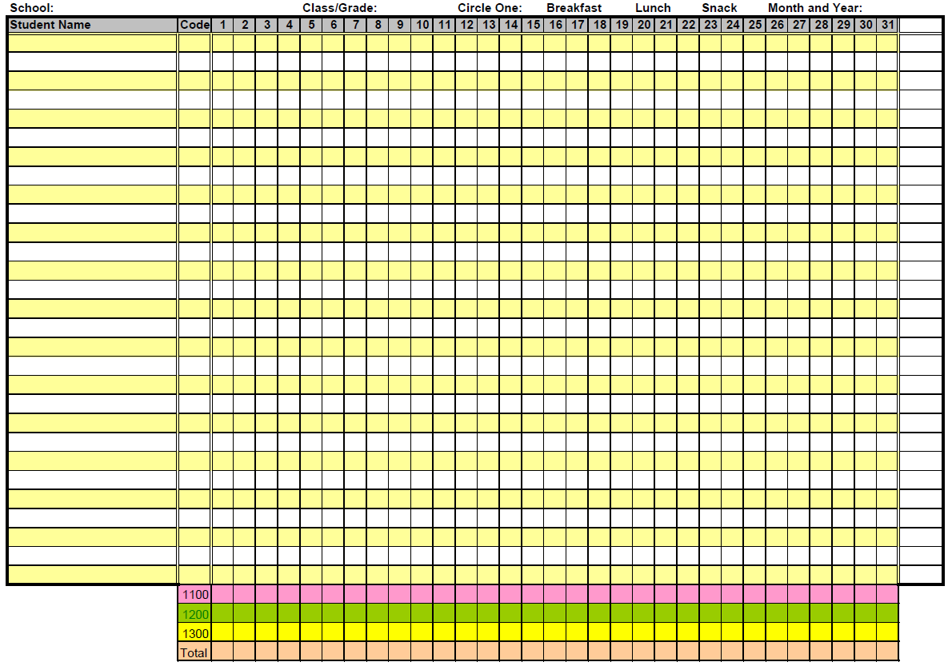
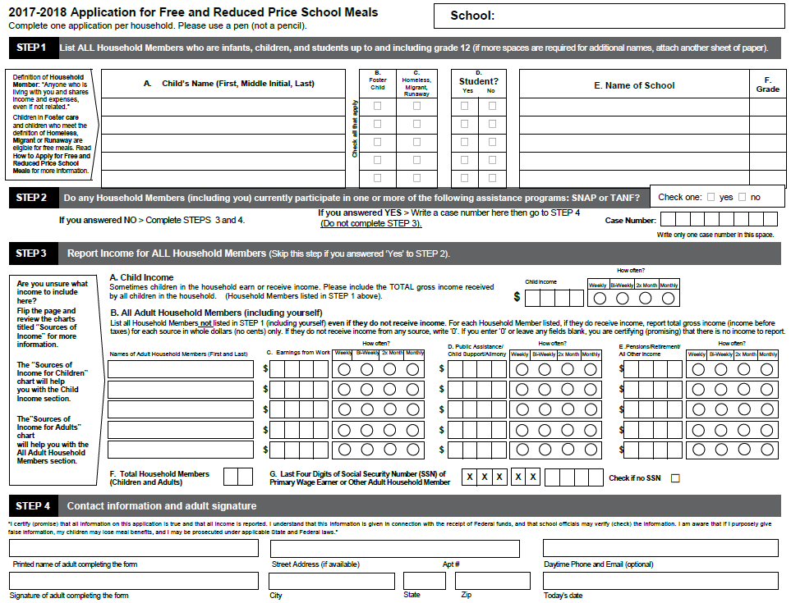
Step 5. On-Site Review
Certification and Benefit Issuance
Reduced-price app for John Smith
Smith, John 1200
Notes:
Validating student certifications:
Compare the benefit issuance document (roster/computer system) to your F/R applications and certification documentation (DC list, migrant list, etc.).
Example: If John Smith is reduced-price on your roster, then the SFA is expected to have a correctly approved reduced-price application for John Smith.

Slide 31
Step 5. On-Site Review
Certification and Benefit Issuance
Smith, John 1200
Free app for John Smith
Common Findings:
Eligibility on the roster/computer POS system did not match F/R application or certification documentation
No documentation to support F/R status
Notes:
SFAs must maintain/update their roster/computer system to ensure that students are receiving the correct benefit.
This slide shows what would be a finding:
John Smith is coded as reduced-price on your roster, but you have a free application on file.
CLICK
Another common finding is having free/reduced price students, but NO documentation (application, DC) to support the F/R status.
Remember, the 30-day carryover is only good for 30 operating days so you must update the students’ eligibility status if no application was submitted or they are not on the DC list for the new school year.
ASK: What are you going to do when you go back to your office?
Compare your roster/computer POS system to your applications/DC list which should match your Master List. The Master List shows the students, their status, when they entered and withdrew from your school, and when students’ status changed during the school year.

Slide 32
Step 5. On-Site Review
Meal Access and Reimbursement
Certification and Benefit Issuance
Verification
Meal Counting and Claiming
Review SFA’s procedures on handling:
30 day carryover
New students
Transfer students
Withdrawn students
Notes:
We’ll review the SFA’s process for transferring free, reduced-price, and paid status from the application/certification documentation to the roster/computer POS:
Procedures on handling:
30 day carryover
New students
Transfer students
Withdrawn students
For RCCIs: have your list of students available (Master List/Admission/Discharge List). Reviewers will need to know when your students entered and left your facility.

Slide 33
Step 5. On-Site Review
Meal Access and Reimbursement
Certification and Benefit Issuance
Verification
Meal Counting and Claiming
Common Findings:
Verified applications were not selected from error prone applications
Confirmation Review was not done or not done correctly
Verification deadlines were not met
Notes:
Verification – this is what Derek explained earlier today.
Verification will be reviewed for the current school year unless the review takes place before November 15. The Program Specialist will review all or select a sample of the verified applications to review depending on the number of applications verified.
Remember, round fractions up to the nearest whole number of applications. Verify only the required number of applications – do not verify extra applications.
Maintain documentation for all applications that are verified.
Common findings:
Not selecting an application to verify from the error prone applications
Confirmation Review was not completed or not done correctly. Remember, the Confirmation Reviewer must confirm that the Determining Official approved the application correctly.
Not meeting the deadlines. Remember to meet all of the verification deadlines, especially the timeliness of eligibility status changes and the due date of the FNS-742 report.

Slide 34
Step 5. On-Site Review
Meal Access and Reimbursement
Certification and Benefit Issuance
Verification
Meal Counting and Claiming
Common Findings:
Meals were not counted at the Point of Service
Nonreimbursable meals were claimed for reimbursement:
Adult Meals
Second Meals
Meals on Sharing Table
Meals lacking required components/food items
Notes:
As you know, we’ll be observing meal service onsite.
“Point of Service” (POS) is that point in the food service operation where a determination can accurately be made that a reimbursable meal has been served to an eligible student.
POS must be a meal clerk at end of line OR
If meal counting is done at the front of the line, an adult must be at the end of the service line to verify students have reimbursable meals and report any ineligible meals.
ALL foods counted towards the reimbursable meal must be offered before the point of service.
If using rosters: they must contain a mark (such as an “X”) to identify students that receive a reimbursable meal. Rosters must be retained as the “source document” supporting the claim for reimbursement.
• POS meal counting is required for ALL programs (NSLP, SBP, After School Snacks, Summer Food Programs). This includes the following special situations: field trip sack lunches, detention meals, earned student meals, and meals served in the classroom (i.e. Head Start or Breakfast in the Classroom).
• Meal counts that are NOT acceptable: classroom attendance counts; tray counts; advanced meals sold; counts taken at the beginning of the serving line without checking to see that the meals are reimbursable at the end of the line; counts claimed by “backing out” numbers.
Remember, DO NOT claim the following for reimbursement:
Adult meals, second meals, meals on the sharing table, meals lacking the required components/food items. If you serve adult meals or second meals, keep a count of how many are served for nonprogram revenue purposes but do not claim these meals for reimbursement.
It is critical that all meal clerks (including substitute meal clerks) are trained in identifying reimbursable meals. They must know what is reimbursable when the school is doing “serve all” and ,if applicable, Offer vs Serve.

Slide 35
Step 5. On-Site Review
Meal Counting and Claiming
Meal Counts
Edit Check Worksheet
Monthly Claim
Common Findings:
Roster/Checklist– manual calculation errors resulted in an overclaim/underclaim of meals
Meal counts/Edit Check Worksheet did not validate the claim for reimbursement
Notes:
The claim will be validated for the Review Period at the sites selected for review.
Remember, the review period is the month of the most recently filed claim. If your onsite review is scheduled at the beginning of the month, it is important that you file your claim before the onsite review.
Reviewers will look over all meal counting sheets to see if the meal counts were totaled correctly by eligibility status, check that the Edit Check Worksheet and claim were completed correctly. The expectation is that all three should match.
On the Off-site Assessment Tool, #306 asks about internal controls to ensure meal counts do not exceed enrollment or attendance adjusted enrollment.
Your internal control is completing the Edit Check Worksheet – you enter an attendance factor that is applied to the daily meal counts. This compares the daily lunch meal counts against the number of students eligible in each category times the attendance factor.

Slide 36
Step 5. On-Site Review
Meal Observation /Meal Pattern
Day of Review (DOR)
Prior to meal service:
Will Meal Pattern be met?
Menu, Production Record,
Product Documentation
Check ‘general areas’
During meal service:
Observe POS procedures
Ensure all meals claimed for reimbursement are counted correctly
After meal service:
Collect DOR meal counts
Notes:
Meal Observation occurs on the ‘Day of Review’ CLICK
Prior to meal service we have one thing on our minds, and that is: Will the meal pattern be met?
To validate if the meal pattern requirements will be met, we will look at your production record and product documentation for the day, prior to service, to assess if the meal pattern will be met.
This is a very important step of the process, and it’s important that you are prepared- because if the meal pattern is not being met, we can provide technical assistance to fix the meal before service!
This would prevent any meals from being disallowed because of an error in menu planning
In addition, we will check the general areas prior to service, this includes determining whether:
Potable water is available
The JFA poster is posted in a publicly visible location
Signage is posted at the beginning of the serving line to indicate what a reimbursable meal will look like that day
Verify that all meal components are being offered PRIOR to the point-of-service CLICK
During meal service-we will stand near the person who takes the ‘point-of-service’ meal count
We will watch for reimbursable meals and nonreimbursable meals
We make sure correct OVS & POS procedures are followed CLICK
After meal service-we will collect a day of review meal count to compare to the meal counts from the Review Period CLICK

Slide 37
Step 5. On-Site Review
Meal Observation / Meal Pattern Day of Review (DOR)
Common Findings:
Nonreimbursable meals:
Serve All – missing one or more components/food items
OVS – did not have ½ cup fruit/vegetable
OVS – had less than 3 components (lunch)
OVS – had less than 3 food items (breakfast)
Ran out of a food item during meal service and no substitution was made
Notes:
CLICK to make green box come up
Common review findings on the day of review include:
Counting meals at the point-of-service that are not reimbursable:
For “Serve All” – meals are missing one or more components/food items.
Ex: Missing milk
OVS – meals do not contain at least ½ cup fruit/vegetable OR
OVS – have less than the 3 required components at lunch OR
OVS – have less than the 3 required food items at breakfast
If your school runs out of a food item during meal service and no substitution is made, all meals after this point would be considered nonreimbursable.
CLICK

Slide 38
Step 5. On-Site Review
Meal Observation / Meal Pattern
Common Findings:
Two acceptable milk types were not available
Serving grains that were not whole grain-rich
Not meeting the daily/weekly requirements for the components
Not meeting the requirements for the vegetable subgroups
Not using the correct serving utensil
No CN Labels/Product Formulation Statements
Notes:
CLICK to make green box come up
Other common findings when determining compliance with meal pattern requirements are:
Not having two acceptable milk types available
Serving grains that are not whole grain-rich
If you are serving grains that are not whole grain-rich, you must complete the “Whole Grain-Rich Exemption Form for SY 17-18”.
Not meeting the daily/weekly requirements for the components
Mostly with grains, meat, and vegetables. This includes missing the component or not serving enough of the component.
Not meeting the requirements for the vegetable subgroups
This includes not serving a vegetable subgroup or not serving enough of a vegetable subgroup.
Not using the correct serving utensil
For example, we found at a school that they were going to use a #10 disher to serve ½ cup of fruit.
ASK: Is this the correct serving utensil? No, #10 = 3/8 cup. Which disher should they have used? #8 disher = ½ cup
Not maintaining labels/CN labels/Product Formulation Statements. Must keep these documents so reviewers can confirm that foods are being credited correctly.
Keep labels/CN labels for all processed items that you serve, such as pancakes, waffles, French toast, bread, cereals, chicken nuggets, hamburger/chicken patty, deli ham/turkey.
Repeat findings may be subject to fiscal action in the second round of the ‘three year review cycle’. Second round began last SY! Last SY, 53% of SFAs had meal pattern findings. Out of that 53%, 75% had repeat findings.
It’s very important that you review your previous review documents to ensure corrective action was implemented.
This is why we have been and continue to emphasize reviewing your menus so you can fix any errors now!
REMINDER: Pre-K meal pattern must be implemented by October 1, 2017.
CLICK

Slide 39
Step 5. On-Site Review
Production Records:
Always fill out to completion!
Common Findings:
No production records
Incomplete production records
Missing menu items/food components
Missing serving size
Missing/incorrect cup or oz equivalent
Notes:
CLICK Let’s talk about production records briefly and what we expect to see onsite.
The production record is the record that shows that reimbursable meals were prepared and served.
We want to see the actual production record that was completed (do not retype the information to give us a clean copy).
CLICK Production records MUST be fully completed.
If you are not already doing so, before you go home for the day, make sure your production records for that day are completed in its entirety:
All components/food items are listed
All sections and all columns are completed for each component/food item (commonly find no documentation of serving size, cup or oz equivalent, total amount prepared, time/temp/initials, adults, leftover)
- Make sure all of the cup/oz equivalents are correct. Keep your CN labels so reviewers can confirm the crediting information.
Missing information may lead to disallowed meals when it cannot be confirmed that reimbursable meals were served. So again, everyday, take 5-10 minutes to look over the production records for that day to make sure you/your food service staff completed everything on the production record.
CLICK

Slide 40
Check your Menus with USDA Certification Worksheets
http://www.fns.usda.gov/school-meals/certification-compliance
Notes:
Remember, as part of the renewal application with HCNP, all SFAs sign the “Attestation of Compliance with Meal Pattern Requirements.”
This means that your SFA is meeting the meal pattern requirements. Even if you receive vended meals, it is your SFA’s responsibility to make sure the vendor is providing meals that meet the meal pattern requirements.
ASK: How do you determine if your menu meets the meal pattern requirements?
CLICK Complete the USDA Certification Worksheets for each week of your cycle menu for each grade group. Take the time to complete these worksheets to determine if any changes need to be made to your menu.
Please keep in mind that this tool is only as good as the information that is entered. We commonly find that SFAs do not enter the correct information into the Certification Worksheet which means that the Worksheet may indicate you’re meeting the meal pattern requirements, but in reality, you’re not. Remember to enter grains and M/MA as oz eq and F/V as cup measurements.
CLICK The USDA Certification Worksheets are available at this website.

Slide 41
Step 5. On-Site Review
General Areas – Dietary Specifications
Nutrient Analysis:
High risk schools
Severe noncompliance
The AR is not closed until the nutrient analysis is complete.
Notes:
A nutrient analysis is done for schools that have been determined to be at high risk or if there is severe noncompliance.
The nutrient analysis determines is the dietary specifications are met: calories, saturated fat, sodium, and trans fat.
If a nutrient analysis must be done, it is important to note that the AR is not closed until the nutrient analysis is complete.

Slide 42
General Areas
Step 5. On-Site Review
Recordkeeping & Reporting
Water Availability
SFA On-site Monitoring
Food Safety
Smart Snacks
Professional Standards
Local Wellness Policy
Civil Rights
Breakfast and Summer Outreach
Meal Charge Policy
Resource Management
Procurement
Notes:
General Areas – This topic has grown with the Administrative Review Process. General Areas includes the following topics: Read slide.
Let’s start with Recordkeeping and Reporting. Next slide.

Slide 43
Step 5. On-Site Review
General Areas – Recordkeeping and Reporting
DOE: 6 years + current year or until audit findings have been resolved
Non-DOE: 3 years + current year or until audit findings have been resolved
Provision: must keep documentation from base year until review/audit findings have been resolved.
Common Finding:
Records were not maintained as required
Notes:
Record Keeping: Must maintain your records!
DOE: 6 years + current year or until audit findings have been resolved
Non-DOE: 3 years + current year or until audit findings have been resolved
Provision schools (CEP, Provision 2): must keep documentation from the base year until review/audit findings have been resolved. Therefore, documentation may need to be kept for at least 4+ years.
Common Finding: Records were not maintained as required.

Slide 44
Step 5. On-Site Review
General Areas – Water Availability
Water must be available free of charge during meal service
Common Findings:
Water was not available during meal service.
Water jug was available but cups were not provided.
Notes:
Water: Free potable water must be available to students at no charge.
See SP 28-2011 for more information on water availability requirement.
Some common findings in this area are:
Water is not available during meal service.
Water jug was available but cups were not provided.

Slide 45
Step 5. On-Site Review
General Areas – SFA On-site Monitoring
Required for SFAs with more than one site
Highly recommended that ALL SFAs complete this even if you only have one site
Common Findings:
Reviews were not completed
SFA did not identify areas that needed to be corrected
Notes:
SFA On-site Monitoring – this is only required for sponsors with more than one site to be completed prior to Feb 1st. Even though this is required for SFAs with more than one site, HCNP highly recommends that ALL SFAs complete the on-site review.
It is not just an exercise in paperwork. Complete these reviews to really see what is happening in your schools. If Corrective Actions are identified, note them and take the appropriate actions to get the school back into compliance. It is better that you identify any noncompliance and have it corrected before we come on-site and find it during our observations.
Some common findings are:
The onsite reviews were not completed.
The SFA did not identify the areas that needed corrective action.

Slide 46
Step 5. On-Site Review
General Areas - SFA On-site Monitoring
LUNCH
BREAKFAST
SFAs must review breakfast
At least half of the sites that serve breakfast must have an on-site review conducted prior to February 1st.
The other half of the sites must be reviewed the next school year prior to February 1st.
Thus each site operating SBP will be monitored at least once every two years.
On-site reviews for lunch must be completed annually prior to February 1st for all sites
Notes:
Read slide. Emphasize the new requirement.
MC-7 form is available on HCNP’s website.

Slide 47
Step 5. On-Site Review
General Areas – Food Safety
Written food safety plan
Must be reviewed annually, updated, and implemented
Common Findings:
No Food Safety Plan
Food Safety Plan was not reviewed/updated annually
Food was not stored or prepared properly
Notes:
Food Safety Plan & Procedures:
ALL SFAs must have a Food Safety Plan, even if you receive vended meals. Reviewers will review your Food Safety Plan and observe to see that procedures are supported by the actions in your kitchens/meal service.
Check to see if your manual supports how your kitchen operates. For example, if your Food Safety Plan manual states that you will be marking foods with the arrival date upon receipt, we will see if this is being implemented.
Double check that your employees are following your Food Safety Plan. SFAs must review and update their Food Safety Plan annually. Maintain documentation that this was completed. Also, train your staff on food safety annually. Maintain documentation to count towards Professional Standards.
Reviewers will also look at:
Temperature logs - equipment, food temperatures
Food storage – no cross contamination, no expired food, food is not stored on the floor
Food preparation - foods are being cooked/reheated properly, no bare hand contact with ready to eat foods.
Common Findings include:
There is no food safety plan or the food safety plan is not complete.
The food safety plan is not reviewed annually or updated annually. Remember to update your food safety plan to align the food temperatures with Hawaii DOH guidelines
Food was not stored or prepared properly; temperatures were not recorded or taken.

Slide 48
Step 5. On-Site Review
General Areas – Food Safety
Post most recent Health Inspection
Must be in a publicly visible location
Common Findings:
No inspection posted
Inspection not posted in a publicly visible location
Most recent inspection was not posted
Notes:
Posting of the most recent Health Inspection - It is required that a copy of the most recent health inspection is posted in a publicly visible location.
Common findings include:
Not posting the inspection. Remember, the inspection and the placard are different. The inspection must be posted for USDA purposes.
The inspection was not posted in a publicly visible location. Posting it in the back of the kitchen is not a publicly visible location. Post it in the main dining area.
An inspection was posted, but it was not the most recent. Remember, once you get inspected, remove the old one and post a copy of the new one.

Slide 49
Step 5. On-Site Review
General Areas – Smart Snacks
Smart Snack requirements must be met for all food and beverages sold to students:
On school campus
Outside of school meal programs
At any time during the school day
Common Findings:
Food/beverages did not meet the Smart Snacks requirements
Documentation was inaccurate or incomplete
No documentation to validate Smart Snacks requirements were met
Notes:
Smart Snacks:
Reviewers must ensure that:
All foods and beverages sold on the school campus (excluding reimbursable meals), during the school day (defined as midnight on a day of instruction to 30 minutes after the end of the official school day), meet regulatory requirements. This includes a la carte items sold during meals, vending machines, school stores, fundraisers, and any other venue; and
State-set fundraising limits are observed. Reminder: HCNP’s policy allows two fundraising exemptions per SY per site to last no longer than one week.
Best practice is to have a binder/folder of all foods sold throughout each school. Maintain appropriate documentation to show reviewers that the food/beverages meet the Smart Snacks requirements.
Common findings:
We have been to schools that sold food/beverages right after school that did not meet the Smart Snacks requirements.
There were also schools that had vending machines and school stores that sold items. Some schools did not have documentation to validate that the items met the Smart Snacks requirements. Some schools had inaccurate or incomplete documentation.
ASK: Can schools sell food/beverages that do not meet the Smart Snacks requirements?
- Yes, outside of the school day. If your school ends at 2:00pm, your school can sell these items after 2:30pm.

Slide 50
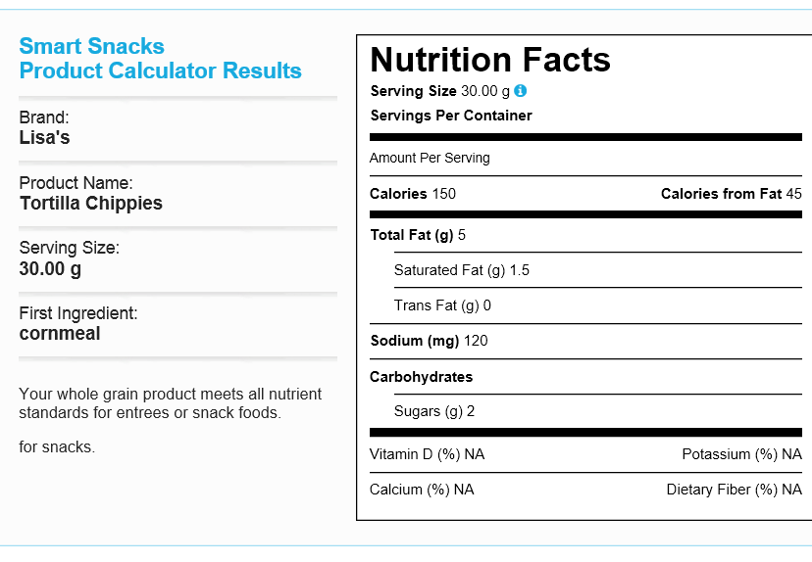
Step 5. On-Site Review
General Areas
Smart Snacks
Smart Snacks Info: http://www.fns.usda.gov/healthierschoolday/tools-schools-focusing-smart-snacks
Notes:
The Smart Snacks Product Calculator is one of the resources available for you to use to determine if your food/beverages meet the Smart Snacks requirements. Please keep in mind that it is only as good as the information that is put into it.
In this example, the product is shown to meet the requirements, however, the first ingredient is cornmeal, which is not whole grain. So the product is not Smart Snack compliant.
We will be reviewing the product documentation not just from Food Services but other departments, including fundraisers. Be sure to communicate and work with other departments about the products they are selling during the school day. Remember, a school day is from midnight to 30 minutes after the end of the official school day.
For more information on the Smart Snacks requirements, visit the website listed on the slide.

Slide 51
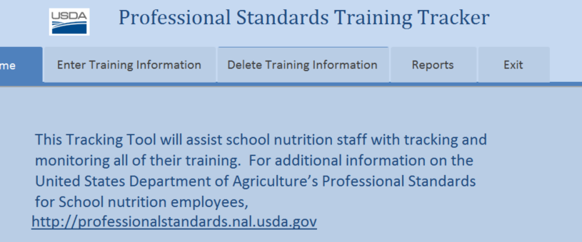
Step 5. On-Site Review
General Areas - Professional Standards
Common Findings:
No documentation of completed training hours
Staff not meeting the required training hours
Not meeting the hiring/training requirements for NEW School Nutrition Program Directors
Notes:
There are two parts to the Professional Standards requirements:
Annual Training Standards
Hiring Standards (for new School Nutrition Program Directors)
We will review your current training documentation to date, the plan to complete the required training hours, and documentation to support that the training occurred.
SFAs must have the following information available upon request:
List of current school nutrition staff personnel
Date hired
Title/Position
Brief list of core responsibilities/duties
Employment status (full time, part time, etc.)
Professional Standards Employee Category (Nutrition Program Director, Manager, Staff)
Documentation must be maintained to demonstrate that new Program Directors hired on or after July 1, 2015 met the hiring standards:
Highest level of education received
Years of school nutrition program experience
Prior food safety training (8 hrs completed not more than 5 years prior to their starting date or completed within 30 calendar days of their start date)
SA granted exceptions
Common findings include:
- Staff are not maintaining documentation of training hours. Remember to complete the training tracker tool.
Staff did not meet the required training hours. Remember, even staff who do meal counting need to meet the training hour requirement.
Hiring a new School Nutrition Program Director that did not meet the hiring or training requirements. Remember, when your SFA hires a new School Nutrition Program Director, the USDA hiring standards must met. If not, seek HCNP’s approval prior to hiring.

Slide 52
Step 5. On-Site Review
General Areas - Professional Standards
 | SY 16-17 & Beyond
Directors | 12 hours
Managers | 10 hours
All Other Staff | 6 hours
Part-Time Staff (<20 hrs/wk) | 4 hours
Professional Standards Info:
http://www.fns.usda.gov/school-meals/professional-standards
Notes:
For more information on the Professional Standards requirements, visit the website listed on the slide.
Develop a plan to meet the Professional Standards requirements.
Training should apply to an employee’s work duties. Consider these options for job-specific training:
State agency-sponsored training
Online courses
Structured, on-the-job training
In-service training
Training you conduct for staff

Slide 53
Step 5. On-Site Review
General Areas – Local Wellness Policy (LWP)
Update your LWP to meet the current requirements
Implement your LWP
Conduct an assessment
Notify the public annually of the LWP, including any updates and the assessment
Common Findings:
LWP was not updated, implemented, or assessed
Public was not notified of the LWP
LWP Info:
http://www.fns.usda.gov/tn/local-school-wellness-policy
https://healthymeals.nal.usda.gov/school-wellness-resources-2
Notes:
Reminder: All SFAs are required to have a LWP.
We mentioned earlier today what the new requirements are for the LWP.
If your SFA has not already done so, update your LWP to meet the current requirements.
The LWP must be implemented.
Remember to conduct an assessment of the LWP to determine compliance with the wellness policy, how your policy compares to model policies, and the progress made in attaining the goals in your policy.
Notify the public annually of the LWP along with any updates and your assessment.
Common findings include:
LWP was not updated, implemented, or assessed.
The public was not notified. Remember to post the LWP on your website.
For more information, visit the websites listed on this slide.

Slide 54
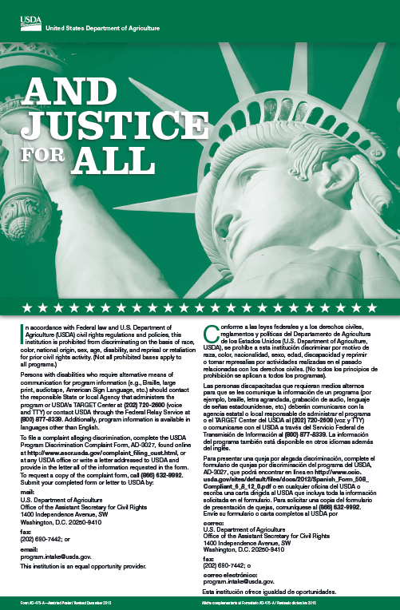
Step 5. On-Site Review
General Areas
Civil Rights
Display “anywhere program benefits are available”
New Poster!
Common Finding:
Poster is not prominently displayed at all appropriate locations
Notes:
There are new posters – they’re green! Make sure the new posters are prominently displayed. Remove all red, white, and blue posters.
Remember the posters must be displayed wherever program benefits are available:
Office where applications are distributed
Dining area
Don’t forget any other meal service location (breakfast, lunch, and afterschool snack) like classrooms, kiosks, etc.

Slide 55
Step 5. On-Site Review
General Areas - Civil Rights
Nondiscrimination Statement
Program materials must contain the current and correct nondiscrimination statement
Update your Civil Rights Binder, website, outreach materials, menus
Short statement: “This institution is an equal opportunity provider.”
Common Findings:
Nondiscrimination statement was missing or not updated on program materials (menu, press release, CEP letters to families, posters with meal prices, etc).
Notes:
Program materials must contain the current and correct nondiscrimination statement. You must use the statement we provided to you. Do not use any other statement. There are different versions of the statement but the one we provided is the one that the Child Nutrition Programs must use.
Make sure all of your program materials have the current nondiscrimination statement (CR Binder, website, outreach materials, menus).
- Remember to use the full version when there is adequate space. The full statement must be included on F/R application forms, notification of eligibility/denial, notice of adverse action, program webpage, public information (program literature).
- Short statement may be used when the document is small and cannot realistically include the full statement without changing the nature of the document. Remember the font size of the statement cannot be smaller than the smallest font on the document.

Slide 56
Step 5. On-Site Review
General Areas – Civil Rights
Train staff annually on Civil Rights
Maintain a Complaint Log each SY
Complete the Civil Rights Ethnic Data Report annually by October 31
Common Findings:
No documentation that staff was trained annually
Complaint Log was not maintained every SY
Notes:
All appropriate staff must be trained annually on Civil Rights.
A complaint log must be maintained every school year, even if your school did not receive any complaints.
Remember to complete the Civil Rights Ethnic Data Report annually by October 31. Answer all of the questions and complete the chart on the form.
Update your Civil Rights Binder:
- complaint form
complaint log
complaint procedures
Common findings include:
Staff training was not documented or not all appropriate staff were trained. Remember, anyone that touches the program must be trained – meal clerk, the office staff who distributes F/R applications, food service staff.
The complaint log was not maintained every school year. Label your logs by school year.

Slide 57
General Areas - Breakfast and Summer Outreach
Step 5. On-Site Review
BREAKFAST
Inform households of availability of breakfast at your school
At the beginning of the SY and multiple times throughout the SY
SUMMER
Advertise and inform families of availability and location of summer meals
Before the end of the SY
Common Findings:
Schools did not do outreach
No documentation that outreach was completed
Notes:
For those that participate in the School Breakfast Program, reviewers will review:
The notifications sent to households informing them of the availability of breakfast at your school.
This must be done at the beginning of the school year and multiple times throughout the school year.
For those that participate in the summer program, reviewers will review:
The advertisement and notifications informing families of the availability and location of summer meals.
This must be done before the end of the school year.
Common findings include:
Schools did not do any outreach
Outreach was only done once during the school year for breakfast
The SFA said they did outreach but there was no documentation to validate it was done

Slide 58
Step 5. On-Site Review
General Areas – Meal Charge Policy
Written and implemented Meal Charge Policy
Communicate policy in writing to all households
Provide the policy to all school/SFA-level staff responsible for policy enforcement
Meal Charge Policy Info:
https://www.fns.usda.gov/school-meals/unpaid-meal-charges
Notes:
Beginning July 1, 2017, all SFAs operating NSLP and/or SBP must have a written and clearly communicated meal charge policy.
At the beginning of each school year, the meal charge policy must be communicated in writing to all households and to households transferring to the school during the school year. Please note that only posting the policy online or sending by email does not meet this requirement. These methods are helpful, but USDA requires that the information be distributed in a way that is accessible by those who do not have a computer or internet access.
Provide the policy to all school/SFA-level staff responsible for the enforcement of the policy.

Slide 59
Step 5. On-Site Review
General Areas – Resource Management
Notes:
Now we are going to talk about the Resource Management part of the AR. Please take out the slide handouts on Resource Management.
Play Shaynee’s PowerPoint. Turn on volume.

Slide 60
Procurement
Procurement Review is part of the AR
Procurement Plan
Code of Conduct
Informal/Formal Procurement documentation
Keep all procurement documentation!
Notes:
Procurement will be reviewed during the Administrative Review.
Reminder: keep all of your procurement documentation for our review. We may look at documents such as:
- Procurement Plan, Code of Conduct, Procurement bid, advertisement, tally/scoring sheet, selection committee, any or all notes on the outcome of procurement
WA’s Notes on SP Memos:
SP01-2016 Procuring Local Meat, Poultry, Game and Eggs in Child Nutrition Programs
SP02-2016 Questions and Answers on the Transition to an implementation of 2 CFR Part 200
SP03-2016 Procurement Standards and Resource Management Requirements related to Franchise Agreements
SP12-2016 Guidance on Competitive Procurement Standards for Program Operators
SP45-2016 Draft Tool for Local Agency Procurement Reviews of SFAs

Slide 61
Step 5. On-Site Review
Afterschool Snack Program (ASP)
School eligibility
Meal counting and claiming
Snacks meet meal pattern requirements
SFA conducts ASP review twice per SY
Food safety and civil rights
Common Findings:
ASP review was not completed by the SFA twice each SY
Meal counting was not done at point of service
No production records/production records were not complete
Notes:
For those that participate in the Afterschool Snack Program, reviewers will review:
- School eligibility – area eligible/ not-area eligible
Meal counting and claiming are accurate
Snacks meet the ASP meal pattern
SFA conducts the ASP review twice per SY (the first review is done during the first 4 weeks of operation and then the second must be done before the end of the SY)
Food safety and civil rights – remember to post the Justice for All poster at all serving locations.
Common findings include:
ASP review was not completed by the SFA twice each SY
Meal counting was not done at the point of service
The SFA did not have any production records or the production records were not complete

Slide 62
Step 5. On-Site Review
Fresh Fruit and Vegetable Program (FFVP)
Claim validation
FFVP service observation
Common Findings:
Unallowable costs were claimed under FFVP
Fruit/vegetable was not served properly
Notes:
For those that participate in FFVP, the claim will be validated for the Review Period. Reviewers will review supporting documentation such as time sheets and invoices.
FFVP service will be observed during the on-site visit to determine if the school operates FFVP properly. Here are some of the things that will be checked:
Fresh fruits/vegetables are served
FFVP is free of charge
Offered during the school day, outside of meal service times
Dip is for use with vegetables only and is low-fat or fat-free and not more than 2 Tbsp per serving
Proper food handling and food safety practices are being followed
Cooked vegetables are offered no more than once per week and only when included as part of a nutrition education lesson
Common findings include:
Unallowable costs were claimed (dried fruit, food items that are not edible, items that are not fruits/vegetables – ex: ground beef). Double check your invoices!
Food safety violations – fruit/vegetables were not stored or served properly. Ex: Teachers did not use gloves when serving apple wedges to students.

Slide 63
Step 5. On-Site Review
Seamless Summer Option (SSO)
Compliance is determined similar to NSLP and SBP
Critical Areas and General Areas
Review occurs the summer after the SFA’s AR
Advertisement of free meals
SFA conducts SSO review at least once a year
Common Finding:
SSO review was not completed by the SFA
Notes:
For those that participate in SSO, compliance is determined in the same manner as NSLP and SBP. The same critical areas (meal counting and claiming, meal pattern, food safety, civil rights, etc.) will be reviewed.
The SSO review occurs the summer after the SFA’s Administrative Review.
Reviewers will also check that the SFA advertised the availability of free meals to and the location to children in the community. This must include the correct nondiscrimination statement.
Remember that the SFA needs to conduct a self-review of the SSO at least once a year.
A common finding is that the SSO review was not completed by the SFA.

Slide 64
Step 5. On-Site Review
Exit Conference
Conducted at the end of the on-site review
Meet with relevant staff (Administrator, NSLP Coordinator, Food Service Manager, Business Manager, etc.)
Outlines commendations, recommendations, technical assistance, review findings
Start corrective action immediately.
Common Issues:
Corrective action was not submitted by the due date.
Corrective action was submitted but was not satisfactory.
Notes:
During the review, the Program Specialist will schedule an exit conference to be held at the end of the on-site review (last day we are on-site).
Meet with relevant staff (Administrator, NSLP Coordinator, Food Service Manager, Business Manager, etc.)
During the exit conference, the following will be presented:
Commendations
Recommendations
Technical assistance that was provided
Review findings
Corrective action must be done immediately for all findings as discussed during the AR/exit conference. An Administrative Review report will be sent to the SFA with all corrective actions that need to be addressed by the specified due date. DO NOT wait until you receive the report to start making corrections. Start as soon as you can because corrective action can be time consuming depending on the findings.
Doing and implementing corrective action is very important. Completed and approved corrective action tells us that your program is in compliance and meals are eligible for reimbursement.
Common issues related to corrective action are:
- Corrective action was not submitted by the due date. A number of SFAs do not make corrections right after we leave.
- Corrective action was submitted by was not satisfactory. The corrective action document will specify what it to be submitted.
Not meeting the corrective action deadline and not submitting corrective action that is acceptable may result in the withholding of funds (we hold your reimbursement until the AR is closed).

Slide 65
Administrative Review - Steps
Off-Site Assessment Tool sent
2) Complete and submit Off-site Assessment Tool
3) Announcement letter
4) Specialist communicates details of visit
5) On- site Review
6) Complete and submit all Corrective Action
7) Review is closed (final letter)
Notes:
Let’s continue to talk about AR findings and corrective action.

Slide 66
Administrative Review
AR Findings may result in:
Technical Assistance
Corrective Action
Fiscal Action
Or a combination of the above
Notes:
Administrative Review findings may result in: • Technical Assistance • Corrective Action • Fiscal Action or • Combination of the above
Let’s begin with what “Technical Assistance” means (next slide)

Slide 67
Technical Assistance
Technical Assistance means help or advice provided to the SFA staff provided by the review team to help improve the school meal program operations.
Notes:
Technical assistance is basically individualized instruction provided by the review team during the Administrative Review to help correct or “fine-tune” the school food service systems in place.
Technical assistance may also be initiated prior to the onsite Administrative Review date. This is typically generated by the information submitted by the SFA on the Off-Site Assessment Tool.
For example, if the information submitted on the Off Site Assessment Tool identifies that the SFA is not using the current nondiscrimination statement on program materials, the Program Specialist could communicate with you by informing you of where you can find the current nondiscrimination statement so your materials can be corrected prior to the date of the onsite review.
In addition to Technical Assistance, the Administrative Review could result in Corrective Action. Let’s talk more about what this means (next slide)

Slide 68
Step 6. Corrective Action
Corrective Action means actions required to correct any violation, practices and training identified during the Administrative Review.
Goal: to ensure that previously deficient practices and procedures are corrected at all schools/sites.
Corrective Action Plan = “Homework”
Submit by the specified due date
Implemented throughout the SFA
Permanently corrected
Notes:
The goal of Corrective Action is to ensure that previously deficient practices and procedures are corrected system-wide at all schools/sites.
The Corrective Action Plan is like the “homework” the SFA is required to complete to document and demonstrate the specific steps taken to permanently correct the problem identified. For example, if the most current food safety inspection was not posted, corrective action would be to post the most recent inspection in a publicly visible location. In your response, you would say how you completed this by describing when and where it was posted.
The Program Specialist will specify the due date to submit your corrective action.
IMPORTANT: Submit corrective action by the specified due date. Failure to do so may result in claims being withheld. Last SY, 7 out of 15 SFAs were in withholding.
Once the SFA submits the corrective action plan, the Program Specialist will review it to ensure that it is complete and accurate. If necessary, the Program Specialist will request further detail or documentation prior to approval. Corrective action is not complete until the program specialist approves it.
The expectation is that Corrective Action be implemented not only at the school selected for review, but at all schools/sites serving program meals and becomes a permanent part of the school meals operations throughout the SFA.

Slide 69
Step 6. Corrective Action
View
Edit
Notes:
This slide shows an example of the corrective action summary in HCNP Systems.
For each corrective action item listed, it is important to point out:
The status (open or complete)
The finding
The corrective action due date which will be specified
If the response was submitted
If the corrective action was approved and the approved date
Under “Action” the icon of the eye is to view whereas the icon of the pencil is to edit.
Let’s look at one of the corrective actions by clicking on the pencil.
Response/Plan/Action: this is where the SFA describes how the issue listed was corrected.
Responses must be complete and fully describe how the corrective action was completed and implemented.
Then in the “Completion Date” section, enter the date the corrective action was completed.
(next slide)

Slide 70
Step 6. Corrective Action
Notes:
This slide shows the finding for Professional Standards.
The finding description is listed – The SFA is not maintaining documentation of training hours completed for each employee.
Notice the blue folder icon is on the right for the SFA to upload supporting documentation for their corrective action response.
The next slide will show the corrective action that is needed.

Slide 71
Step 6. Corrective Action
Notes:
This slide shows what would be listed under the finding that was shown on the previous slide.
The due date of the corrective action would be specified by HCNP.
In red, you can see the corrective action is specified for the SFA. Complete the tracking log to keep track of employees’ training hours. Submit a plan on how each employee will meet the required training hours by the end of SY 16-17.
In blue, you can see the SFA’s response. When the SFA’s response is not satisfactory, the SA will specify what information is still needed. This will be shown on the next slide.

Slide 72
Step 6. Corrective Action
Notes:
This slide shows the further corrective action needed.
The due date of the corrective action would be specified by HCNP.
In red, you can see HCNP’s response on what is still needed for corrective action. In this example, the SFA still needs to submit a plan on how each employee will meet the required training hours.
In blue is where the SFA would submit their response.

Slide 73
Step 6. Corrective Action
Corrective Action responses must:
Be complete
Demonstrate the findings/issues were corrected
Start correcting all findings immediately!
(during the AR and immediately after the exit conference)
Notes:
It is important to remember that corrective action responses must:
Be complete AND
Demonstrate the findings/issues were corrected.
Responses will not be accepted if the SFA does not submit sufficient explanation and/or documentation.
Make corrections to all findings immediately! This means during the AR and immediately after the exit conference.
If we inform you that the Justice for All poster is not posted – post it during the review so we can say it was corrected.
If we find that civil rights training was not completed for all applicable staff, do training with your staff within a day or two of us leaving. Do not wait until you receive the corrective action to make the corrections. The goal is to have all/most of the corrections completed and implemented by the time you receive the corrective action.

Slide 74
Fiscal Action
Critical Areas
Performance Standard 1: Meal Eligibility; Meal Counting and Claiming; Claim Consolidation
Certification and Benefit Issuance Errors
Meal Counting and Claiming Errors
Claim Consolidation Errors
Performance Standard 2: Reimbursable meals must comply with meal pattern requirements
Missing Meal Components
Non-reimbursable meals (during observation)
Repeat finding of meal pattern violations
Notes:
Fiscal action is a term used to describe the recovery of meal reimbursement dollars due to overpayment as a result of school meal program violations. This means that the SFA is required to pay school meal program dollars back to USDA.
The areas that can result in fiscal action are called “critical areas” which consist of Performance Standard 1 and Performance Standard 2:
Performance Standard 1 is the standard requiring that all free, reduced and paid meals claimed for reimbursement are served to eligible children respectively, and are counted, recorded, consolidated and reported through a system that yields correct claims.
Findings that may result in fiscal action:
Certification and Benefit Issuance Errors (meal eligibility errors)
Meal Counting and Claiming Errors
Claim Consolidation Errors
Performance Standard 2 is the standard requiring that reimbursable meals must meet the meal pattern requirements as stated in the Code of Federal Regulations (7 CFR 210.10, 220.8).
Findings that may result in fiscal action:
Missing Meal Components
Non-reimbursable meals (during observation)
Repeat finding of meal pattern violations

Slide 75
Fiscal Action
Program Specific:
NSLP (including ASP, FFVP, SSO)
SBP (SSO)
$600 disregard
Notes:
Fiscal action is “Program Specific”, which means that fiscal action is calculated for each school meal program itself such as the School Breakfast Program (includes SSO Breakfast); National School Lunch (inc. After School Snack Program, Fresh Fruit and Vegetable Program, SSO Lunch). In other words, if the SFA participates in breakfast, lunch, and snack, any fiscal action for lunch and snack are added together for a total. Fiscal action for breakfast is separate.
USDA has a $600 disregard. HCNP may disregard an overclaim if the overclaim does not exceed $600 per program.
Fiscal action is calculated once corrective action has been completed and approved. The closure letter will state the fiscal action amount.

Slide 76
Administrative Review - Steps
Off-Site Assessment Tool sent
2) Complete and submit Off-site Assessment Tool
3) Announcement letter
4) Specialist communicates details of visit
5) On- site Review
6) Complete and submit all Corrective Action
7) Review is closed (final letter)
Notes:
And finally the last step – the review is closed.

Slide 77
Step 7. Review Closed / Final Letter
All corrective action is completed and approved.
Fiscal action is resolved.
Notes:
Generally, once all corrective action has been completed and accepted the review is ready to be closed. If there is fiscal action that can be disregarded, the review is closed. However, if the fiscal action exceeds the disregard, the review is closed once fiscal action is resolved.
Fiscal action is taken from claims that have been submitted but have not been paid. However, if all claims have been paid, the SFA will need to inform HCNP on the method of payment: check, money order, or downward revision of claims for reimbursement.
Review findings may be appealed. When fiscal action exceeds the disregard, the final letter will include appeal procedures.

Slide 78
Administrative Review
Results of Administrative Reviews are now required to be posted on the HCNP website.
Notes:
The USDA now requires State Agencies to post Administrative Review results on our website. This requirement began last school year. This means that the results from the Administrative Reviews are posted on our public website within 30 days. Names of staff and students are removed prior to posting.

Slide 79
Questions
Track your training:
Key Area: Administration (3000)
Key Topic: Program Management (3200)
Notes:
Remember to track your training hours. Record the time we spent on this area/topic in your training tracker tool.
Any questions?

Slide 80
In accordance with Federal civil rights law and U.S. Department of Agriculture (USDA) civil rights regulations and policies, the USDA, its Agencies, offices, and employees, and institutions participating in or administering USDA programs are prohibited from discriminating based on race, color, national origin, sex, disability, age, or reprisal or retaliation for prior civil rights activity in any program or activity conducted or funded by USDA.
Persons with disabilities who require alternative means of communication for program information (e.g. Braille, large print, audiotape, American Sign Language, etc.), should contact the Agency (State or local) where they applied for benefits. Individuals who are deaf, hard of hearing or have speech disabilities may contact USDA through the Federal Relay Service at (800) 877-8339. Additionally, program information may be made available in languages other than English.
To file a program complaint of discrimination, complete the USDA Program Discrimination Complaint Form, (AD-3027) found online at: http://www.ascr.usda.gov/complaint_filing_cust.html, and at any USDA office, or write a letter addressed to USDA and provide in the letter all of the information requested in the form. To request a copy of the complaint form, call (866) 632-9992. Submit your completed form or letter to USDA by:
(1) mail: U.S. Department of Agriculture
Office of the Assistant Secretary for Civil Rights
1400 Independence Avenue, SW
Washington, D.C. 20250-9410;
(2) fax: (202) 690-7442; or
(3) email: program.intake@usda.gov.
This institution is an equal opportunity provider.

