Slide 1
Civil Rights Training
September 2017
This institution is an equal opportunity provider.
Notes:
Thank you for participating in the Hawaii State Department of Education Child Nutrition Programs Civil Rights Training. Documenting your participation provides compliance with training regulations required by United States Department of Agriculture (USDA) funded Food and Nutrition Service agencies, sponsors, and volunteers.

Slide 2
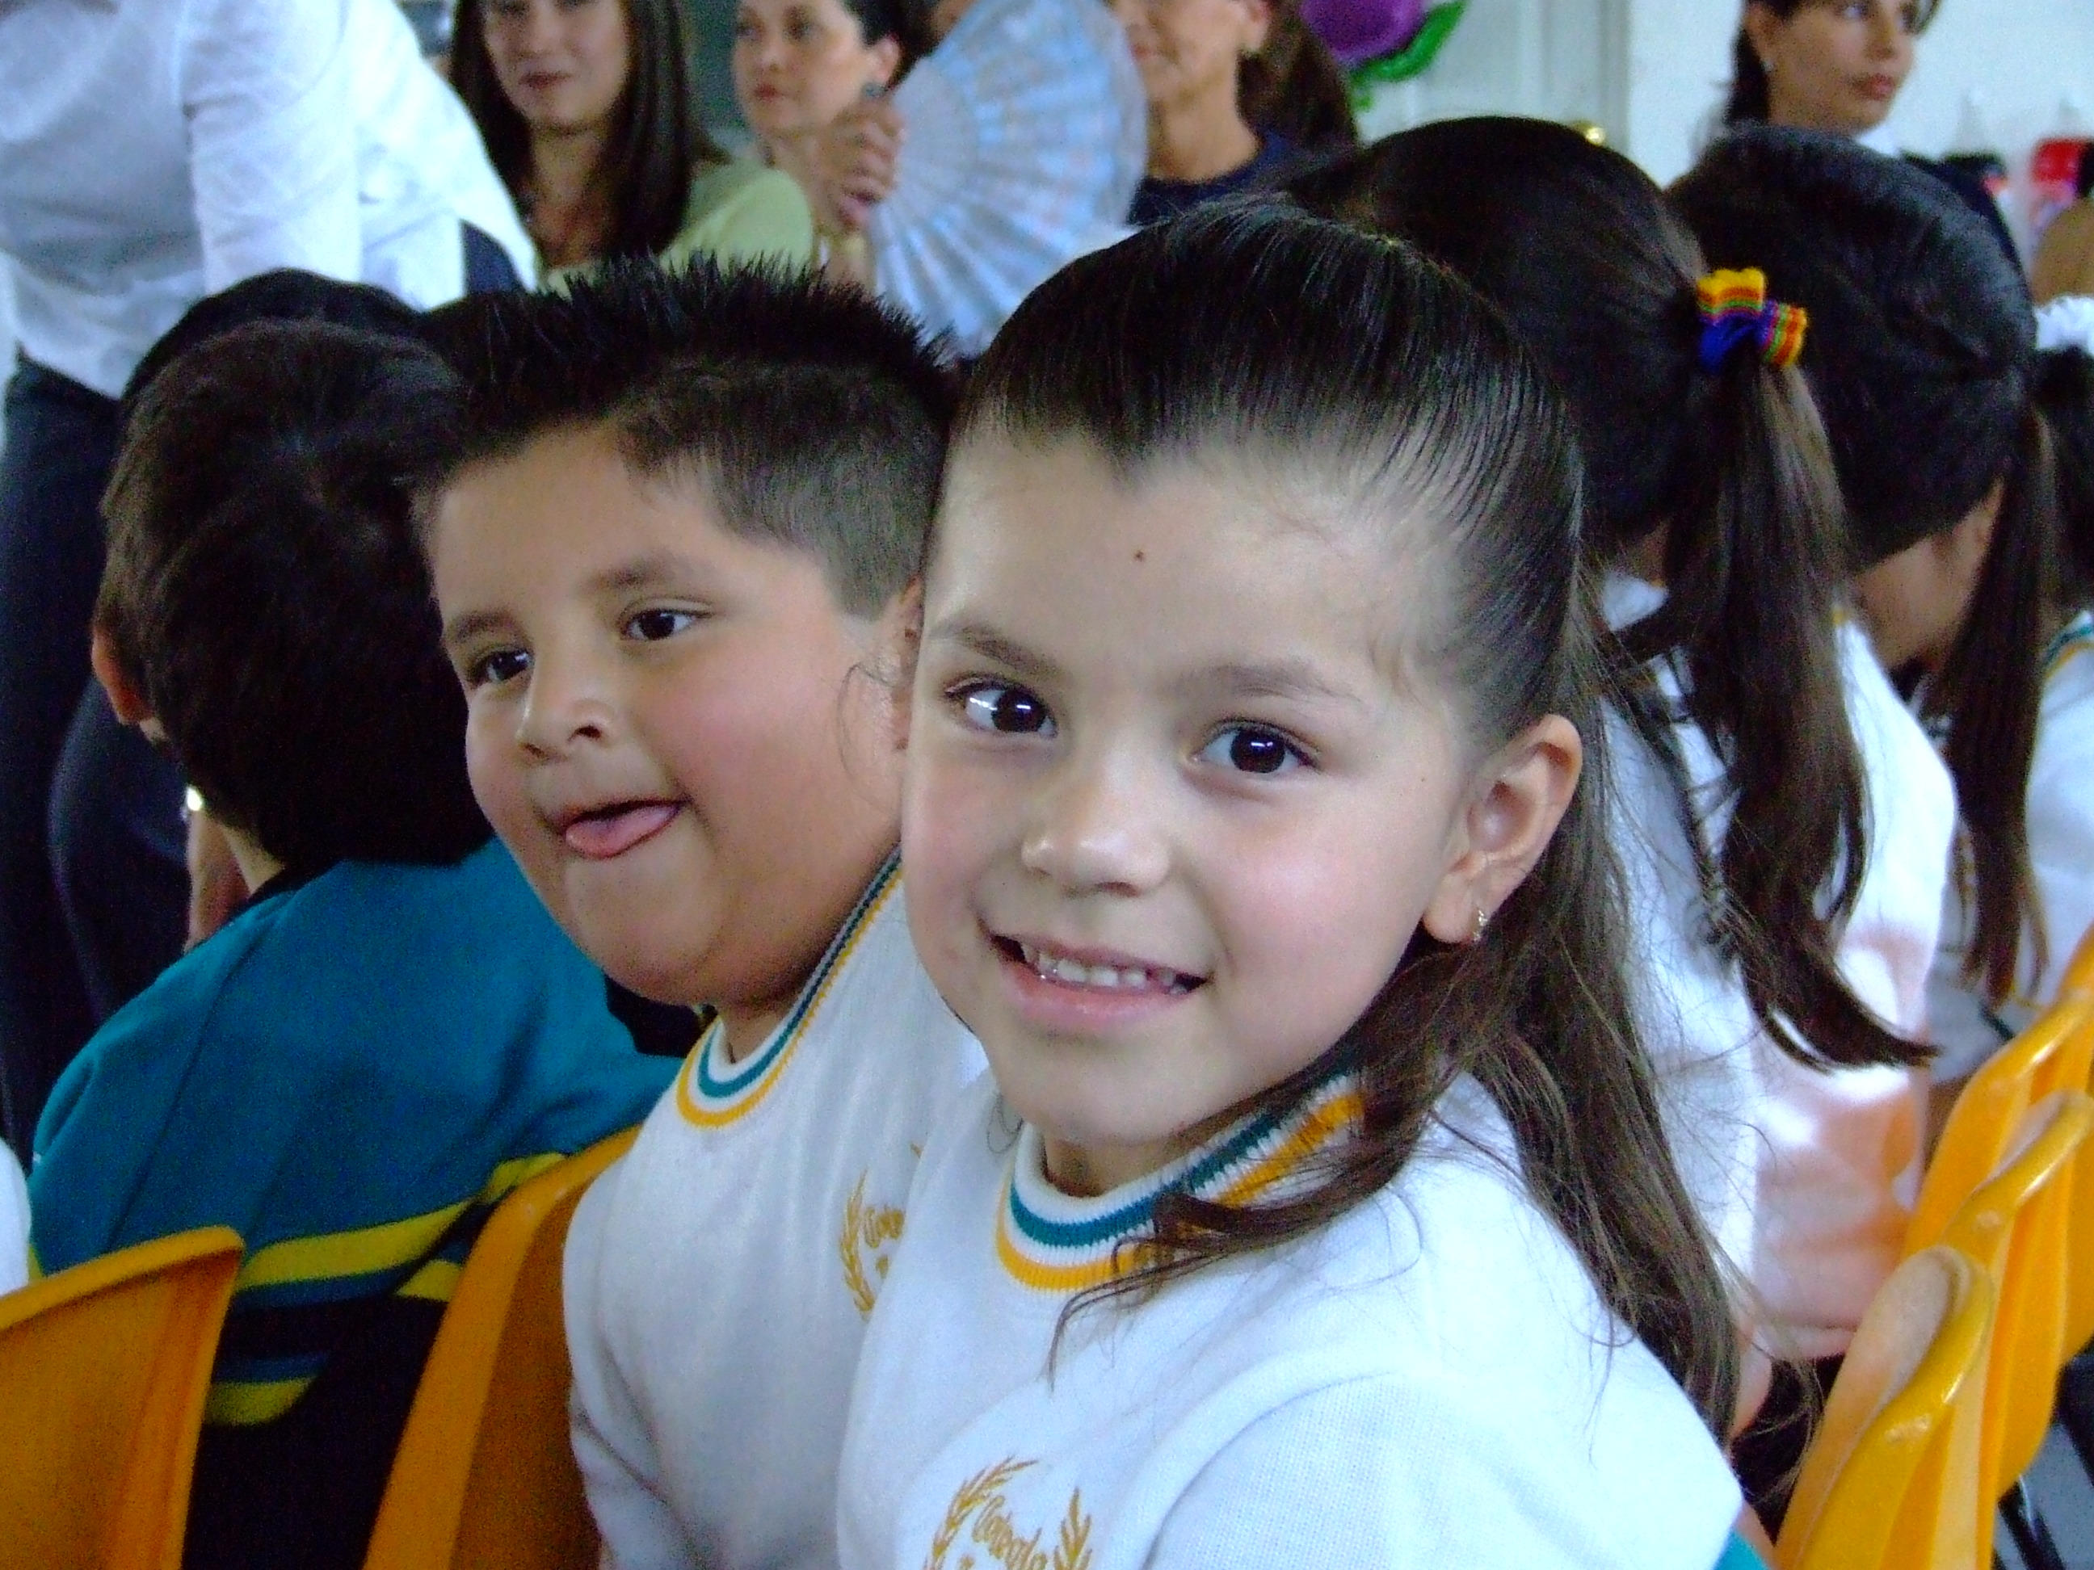
Reason For Training: Ensures Civil Rights Are Protected
Ensures that program recipients are being treated without discrimination while participating in Child Nutrition Programs
Notes:
Training is required so that all people involved in the administration of programs receiving Federal financial assistance will understand civil rights related laws, regulations, procedures, and directives. It also ensure that equal access is being provided. Following the guidelines that we will be discussing today will also help prevent civil rights complaints against your SFA.

Slide 3
Annual Training Requirements
Collection and use of data
Effective public notification systems
Complaint log and procedures
Compliance review techniques
Resolution of noncompliance
Requirements for accommodation of persons with disabilities
Requirements for language assistance
Conflict resolution
Customer service
Notes:
State agencies are responsible for training Child Nutrition Program sponsors. Sponsors are then responsible for training all nutrition program staff at their school. These are all the area in which we will be covering today as well as all of the areas you should be training your staff on.
Civil rights training must occur before new staff members assume their duties in Child Nutrition Programs and then annually thereafter. Civil rights documentation must be kept for three years plus the current year per USDA or longer (6 years plus the current school year) for DOE schools. You must document the training with an agenda containing the date(s) training occurred and a sign in sheet for all participants. Your training agenda must follow the training requirements listed here at a minimum:
Collection and use of data
Effective public notification systems
Complaint log and procedures
Compliance review techniques
Resolution of noncompliance
Requirements for reasonable accommodation of persons with disabilities
Requirements for language assistance
Conflict resolution
Customer service
This year the USDA has vastly expanded its interpretation of civil rights in meal modifications as we will discuss in just a moment.

Slide 4
WHO IS REQUIRED TO FOLLOW CIVIL RIGHTS?
Even one dollar of Federal money brings the entire scope of the operations within the jurisdiction of Section 504, even where the requested modification is not related to the part of the operations that receives Federal money.
Notes:
It is important to understand that all SFA’s must follow the Civil Right Guidelines, including charter schools. No one is exempt from them and there will be liabilities against any SFA if the guidelines are not met or at least a reasonable attempt has been made to meet these mandates.
So even if you school only received one dollar of federal money, you are to comply with the civil rights requirements.

Slide 5
Civil Rights Program Authorities
Title VI of the Civil Rights Acts of 1964
Civil Rights Restoration Acts of 1987
Section 504 of the Rehabilitation Act of 1973
Americans with Disabilities Act (ADA) of 1990
ADA Amendments Act of 2008
Title IX of the Education Amendments of 1972
Age Discrimination Act of 1975
And many more…
Notes:
Listed here are some of the main players when it comes to Civil Rights. Together, these are the acts that established the six protected classes.

Slide 6
Protected Classes
Race
Color
National Origin
Age
Sex
Disability
Notes:
The six protected classes recognized in USDA funded Child Nutrition Programs are still:
Race
Color
National Origin
Age
Sex (Gender)
Disability
Note religion is not a discrimination under NSLP however, future guidelines are being developed by the USDA. This is why the USDA does not require SFAs to accommodate religious food preferences.
Also, the civil rights data that you collect annually ensures that all program participants are treated equally based on the six protected classes, which I will cover later in this presentation.

Slide 7
Disability –
Under Section 504 of the Rehabilitation Act of 1973, and the Americans with Disabilities Act (ADA) of 1990, a "person with a disability" means any person who:
has a physical or mental impairment which substantially limits one or more major life activities
has a record of such an impairment, or
is regarded as having such an impairment
Notes:
Let’s take a closer at the term disability as it relates to civil rights in Child Nutrition Programs. A person with a disability, as defined in the Americans with Disabilities Act of 1990, refers to any person who has a physical or mental impairment which substantially limits one or more major life activities, has a record of such an impairment, or is regarded as having such an impairment. The term "physical or mental impairment" includes many diseases and conditions.
New Disability Laws now say SFA’s have a duty to provide accommodations if a person has an physical or mental impairment that limits their life activities. And/or a person who has a record of such an impairment (such as if a person had cancer and was successfully treated for it, they are considered to have a record of an impairment) and the third one is not as prevalent in the NSLP but still applies- is a person who is regarded as having an impairment. This might be an example of a person who is thought to have HIV but does not have it.

Slide 8
ADA Amendments Act of 2008
Expanded and clarified the definition of Disability
Did NOT change the expectation to provide a reasonable modification
DID make very clear that the emphasis must be on providing the reasonable modification and not burdening the disabled person with ‘proving’ he or she has a disability.
Notes:
The definition of disability was just expanded and clarified, it did not change the expectation of providing reasonable modifications.
It did make it clear that the emphasis must be on providing the reasonable modification and not placing a high burden on the disabled person to prove he or she has a disability or to delay the modification with requiring the participant to jump through hoops (literally and figuratively) in order for you to accommodate the request.

Slide 9
Expanded Definition of Disability for CNPs
Revises “Substantially Limits”
Need not prevent or severely prevent a major life activity
Individualized Assessment
Without regard to alleviated symptoms by medications.
May include an impairment that is episodic or in remission if it would substantially limit a major life activity when active.
Notes:
With the expansion of the definition, again, the emphasis must be on providing a reasonable modification and not trying to determine if the disability severely/significantly restricts a major life activity. It’s is important to remember that every request is unique and that all requests should be individualized in its assessment and its outcomes. No more one size fits all.
You also do not want to deny a modification to a student who has medication to alleviate the symptoms of their disability. For example, you cannot serve strawberries to a child that is allergic to strawberries because they have medication that prevents them from having a reaction. You have to serve them a different fruit.
Even those who request a modification based on a history of an impairment (such as MS that is in remission) is considered an impairment.
MS - Multiple Sclerosis – a chronic degenerative disease of the central nervous system. Symptoms of the disease tend to occur occasionally and at irregular intervals.

Slide 10
USDA has Expanded Definition of Disability for CNP’s
In addition to Major Life Activities: Seeing, hearing, walking, speaking, learning, reading, eating, breathing
Major Bodily Activities: Digestive*, Immune System, Respiratory, Circulatory, Neurological/Brain
Notes:
Added to the Disability list is a new category called MAJOR BODILY ACTIVITIES.
These are major bodily functions with Digestive being a big one. Now, lactose intolerance, since it has a major impact on Digestive, is considered a Disability under civil rights regulations.

Slide 11
Types of Disability Discrimination
Denial of benefits or services that others receive
Delay in receiving benefits or services that others receive
Different treatment than others, leading to disadvantage
Ineffective communication
Failure to provide reasonable accommodation
Inaccessible Facilities
Failing to provide non-English materials
*SFAs must understand & accept that
providing modifications is the new normal*
Notes:
Preventing discrimination is a key component of civil rights training. Discrimination complaints are defined as, “Any complaint filed by persons (non-employee), organizations or companies who, based on being a member of a protected class, allege discrimination in a program or activity conducted or assisted.”
Discrimination occurs when participants are Denied benefits or services that others receive, when participants are Delayed in receiving benefits or services that others receive, or when participants are treated Differently than others, resulting in a disadvantage. It’s important to note that discrimination may be either intentional or by neglect.
For those with disabilities discrimination may also be: if the team of staff do not effectively communicate and provide the accommodation agreed upon, failure to provide an accommodation that suits the child’s needs, serving meals at a time, place, or in a manner that is inaccessible by the individual, or failing to provide materials that give non-English speaking persons full and equal opportunity to receive benefits.
Child Nutrition Programs often take place in low income neighborhoods, where, due to economic disadvantage, children and parents have extraneous circumstances to overcome in regard to their food security. Civil rights are in place to protect children and families from being discriminated against while participating in USDA funded food programs.
This is new - SFA’s must now accept the fact that providing modifications is the new standard.

Slide 12
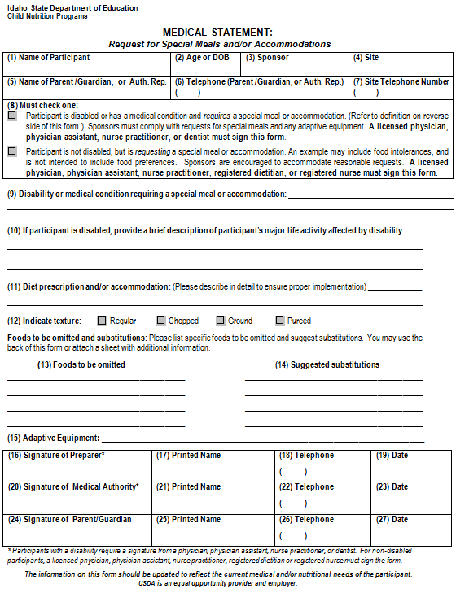
Medical Statement Form
Awaiting USDA Updating
What food to be avoided?
Brief explanation of how exposure to food affects the participant
Recommended substitute(s)
Medical authority signature
Notes:
The USDA is in the process of updating forms and guidance regarding special meals and/or accommodations, so the CNP standard medical statement form shown here will be updated as guidance becomes available. One example of the way it is changing is that the diagnosis can no longer be required. The medical authority needs only to put a brief explanation of how the disability effects the child.
The medical authority should also include which foods to avoid and which substitutions need to be made if the disability warrants it.
Also note the circled areas highlighting the place for the medical authority to list the foods to be omitted (red circle) and suggested substitutions (green circle). Brand names are not required unless there is a specific reason for having that particular brand. For example, an autistic child who is failing to thrive will only eat one brand of crackers, then those crackers must be provided as possible.
The medical statement is not considered complete until the medical authority signs it.

Slide 13
Medical Statement Requirements
Statement provides sufficient information about impairment (diagnosis not required and should not be requested), how it restricts diet, and how to accommodate condition
Seek clarification if inadequate or unclear
Clarification should not unnecessarily delay modification – it could be characterized as harassment/denial
Notes:
May NOT request the child’s diagnosis or medical chart. Medical authorities may put it, they may not. Either way, the information received should be kept private
If the statement is unclear, you need to seek clarification and follow the portion of the statement that is clear to the greatest extent possible. Remember, the new policy is to start a diet request ASAP.

Slide 14
Medical Statement Requirements
May accept statements signed by:
Physician (MD)
Physician Assistant (PA)
Nurse Practitioner (APRN/RPN)
Osteopathic Physician (DO)
Naturopathic Physician (ND)
Medical Statement may be requested, but it is NOT required for substitutions within meal pattern requirements.
Notes:
Listed here are the recognized medical authorities that are allowed to write medical prescriptions under Hawaii Statutory Law.
Registered Dietitians and Registered Nurses are not authorized to write prescriptions.
Osteopathic medicine provides all of the benefits of modern medicine including prescription drugs, surgery, and the use of technology to diagnose disease and evaluate injury. It also offers the added benefit of hands-on diagnosis and treatment through a system of treatment known as osteopathic manipulative medicine. Osteopathic medicine emphasizes helping each person achieve a high level of wellness by focusing on health promotion and disease prevention.
Naturopathic medicine is a distinct primary health care profession, emphasizing prevention, treatment, and optimal health through the use of therapeutic methods and substances that encourage individuals’ inherent self-healing process. The practice of naturopathic medicine includes modern and traditional, scientific, and empirical methods.

Slide 15
To verify if a person is licensed by the State of Hawaii to write prescriptions, verification can be determined on the DCCA website:
http://pvl.ehawaii.gov/pvlsearch/app

Slide 16
Requirements for Reasonable Accommodation for Persons with Disabilities
A change or alteration in policies, practices, and/or procedures to accommodate a disability
Duty to negotiate over modification. This means simply saying “no” is almost never appropriate.
On a case-by-case basis
Providing appropriate modifications is the primary objective, not ferreting out whether the participant has a disability or abusing the process
Notes:
Reasonable modification can be defined as a change or alteration in policies, practices, and/or procedures to accommodate a disability
Throughout this training, I’ve stated the emphasis is on making a modification. This mean that rather than saying no to a request, you must negotiate and come to an agreement with the parent or guardian on what the appropriate modification should be. If a medical statement is required, the modification should be based off the information provided in the statement.
Decisions for a reasonable modification must be based on facts. And not on stereotypes that follow certain conditions or individuals

Slide 17
Requirements for Reasonable Accommodation for Persons with Disabilities
Handicap accessibility
Food allergies
Accommodations/Modifications addressed in 504, Individual Education Plan (IEP),
Call State agency at 808-587-3600 for further guidance
Notes:
Examples of a reasonable modification may be:
Braille menus for blind students, ramps to provide program access to those in wheel chairs, and making food component substitutions for those with food allergies.
If a student has a 504 plan or and IEP, accommodations listed in the plan must be made.
And if you are unsure on how to reasonably accommodate a request made, give us a call, and we can help you work through it.

Slide 18
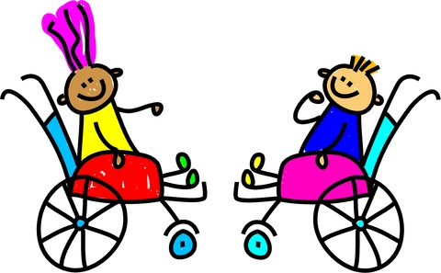
Requirements for Reasonable Accommodation for Persons with Disabilities
Should be related to the disability or limitations caused by the disability
Does not have to be the modification requested
Meal accommodations do not need to mirror the meal or meal item substituted.
Should be implemented even where the person requesting modification believes more should be done
Must be free of charge
Notes:
Accommodations should be related to the disability. However, it does not have to be the exact modification requested.
If the request is for a brand name item, unless medically necessary, you can serve a generic brand.
If a parent request that their child have blueberries instead of strawberries because they’re allergic, you do not have to serve blueberries. You just have to serve a fruit item the student is not allergic to.
Or, if a student cannot eat cheese pizza because they are lactose intolerant, he or she does not have to be given a modified pizza (a sandwich or salad is ok). A student does not necessarily get the food preference they want but rather what you can reasonably provide.
Accommodations must be free to the participant. You may use your nonprofit food service account to cover these costs. There are rare exceptions to this in which require prior State Agency approval.

Slide 19
Requirements for Reasonable Accommodation for Persons with Disabilities
Consider costs/resources, and the participant’s age and ability
“Lifestyle” choices (e.g. vegetarian) and religion are not considered disabilities and need not be accommodated.
Notes:
Reasonable accommodations should be age appropriate. For example, a pre-K student with tree nut allergies can not be expected to avoid foods that might have nuts in them where as a High Schooler should have a better understanding of which foods might have nuts in them.
You are not required to accommodate religious or lifestyle diet preferences. You, however, can absolutely accommodate them if you are able. Keep in mind though, what you do for one child, you’ll need to do for others.

Slide 20
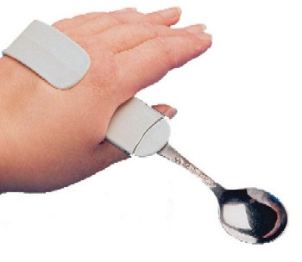
Requirements for Reasonable Accommodation for Persons with Disabilities
Ensure food service areas are accessible
Provide auxiliary aides and services, if needed.
Adaptive feeding equipment
Meal tracking assistance
Other effective methods
Notes:
Accommodations may go beyond food modifications. It could include facility accessibility and adaptive feeding equipment. Again, within reason you may use your nonprofit food service account to fund this type of accommodation.

Slide 21
Food Allergies
Many food allergies fall under the definition of disability expanded by the ADA Amendments Act (ADAAA).
According to the CDC: “In the United States, the following eight foods or food groups account for 90% of serious allergic reactions: milk, eggs, fish, crustacean shellfish, wheat, soy, peanuts, and tree nuts.”
Applies to much more than just “life threatening” allergic reactions.
“Digestive” and “Respiratory” functions are specifically listed in the ADAAA.
Notes:
Food allergies may be your most common nutrition program related disability you encounter. It’s important to know that all food allergies qualify as a disability and not just the life threatening ones.
According to The Centers of Disease Control and Prevention, these 8 foods or food groups account for 90% of serious allergic reactions in the U.S. Many of these foods are ingredients in items you wouldn’t think they’re in, so it’s important that the medical authority include on the medical statement which foods and/or food products to eliminate. And it’s the responsibility of whomever orders your food to check the ingredients list for all menu items you serve including new products you bring in.

Slide 22
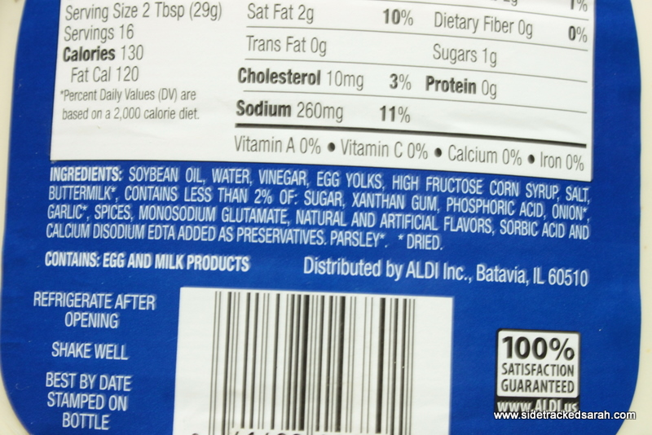
Ranch Dressing
Notes:
Which of the eight allergens can you find in this ingredient list for Ranch Dressing? – egg, milk
So a student who is allergic to eggs and/or milk may not be able to have ranch dressing. I say may because in some instances products that contain an allergen may not bother some individual as much as the actual allergen. A classic example is someone who is lactose intolerant. They may have a reaction to drinking a glass a milk but be fine to eat cheese and yogurt. Again, this is why it’s important for the medical authority to include what the child can and cannot have.
Soybean oil will not be labeled as a major allergen on an ingredient statement. There are clinical studies showing that highly refined oils can be safely eaten by allergic individuals. This is because highly refined oils contain extremely small levels of allergenic protein.

Slide 23
USDA POLICY
Universal exclusions of specific foods or food groups is not an FNS policy, but could be appropriate depending on the circumstances, and is within the discretion of recipients
Notes:
Read slide. This is basically saying that the USDA does not encourage school wide bans on peanuts, but that it may be necessary given the severity of the allergy.
Since it is difficult to guarantee to parents that your school is 100% peanut free, many schools are now using the term “Allergy Aware”. Allergy aware schools are putting more emphasis on education rather than the total elimination of a food allergen.

Slide 24
Integrated Environment
Integration Clause: disabled individuals should be accommodated in the least restrictive and most integrated setting possible.
Balance safety vs. stigma. Age and severity are the primary considerations.
Notes:
Integration Clause in Section 504 of the Rehabilitation Act of 1973 states that disabled individuals should be accommodated in the least restrictive and most integrated setting possible
In a food allergy context, this most often comes into play where children with food allergies are ostracized in some way during meal time
SFAs must always balance safety vs. stigma. Age, maturity, and severity of the allergy are the primary considerations.

Slide 25
Implementation & Compliance
Develop procedures for parents/guardians to request reasonable modifications
Train staff on reasonable modification procedures and legal requirements
Appoint a 504 Coordinator to ensure compliance
Implement guidelines and render decisions on modification requests.
Notes:
SFAs must have procedures in place so that parents may request a modification. Your food service staff must be trained on the agreed upon modifications.
If you don’t have one already, someone at your school should be appointed as the 504 coordinator. The coordinator should assemble a team in order to implement guidelines and render decisions on modification requests.

Slide 26
Procedural Safeguards
The Procedural Safeguards process requires SFAs/LEAs to provide notice and information to parents and guardians regarding how to request a reasonable modification and their procedural rights, which include the right to:
File a grievance
Receive a prompt response
An impartial hearing
Be represented by counsel, if desired
Receive notice of the final decision
Notes:
which include the right to:
File a grievance if they believe a violation has occurred regarding the request for a reasonable modification,
Receive a prompt and equitable resolution of the grievance,
Request and participate in an impartial hearing to resolve their grievance,
Be represented by counsel at the hearing (if desired),
Examine the record, and
Receive notice of the final decision and a procedure for review, i.e., right to appeal the hearing’s decision.
The consequences of not following these safeguards include potential legal proceedings (i.e. the SFA may be held liable)

Slide 27
UPDATED GUIDANCE
USDA SP 40-2017: Accommodating Children with Disabilities in the School Meal Programs
SP 59-2016: Policy Memorandum on Modifications to Accommodate Disabilities in the School Meal Programs
https://www.fns.usda.gov/2017-edition-accommodating-children-disabilities-school-meal-programs
https://edu.wyoming.gov/downloads/nutrition/2016/sp59-2016.pdf

Slide 28
Collection and Use of Data
Required to obtain data by ethnic and racial category
Systems for collecting actual ethnic and racial data may be program specific
Annual reporting on the ethnic and racial data
Notes:
Sponsors are required to report ethnicity and race of all program participants annually. The preferred method of data collection, according to Food and Nutrition Service, is self identity. For example, a parent checks an ethnicity or race box on their enrollment form or meal benefit application.
In the case that no self identification is made, a visual identification should be documented.
Please remember you cannot ask a child his or her race or ethnicity.
State agencies require annual reporting on the ethnic and racial data of participants. Each Child Nutrition Program area has a data collection form specific to their program posted on the hcnp website, http://hcnp.hawaii.gov .

Slide 29
Collection and Use of Data Ethnic Categories
Not Hispanic or Latino
Hispanic or Latino
A person of Cuban, Mexican, Puerto Rican, South or Central American, or other Spanish culture or origin - regardless of race
Notes:
Data documentation must be kept for three years plus the current year per USDA or longer if required by your agency. When obtaining data, both ethnicity and race need to be recorded for each participant.
Ethnicity refers to the question: “Is a person Hispanic or Latino or Not Hispanic or Latino?” Participants can choose from either category.

Slide 30
Collection and Use of Data Racial Categories
Black or African American – A person having origins in any of the black racial groups of Africa
White - A person having origins in any of the original peoples of Europe, the Middle East, or North America
Asian - A person having origins in any of the peoples of the Far East, Southeast Asia, or the Indian subcontinent, including: Cambodia, China, India, Japan, Korea, Malaysia, Pakistan, the Philippine Islands, Thailand, and Vietnam
Notes:
Race refers to the specific country of origin of the program participant. Racial categories include:
Black or African American – A person having origins in any of the black racial groups of Africa.
White - A person having origins in any of the original peoples of Europe, the Middle East, or North America.
Asian - A person having origins in any of the peoples of the Far East, Southeast Asia, or the Indian subcontinent, including: Cambodia, China, India, Japan, Korea, Malaysia, Pakistan, the Philippine Islands, Thailand, and Vietnam.
(racial categories continue on next slide)

Slide 31
Collection and Use of Data Racial Categories
Native Hawaiian or Other Pacific Islander - A person having origins in any of the original peoples of Hawaii, Guam, Samoa, or other Pacific Islands
American Indian or Alaskan Native - A person having origins in any of the original peoples of North America (including Central America) who maintains tribal affiliation or community attachment
Notes:
Native Hawaiian or Other Pacific Islander - A person having origins in any of the original peoples of Hawaii, Guam, Samoa, or other Pacific Islands.
American Indian or Alaskan Native - A person having origins in any of the original peoples of North America (including Central America) who maintains tribal affiliation or community attachment.
Please make sure that all program participants are documented by both Ethnicity and Race. Data is used to help determine areas of potential need and help prevent any discrimination of the participant or a group of participants.

Slide 32
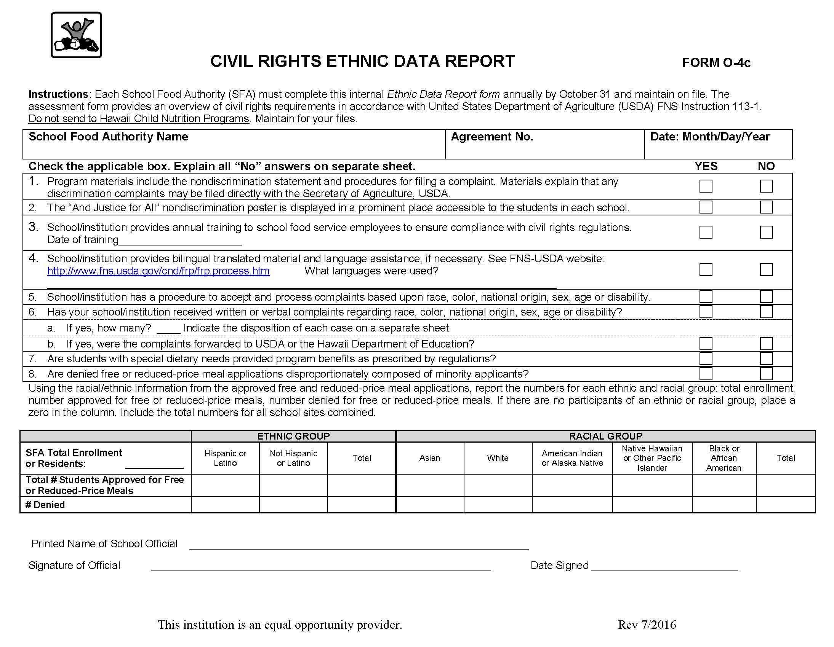
Form O-4c
Notes:
Form O-4c should be filled out annually and kept on file by each SFA. Although the form will not be turned in to HCNP, it will be requested for review during the Administrative Review. There is also a tool on HCNP website to assist in tallying data to fill out this form.
Remember, it is not okay to ask a child what racial group he/she belongs to. If racial group is not voluntarily provided, SFA is required to inform applicant that a visual identification will be recorded. (FNS 113 Part XII)
Due October 31st.

Slide 33
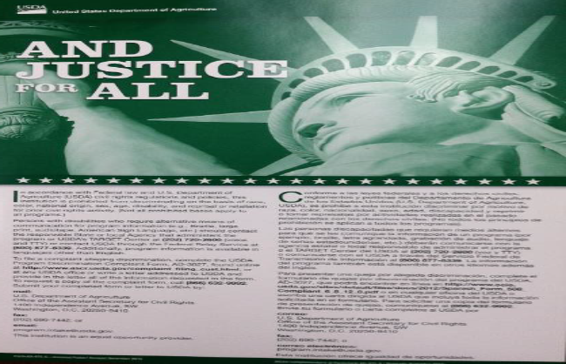
Public Notification Systems Basic Elements
Program availability
Inform potentially eligible persons of their program rights
Complaint information
Applicants and participants must be advised of their right to file a complaint
Non-discrimination poster statement
Prominently display current “And Justice For All” poster
Notes:
Sponsors are required to make public, via public announcement, their program availability to ensure that qualified participants are aware of the program and their rights.
Applicants and participants must be advised of their right to file a complaint as well as the details of the complaint process
Non-discrimination posters must be displayed in a prominent public place such as a school office where meals are paid, the cafeteria, the class room for special needs where the point of service may occur or all if applicable. For the National School Lunch Program, posters must be displayed where free and reduced applications are determined and where money is collected.
Please make sure you are displaying the correct non-discrimination poster. The USDA released a new edition dated December 2015 as shown here in the GREEN poster. Please discard all old blue and red posters.
You may request new posters from HI Child Nutrition Programs at 808-587-3600.

Slide 34
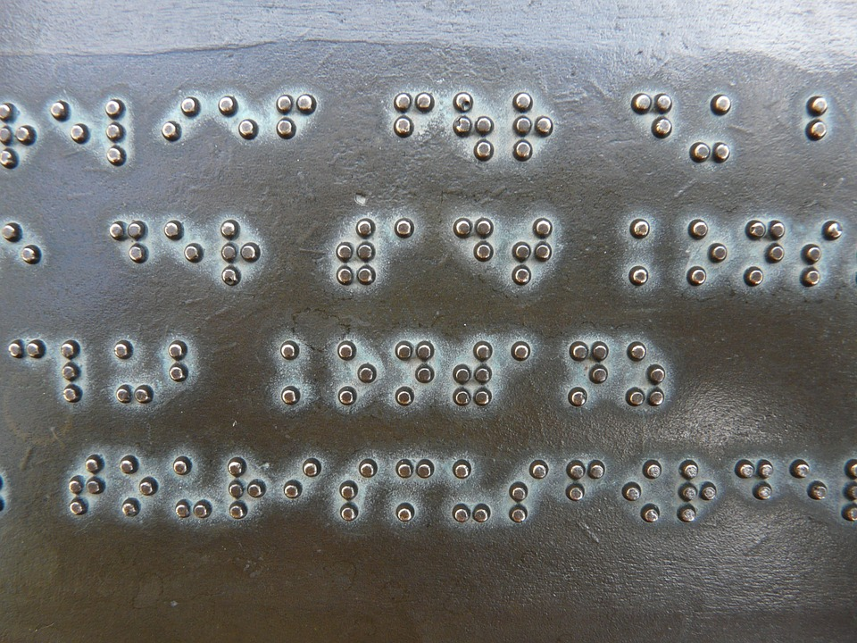
Public Notification Systems Methods
Inform potentially eligible applicants about the program
Provide information in alternative formats for those with disabilities
Include non-discrimination statement on all material provided to public
Convey an equal opportunity message in all pictures
Notes:
Compliance with public notification systems includes informing potentially eligible applicants about the program and providing information in other formats for those with disabilities. An example of this may be providing large print or braille menus for those who are visually impaired.
Non-discrimination statements must be included on all media mentioning USDA funded Child Nutrition Programs, including menus, flyers, internet pages, and other food related program announcements.
Equal opportunity must be conveyed when using photographs. Include a good representation of various ages, races, genders, etc.

Slide 35
Long Statement in English Use on all documents longer than one page or one sheet of paper
In accordance with Federal civil rights law and U.S. Department of Agriculture (USDA) civil rights regulations and policies, the USDA, its Agencies, offices, and employees, and institutions participating in or administering USDA programs are prohibited from discriminating based on race, color, national origin, sex, disability, age, or reprisal or retaliation for prior civil rights activity in any program or activity conducted or funded by USDA.
Persons with disabilities who require alternative means of communication for program information (e.g. Braille, large print, audiotape, American Sign Language, etc.), should contact the Agency (State or local) where they applied for benefits. Individuals who are deaf, hard of hearing or have speech disabilities may contact USDA through the Federal Relay Service at (800) 877-8339. Additionally, program information may be made available in languages other than English.
To file a program complaint of discrimination, complete the USDA Program Discrimination Complaint Form, (AD-3027) found online at: http://www.ascr.usda.gov/complaint_filing_cust.html, and at any USDA office, or write a letter addressed to USDA and provide in the letter all of the information requested in the form. To request a copy of the complaint form, call (866) 632-9992.
Submit your completed form or letter to USDA by:
(1) mail: U.S. Department of Agriculture
Office of the Assistant Secretary for Civil Rights
1400 Independence Avenue, SW
Washington, D.C. 20250-9410;
(2) fax: (202) 690-7442; or
(3) email: program.intake@usda.gov
USDA Child Nutrition Programs recognize the following protected classes: race, color, national origin, sex, age, and disability.
This institution is an equal opportunity provider.
Notes:
The non-discrimination statement is a USDA statement that must be present on all publications and media announcements mentioning USDA Child Nutrition Programs. The long non-discrimination statement must be listed on all printed material over one page in length. The short non-discrimination statement may be used on printed materials that are only one page or one sheet of paper (including front and back) in length.
This slide shows the long statement.
The Hawaii Child Nutrition Programs has translated this statement into 12 languages (Cantonese, Chuukese, Ilocano, Japanese, Korean, Mandarin, Marshallese, Samoan, Spanish, Tagalog, Tongan and Vietnamese).
These translations are posted at http://hcnp.hawaii.gov/civil-rights-2/ .
The first paragraph of the statement includes more protected classes than are recognized by Child Nutrition Programs. The Hawaii Department of Education, Child Nutrition Programs received approval from USDA to add the sentence near the bottom of the long statement that reads, “USDA Child Nutrition Programs recognize the following protected classes: race, color, national origin, sex, age, and disability.”
When you use the long statement, make sure that you get the entire statement on your document.

Slide 36
Short Statement Use on all documents that are only one page or one sheet of paper in length
This institution is an equal opportunity provider.
Use other languages as required.
Pens, buttons, etc. are exempted due to size.
When in doubt, always include the Statement.
Notes:
This slide is an example of the non-discrimination short statement in English for any document one page or one sheet of paper in length (including front and back).
Small items such as a pencil or pen, etc. does not have to have a statement due to lack of space.
When in doubt, be safe and add the Statement on your document.

Slide 37
Nondiscrimination Statement
Application Form (s)
Notification of Eligibility or Ineligibility
Notice of Adverse Action Form
Program (Home) Web Page
Public Information, including program literature
e.g. outreach
Notes:
At a minimum, the Nondiscrimination Statement should be on any Application Form(s), Notification of Eligibility or Ineligibility, Notice of Adverse Action Form, Program (Home) Web Page, Public Information, including program literature (e.g. outreach)

Slide 38
Complaint Procedure
Right to File
Any person alleging discrimination based on a protected class has the right to file a complaint within 180 days of the discriminatory action
Acceptance
All complaints must be forwarded to the State Agency within FIVE DAYS.
Verbal
If a person makes a verbal complaint , the person to whom the allegations are made must write up the complaint, making an attempt to collect specific information
Notes:
The USDA has set a procedure for discrimination complaints based on instructions in FNS113. The USDA complaint form is posted at HCNP’s website, http://hcnp.hawaii.gov, under Civil Rights on the home page, as it applies to all programs. You may also find it under the program that you participate in such as the National School Lunch Program (NSLP) or the Child and Adult Day Care Food Program (CACFP).
Any person alleging discrimination based on a protected class has the right to file a complaint within 180 days of the discriminatory action. All complaints must then be forwarded to the State Agency within 5 days.
Sponsors are also required to make civil rights complaint information available upon request. When documenting a civil rights complaint, the following information should be included:
Name, address, and telephone number of the complainant
Specific location delivering the service
Nature of the incident that led to the complainant to feel discrimination was a factor
The basis on which the complainant believes that discrimination exists
Names and titles, phone numbers, and business or personal addresses of persons who may have knowledge of the discriminatory action
Date(s) the action occurred

Slide 39
Sponsor Complaint Procedure, Log, and Form
Sponsors must keep a Civil Rights Binder or File with the required civil rights complaint documents:
Written civil rights complaint procedure
Annually dated civil rights complaint log
Copies of civil rights complaint forms
Notes:
Sponsors must keep a Civil Rights Binder or File with the required civil rights complaint documents including the following:
-A written civil rights complaint procedure. The procedure should state the organization’s policy on how to proceed when obtaining a civil rights complaint.
-An annually dated civil rights complaint log, even when no complaints are received/documented (in a couple of slides, we will see how log is documented when there were no complaints). Information in the civil rights binder or file must be annually updated and maintained for three years plus the current year or longer if applicable. It will be reviewed by the State agency during the administrative review.
All Civil Rights complaints must be documented in Civil Rights binder, even after problem is resolved.
-Copies of the civil rights complaint form in English must be available at all child nutrition program sites. You may use the free translation website, shown later, if complaint forms are needed in other languages.
A sample complaint form in English can be found http://hcnp.hawaii.gov

Slide 40
Sponsor Complaint Procedure, Log, and Form
Information in the civil rights binder/file must be annually updated and maintained for three years plus the current year
Notes:
Read slide.
A common AR finding has been that the Civil Rights binder has not been maintained or updated.

Slide 41
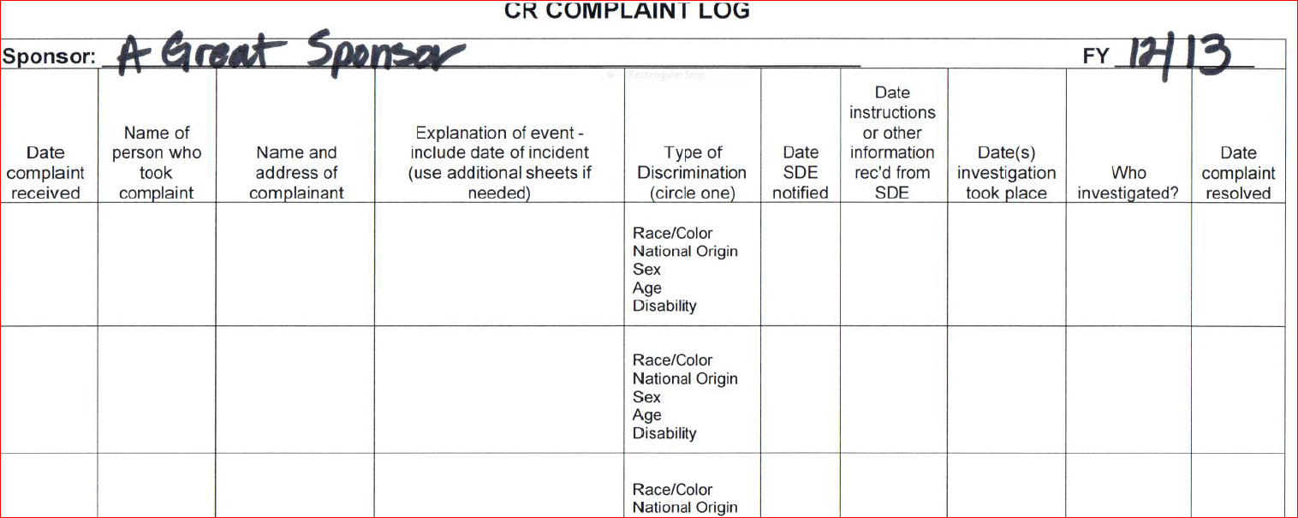
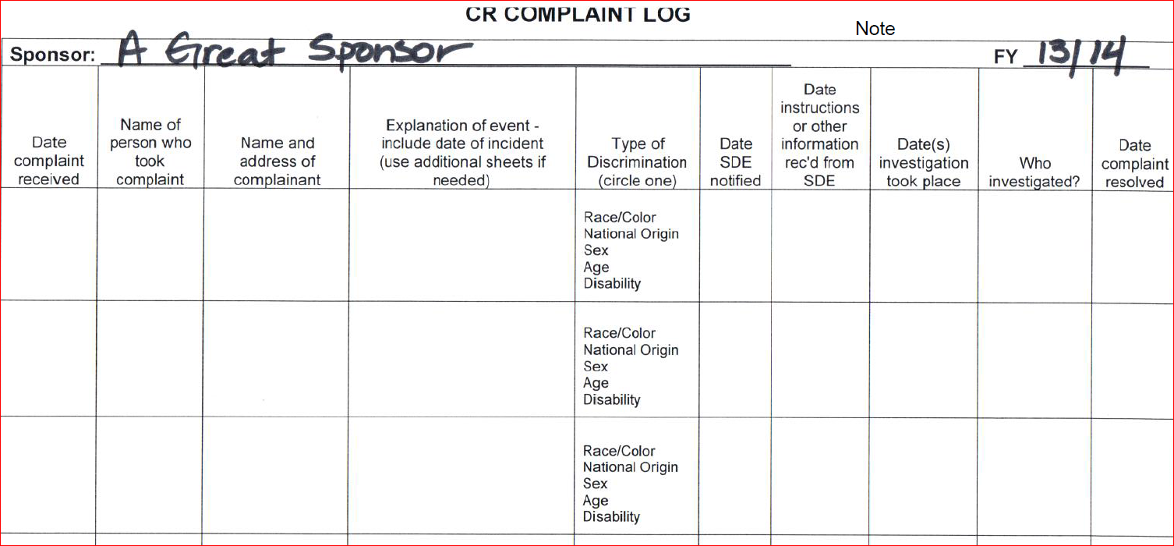
Sample Complaint Logs
No Complaints 6/5/2013
Notes:
Here are samples of civil rights complaint logs. You must have one report for each school year. At the end of the school year, if the school site has had no complaints, be sure to note “No Complaints” on the log along with the date. NOTE: Must begin a log for the new, upcoming school year.

Slide 42
Compliance Review and Resolution of Non-Compliance
Reviews
Reviews
USDA Regional Office
State Agency
Local Agencies (SFAs)
Reports
Notes:
This slide represents the flow of information when a complaint and or procedure for civil rights is being followed up on for compliance. Regional Food and Nutrition Service offices are involved in compliance reviews of State agencies. State agencies are required to ensure compliance within local agencies.
State and local agencies must receive a pre-approval visit for civil rights compliance before receiving federal funds.
Significant findings made by the State Agency are reported to the appropriate USDA Regional Office. Corrective action is put in place until non-compliance is resolved.
All reports must be maintained as part of records for future review.

Slide 43
Requirements for Language Assistance
Enrollment forms
Menus
Informational brochures
Letters to families and notifications
Free Translations – see http://www.freetranslation.com
Hawaii Bilingual Access Line: (808) 526-9724
Esta institución es un proveedor que ofrece igualdad de oportunidades.
Notes:
Civil rights requirements state that provisions must be made for non-English speaking program participants.
Children must not be used to translate for a parent. “I speak”
For example, enrollment forms or menus may need to be translated into Spanish in areas where Spanish is necessary in order for families to comprehend the information. Another example of language assistance would be providing braille or large print for visually impaired program participants.

Slide 44
Conflict Resolution
All complaints alleging discrimination on the basis of race, age, color, national origin, sex, or disability, must be:
forwarded to the State agency within five days
processed by USDA within 90 days
Notes:
The process for conflict resolution includes making sure all complaints alleging discrimination on the basis of race, age, color, national origin, sex, or disability must be forwarded to the State agency within five days and must be processed by USDA within ninety days.

Slide 45
SFA Checklist
Annual Civil Rights training for all staff & volunteers
DOCUMENT TRAINING
Display current “And Justice For All” poster
Collect and record race and ethnic data annually
Offer meals to all
Maintain Civil Rights Complaint Log(s)
Non-discrimination statement on all printed materials mentioning Child Nutrition Programs
Keep all records for three years plus the current year
Notes:
Let’s summarize the important civil rights sponsor requirements for participation in Child Nutrition Programs.
Requirements include:
Train all staff on civil rights topics covered today. Document training with an agenda, dates, and signatures and have documentation available for the State agency to review.
Prominently display the current “And Justice For All” poster in a public place. Best practice is to place the poster both in a public entry as well as in the food service area. For NSLP, posters must be displayed where free and reduced applications are determined and where money is collected.
Collect and record race and ethnic data for all participants annually. Remember data collection can be specific to your program.
Offer meals to all infants and children in care, without discrimination.
Maintain an annually dated Civil Rights Complaint Log
Place the non-discrimination statement on all printed materials mentioning Child Nutrition Programs, including menus, enrollment forms, and electronic announcements mentioning the USDA funded food programs.
Keep all civil rights records for three years plus the current year per USDA however your agency may have a longer retention policy. Records to be retained includes the annually updated civil rights complaint binder containing a complaint procedure, an annually updated complaint log, and complaint forms.

Slide 46
Professional Standards
http://professionalstandards.nal.usda.gov/
Key Area: Administration 3000
Key Topic: Policies and Procedures 3420
Notes:
Here are the key area and key topic learning codes pertinent to this webinar to meet the Professional Standards training and recording requirements.
The first web site will provide you with the master list of all learning codes.
Please count the time spent on this webinar toward your annual Professional Standards training requirements. Also please remember to track the training you may provide for your foodservice employees using this ppt.
Each school must retain documentation of their school food service trainings to comply with the USDA Professional Standards; you may use the FNS online tracking tool at the 2nd website shown or use one of the tracking logs developed by HCNP which will be posted soon at http://hcnp.hawaii.gov , then click on the NSLP. Look for the Professional Standards section.

Slide 47
Non-discrimination Statement
In accordance with Federal civil rights law and U.S. Department of Agriculture (USDA) civil rights regulations and policies, the USDA, its Agencies, offices, and employees, and institutions participating in or administering USDA programs are prohibited from discriminating based on race, color, national origin, sex, religious creed, disability, age, political beliefs, or reprisal or retaliation for prior civil rights activity in any program or activity conducted or funded by USDA.
Persons with disabilities who require alternative means of communication for program information (e.g. Braille, large print, audiotape, American Sign Language, etc.), should contact the Agency (State or local) where they applied for benefits. Individuals who are deaf, hard of hearing or have speech disabilities may contact USDA through the Federal Relay Service at (800) 877-8339. Additionally, program information may be made available in languages other than English.
To file a program complaint of discrimination, complete the USDA Program Discrimination Complaint Form, (AD-3027) found online at: http://www.ascr.usda.gov/complaint_filing_cust.html, and at any USDA office, or write a letter addressed to USDA and provide in the letter all of the information requested in the form. To request a copy of the complaint form, call (866) 632-9992.
Submit your completed form or letter to USDA by:
(1) mail: U.S. Department of Agriculture
Office of the Assistant Secretary for Civil Rights
1400 Independence Avenue, SW
Washington, D.C. 20250-9410;
(2) fax: (202) 690-7442; or
(3) email: program.intake@usda.gov
USDA Child Nutrition Programs recognize the following protected classes: race, color, national origin, sex, age, and disability.
This institution is an equal opportunity provider.
Notes:
This slide contains the required USDA Child Nutrition Programs non-discrimination statement for this presentation.

Slide 48
Mahalo !
Hawaii Child Nutrition Programs
Phone : 808-587-3600
http://hcnp.hawaii.gov
Notes:
On behalf of kids, parents, and our staff here at the Hawaii Child Nutrition Programs - Mahalo for viewing the annual Civil Rights Training presentation and Mahalo for doing your part to provide healthy meals to Hawaii's keiki , youth and others.
Please contact Hawaii Child Nutrition Programs at 808-587-3600 if you need further assistance.
This concludes the presentation.

