Slide 1
Hawaii Child Nutrition Programs
Food Safety

Slide 2
What’s in the News related to Food Safety?
Rat Lungworm Disease
How is Rat Lungworm spread?
Message: Thoroughly inspect and rinse produce, especially leafy greens, in potable water. Even if package states the produce has been prewashed, it is a State of Hawaii regulation to wash all produce before use.
Notes:
Affects the brain and spinal cord
The parasitic nematode is only found in rodents. However, infected rodents can pass larvae of the worm in their feces. Snails, slugs, and other animals (such as freshwater shrimp, land crabs, and frogs) can become infected by ingesting this larvae. These are considered intermediate hosts. We can become infected if we eat a raw or undercooked infected intermediate host. For some incidents here in Hawaii, people are infected by consuming raw produce that contains a small infected snail or slug, or part of one.
So the key is to thoroughly inspect and wash all produce. Even if the package states that it has been prewashed, it is a State of Hawaii regulation to wash all produce before use.

Slide 3
Administrative Review Observations SY 2016-17
Food safety plans are incomplete
Food safety plans are not being reviewed annually with corrective action not being taken or documented (SFA & Vendor)
Annual food safety training on Standard Operating Procedures (SOP) not taking place.
Food safety inspections are not being requested twice a school year.
Temperature logs are not being completed.
FIFO not being followed properly
HACCP not being followed for FFVP.
Notes:
Let’s talk about the common findings we observed during last school year’s Administrative Reviews.
The first one is incomplete food safety plans. We find a lot of times that SFAs have printed our food safety plan template, however, the template has not been completed with information specific to the school. We also see that standard operating procedures are either not included in the food safety plan or have not been signed, dated, and implemented.
Food safety plans are not being reviewed annually. This means reviewing the content and reviewing the implementation of the plan. It is the SFA’s responsibility to oversee that the Vendor is incompliance with food safety standards. This also means that SFAs do not know if corrective actions are needed at the school or the vendor’s facility. And it’s okay if corrective actions are needed. We just want to see that it is being documented and addressed appropriately.
SFAs are not training their meal program staff on the SOPs annually. You decide when and how often, but it has to be done at least once a year and documented.
Food Safety Inspections are not requested twice a school year.
Temperature logs are not being maintained. This goes for food and equipment. Either logs are not being kept or the same temperature is being listed at the same time every. This looks as if the temperatures are not truly being taken. Temperatures must be taken daily and recorded at the exact minute it is taken. Also, concentration logs must be kept for the sanitizer in compartment sinks and buckets.
First in, First out procedures are not being followed properly. Products must be clearly marked with either the date the product was received or the “use by” date (the SFA is to establish which date to use). Old inventory should be rotated to the front to be used first when new inventory is received.
We also found that produce is not being covered, served with bare hands, and family style with all students eating out of the same container – “double dipping”. All nutrition program staff must be trained on food safety at least once a year. This includes FFVP staff.

Slide 4
HACCP
Schools Are Required by Federal Law to Have a Food Safety Plan Based on HACCP Principles.
Notes:
Schools are required by federal law to have a food safety plan based on HACCP principles. We have created a food safety plan template based on HACCP principles as well as SOPs and have made that available to you on the HCNP website. There’s a template for both self-prep sites and vended sites. If you do not use our version, it must contain similar content and the signature lines included on our SOPs.

Slide 5
HACCP stands for:
A. Harry and Connie Clown Party
B. Hepatitis A Cross Contamination Prevention
C. Hazard Analysis Critical Control Points
D. Happy Al’s Cookie and Cracker Program
Notes:
Answer = C

Slide 6
HACCP
What is HACCP?
Hazard Analysis Critical Control Points
Why is it Important?
Provides a systematic approach to identifying food safety hazards
http://www.fns.usda.gov/sites/default/files/Food_Safety_HACCPGuidance.pdf
Notes:
HACCP stands for Hazard Analysis and Critical Control Point. It is a systematic approach to identifying food safety hazards.
Combined with Standard Operating Procedures, a food safety plan based on HACCP principles will prevent, eliminate, or reduce the occurrence of Food Borne Illness risk factors.
SOPS control for non-specific hazards; HACCP controls for specific, measurable hazards. The key with application of HACCP principles is that the hazards must be measurable through Critical Control Points and critical limits.
The USDA issued guidance for SFAs in 2005 that is comprehensive and still applicable and you can download the Guide by going to:
http://www.fns.usda.gov/sites/default/files/Food_Safety_HACCPGuidance.pdf
Recommended review materials for instructors:
http://www.fns.usda.gov/fns/safety/pdf/HACCPGuidance.pdf
http://www.fda.gov/Food/FoodSafety/RetailFoodProtection/FoodCode/FoodCode2009/ucm188363.htm
http://www.fda.gov/Food/FoodSafety/RetailFoodProtection/ManagingFoodSafetyHACCPPrinciples/Operators/default.htm

Slide 7
HACCP Principles
Conduct a Hazard Analysis
Determine Critical Control Points
Establish Critical Limits
Establish Monitoring Procedure
Notes:
The USDA provides recipes on their website called What’s Cooking – some of their recipes already have HACCP steps included. And we’ll take a look at one in just a moment. But if you create your own standardized recipes or get recipes from different sites, you will need to follow the steps listed here and include HACCP principles in each recipe.
The first step is to determine how the menu item is prepared.
Is it prepared and served without cooking?
Is it prepared and cooked for same-day service?
Is it prepared, cooked, held, cooled, reheated, and served?
Identify where the food safety hazards may be during the process.
To determine the critical control points, identify the points during the process where food borne illness and other hazards can be prevented, eliminated, or reduced to safe levels
Depending on the food there may be more than one CCP.
To establish critical limits, determine the minimum or maximum limits that must be met to prevent, eliminate, or reduce the hazard to a safe level. These are your cooking, holding, and cooling temperatures.
And last but not least, you need to establish monitoring procedures. Once the critical limit is established determine how best to check that limits are consistently met. Identify who will monitor and how often.

Slide 8
HACCP Principles
Identify Corrective Actions
Keep Records
Review Your Food Safety Plan Annually and Revise as Necessary.
Document Each Time Your Food Safety Plan is Reviewed.
Notes:
If issues are observed, identify corrective actions
What steps must be taken if a critical limit is not met?
In our food safety plans, corrective action recommendations are made for general situations.
Maintain all documentation on corrective actions
Maintain, update, and document your review of the food safety plan and SOPs once a year at a minimum.

Slide 9
Temperature Danger Zone
Notes:
Temperature, if not controlled properly during food preparation and service, can contribute to a higher risk of foodborne illness. It is important to keep hot foods hot and cold foods cold. And it is most important to keep food out of the temperature danger zone. The temperature danger zone is defined as 41-135 degrees. This is the temperature range in which pathogenic bacteria can multiply rapidly and possibly cause foodborne illness.

Slide 10
The Process Approach to HACCP
Notes:
The Process Approach to HACCP is a method of classifying food preparation into three broad categories. These categories are based on the number of times a menu item makes a complete trip through the temperature danger zone (again that’s 41-135). The way food is prepared determines into which of the three food preparations processes it will fall into – so as you can see, no cook never goes through the danger zone, same day goes through the danger zone once, and complex goes through it two or three times.
Our food safety templates require you to classify all of your menu items into these three categories. Let’s take a closer look at each process.

Slide 11
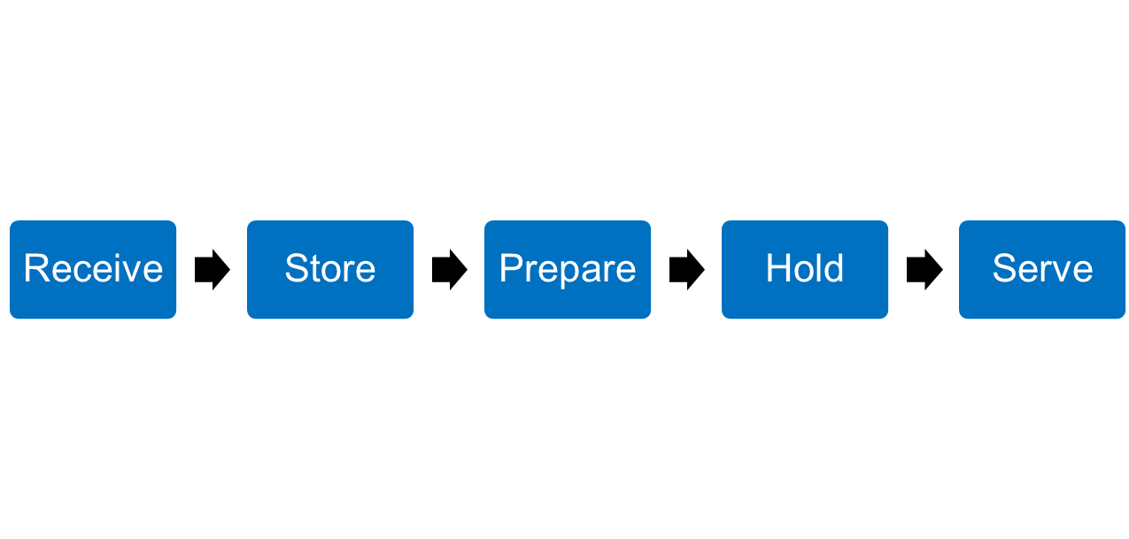
Process 1 Preparation with No Cook Step
Example Flow / Operational Steps to Consider
Spinach & Romaine Salad
Notes:
Process #1 – No Cook. This is when menu items do not go completely through the danger zone. The example I have here is a spinach and romaine salad.
You receive the lettuce, store it in the fridge, prepare the salad, cold hold, then serve it. It should never go through the temperature danger zone. What’s another process one menu item that you serve?

Slide 12
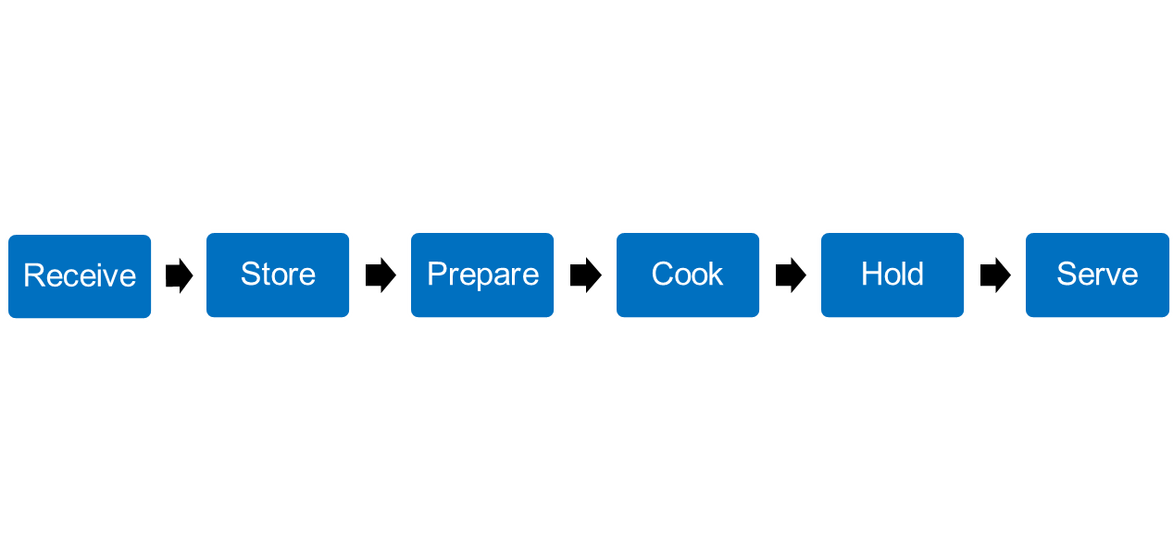
Process 2 Preparation for Same Day Service
Example Flow / Operational Steps to Consider
Hamburger Patty
Notes:
Process #2 – Same Day Service. Most of your entrees will probably fall within process #2. This means your menu item takes one complete trip through the danger zone (going up during cooking) and is served.
“Cook” can also be “reheat” if the item is commercially prepared and being reheated for the first time

Slide 13
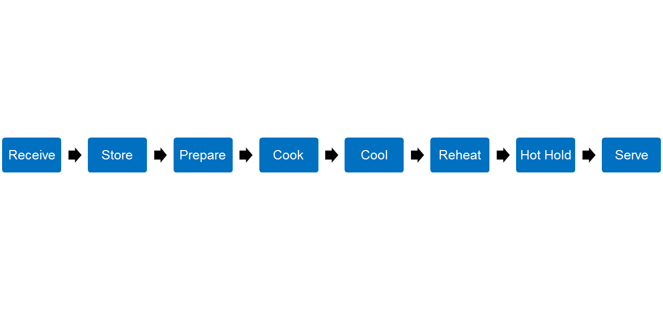
Process 3 Complex Preparation
Example Flow / Operational Steps to Consider
Baked Lasagna
Notes:
Process #3- Complex Food Preparation. The menu item goes through both heating and cooling, taking two or more complete trips through the danger zone. The example I have here is a lasagna that is being made a day ahead of time. It’s prepared, cooked, and cooled. That’s two trips through the danger zone. And then the day of service, it is reheated, hot held, and served taking another trip through the danger zone.
Again, you must document the appropriate process for each menu item in your food safety plan. If it is not, it will be considered a finding for an incomplete food safety plan. If your meals are vended, your vendor will need to have the processes in their food safety plan or something similar if they use a different template.

Slide 14
USDA What’s Cooking Recipes
https://whatscooking.fns.usda.gov/quantity/child-nutrition-cnp/meat-lasagna

Slide 15
Standard Operating Procedures
Purpose
Instructions
Monitoring
Corrective Action
Verification and Record Keeping
Notes:
SOPs are also control measures and should not be forgotten as part of the Process Approach. In addition to the established CCPs for each of the three processes, applicable SOPs should be followed for the preparation and service of all menu items. SOPs serve as general control measures for nonspecific hazards. So SOPs compliment the Process Approach by providing a general safety net. Whereas, the CCPs determined for each of the three processes safeguard against specific hazards.

Slide 16
Standard Operating Procedures
HCNP Website
Click on “Food Safety” tab:
Food Safety Program
Standard Operating Procedures
Tailor Existing SOPs to Individual SFAs
Notes:
As I stated earlier, we have provided you with SOP templates on our website for your use. You just have to print out the ones that pertain to your SFA (edit if needed to better suit your SFA), and combine them with your food safety plan. Once the SOPs have been reviewed and implemented, remember to sign and date each SOP. The SOPs include instructions, critical limits, as well as monitoring, corrective action, and verification and record keeping procedures.

Slide 17
Food Safety Plan Review and Update
Review Your Food Safety Program Annually
Revise and update as necessary
Process Approach (Process 1, 2, 3)
SOPs
Danger Zone: 41ºF - 135º F
(Hawaii Food Rule since February 2014)
Notes:
Again, review you food safety program ANNUALLY and document that you did it.
Don’t just complete it once and never look at it again. Again, this is a common finding during the Administrative Reviews.
Revise/update your plan as needed including:
The Process Approach – Did you add or remove an entrée item? Have critical control points changed?
SOPs (remember to sign and date them annually once it has been reviewed/revised)
Danger zone (remember to check that your food safety program has been updated to reflect the new Hawaii Food Rule. We are still finding documents with the incorrect temperatures)
Cold foods must be held at or below 41 degrees. Hot foods must be held at or above 135 degrees.

Slide 18
Maintain Documentation
Train Staff Annually on SOPs
Record Temperatures
Equipment
Cooking
Holding
Receiving
Storage
Production Records
Temperature Logs
Invoices
Delivery Receipts
Notes:
If you haven’t caught on yet, catch on now cause I promise this is the last time I’ll say it – Train all nutrition program staff ANNUALLY on food safety and the SOPs.
It doesn’t have to be a whole day of training. You can keep your trainings short and sweet. For example, set-up your training schedule to review 1-2 SOPs with staff once a week (15 minute trainings).
And don’t forget to maintain the training documentation – this is the sign in sheet, agenda, trainer, and materials used in the training.
You are required to record cooking, holding, receiving, and storage temperatures. Storage includes your pantry, refrigerators, milk coolers, and freezers.
Temperatures can be recorded on production records, temperature logs, invoices, or delivery receipts. When recording temperatures, initial and date next to the temperature. This is critical in the event students and/or staff get sick. Maintaining good and accurate records will be helpful to demonstrate that the food was stored/cooked/held at the proper temperatures.

Slide 19
Sanitation Inspection Required
USDA Requires Schools to Have TWO Sanitation Inspections Each Year
School Year: July 1 – June 30
Applies to ALL Schools - Self-prep and Vended
Each Site in Your SFA
Notes:
School are required to have two sanitation inspections each year. All schools within your SFA must be inspected no matter if you are a self-prep or vended site.

Slide 20
Inspection Requests
Complete Form O-7 (Request for Sanitation Inspection)
Go to: http://hcnp.hawaii.gov/overview/nslp/
Click “Food Safety” → “Sanitation Inspection”
Submit to Your Local DOH Sanitation Branch Office
REMEMBER: Keep a Copy of Your Request
Notes:
In order to be inspected, you must submit an inspection request. You will need to fill out form O-7. That you can find on the HCNP website. Make a copy of the request to keep on file and then submit the form.
Specialists will ask to see your sanitation request(s) during the Administrative Review.
Remember: If you submit a request, but the Dept of Health does not come to inspect your SFA, it is ok. Your responsibility is to request for both inspections and to maintain the documentation that shows you made the request. Failure to keep documentation or to request an inspection will result in a finding during your Administrative Review.

Slide 21
Inspection Requests
HCNP Recommends:
Submit your 1st request in September
Submit your 2nd request in February
Notes:
Here is what we recommend. Send your first request off in September and your second in February. As you know, we are already well into the month of September, so if you haven’t submitted your first request, I recommend your SFA doing that within the next few days.

Slide 22
Post Your Inspection
Post Your Most Current Sanitation Inspection
Post in a publicly visible area like the main dining area
This is a common finding during the Administrative Review
Notes:
If the Department of Health does come to your school to conduct an inspection, you must post the inspection results in a publicly visible location. It is common to find that schools either do not post the inspection or it is in a location where it cannot easily be seen. So post it where it can be seen.

Slide 23
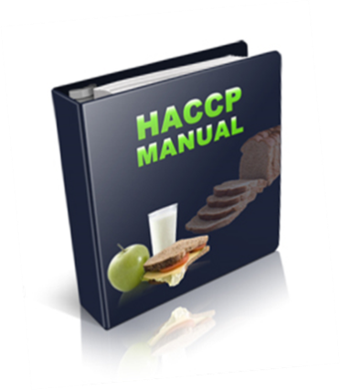
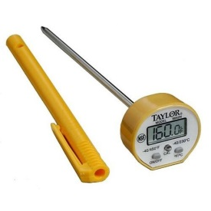
Vendors
Vended Meal Sites
Your vendor must also have a Food Safety Program
Check that your vendor has implemented their Food Safety Program
Check that your solicitation and/or contract with the vendor requires compliance with a Food Safety Plan
Food and Equipment Temperature Logs
Training Documentation
Notes:
For those of you who receive vended meals, it is your responsibility to make sure your vendor also has a food safety program in place. This includes:
A Food safety plan
Maintaining food and equipment temperature logs
And Training documentation
Don’t just take your vendor’s word for it. You need to physically lay eyes on their facility, food safety plan, and related documents. Give your vendor corrective actions if needed.
If your solicitation or contract with the vendor does not require compliance with a Food Safety Plan, you need to look into making an addendum. Vendor compliance is required.

Slide 24
Questions?

Slide 25
.
In accordance with Federal civil rights law and U.S. Department of Agriculture (USDA) civil rights regulations and policies, the USDA, its Agencies, offices, and employees, and institutions participating in or administering USDA programs are prohibited from discriminating based on race, color, national origin, sex, disability, age, or reprisal or retaliation for prior civil rights activity in any program or activity conducted or funded by USDA.
Persons with disabilities who require alternative means of communication for program information (e.g. Braille, large print, audiotape, American Sign Language, etc.), should contact the Agency (State or local) where they applied for benefits. Individuals who are deaf, hard of hearing or have speech disabilities may contact USDA through the Federal Relay Service at (800) 877-8339. Additionally, program information may be made available in languages other than English.
To file a program complaint of discrimination, complete the USDA Program Discrimination Complaint Form, (AD-3027) found online at: http://www.ascr.usda.gov/complaint_filing_cust.html, and at any USDA office, or write a letter addressed to USDA and provide in the letter all of the information requested in the form. To request a copy of the complaint form, call (866) 632-9992. Submit your completed form or letter to USDA by:
(1) mail: U.S. Department of Agriculture
Office of the Assistant Secretary for Civil Rights
1400 Independence Avenue, SW
Washington, D.C. 20250-9410;
(2) fax: (202) 690-7442; or
(3) email: program.intake@usda.gov.
This institution is an equal opportunity provider.

