Slide 1
Revenue from Nonprogram Foods Sold in Schools
Part 2
HAWAII CHILD NUTRITION PROGRAMS
Notes:
Welcome to part 2 of the Revenue from Nonprogram Foods Sold in School training.

Slide 2
What’s New
Starting SY2017-2018, HCNP will use the USDA Non Program Revenue Tool (NPR Tool) to calculate Non program revenue. This report will be sent with the Annual Financial Report and is due to HCNP by October 13, 2017.
Notes:
Starting SY2017-2018, Hawaii Child Nutrition Programs (HCNP) will use the USDA Non Program Revenue Tool (NPR Tools) to calculate Non program revenue. This report will be sent with the Annual Financial Report and is due to HCNP by October 13, 2017.

Slide 3
What are nonprogram foods?
Common examples of nonprogram foods include:
À la carte items, including crossover items;
Adult meals;
Second meals;
Catered meals; and
Contract Meals
Notes:
“Common examples of nonprogram foods include à la carte items and adult meals. Both are typically purchased with funds from a School Foods Authorities (SFA) nonprofit school food service account, and are not reimbursable. We’ve listed two other common examples of nonprogram foods, second meals and catered meals, on this slide.

Slide 4
Ala Carte items
Milk
Juice box
Water
Vended meals (vended from an outside source)
Notes:
If a SFA only sells ala carte items like milk, juice box, water, or vended meals where there is an identifiable per service cost, the price of the ala carte items must be equal to or greater to the cost of purchasing the food.
If a SFA only sells these type of ala carte items, then the SFA is not required to complete the USDA Nonprogram Revenue Rool. To document that the SFA is in compliance with the NPR requirements, the SFA should printout of the menu showing the selling price of the items, and printed receipts of the items sold. If the cost of the ala carte items should increase, the SFA must either increase the price of the ala carte item(s) or contribute more to the nonprofit school food service account to cover the cost of the nonprogram food.

Slide 5
USDA Nonprogram Revenue Tool
Notes:
SFAs that sell other Nonprogram foods which does not have an identifiable food cost will have to complete the USDA Non Program Revenue Tool.
The USDA NPR tool, will help the SFA identify the amount of revenue the SFA need to collect to pay for the nonprogram food cost.

Slide 6
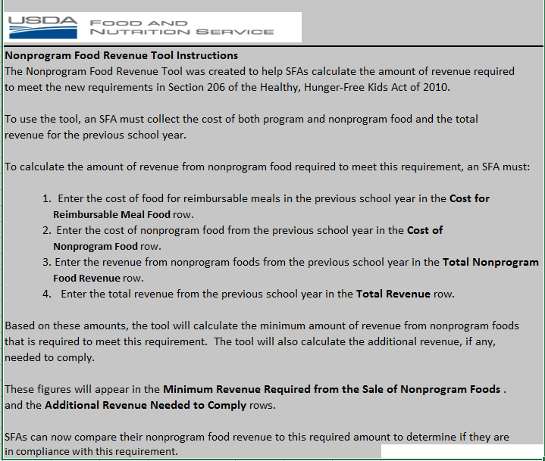
Notes:
Please read tab 1 which is the USDA NPR instruction before starting the USDA NPR Tool.

Slide 7
Instructions
To calculate the amount of revenue from nonprogram food required to meet this requirement, as SFA must:
Enter the cost of food for reimbursable meals in the previous school year in the Cost for Reimbursable Meal Food row.
Enter the cost of nonprogram food from the previous school year in the Cost of Nonprogram Food row.
Enter the revenue from nonprogram foods from the previous school year in the Total Nonprogram Food Revenue row.
Enter the total revenue from the previous school year in the Total Revenue row.
Notes:
To complete the USDA NPR Tool, the SFA must have the following information:
Cost for reimbursable Meal Food
Cost of Nonprogram Food
Total Nonprogram Food Revenue
Total Revenue

Slide 8
TIME PERIOD FOR USDA NPR TOOL
SFAs will separate their nonprogram foods costs from their program food costs for a period of at least 5 consecutive operative days from a closed fiscal year.
This selected days must represent typical food service operations. Assessments cannot include data from summer school, holidays, or vacations or special circumstances that might distort the program and nonprogram food data.
Notes:
SFAs will separate their nonprogram foods costs from their program food costs for a period of at least 5 consecutive operative days from a closed fiscal year.
This selected days must represent typical food service operations. Assessments cannot include data from summer school, holidays, or vacations or special circumstances that might distort the program and nonprogram food data.
Avoid time periods right before or after holidays too.

Slide 9
How does an SFA determine “cost of food used”?
The cost of food used is the amount expended for the purchase of ALL foods in the nonprofit school food service operation. If the food is made from scratch, the SFA would determine the price of ingredients to calculate the food cost. The SFA should NOT include labor or other costs in this calculation.
Notes:
The SFA should not include labor or other costs in this cost of food used, if the SFA is only preparing meals for its school.
If the SFA sells vended meal, then it must factor in labor for the food cost.

Slide 10
USDA Food Buying Guide
https://foodbuyingguide.fns.usda.gov/Home/Home
Notes:
The USDA Food Buying Guide is a great reference material to help calculate the portion size for the ingredients and the number of servings it contains. For example: there are 21 servings of diced peaches in a #10 can for a ¼ cup portion.

Slide 11
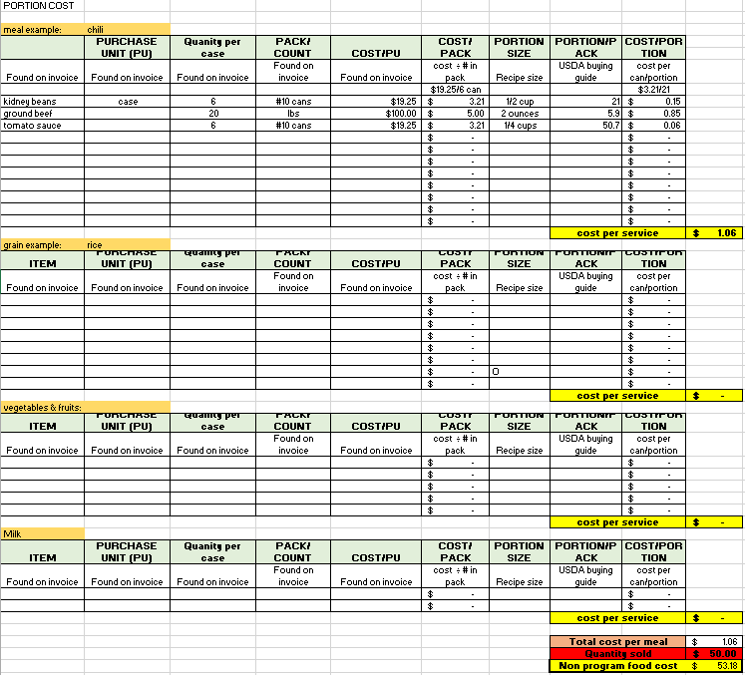
Portion Cost
Notes:
To help calculate the total nonprogram food cost for a 5 consecutive days, HCNP will also include a Nonprogram Food Cost Calculations Worksheet..

Slide 12
Recipe Cost Per Unit
Notes:
The file will contain 17 tabs, one is a sample tab. The tabs for each day are broken down by breakfast, lunch, and ala carte. The breakfast tab and lunch tab will calculate the total meal cost for adult meals or student second meals. The ala carte tab is for all individual sale items.
The SFA will have to complete all 15 tabs for Days 1 through Days 5
Remember “ALL” foods must be accounted for. No exception.

Slide 13
How to complete the portion cost
Notes:
To calculate the portion cost of each meal the preparer will need the purchase invoice, recipe, and production record for each meal served.
The information from the invoice(s) will be used to complete the first 5 steps.
Enter the item purchased
Purchase unit, example case
Quantity in the purchase unit. Example, There are 6 cans in the case of kidney beans.
Size or measurement of item
Cost of the item
The spreadsheet will calculate the cost per item
Information from the production records and/or recipe will be needed to complete steps 6 &7.
6) Then enter the the portion size of the recipe
7) Using the USDA Buying guide complete the amount portion serving size per item
The spreadsheet will calculate the cost per portion size
8) Repeat this step for each main ingredient.
After all the ingredients are entered, scroll down to the yellow cell. It will calculate the total serving cost of the item.

Slide 14
Quantity of nonprogam meals served
Notes:
Scroll to the bottom of the page and enter the quantity of nonprogram meals (adult meals or 2nd student meals) in the red cell.

Slide 15
NPR COST TOTAL
Notes:
The NPR Total tab will automatically retrieve the information from the 15 tabs. For this specific time period, $106.35 is the total nonprogram cost.

Slide 16
USDA NPR TOOL Noncompliance
Notes:
Now let use the data for HCNP’s Nonprogram Food Cost Calculation worksheet to complete USDA NPR Tool.
Enter the food cost of the reimbursable meal. In this example it is $1,000 (see orange arrow)
Enter the $106 cost of the nonprogram food (see green arrow)
In this example the total food cost is $1106 which is the cost of the reimbursable meal food plus the cost of the nonprogram food (see blue arrow).
3) Enter the total Nonprogram food revenue, in the example, use $50 (see red arrow)
4) Finally, enter the total revenue received from reimbursable meals and nonprogram food revenue, $1,100
The USDA NPR tool calculates the minimum portion of revenue from nonprogram funds.
The minimum portion of revenue from nonprogram foods are 10%. (which is $106/$1,106). Using this 10%, the SFA would take the total revenue for the year multiplied by 10% to calculate the total nonprogram revenue the SFA should have collected. If the SFA did not collect enough nonprogram revenue, then a general funds transfer will be needed.
In this example the Total Nonprogram Food Revenue received was $50. This amount was not sufficient to cover the nonprogram food cost. On the last line it calculated $56 additional funds needed to meet compliance (see purple arrow).
The SFA will have to transfer in general funds to cover the deficit. Moving forward the SFA can either increase the cost of the item to bring in more revenue to cover the deficit or continue to transfer in general funds.

Slide 17
USDA NPR TOOL Compliance
Notes:
In this example the Total Nonprogram Food Revenue received was $110 (see green arrow). This amount was sufficient to cover the nonprogram food cost. On the last line it calculated zero additional funds needed to meet compliance (see blue arrow).

Slide 18
Multiple Entrees
If more than one entrée is sold, the SFA can take the average cost of the entrées.
Pizza | $ 3.00
hamburger | $ 2.00
Total | $ 5.00
Average cost of both entrees:
$5.00/2=$2.50
Notes:
If more than one entrée is sold, the SFA can take an average cost of the 2 entrée.
Example: There are 2 entrees-pizza or cheeseburger. Add the cost of the pizza and cheeseburger together and divide that amount by two.

Slide 19
Reference
Nonprofit School Food Service Account Nonprogram Food Revenue Requirements (289.03
https://www.fns.usda.gov/nonprofit-school-food-service-account-nonprogram-food-revenue-requirements
SP 13 -2014 - USDA Food and Nutrition Service
https://www.fns.usda.gov/sites/default/files/SP13-2014os.pdf
MEMO CODE: SP 39-2011 – Revised
https://www.fns.usda.gov/guidance-paid-lunch-equity-and-revenue-nonprogram-foods
Notes:
Please review these website for more information on the Nonprogram Food Revenue

Slide 20
Questions?
Contact:
Shaynee Moreno
Email: Shaynee_Moreno@notes.k12.hi.us
Notes:
Please contact Shaynee Moreno at the Hawaii Child Nutrition Programs if you have questions.

Slide 21
Nondiscrimination Statement
In accordance with Federal civil rights law and U.S. Department of Agriculture (USDA) civil rights regulations and policies, the USDA, its Agencies, offices, and employees, and institutions participating in or administering USDA programs are prohibited from discriminating based on race, color, national origin, sex, disability, age, or reprisal or retaliation for prior civil rights activity in any program or activity conducted or funded by USDA.
Persons with disabilities who require alternative means of communication for program information (e.g. Braille, large print, audiotape, American Sign Language, etc.), should contact the Agency (State or local) where they applied for benefits. Individuals who are deaf, hard of hearing or have speech disabilities may contact USDA through the Federal Relay Service at (800) 877-8339. Additionally, program information may be made available in languages other than English.
To file a program complaint of discrimination, complete the USDA Program Discrimintion Complaint Form, (AD-3027) found online at:
http://www.ascr.usda.gov/complaint_filing_cust.html, and at any USDA office, or write a letter addressed to USDA and provide in the letter all of the information requested in the form. To request a copy of the complaint form, call (866) 632-9992. Submit your completed form or letter to USDA by:
1) mail: U.S. Department of Agriculture
Office of the Assistant Secretary for Civil Rights
1400 Independence Avenue, SW
Washington, D.C. 20250-9410;
2) fax: (202) 690-7442; or
3) email: program.intake@usda.gov
This institution is an equal opportunity provider.
Notes:
This institution is an equal opportunity provider.

