Slide 1
Whole Grain-Rich Criteria and Crediting Menu Items
Hawaii Child Nutrition Programs
June 2017
Notes:
Whole Grain-Rich and Crediting Menu Items. These are critical areas when it comes to planning a menu and meeting the meal pattern requirements.
Remember, repeat findings in not meeting the whole grain-rich criteria or not meeting the meal pattern requirements may result in fiscal action (recovery of meal reimbursment dollars due to overpayment as a result of program violations).
As we have mentioned before, regardless if your school meals are self-prep or vended, the SFA is responsible for ensuring compliance with the meal pattern requirements.

Slide 2

Overview
Whole grain-rich criteria
Crediting of food items towards the meal pattern requirements
Child Nutrition Labels
Food Buying Guide Calculator
Notes:
We will be reviewing:
The whole grain-rich criteria
The crediting of food items towards the meal pattern requirements
How to read Child Nutrition labels
Using the Food Buying Guide Calculator

Slide 3
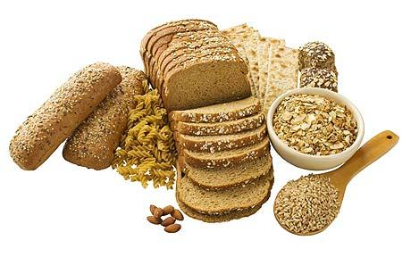
Whole Grain-Rich Criteria
SP 30-2012 https://www.fns.usda.gov/sites/default/files/SP30-2012os.pdf
Notes:
First, let’s look at the whole grain-rich criteria.

Slide 4

Whole Grain-Rich Criteria
Whole grain-rich products must contain:
  100% whole grain
  OR
  A blend of whole-grain meal and/or flour and enriched meal and or flour.
  Whole grain-rich products must contain at least 50% whole grains and the remaining grain content must be enriched.
Notes:
What is a whole grain-rich product? Read slide.

Slide 5
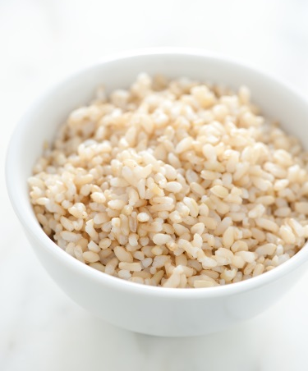
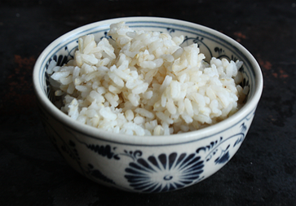
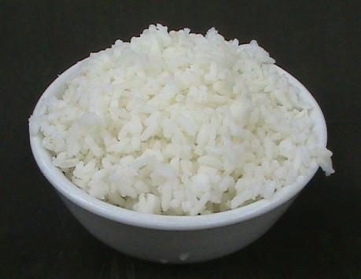
Whole Grain-Rich Criteria
Whole Grain-Rich
Not Whole Grain-Rich
100% Brown Rice
50% Brown Rice
50% Enriched White Rice
100% White Rice
Notes:
This slide uses rice to help explain the whole grain-rich definition.
100% Brown Rice is whole grain-rich.
Hapa Rice made with 50% Brown Rice and 50% Enriched White Rice is whole grain-rich.
100% White Rice/Enriched White Rice is not whole grain-rich.

Slide 6
Whole Grain-Rich Criteria
Grains must meet at least one of the following three criteria:
Lists whole grain as the first ingredient.
Contains at least 8 grams whole grain per oz eq.
Includes FDA approved whole grain health claim or other documentation.
Notes:
How do you know if a product is whole grain-rich?
First, the item must meet the serving size requirements outlined in Exhibit A.
Then, the item must meet one of the following three criteria:
A whole grain is listed first on the ingredient list.
The whole grain content per oz eq must be greater than or equal to 8 grams. This can be determined from information provided on the product packaging or by the manufacturer, if available.
The product may include the FDA whole grain health claim on its packaging.
We will show you the FDA whole grain health claims on another slide.
In this presentation, we will primarily focus on the first item - identifying whole grains as the primary ingredient.

Slide 7
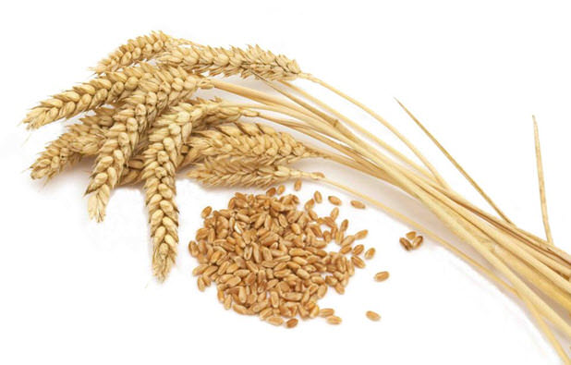
Whole Grains
Look for the word whole listed before the grain
Ex: whole wheat
The words berries and groats are used to designate whole grains
  Ex: wheat berries or oat groats
Whole grains
  Ex: rolled oats, oatmeal, brown rice, wild rice, quinoa
Whole grain ingredients
  Cracked wheat
  Crushed wheat
  Whole wheat flour
  Graham flour
  Entire-wheat flour
  Bromated whole-wheat flour
  Whole durum wheat flour
Notes:
This slide shows some examples of whole grains.
Read slide.

Slide 8
Not Whole Grains
Grain ingredients that should not be considered whole grains:
Flour
White flour
Wheat flour
All-purpose flour
Unbleached flour
Bromated flour
Enriched flour
Enriched bromated flour
Instantized flour
Phosphated flour
Self-rising flour
Enriched self-rising flour
Bread flour
Cake flour
Durum flour
Corn grits
Hominy grits
Hominy
Farina
Semolina
Degerminated corn meal
Enriched rice
Rice Flour
Couscous
Notes:
This slide shows examples of ingredients that should not be considered whole grains.
Read some examples.

Slide 9
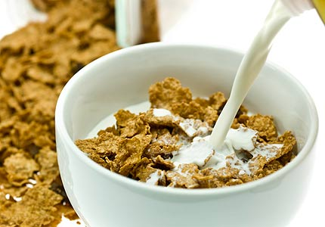
Breakfast Cereals
Ready-to-Eat (RTE) breakfast cereals must list a whole grain as the primary ingredient and must be fortified
Notes:
Read slide.

Slide 10
Whole Corn “treated with lime”
Must bear one of the FDA whole-grain health claims on product packaging
“Diets rich in whole grain foods and other plant foods, and low in total fat, saturated fat, and cholesterol, may reduce the risk of heart disease and certain cancers.”
OR
“Diets rich in whole grain foods and other plant foods, and low in saturated fat and cholesterol, may help reduce the risk of heart disease.”
Manufacturers documentation
Notes:
Whole corn “treated with lime” (often used in tortilla chips, taco shells and tamales, and may be called “masa”).
These items must bear one of the FDA whole-grain health claims on product packaging in order to meet the whole grain-rich criteria.
Manufacturers may also provide documentation showing that their product meets the requirements for these claims to demonstrate that the whole grain-rich criteria are met.

Slide 11
Noncreditable Grains
Grain ingredients that do not contribute toward the meal pattern:
Oat fiber
Corn fiber
Bran
Germ
Modified food starch
Corn starch
Wheat starch (including potato, legume, and other vegetable flours)
Ingredients must be present at a level of less than 2% of the product formula (or less than 0.25 oz eq) for the product to be creditable
Notes:
This slide shows noncreditable grains. This means that these grains do not contribute toward the meal pattern.
If these ingredients are included in purchased grain products, these ingredients must be present at a level of less than 2% of the product formula (or less than 0.25 oz eq) for the product to be creditable at lunch or breakfast.

Slide 12
Whole Grain Activity
  For each food label, determine if the item is whole grain-rich.
  Write your answer and reason on the answer sheet.
  WHOLE GRAIN-RICH: Must contain at least 50% whole grains and the remaining grain, if any, must be ENRICHED
Notes:
Read slide. Work together on the first food item to get them started.

Slide 13
Whole Grain Exemption
If your SFA has hardship in meeting the whole grain-rich requirement, complete HCNP’s whole grain-rich exemption request form
Notes:
Read slide.
Your SFA will need to provide written justification or other documented evidence to demonstrate hardship.
When the request is approved by HCNP, the SFA’s menus must meet the requirement of at least half of the grains offered weekly are whole grain-rich.

Slide 14

Crediting Menu Items
Notes:
Next we’ll discuss how to credit menu items.

Slide 15
Crediting
Meat/meat alternate oz eq:
 | Portion Size | Crediting
Yogurt | ½ cup or 4 oz | 1 oz eq
Nut Butters | 2 Tbsp | 1 oz eq
Cooked Beans | ¼ cup | 1 oz eq
Notes:
When crediting meat/meat alternates, here are some equivalents to keep in mind when planning/reviewing your menu:
Read slide.

Slide 16

Crediting – Round Down
Grains and Meat/Meat Alternates:
Round down to the nearest 0.25 oz eq
Example:
WW Roll weighs 1.2 oz (credited as 1 oz eq)
Fruit and Vegetables:
Round down to the nearest 1/8 cup
Notes:
When calculating crediting amounts, round down.
Read slide.

Slide 17
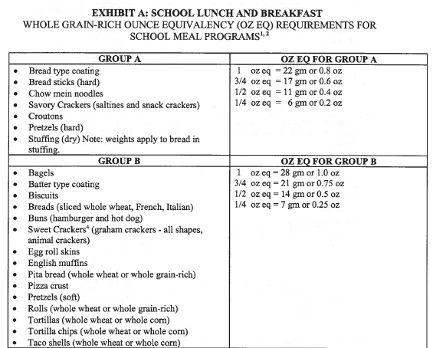
Grains – Exhibit A
Grain Items
Oz Eq
Ex: Hard Pretzels: a 0.8 oz (22 g) portion credits as a 1 oz eq of grain
Notes:
The Exhibit A chart is a very useful resource. This chart helps you to determine how grain items credit toward the meal pattern and the portion size needed to credit as a 1 oz eq. There are 16 grams of creditable grain ingredients in a 1 oz eq.
Exhibit A categorizes the various grain items into groups (left column).
In the right column, you’ll see the oz eq and the corresponding portion size (minimum weight equivalent) of the product.
For example, when you look at hard pretzels under Group A, a portion of pretzels that weighs 0.8 oz or 22 grams is credited as a 1 oz eq of grain.

Slide 18
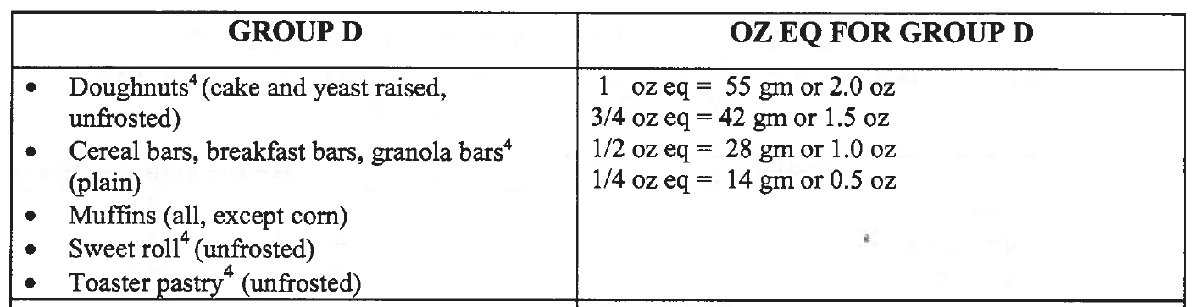
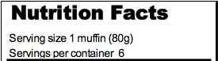
Example: Blueberry Muffin
What is the oz eq for 1 blueberry muffin?
Notes:
Let’s look at another example: Blueberry Muffin.
First, look for the group that banana muffin falls under. Group D consists of all muffins except corn.
Using the Nutrition Facts label, you can see that 1 muffin weighs 80 grams. Take 80 grams and divide it by 55 grams (which is the grams to oz eq conversion factor for Group D).
This equals 1.45 oz eq of grain. Round down to the nearest 0.25 oz eq which is 1.25 oz eq.

Slide 19
Grains – Calculating Oz Eq
To determine the oz eq grains of a grain item:
Grams of whole grain meal and/or flour
or
Grams of whole grain plus enriched meal and/or flour
÷
Number of servings the recipe or formulation yields
÷
16 grams per oz eq standard
Notes:
To determine the oz eq of grains in a food item (such as a standardized recipe) follow this formula:
Read slide.

Slide 20
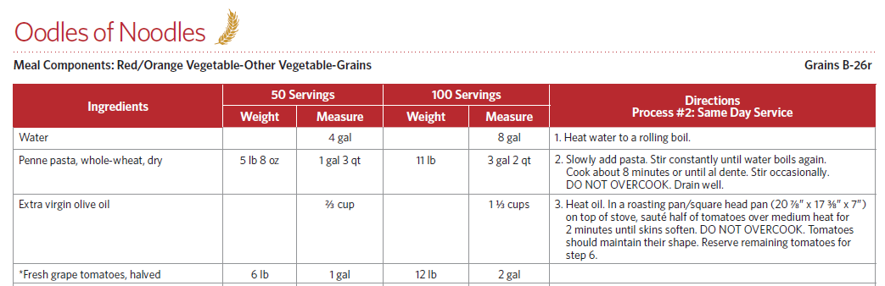
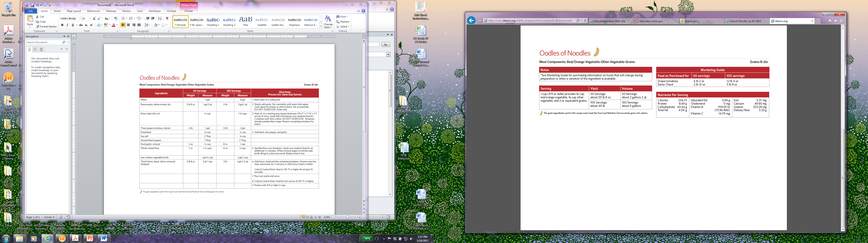
Standardized Recipe
Notes:
When menu items have two or more ingredients, there must be a standardized recipe. Examples include a green beans with salt, tuna sandwich, and cheese pizza. USDA standardized recipes can help determine how the food item credits towards the meal pattern requirements.
This slide shows parts of the USDA standardized recipe for Oodles of Noodles. The top half of the slide shows a portion of the recipe – some of the ingredients and the measurements for 50 and 100 servings along with the directions.
The bottom half of the slide shows the serving size as 1 cup (8 oz ladle) and this provides 1/8 cup of red/orange vegetable, 1/8 cup of other vegetable, and 2 oz eq grains.

Slide 21

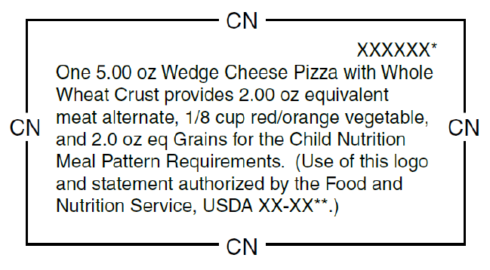
Child Nutrition (CN) Label
This sample CN label indicates that a 5 oz serving of pizza provides:
  2 oz eq meat/meat alternate
  1/8 cup vegetables (red/orange)
  2 oz eq grains
Notes:
A Child Nutrition Label (CN Label) identifies the contribution of a product towards the meal pattern requirements. Child Nutrition Labels are the gold standard. The crediting statement is approved by USDA.
CN labels are available for main dish items which contribute to the meat/meat alternate component of the meal pattern requirements. Examples include but are not limited to beef patties, cheese or meat pizzas, and breaded fish portions.
The CN label is found on the product’s packaging.

Slide 22
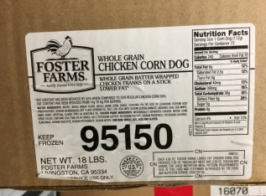


Documenting a CN Label
Remove the CN Label from the product carton
Photograph of the CN Label
  Label must be attached to the product carton
Photocopy of the CN Label
  Label is laser printed on product carton
  Label cannot be easily removed
  Photocopies and photographs of CN Labels must be visible and legible.
Notes:
Remember to keep your Child Nutrition Labels! This is critical during the Administrative Review when we are verifying the crediting of your food items.
This slide shows the acceptable ways to keep documentation of your CN Labels. Read slide.

Slide 23
CN Label with Watermark
Watermarks are used when the CN logo and contribution statement are on product information other than the actual product carton
Manufacturers may provide schools with a watermarked CN Label during the bidding process
Notes:
Read slide.

Slide 24
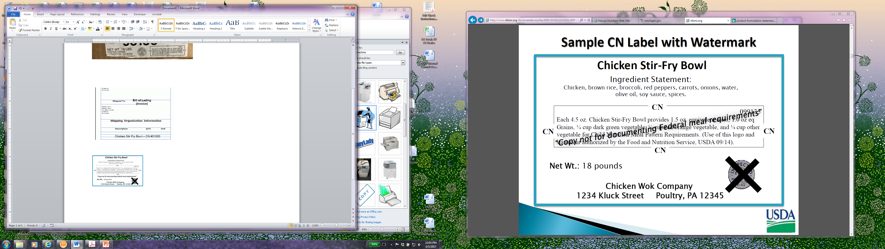
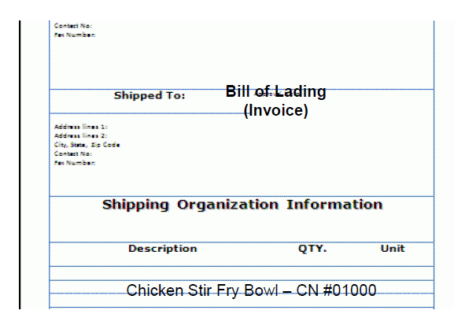
CN Label with Watermark
CN Labels copied with a watermark are acceptable when attached with Bill of Lading or invoice.
  Watermarked CN Label with product name and CN number
  Bill of Lading (Invoice) must specify the product name
Notes:
Read slide.
Example of a CN Label with a watermark.
Example of the Bill of Lading (Invoice) that specifies the product name.

Slide 25
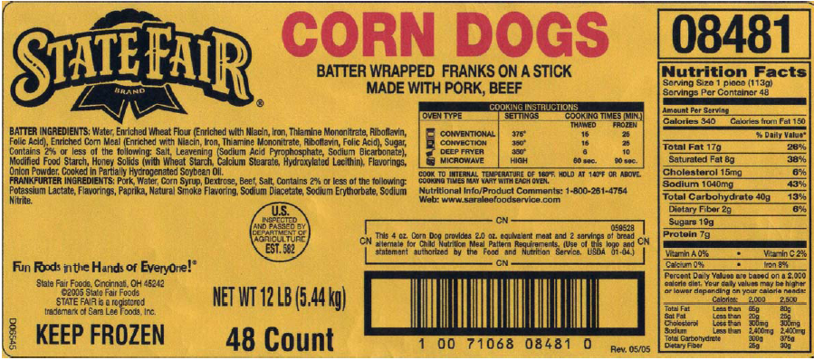
Child Nutrition (CN) Label
Read the ingredient list. Batter contains only enriched wheat flour and enriched corn meal. This product is not whole grain-rich.
Notes:
This is an example of what the CN label looks like on a product’s packaging (outlined in red).
Note: Even though a product has a CN label, you must still check whether the product is whole grain-rich by reading the ingredient list (outlined in blue). The batter contains enriched wheat flour and enriched corn meal. Therefore, this product is not whole grain-rich.

Slide 26
Product Formulation Statement (PFS)
Request a PFS when purchasing a processed product without a CN Label
SFAs are responsible for verifying and keeping records of PFS
Must be on company’s letterhead
  Signed by person of authority
Notes:
Read slide.
The Product Formulation Statement must be current. PFS that are signed prior to SY 12-13 are not acceptable.

Slide 27

Crediting Activity
  Determine the crediting amount for each food item and portion size listed. Record your answer on the answer sheet.
  Helpful Tip: 28 grams = 1 ounce
Notes:
Find the handout, “Determining the Crediting Amount.”
Using the food labels, determine the crediting amount for each food item and portion size listed.
Remember that 28 grams equals 1 ounce.

Slide 28
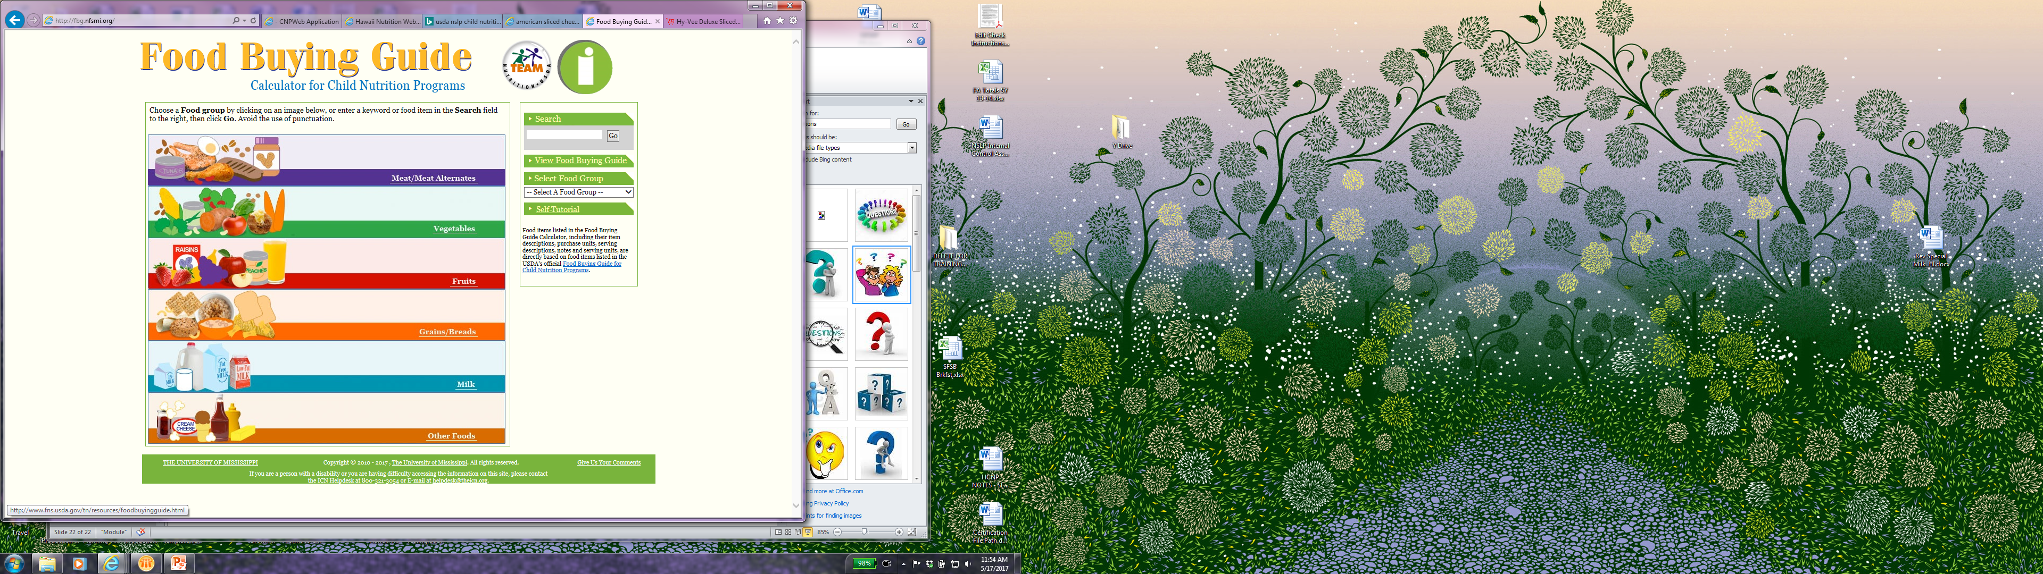
Food Buying Guide Calculator
http://fbg.nfsmi.org/
Notes:
Now we will review how to use the Food Buying Guide Calculator.
The Food Buying Guide Calculator is a useful tool. It helps to calculate the amount needed of a particular food item based on the serving size and number of servings.

Slide 29
Food Buying Guide Calculator
Choose a food component or enter a keyword in the search box.
Notes:
First, choose a food component or enter a keyword in the search box.
For today’s presentation, we will select the vegetables component.

Slide 30
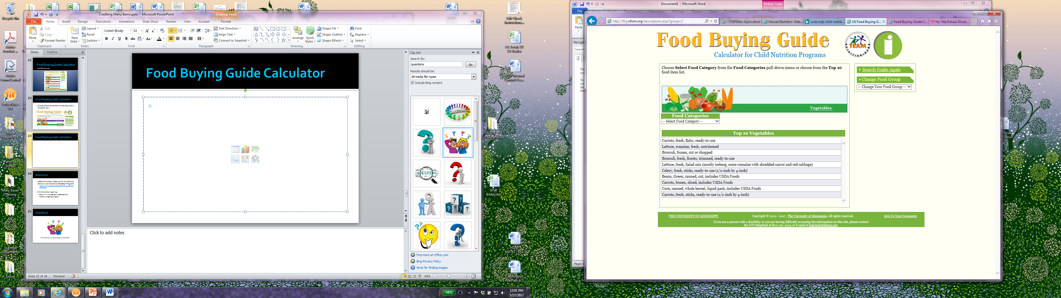
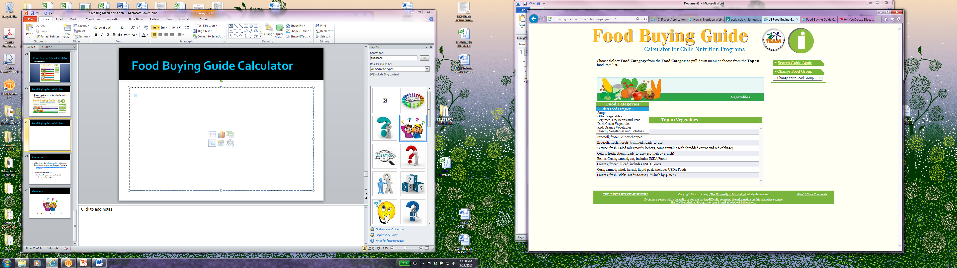
Notes:
The screen shot at the top shows a table called “Food Categories”. When you click on the arrow, a list of categories appears. With the exception of “Soups”, the other categories are the vegetable subgroups. This is one of many resources you may use if you are not sure which vegetable belongs in which subgroup.
For our example, let’s look for mixed vegetables (broccoli, cauliflower, and carrots). This would be considered an “other vegetable”.
Use the drop down arrow under Food Categories.
Select Other Vegetables.

Slide 31
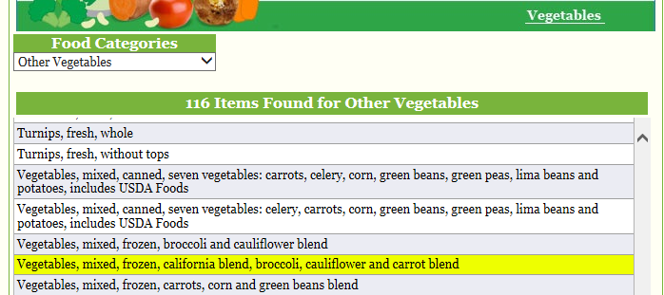
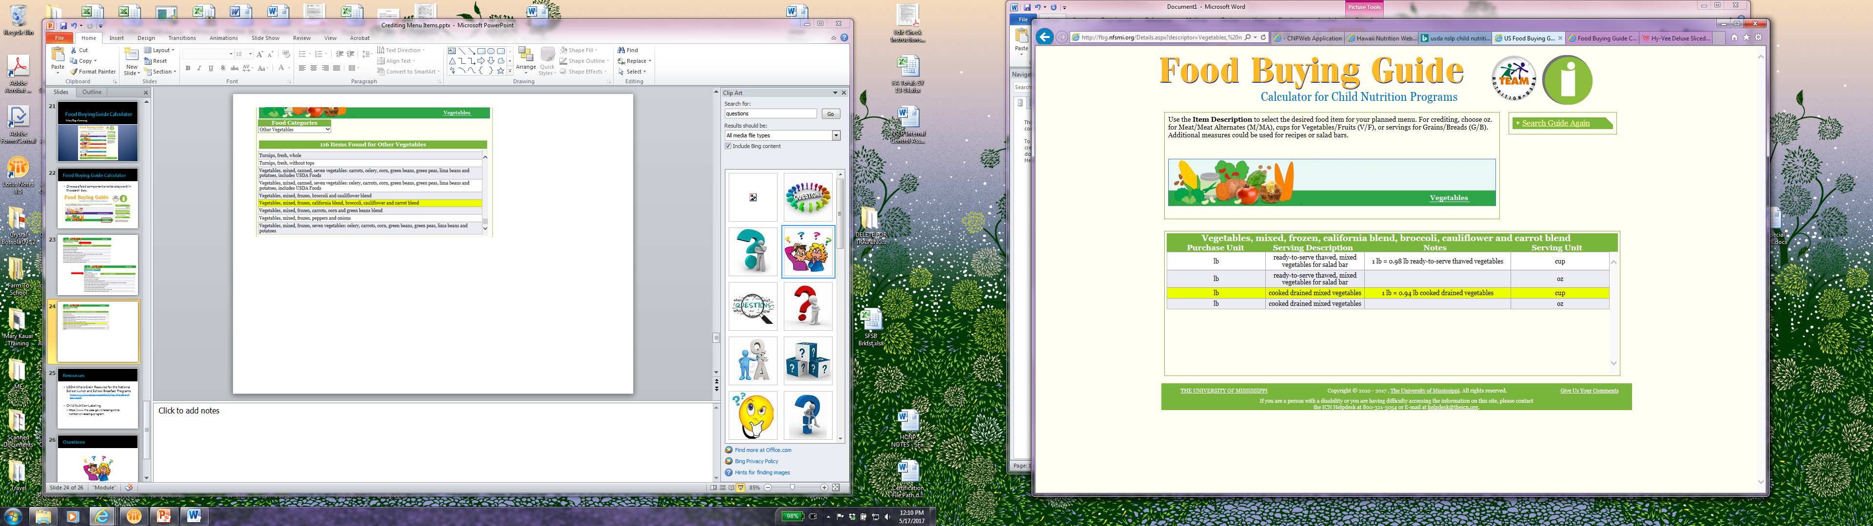
Notes:
A list of the various vegetables in the “Other Vegetable” subgroup category appears.
Select the Mixed Vegetables California Blend.
You will then see the screen shot on the bottom of the slide. Select the option that applies. Since the cook will be cooking the vegetables, and a ¾ cup portion of vegetables will be served, we will select the third option that says “cooked drained mixed vegetables” and the serving unit is in cups.

Slide 32
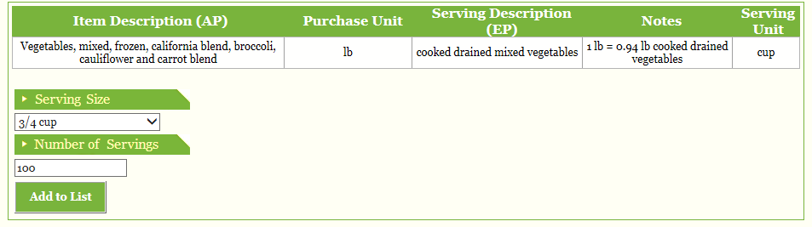
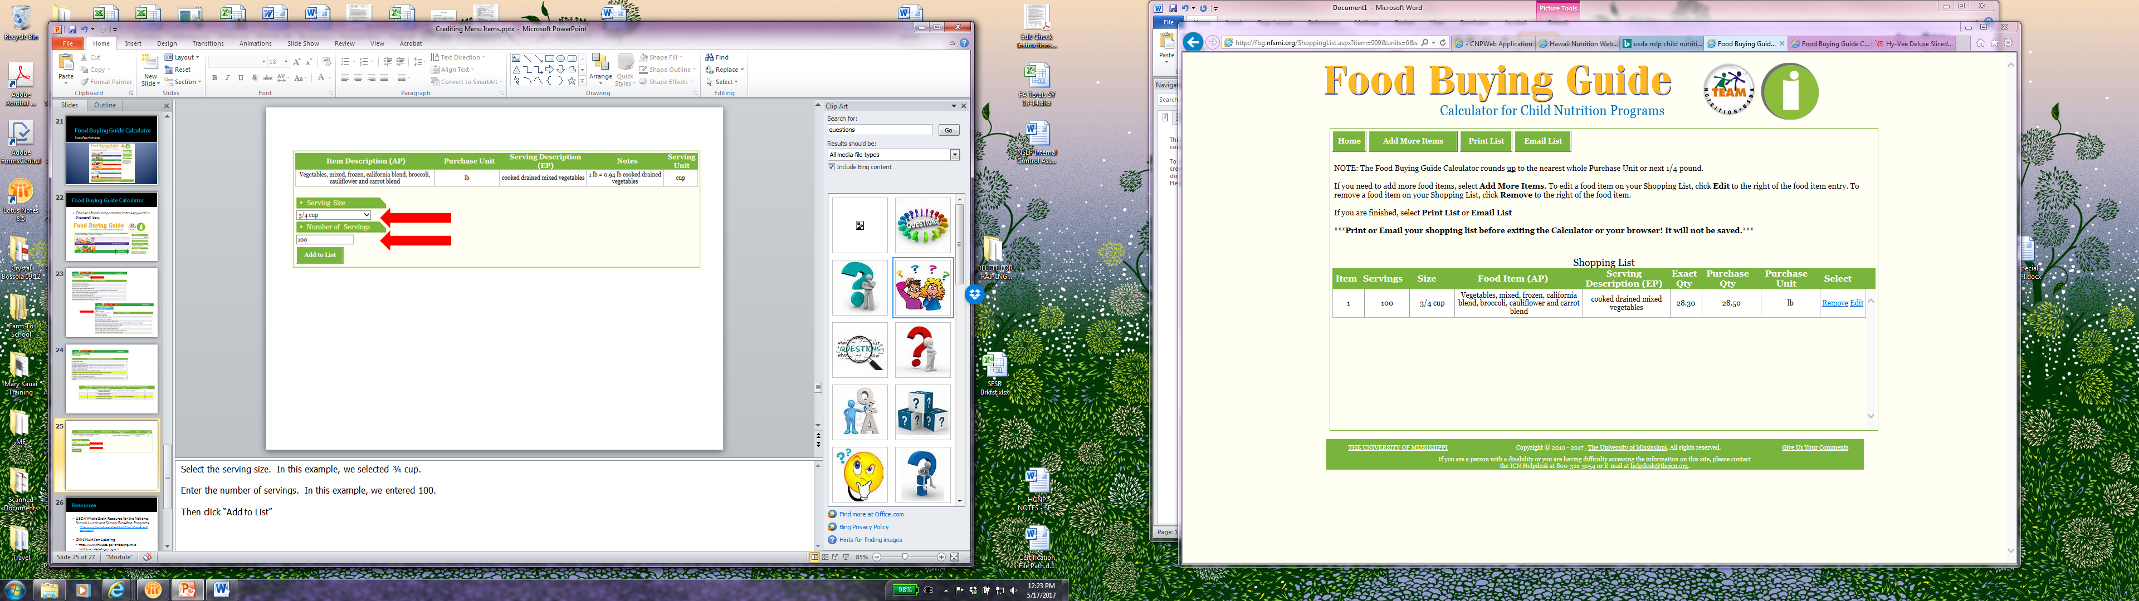
Notes:
Then, select the serving size. In this example, we selected ¾ cup.
Enter the number of servings. In this example, we entered 100.
Then click “Add to List”
The calculator will calculate how many pounds of product is needed to provide 100 - ¾ cup servings of vegetables. You can see that 28.3 pounds are needed but you would purchase at least 28.5 pounds.

Slide 33
Resources
USDA Whole Grain Resource for the National School Lunch and School Breakfast Programs
  https://www.fns.usda.gov/sites/default/files/WholeGrainResource.pdf
USDA Recipes for Schools
  http://www.nfsmi.org/Templates/TemplateDefault.aspx?qs=cElEPTEwMiZpc01ncj10cnVl
Child Nutrition Labeling
  https://www.fns.usda.gov/cnlabeling/child-nutrition-cn-labeling-program
Product Formulation Statements
  https://www.fns.usda.gov/cnlabeling/food-manufacturersindustry
Tip Sheet for Accepting Processed Product Documentation
  https://www.fns.usda.gov/sites/default/files/cn/cnl_tipsheet-processedproduct.pdf
Notes:
Here are a couple of resources that contain more information:
USDA Whole Grain Resource for the National School Lunch and School Breakfast Programs
USDA Recipes
Child Nutrition Labeling
Product Formulation Statements
Tip Sheet for Accepting Processed Product Documentation

Slide 34

Questions
This institution is an equal opportunity provider.

