Slide 1
Production Records
Hawaii Child Nutrition Programs
NSLP Training
SY 2016-17

Slide 2
Objectives
Upon completing this presentation, you will be able to:
  Recognize a production record (PR)
  Understand how the PR is a helpful management and communication tool
  Demonstrate how to use the Food Buying Guide Calculator
  Recognize all data required to be on a PR
  Exhibit the ability to complete a PR
Notes:
Upon completing this presentation, you will be able to:
Recognize a production record
Understand how the PR is a helpful management and communication tool
Demonstrate how to use the Food Buying Guide Calculator
Recognize all data required to be on a production record
Exhibit the ability to complete a production record

Slide 3

PR Defined: WHAT
A required daily documents that records all reimbursable meals prepared and served daily through the National School Lunch Program and School Breakfast Program.
Notes:
What is a production record? It is a document that records all reimbursable meals planned, prepared, and served through the school nutrition programs. Maintaining production records is a requirement of the Federal Regulations. This goes for all school nutrition programs including NSLP, SBP, Afterschool Snack Program (ASP), Seamless Summer Option (SSO), and Summer Food Service Program (SFSP).

Slide 4
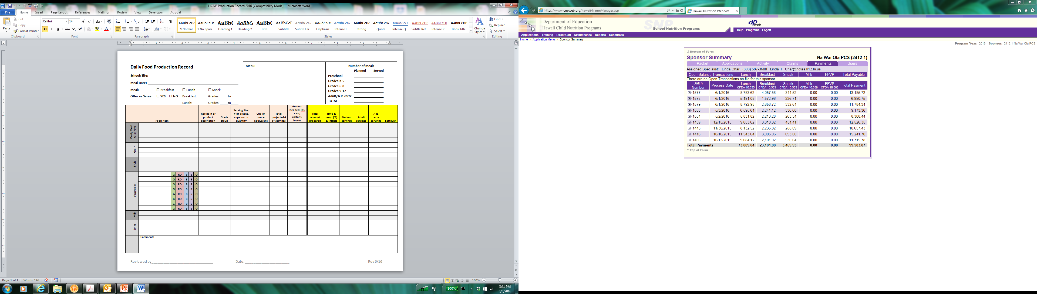
HCNP PR Template
Notes:
Here is an example of what a production record looks like. This is actually our template that we encourage everyone to use. If you choose not to use our template, your template must at least have all the same information as ours.

Slide 5

PR Defined: WHO
Menu Planner
Kitchen Manager
Production Staff
Notes:
Who is involved in completing a production record? Filling in a production records is a team effort between the menu planner, kitchen manager, and production staff.

Slide 6
PR Defined: WHY
To support meal claims submitted for reimbursement
To help manage the food service operation and communicate information necessary to produce compliant meals
To demonstrate compliance with the meal pattern requirements for each age/grade group
Records are reviewed by the State Agency during an Administrative Review
  Records must be kept for 3 years plus the current school year
Notes:
Why are production records required? Production records are your proof that a reimbursable meal was served and that all meal pattern requirements were met. They should support what you input on your month claims. Your production records should assist you in managing your food service operation as well as communicate the information necessary to produce compliant meals. We will review your production records during your Administrative Review, so it’s very important to keep your production records on file for the required 3 years plus the current school year.

Slide 7

PR Defined: WHEN
Information is recorded on the PR at three different times:
  Prior to production
  At the time of meal production
  Immediately after the meal service
Notes:
When are production records completed? There are three different times in which you should be documenting information on the production record. Prior to meal production, during meal production, and immediately following the meal service.

Slide 8

Important to Know
No Production Records = Fiscal Action!!
Notes:
No production records = fiscal action. If you fail to maintain records or have records that go missing, fiscal action will occur. Again, production records are your proof that you served your students a reimbursable meal.

Slide 9
Production Records act as a communication tool.
What useful information can be communicated between the menu planner and kitchen staff?
Notes:
As I mentioned earlier, production records can serve as a communication tool. What helpful information can the production record communicate? Just blurt some ways out.

Slide 10
Functions of a PR
PRs contain historical and future information about the meals planned, prepared, and served
You can use PRs as a management tool to:
  Evaluate acceptability of meals
  Plan future meals (forecasting)
  Order supplies
Notes:
Let’s go into further detail of some of the ways you just mentioned. Production records contain historical and future information about the meals you have planned, prepared, and served. As a management tool, you records can be used to evaluate the acceptance of meals, forecast future meals, and order supplies.

Slide 11
1. Evaluate Acceptability
What: Identify menu items with high or low customer acceptance. Identify food items that are increasing or decreasing in popularity over time.
Why: Improve customer satisfaction and increase participation in the program; reduce waste due to non-acceptance; increase cost savings
How: Use production and service information on past PRs to evaluate how well students accept a menu item.
Notes:
Evaluate acceptability. This is where you identify menu items with high or low customer acceptance and identify food items that increase or decrease in popularity over time. Why should you do this? So that you can improve your customer satisfaction and increase participation in the program. Because higher participation means more of your kids are being fueled to learn. Evaluating your production records can also help you reduce waste thus saving money. You can do this by using your production and service information of past production records to evaluate how well students accept a menu item. Are you making too much of a certain entrée? Is there an item that your students are totally not interested in that you should think about changing to something else? Let your production records help you to efficiently manage your kitchen.

Slide 12
2. Forecasting
What: Predict the number of portions to plan for future meal service
Why: Reduce the likelihood of food shortages or waste due to over-production; increase cost savings; communicate to kitchen staff how much food to prepare and serve
How: Past PRs are a valuable tool to forecast the number of future portions to plan, based on prior preparations of the same or similar menu item.
Notes:
Forecasting. Forecasting is predicting the number of portions to plan for a future meal service. You want to do this so that you can reduce your likelihood of food shortages or waste due to over-production. This in turn will save you money if effectively communicated to the kitchen staff. In order to forecast, you will need past production records in which the particular item was serve to help you predict the number of portions to plan.

Slide 13
2. Forecasting: 3-Day Moving
Average
Review past PRs for the last three times a menu item was offered.
Add the number of portions served on the past three service dates.
Take total and divide by 3 to get an average.
Menu Item | Number of Portions Served
 | 1/16 | 2/27 | 4/3
Pizza | 155 | 162 | 170
Notes:
Who here has heard of the three-day moving average? Show of hands. One way method of forecasting is the three-day moving average. In order to calculate the average, you’ll need to add the number of portions served on the past three service dates. Then you’ll take that total and divide by three to get an average. Round up to the nearest whole number.

Slide 14
2. Forecasting: 3-Day Moving
Average
Menu Item | Number of Portions Served |  |  | Forecast Calcu-lation | Number of Planned Portions
 | 1/16 | 2/27 | 4/3 |  | 5/15
Pizza | 155 | 162 | 170
Notes:
So on January 16, you served 155 slices of pizza. On February 27, you served 162. And on April 3, 170. Tell me how many slices you should serve on May 15.
=162.333333
Number of planned portions: 163
The moving part of this average comes when you plan the next meal service. You plan to serve pizza again on 6/26 and need to determine how many portions to plan. Drop the oldest date of service (in this example it would be 1/16) and move each date down one spot. So you would be adding 2/27, 4/3, and 5/15

Slide 15
2. Forecasting: 3-Day Moving
Average
Menu Item | Number of Portions Served |  |  | Forecast Calcu-lation | Number of Planned Portions
 | 1/16 | 2/27 | 4/3 |  | 5/15
Pizza | 155 | 162 | 170 | 162.3 | 163
Notes:
I got 162.3, so the number of planned portions should be 163. The moving part of this average comes when you plan the next meal service with pizza. You would drop the oldest date of service (in this example it would be January 16) and move each date down one spot. So you would be adding 2/27, 4/3, and 5/15.

Slide 16

3. Order Supplies
What: Determine amount and type of foods to purchase
Why: Save time; control costs; ensure quality
How: Use recorded information to quickly order or reorder products.
Notes:
Production records can also act as a tool for ordering supplies; assisting you in knowing what type of foods and how much to purchase. Using your production records during the ordering process can save you time, control cost, and ensure your purchasing quality foods.

Slide 17
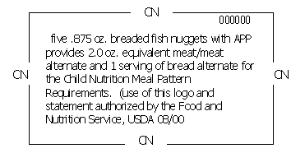
Supporting Materials
Cycle Menus
Menu Planning Template
Standardized Recipes
Product Formulation Statements
Child Nutrition (CN) Labels
Exhibit A
Notes:
Now we’re going to talk about what you need in order to correctly complete your production records. Most of these Rachel just covered with you, but we’re going to touch on them again.
Menus and planning templates – So of course you will need your cycle menus and your menu planning templates. These tell you when and what to serve on which day.
Standardized recipes – you have to know what all is in a recipe to complete your menu planning template. Are you crediting all that you can from a recipe? Say you have Spaghetti as the entrée. You’re probably counting the ground beef as the meat and the pasta as the grain, but are you counting the tomato sauce as a red/orange vegetable? Standardized recipes can tell you what and how much to credit.
Product formulation statements – are developed by manufacturers to provide specific information about their products. They typically include a detailed explanation of what the product contains and the amount of each ingredient in the product by weight. They also include how the products credit toward the meal pattern requirements. For example, say you are serving a granola bar at breakfast. The granola bar contains other ingredients such as dried fruit and nuts. You will need a product formulation statement to tell you how much grain you can credit towards the meal pattern.
Child Nutrition Labels – the picture on this slide is a child nutrition label. It’s a product label that contains a statement that clearly identifies the contribution that the product makes towards the meal pattern requirements. However, not all products come with a CN label, thus you will need a product formulation statement.
Exhibit A – tells you how to credit different grain items. Does everyone still have the copy Rachel gave you? Hold on to it because you may need it for an activity later.

Slide 18
Supporting Materials
Food Buying Guide
  Serves as the principal tool to determine how much food to purchase and prepare.
  Identifies each food item’s contribution to the meal pattern
  https://www.fns.usda.gov/tn/food-buying-guide-for-child-nutrition-programs
Food Buying Guide Calculator
  Individual calculators for each of the 6 food groups outlined in the Food Buying Guide.
  http://fbg.nfsmi.org/
Notes:
The food buying guide. I know Rachel just reviewed this, but just to tie it all in with production records. The guide serves as a tool to determine how much food you need to purchase and prepare. You can make your calculations based on the guide; however, the Institute of Child Nutrition has created a calculator for you. There’s a calculator for each of the 6 food groups based on the information in Food Buying Guide. Let’s do a sample calculation.

Slide 19
Sample Calculation
Use the following information to calculate how much food to order:
  Planned Menu Item: romaine lettuce
  Number of Portions Planned: 135
  Portion Size: ½ cup
  http://fbg.nfsmi.org/
Notes:
So we want to find out how much romaine lettuce we need in order to serve 135 students a ½ cup. We’re going to click on the vegetables group. Click on the food categories drop down menu, and select dark green vegetables. From here, we’re going to scroll down until we find romaine lettuce. Then find the option that best describes what you are planning to serve. Click on the serving size drop down menu and select ½ cup. Remember this is the planned serving size, not the equivalent. Green leafy greens credit as half the amount served. We are planning to serve ½ cup of romaine lettuce, but we will credit it towards the meal pattern as ¼ cup. Click on ½ cup and input the number of servings. 135. Then click on Add to List. So it calculated that we will need exactly 8.63 pounds for 135 servings. So I will need to purchase 8.75 pounds, and I would plan to serve the entire 8.75 pounds to have a little extra on hand.

Slide 20
Remember when to fill out PRs?
  Prior to production
  At the time of meal production
  Immediately after the meal service
Notes:
Going back to those three times when the production record should be filled out. 1. Prior to production. 2. At the time of meal production. And 3. Immediately following the meal service. Let’s go into further detail for each time.

Slide 21
Complete Prior to the Meal Service
Notes:
The circled areas are those in which should be completed prior to the meal service. The top left section is where you’ll put the name of your school, the date of the meal service, check which meal service it’s for, check if your school is participating in Offer vs Serve, and which grades you’re serving.
The box in the middle is where you’re going to write what is listed on your monthly menu. The one you send home with your students or post on your school website. All menu items should be listed here.
In the box on the top right, you’re going to put how many students you’re planning for.
In the big box/the left side of the production record, is where you’re going to put what and how much you’re planning for the meal service.
All four of these areas should be filled out prior to the meal service. I highly recommend typing out each day of your cycle menu on to a production record as a template or at least writing it in the day before the service. Mornings can get hectic and you can forget to prepare the production record for the meal service. This can lead to production records never being filled out.
Some of the information will always be the same; however you may not always need to serve the same amount. For example, you have 100 students at the school and you usually feed 75 of them. But it turns out that for some days, the menu is not very popular and you find you are only feeding 60. You need to change the information on the production record to reflect this. Or maybe there are a few classes out on a field trip. You wouldn’t want to make as much as you normally do.

Slide 22
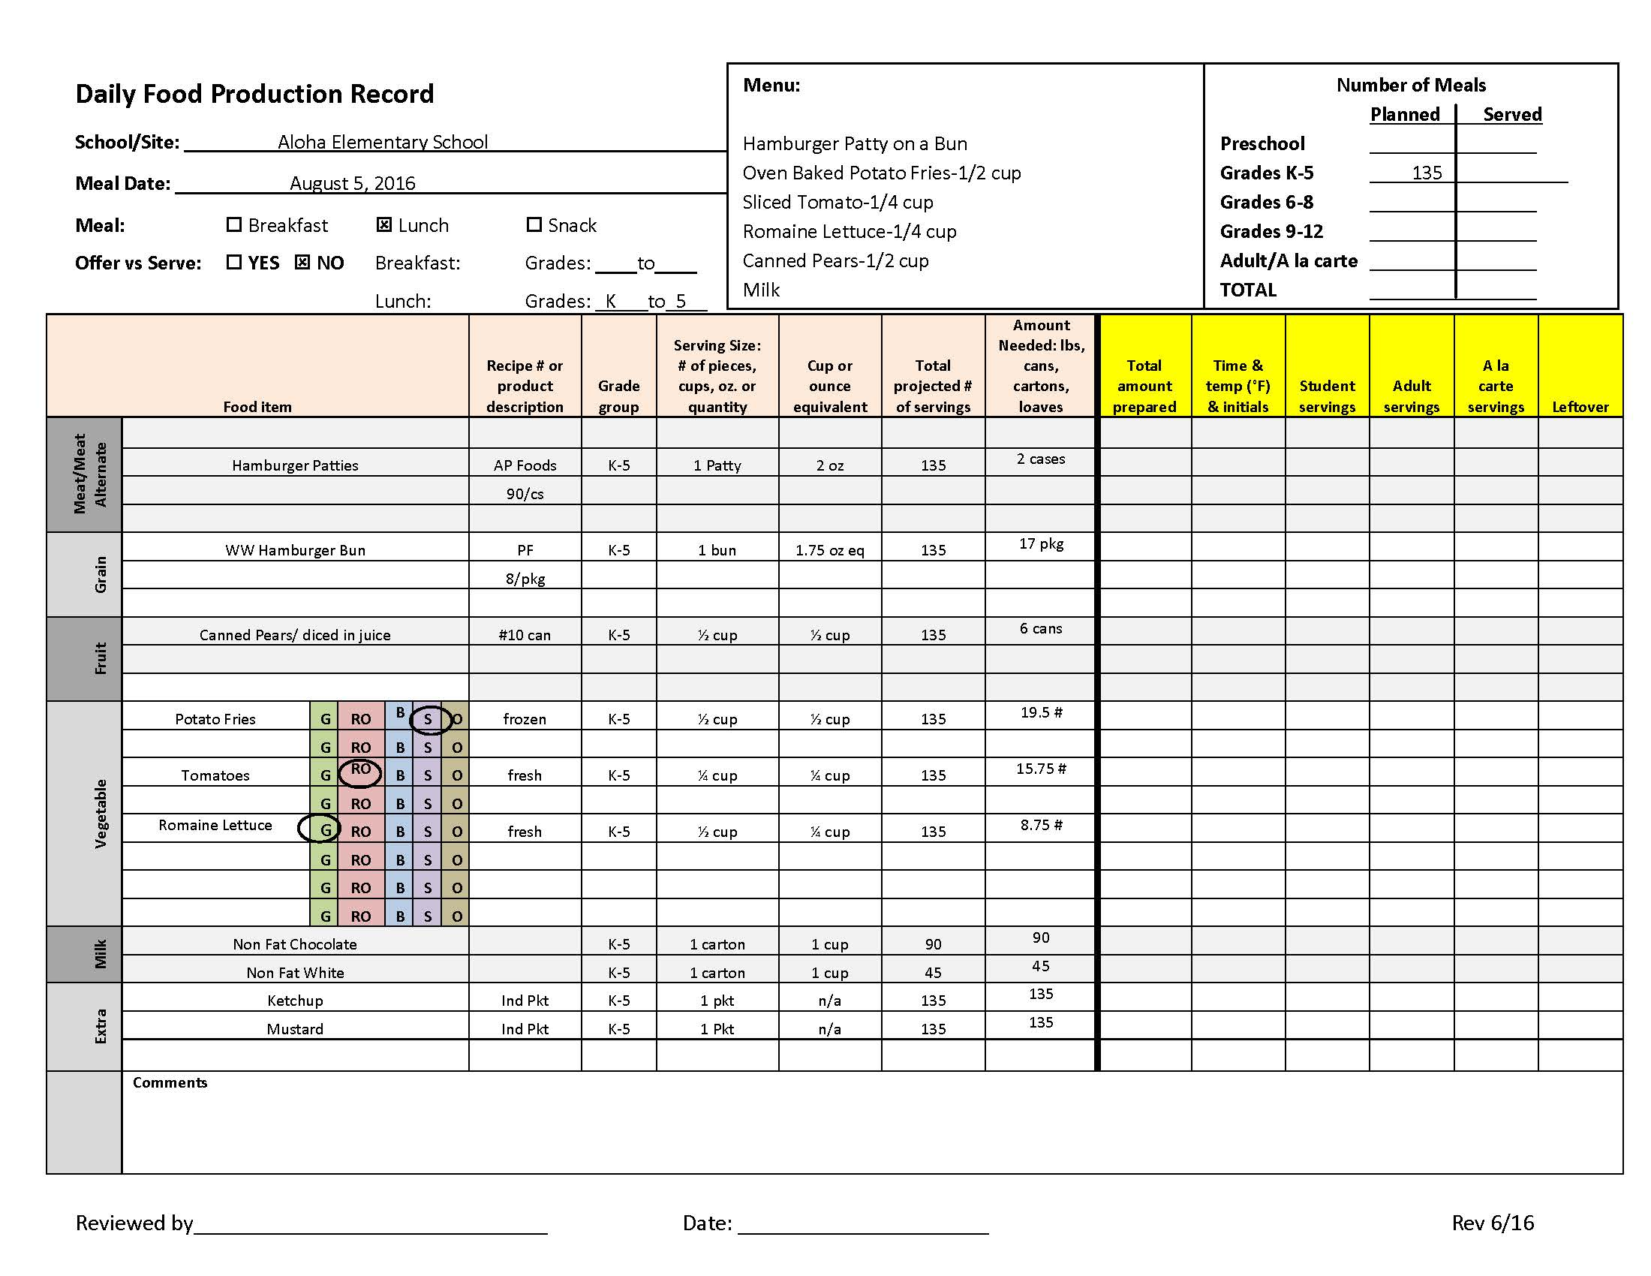
Notes:
Okay so here is an example of a production record template ready for meal service. As you can see there they have their school name, date, and service information. The menu is listed. They’re planning to have hamburgers with lettuce and tomato, French fries, pears, and milk. And they’re planning to serve 135 students grades K-5. In the “Food Item” column, they have listed the hamburger meat as the meat component, the bun as the grain, pears as the fruit, fries, tomatoes, and lettuce as the vegetables. Notice they circled which category each vegetable falls into. Fries are a starchy vegetable. Tomatoes are red/orange vegetable, and romaine lettuce is a dark green vegetable. The types of milk are listed in detail. They have nonfat chocolate and nonfat white. Then they have listed their condiments in the extra category.
The next column over is for product description. For the hamburger meat, the brand is listed. Same for the bread along with the amount per case and package. The pears are #10 cans, and the vegetables are either frozen or fresh. You can also put the brand and case size here so that it assists you better with future orders. For the milk, you can put the brand. And the condiments are listed as individual packets rather than self-service bottles (we highly encourage the use of packets or individual portions when serving condiments).
Then you have the grade group listed. We’ll touch on this more later.
In the serving size column, you want to put the actual portion size of each item listed in terms of pieces, cups, ounces, or quantity. So for the potion size of the hamburger patty, it’s one patty. The bun is one bun. ½ cup of pears, ½ cup fries, ¼ cup tomatoes, and ½ cup romaine lettuce. Milk is listed as 1 carton and the condiments as 1 packet each.
For the next column, this is how each food item credits towards the meal pattern. The meat/meat alternate and grain components should always be listed in terms of ounces. And fruit, vegetables, and milk should always be listed in terms of cups. So for the hamburger patty, it is a 2 ounce cooked patty, thus it is equivalent to 2 ounces of meat. For the hamburger bun, you will need the food label and Exhibit A to determine how many ounces of grain it contributes to the meal pattern. In this case, the bun is equivalent to 1.75 ounces of grain. For fruit a ½ cup is equivalent to ½ cup. The only time the fruit equivalent does not equal the exact measurement is when you’re serving dried fruit. Dried fruit credits as double the amount served. For example, 1/4 cup of raisins is equivalent to ½ cup fruit. For vegetables, ½ cup is equivalent to ½ cup. The only time the vegetable equivalent does not equal the exact measure is when you’re serving leafy greens. In this example, ½ cup of Romaine lettuce is equivalent to ¼ cup of vegetable. Milk is a cup to a cup, and extras do not count towards the meal pattern. So there will be no equivalent.
For the column – total projected # of servings – this is where you input how many portions you’re planning to serve. You will need to go back to the numbers you put in the top right box, the number of meals planned. You plan to serve 135 students, so you will need 135 hamburger patties. This particular school does not participate in offer versus serve, so they will need 135 of each of the food items. If your school participates in OVS, then your numbers would look a little different.
Next column, Amount Needed listed in terms of pounds, cans, cartons, packages, etc. This is the amount of each menu item you’ll need to produce the projected amount of servings. This is where the Food Buying Guide Calculator comes into play. So in our earlier calculator example, we wanted to know how much romaine lettuce we would need to serve 135 ½ cups. And we got 8.75#, right? So that’s what you put in this column. For the hamburger patties, they’re listed in terms of cases. We’ll need 17 packs of buns for 135 servings, and we’ll need 6 #10 cans for 135 ½ cups of pears. For milk, you’ll want to project how many students will want chocolate and how many will want white. Doing this reduces milk waste and cost.
Everything I just covered on this slide should be typed up before the actual meal service.

Slide 23


Complete Day of Meal Service
Record the food temperatures in ink, not pencil.
Notes:
Moving on to the two columns that should be completed during meal production. These are total amount prepared and the time and temperature of each food item. The total amount prepared should match the total amount planned, however there are times that it won’t. If there is a class field trip, you may need to prepare less than you had originally planned for. Or if you don’t have enough of a certain item on hand, you may have to serve what you have with the addition of a substitution. The amount documented should yield enough for each student to have the full serving. This is something we check during an Administrative Review.
Okay now the time and temperature column. We saw quite a few mistakes made here during our Administrative Reviews. You must document temperatures in ink, and you must record the actual time that you took the temperature. Do not write down the same time or temperature for all food items as it looks like you are not actually taking the time to take the temperature. If the same person is taking all of the temperatures, you can initial once at the top of the column. If multiple staff are filling in the temperatures, then you’ll have to squeeze it in.

Slide 24
Immediately after the Meal Service
Notes:
The circled areas are the ones in which you’ll complete immediately following the meal service. Fill in how many student servings, adult servings, and a la carte servings if applicable. You’ll also record that number in the top right box.
The leftovers column is another area where mistakes were seen. Leftovers must be documented. Documenting your leftovers is what helps you forecast and identify trends. Are you producing too much? Not enough? You won’t know that unless you document your leftovers.
The comments section is there for you to leave notes about the meal production and meal service. If you ended up not needing to prepare as much as you planned due to a class field trip, you would want to note that in the comments section.
Also, don’t forget to sign and date the form once completed.

Slide 25
Leftovers
Documenting your leftovers is very important for forecasting.
Document the number of portions you have left after the students have been served, but before the food is thrown away.
In the comments section or to the right of the leftover column, document what was done with the leftovers.
  Freezer (F), Cooler (C), Waste (W)
Notes:
Continuing with leftovers. Again it is important information. It doesn’t have to be exact measurements, but put the number of servings you think you have left. Don’t put 2 pans – that is vague information. I also encourage you to put an F, C, or W by each item to indicate if leftovers were placed in the freezer, cooler, or if they were thrown away.

Slide 26
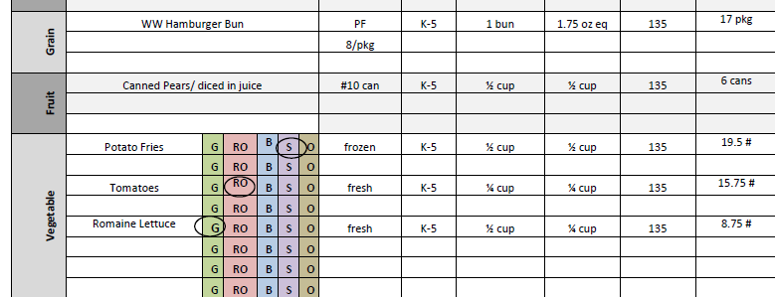
Substitutions
All substitutions must be recorded on the production record.
Mark one line through the original menu item and write in the substitution.
Complete PR on the new item
Canned Peaches
Notes:
Substitutions. All substitutions must be recorded on the production record. If you have to substitute an item, mark one line through the original product and write in the new product as I have shown you here. You will then complete the production record for the new item listed.

Slide 27
Separate Menus for Grade Groups
Notes:
If you have two separate menus for different age groups, you can include them both on one production record. You will just want to ensure you correctly fill in the top right box and separate each group as I’ve shown you here.

Slide 28
Activity
Fully complete a production record using the following information:
  No OVS
  Number of meals planned for:
    87 students K-5
    58 students 6-8
  Projected # of Servings: 145
  Menu:
    Corndog - 1
    Corn* – ¾ cup
    Peaches* – ½ cup
    Milk – 1% white and nonfat chocolate – 1 cup
    Ketchup and mustard packets – 1 each
    *Corn and peaches both from #10 cans
Notes:
Now we’re going to break into groups and fully complete a production record using the information I have provided you with and the labels that Rachel gave you in the last presentation. You are serving 145 students in grades K-8, and the menu is corndog, mixed vegetables, peaches, and milk. There is no separate menu. Don’t forget about your condiments. If you don’t have access to internet in order to look up the Food Buying Guide Calculator, we can do that part together. You will not be able to complete the right side of the production record. We’ll do that part later. Okay you have 10 minutes, go!

Slide 29
Activity
During meal production you prepare the amount you planned for.
All food items are within temperature requirements.
Fill in your production record with times and temperatures (don’t forget to initial!)
Notes:
Read slide.

Slide 30
Activity
Following the meal service, your POS system tells you:
  126 students took a reimbursable meal
About how many servings of each food item do you have left?
Fill in the remainder of your production record. You can decide what you do with your leftovers (F/C/W).
Notes:
Read slide

Slide 31

Discussion
  Share your answers
  What did you learn?
Notes:
Discuss the correct wat to complete the PR.

Slide 32
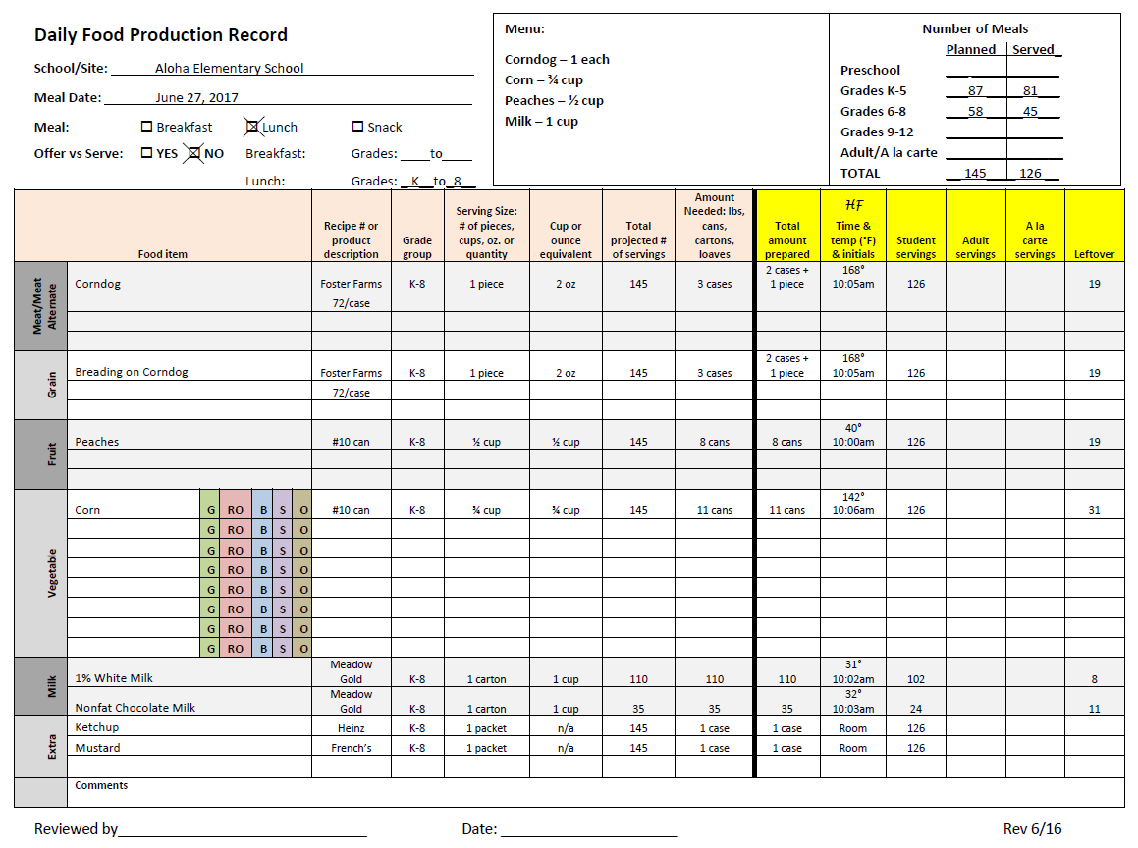

Slide 33


