Slide 1
Accommodating Disabilities in the School Meal Programs
Hawaii Child Nutrition Programs
June 2017 Training

Slide 2
Objectives
Learn the federal regulations which require schools to make reasonable accommodations for children with special dietary needs
Describe the responsibilities of school food service in complying with these regulations
Review the Special Diet Guidance as laid out in SP 26-2017
Notes:
Read slide

Slide 3
Laws and Regulations
The Rehabilitation Act of 1973
Individuals with Disabilities Education Act (IDEA)
Americans with Disabilities Act (ADA)
USDA nondiscrimination regulation (7 CFR 15b)
Memorandum SP 59-2016
Notes:
All guidance for accommodating special diets stems from these laws and regulations here. (Read law and regulations on slide) You’ll hear me reference these throughout this presentation. For the sake of time, I won’t go into great detail about each law and regulation, however I highly recommend reading in full SP 59-2016. This memo explains how each law and regulation relates to the Child Nutrition Programs.

Slide 4
What is considered a disability?
Any person who has a physical or mental impairment which substantially limits one or more major life activities, has a record of such an impairment, or is regarded as having such an impairment.
Section 504 of the Rehabilitation Act of 1973
Americans with Disabilities Act of 1990
Departmental Regulations at 7 CFR part 15b
Major life activities include, but are not limited to:
Caring for oneself, performing manual tasks, seeing, hearing, eating, sleeping, walking, speaking, breathing, reading, communicating
Major life activities also include the operation of a major bodily function including, but not limited to”
Functions of the immune system, normal cell growth, digestive, bowel, bladder, neurological, brain, respiratory, circulatory, endocrine, reproductive functions
Notes:
Read slide
SFAs should not be engaged in weighing medical evidence against the legal standard to determine whether a particular physical or mental impairment is severe enough to qualify as a disability. After the passage of the ADA Amendments Act, most physical and mental impairments will constitute a disability.
An impairment may be covered as a disability, even if medication, or another mitigating measure may reduce the impact on the impairment. For example: A child may be able to control an allergic reaction with medication, however that should not be a consideration in determining whether the allergy is a disability. Refer to SP 26-2017 – review pages 4-5 under What is a Disability

Slide 5
Medical Statement
Program regulations require SFAs to provide modifications for children with disabilities on a case-by-case basis when requests are supported by a written statement from a State licensed healthcare professional, such as a physician or nurse practitioner.
SFAs may choose to accommodate requests related to a disability that are not supported by a medical statement if the requested modification can be accomplished within the program meal pattern.
Meals that do not meet the program meal pattern are not eligible for reimbursement, unless supported by a medical statement.
Notes:
Read slide

Slide 6
Medical Statement
What should be included in the medical statement?
Description of the child’s physical or mental impairment that is sufficient to allow the SFA to understand how it restricts the child’s diet
Explanation of what must be done to accommodate the child; and
The food or foods that must be omitted and recommended alternatives, if appropriate.
Notes:
Read slide.
After second bullet point: The statement no longer has to state the actual diagnosis. It just has to explain how the child’s diet is impaired.
After reading the slide: If the child requires caloric modifications or the substitution of a liquid nutritive formula to accommodate a disability, this information must be included in the statement as well.

Slide 7
Who Can Sign the Statement?
May accept statements signed by:
Physicians
Nurse Practitioners
Physician Assistants
Note: A Registered Dietitian Nutritionist (RD or RDN) may assist in implementing meal modifications, as appropriate, but the medical statement must be signed by one of the professionals listed above.
Notes:
Read slide.

Slide 8
What if the statement is unclear?
The SFA should follow the portion of the medical statement that is clear to the greatest extent possible.
Immediately contact the child’s parent or guardian for guidance until an updated medical statement can be obtained.
If the statement is unclear and the parent does not know the proper modifications, request that the parent contact the physician for further instruction.
All communication with the parent should be documented including the instruction provided from the parent until an updated medical statement is received.
Notes:
Read title. For example: statement stated the child is allergic to nuts. You may want to gain clarification on what type of nut? And to what extent is the allergy. Does the student need to be assigned a designated seat in the cafeteria?
Read slide
After second bullet: Most parents requesting a special diet will have further direction regarding their child’s dietary needs than what is included in the medical statement.
After reading slide: Even after receiving the updated medical statement, I recommend documenting any communication with the parent that includes important information regarding the special meals. The primary goal is to feed a special needs child as soon and safely as possible.

Slide 9
Reasonable Modifications
A reasonable modification is a change or alteration in policies, practices, and/or procedures to accommodate a disability that ensures children with disabilities have equal opportunity to participate in, or benefit from, a program.
Special meals should be provided at no additional charge.
Most disabilities can be managed within the program meal pattern requirements when a well-planned variety of nutritious food is available to children.
If a child is allergic to pineapple, substitute with a different fruit.
If modification requests include a brand name item, in most instances, a generic brand is sufficient, unless the brand name is medically necessary.
Notes:
Read Slide.
After third bullet: Or a child is lactose intolerant, then you would substitute with a lactose-free milk.

Slide 10
Reasonable Modifications
Take every request at face value
Make accommodations where you can.
“Reasonable” is the key word
May be different for each situation
May not say “this goes outside of our district’s policy” – the disability law requires that you to make the necessary accommodations. For example: seating children with peanut allergies separately from other students.
Some burden for the district is always expected
Notes:
Read slide.

Slide 11
Reasonable Modifications
When determining what is appropriate, the age and maturity of the child should factor into all decisions.
Younger children may need greater assistance with selecting and eating their meals
Older children may be able to take a greater level of responsibility for some of their dietary decisions.
SFAs are not required to provide modifications that would fundamentally alter the nature of the program. SFAs concerned that a requested modification would alter the nature of the program should contact HCNP.
The emphasis should be on working with parents and guardians to develop an approach that will be effective for the child.
Notes:
Read slide.
After first bullet: Modifications should be assessed on a case-by-case basis. However it may be beneficial to create SOPs on common disabilities to ensure consistency.

Slide 12
Reasonable Modifications
In certain situations, disability accommodations may require additional equipment; separate or designated storage/preparation areas, surfaces, or utensils; and specific staff training and/or expertise. For example:
Some children may require the physical assistance of a food service aide to consume their meal, while other children may need assistance tracking their dietary intake (carbohydrates for children with diabetes)
Notes:
Read slide.

Slide 13
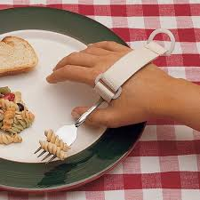
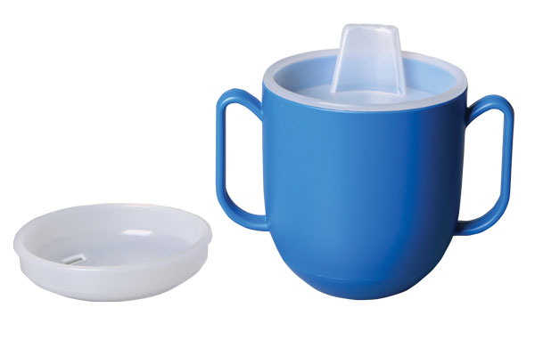
Accessibility
SFAs are responsible for the accessibility of food service areas and for ensuring the provision of food service aides, where needed, to assist in preparing and serving meal accommodations.
No additional school meal program reimbursement is available for these types of accommodations. However, any additional costs for adaptive feeding equipment or for aides are considered allowable costs for the nonprofit school food service account.

Slide 14
Can the SFA decline a requested modification?
It is almost never appropriate for an SFA to decline to provide an effective meal modification to accommodate a child’s disability, if the modification request is related to the child’s disabling condition.
If an SFA declines a request, the SFA must ensure that the child’s parent or guardian understands their rights under the Procedural Safeguards process.
Notes:
Read slide.
We’ll discuss the situations in which it may be appropriate to decline a request in just a minute.

Slide 15
Can OVS be used to accommodate a meal modification?
NO
Children with disabilities must have the opportunity to select all required food components for the meal. For example:
A child who has Celiac Disease or a gluten intolerance must have a choice of a bread/grain items that is gluten free.
Notes:
Read slide

Slide 16
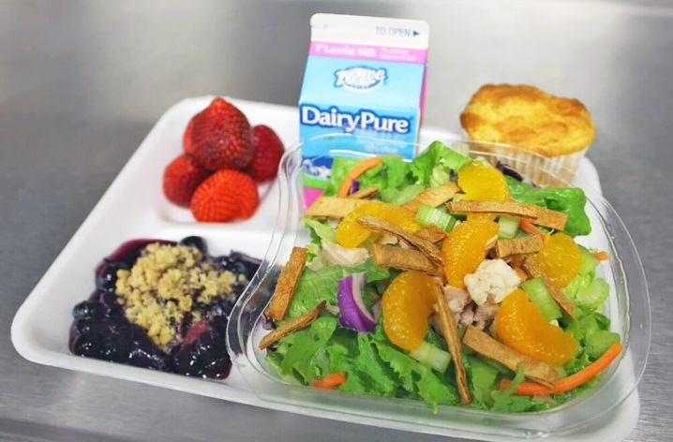
Accommodating modification requests for students who do not have a disability
SFAs are not required to make meal modifications for children without a disability.
Religious preferences, vegetarianism, low-carbohydrate diet
If the SFA chooses to provide a modification for a child without a disability, the modification must be consistent with the meal pattern requirements for the meal to be considered reimbursable.
Notes:
Read slide
If the meal is not in compliance with the meal pattern requirements and you do not have a medical statement, it is not considered reimbursable. Fiscal action will occur if this is found during an Administrative Review.
Also, if you choose to honor these type of meal modifications, you have to honor all students with the same request. You cannot pick and choose who you will accommodate.

Slide 17
Reimbursement
Modified meals are reimbursed based on the rate of the child’s eligibility for free, reduced price, or paid meals, regardless of the modification.
Meal modifications do not have to meet the program meal pattern requirements in order to be claimed for reimbursement if they are supported by a medical statement.
However, SFAs should ensure that meal modifications meet the nutritional needs of the child.
Notes:
After first bullet: The SFA will not receive additional reimbursement to cover the extra costs sometimes associated with providing a reasonable modification. However, you may use funds from the non-profit school food service account, the general fund, or special education funds (if specified in the child’s IEP – individualized education program)

Slide 18
Serving Meals in an Integrated Area
SFAs must provide all meal services in the most integrated setting appropriate to the needs of the disabled child.
Exclusion of any child from the program environment is not considered an appropriate or reasonable modification.
It may be appropriate to require children with very severe food allergies to sit at a separate table to control exposure, however it is not appropriate to also use this table to segregate children as punishment for misconduct.
Other children should be permitted to join the child with the food allergy, provided they do not bring any foods that would be harmful to the child.
Notes:
Read slide

Slide 19
Procedural Safeguards
The Procedural Safeguards process requires SFAs/LEAs to provide notice and information to parents and guardians regarding how to request a reasonable modification and their procedural rights, which include the right to:
File a grievance if they believe a violation has occurred regarding the request for a reasonable modification,
Receive a prompt and equitable resolution of the grievance,
Request and participate in an impartial hearing to resolve their grievance,
Be represented by counsel at the hearing,
Examine the record, and
Receive notice of the final decision and a procedure for review, i.e., right to appeal the hearing’s decision.
Notes:
Read slide.

Slide 20
Procedural Safeguards
SFA/LEA must designate at least one person to coordinate compliance with disability requirements.
This position is often referred to as the Section 504 Coordinator.
The 504 Coordinator who is responsible for addressing requests for accommodations in the classroom may also be responsible for ensuring compliance with disability requirements related to meals and the meal service.
All food service staff should be aware of the procedures and know how to contact the Section 504 Coordinator.
SFAs/LEAs are encouraged to develop a Section 504 Team to discuss best practices and develop a more holistic plan to create a safe learning environment for all children.
Notes:
Read slide.
The most effective team will include school food service staff, school administrators, school medical personnel, parents or guardians, children (when age-appropriate), and other school officials with relevant experience, such as school dietitians. Using a team approach ensures information is shared consistently throughout the school environment and will help to protect children in situations where food is served outside the cafeteria, such as classroom parties.

Slide 21
How often must the medical statement be updated?
When SFAs receive updated medical information, they must ensure that the medical statement on file reflects the current dietary needs of the participating child.
SFAs may require updates as necessary to meet their responsibilities, but should carefully consider the burden obtaining additional medical statements could create for parents and guardians when establishing such requirements.
Notes:
Read slide.
For those who already have medical statements on file, there’s no need to request a new statement unless you feel it’s necessary to have an updated version.

Slide 22
Discontinuing a Modification
It is not required to obtain a written document from a state licensed healthcare professional when rescinding the original medical order.
However, it is highly recommended that the SFA maintain documentation when ending a meal accommodation.
Ask the child’s parent or guardian to sign a statement indicating their child no longer needs a meal accommodation before ending the accommodation.
“If it’s not documented, it was not done.”
Notes:
Read slide.

Slide 23
Food Allergies
An immune system response to a food that the body mistakenly believes is harmful
Can range from relatively mild to severe (anaphylaxis)
Common food allergies are peanuts, tree nuts, milk, eggs, soy, wheat, fish, and crustacean shellfish
Meets the definition of “disability,” and the substitutions prescribed by the licensed physician must be made
Notes:
Now I’m going to discuss a few of the more common scenarios that you’ll see.
Read slide.

Slide 24
Food Intolerances
An adverse reaction to food that does not involve the immune system
Not typically a disability as defined under Section 504 of the Rehabilitation Act or Part B of IDEA
School food service may, but is not required to, make food substitutions for them
Follow prescribed substitutions if made by the licensed physician
Notes:
Read slide.

Slide 25
Diabetes
Disorder in which the body is unable to produce or to respond to insulin.
2 forms of diabetes:
Type 1
Type 2
Meets the definition of “disability,” and the substitutions prescribed by the licensed physician must be made
Notes:
Read slide.

Slide 26
Other Special Dietary Needs
Accommodations may be made for children with special medical or dietary needs, not considered disabilities
School food service’s discretion
Case-by-case basis
Examples:
High cholesterol
Lactose intolerance
Notes:
Read slide

Slide 27
Recapping Responsibilities
Must make food substitutions or modifications for students with disabilities
Substitutions and modifications must be based on medical statement provided by state licensed health care professional.
Under NO circumstances are school food service staff to revise or change a diet prescription or medical order.
Document, document, document
Retain documentation on site. Documentation will be asked for during an Administrative Review.
Ensure that the medical statement reflects the current dietary needs of the child. Request for the statement to be updated as needed.
Know the Procedural Safeguards process and how to contact the 504 Coordinator
Notes:
Read slide.

Slide 28
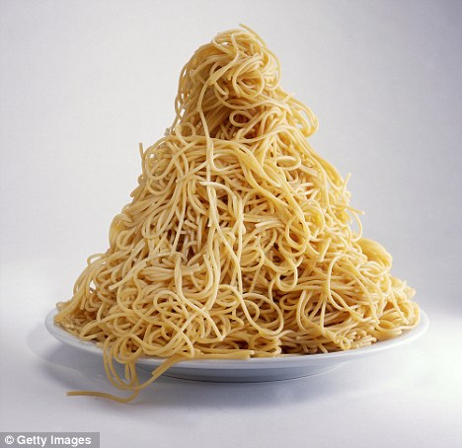
Situation #1
A licensed physician has prescribed portion sizes that exceed the maximum quantity requirements set forth in the regulations. Is the school required to provide these additional quantities?
Notes:
Yes. The school is required to provide additional quantities to accommodate the child.

Slide 29
Situation #2
A child’s parents have requested that the school prepare a strict vegetarian diet for their child based on a statement from a health food store “nutrition advisor” who is not a licensed physician. Must the school comply with this request?
Notes:
No. The school does not have to comply with this request since it is not a statement signed by a licensed professional. The school may decide to honor the request if they wish as long as the meal meets the meal pattern requirements.

Slide 30
Situation #3
A child has a life threatening allergy which causes an anaphylactic reaction to peanuts. The slightest contact with peanuts could be fatal. To what lengths must the food service go to accommodate the child?
Notes:
The school will have to prevent cross-contamination with separate prep and serving areas
The school may have to accommodate a separate dining area for the child.
The school may even need to establish a school wide ban on peanuts and foods made with peanuts to accommodate the child.

Slide 31
Situation #4
A school wishes to serve meals to children with disabilities in an area separate from the cafeteria where the majority of school children eat. May the school establish a separate facility for these children?
Notes:
No.
Schools must provide all meal services in the most integrated setting appropriate to the needs of the disabled child. It may appropriate to designate a separate table for children with severe allergies like the previous example, however, to require children to dine in an area other than the cafeteria would be inappropriate, unless stated in the medical statement.

Slide 32
QUESTIONS?

