Slide 1
Fresh Fruit and Vegetable Program
July 18, 2017 Training Session
Al Tachibana, Program Specialist
Fresh Fruit and Vegetable Program & NSLP Equipment Assistant Grants

Slide 2
A Brief History of FFVP
2002 – FFVP pilot began
  4 states / 1 ITO
2004 – FFVP permanent program under NSLA
  Only for 10 states / 2 ITOs
2006 – Expanded FFVP to six more states
2008 – Nationwide FFVP funding
  HAWAII began operating FFVP
  Consolidated Appropriations Act
  Farm Bill

Slide 3
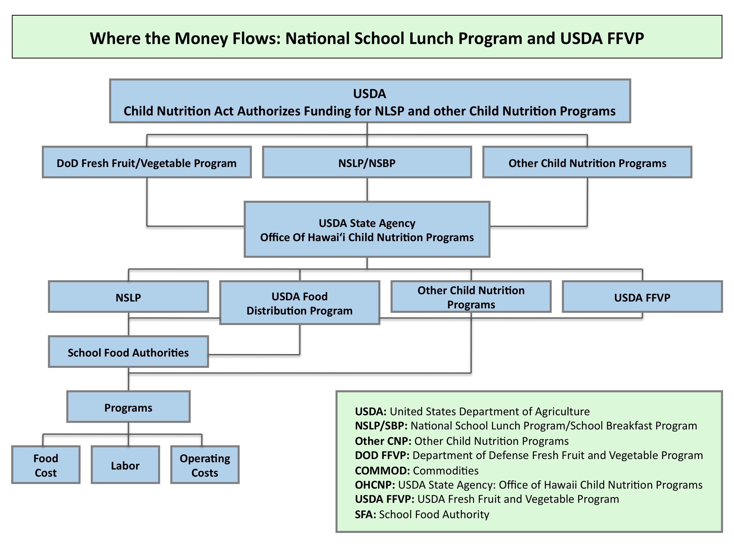

Slide 5
FFVP GOALS
Create a healthier school environment by providing healthy food choices.
Expand the variety of produce students consume.
Increase students’ produce consumption.
Make a difference in students’ diets to impact their present and future health.

Slide 6

F&V Riddle:
Why did the honeydew jump into the lake?

Slide 7

FFVP HANDBOOK (2010)

Slide 8
FFVP is…
A social equity program that addresses health disparities in our community
“FFVP is seen as an important catalyst for change in efforts to combat childhood obesity by helping children learn more healthful eating habits. The FFVP introduces school children to a variety of produce that they otherwise might not have had the opportunity to sample.” – FFVP Handbook, USDA

Slide 9
USDA Evaluation of FFVP
March 2013
Students at schools participating in FFVP consumed 15% more fruits and vegetables
Fruit and vegetable consumption increased by 1/3 cup among students participating in the program, compared to non-participating students
Increased fruit and vegetable consumption appears to have replaced consumption of other foods
Children in low socio-economic status households are more likely to have the lowest intakes of fruits and vegetables (Dubowitz et al., 2008)
http://www.fns.usda.gov/ORA/menu/Published/CNP/FILES/FFVP_Summary.pdf

Slide 10
FFVP Usage in Hawaii
July 2015-June 2016 claims
Any unused funding goes back to the USDA at the end of the year
In SY15-16, just 80% of Hawaii’s FFVP funds was used
In total, approximately $425,000 of available FFVP funds had to be returned to the USDA (incl. HCNP unused admin. funds)
For this SY16-17, we are looking at $1 million of FFVP funs returning to USDA
Notes:
Graph not linked to a table. Figures corrected but chart is not accurate.

Slide 11
Program Goals
Create a healthier school environment
Expand variety of fruits & veggies children experience
Increase fruit & veggie consumption
Make a difference in children’s diets to impact their present and future health

Slide 12
From 2012-2013 USDA Report of FFVP Implementation

Slide 13
Possible ways HCNP could help to make FFVP easier.
Provide more information on Fresh Fruits & Vegetables (much free materials can be downloaded from USDA Website)
Find additional vendors to keep cost down and have more choices (Procurement [proper purchasing of fruits and vegetables] is an ongoing and a growing focus throughout USDA programs) and is part of any program Administrative Review)
Provide a video to introduce the program and motivate kids to eat fresh fruits and veggies
Provide health and physical education resources and offer professional development opportunities
Work with communities partners like FoodCorps and the Hawaii School Garden Hui (HFSSGH) that can assist schools with their Wellness, FFVP, and Farm to School programs.

Slide 14
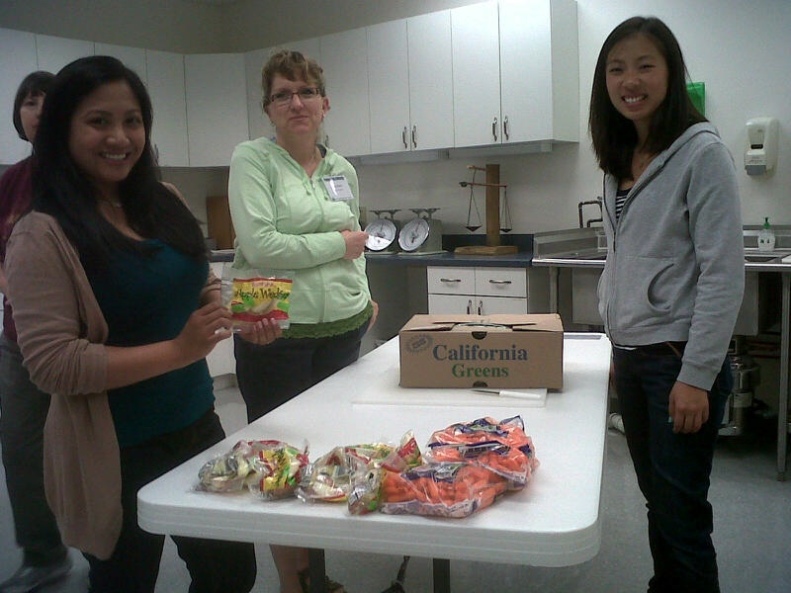
Program Objectives
Build a strong school-level FFVP team
Tie FFVP into school’s Wellness Plan
Develop effective program Action-Implementation Plan
Integrate FFVP into core curriculum
Create healthier school community
Develop nutrition education
Manage budget & claim procedures

Slide 15
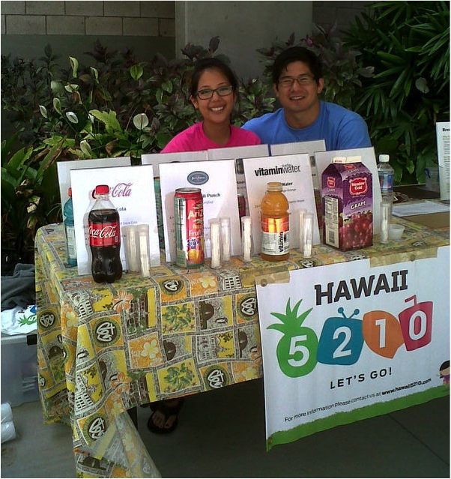
Work with National, state and local partners…
Action for Healthy Kids, Alliance for Healthier Generation
Community Health Center, Public Health Nurses
Hawaii Education Matters, PTSA, Parent Groups
Kokua Hawaii Foundation, Hawaii School Garden Network
Hawaii 5210, Kaiser Permanente, HMSA
FoodCorps

Slide 16
School Eligibility
Must be a school serving K-6th grade
Operate NSLP
Submit a yearly application
Priority schools have 50% or more of students eligible for free or reduced price meals
Committed to fulfilling program objectives

Slide 17
Approved Schools
Receive funds based on an allocation of $50 - $75 per student
Must submit a correct monthly claim on time and stay within budget
10% administrative (DOE schools 7%) – for planning, paperwork, nutrition education planning, not prep/service
Up to 20% for program operating costs to include salary and fringe benefits for employees who wash, prep, distribute and serve food

Slide 18
Handbook Highlights
FFVP encourages… (pg. 8)
  Schools to make “every effort to provide fresh fruits and vegetables a minimum of twice a week as repeated exposure to new foods is a key to acceptance”
  A variety of implementation strategies
  Complementary nutrition education
Schools should develop guidelines to remind children of good manners when they receive and eat their fruit and vegetable snacks, and to dispose their trash (pg. 13)

Slide 19
Handbook Highlights
FFVP does not allow (pg. 14)
  Processed or preserved fruits and veggies (canned, frozen, or dried)
  Dip for fruit
  Fruit Strips, Leather, Jellied Fruit, Trail Mix
  Fruit or Vegetable juice, or FV Pizza
  Smoothies
Only teachers who are directly responsible for serving FV to their students in a classroom setting may partake in FV (pg. 10)
Free FV cannot be used as gifts or rewards. FV cannot be withhold as a form of discipline (pg. 10)

Slide 20
Handbook Highlights
Limitations (pg. 15)
  Dips for veggies
    Must be yogurt-based, or low-fat/non-fat dips
    Serving size limited to 1-2 tablespoons
  Service of “prepared” vegetables
    Fresh vegetables that are steamed or baked such as sweet potato and kalo, or stir fried, must be limited to once-a-week and always as part of a nutrition education lesson related to the prepared item

Slide 21
Handbook Highlights
Leftovers (pg. 18)
  Plan to reduce waste (order as accurately as possible)
  Follow safe food storage practices
  If still good, use leftover FV in next FFVP snack
  Leftover FV should not be going home with staff or teachers

Slide 22
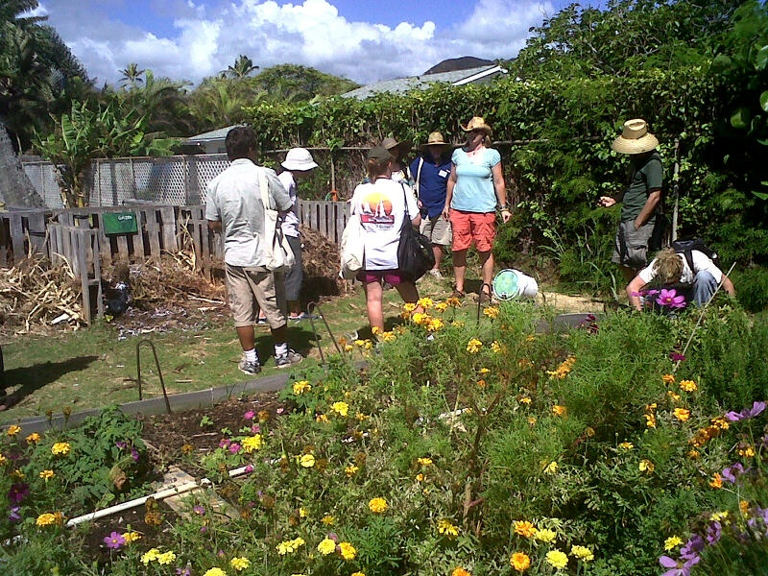
Program Implementation (strongly suggested for successful program)
Program should begin within 30 days of the start of the school year
Snack days are consistent and integrated in weekly schedule
FFVP is integrated into core curriculum
Plan ahead – create a full years calendar with seasonal produce
Establish relationship with vendors
Involve faculty and staff, PCNC, parents and Wellness Team

Slide 23

Best times and Places to Serve
Do serve during the school day as snack
Do not serve during breakfast, lunch, after school or summer school.
Do serve inside classrooms, hallways, kiosks
Integrate within a core subject and as part of a nutrition education activity

Slide 24
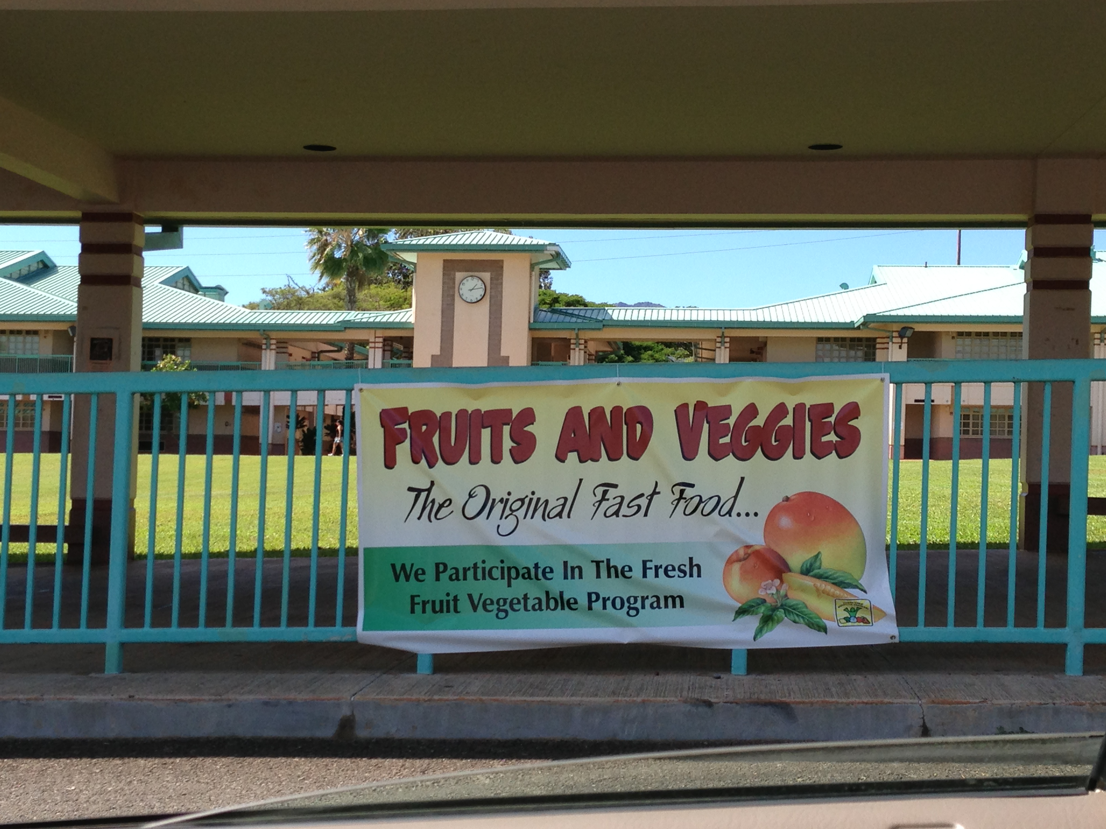
Marketing and Promotion
No funds available for promotional activities
Lots of resources on the internet
Invite community partners and local resources to assist
Engage the entire school community and integrate FFVP into all of your school programs and special events

Slide 25

Nutrition Education
Make nutrition education a priority in Wellness Policy and school’s Academic and Financial Plan
Integrate nutrition education into core subjects: language arts, math, art, science
Consider planting a school garden

Slide 26
School Environment
Create FFVP bulletin board, posters
Create a snack, celebration, fundraising policy consistent with Wellness Guidelines
Invite local chefs to participate in food demonstrations
Use vendors as resources
Have parent-child cooking classes
Develop a year-round theme:
  Eat a Rainbow – Each week a different color
  Seasons/Holidays/Cultures – Each month

Slide 27

FFVP and the Wellness Policy
FFVP guidelines support efforts of school’s Wellness Policy

Slide 28

5 Steps Towards Creating a Healthier School
1. Get Local Support
  To access local resources, banners, brochures, flyers, posters, speakers, training and funding opportunities, register to become a Hawaii 5210 school at http://www.hawaii5210.com

Slide 29
Contact Information
Mahalo!
Al Tachibana
Fresh Fruit & Vegetable Program
650 Iwilei Road, Suite 270
Honolulu, HI 96817
Alvin_Tachibana@notes.k12.hi.us
Office: 808-587-3600

Slide 30
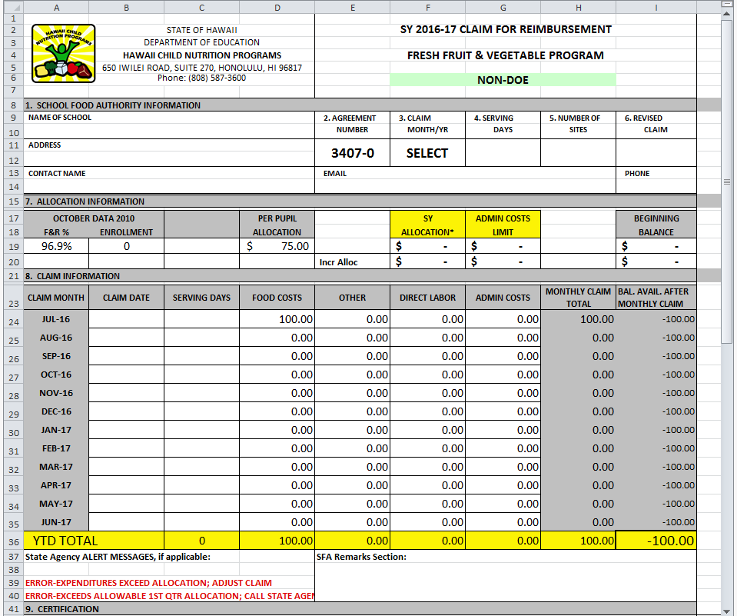
FFVP CLAIMS WORKSHEET

Slide 31
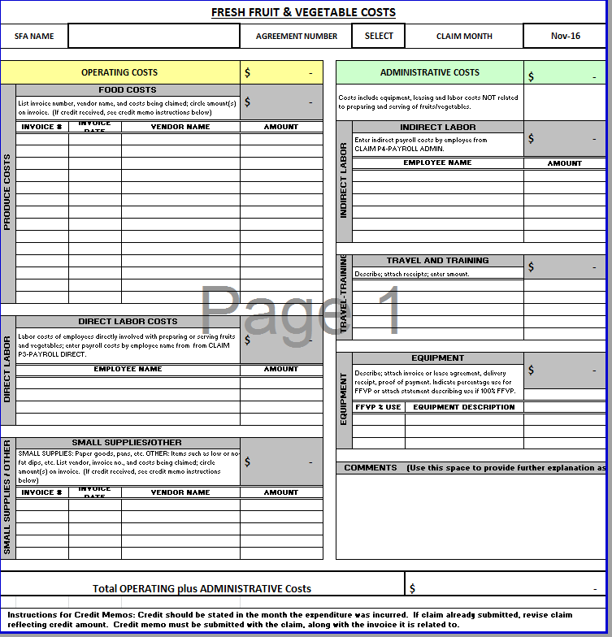
FFVP MONTHLY CLAIM

