Slide 1
How to Register for a Course/Training on HCNP_S
HCNP Systems CNPweb™
Sponsor/SFA Procedures
Step-by-Step
Notes:
Hi! Welcome to How to Register for a Course/Training on the HCNP Systems. From now on this is how you the Sponsors/SFA’s will register for the annual training courses offered by HCNP on our HCNP system. You can access HCNP_S on www.cnpweb.org/hawaii or go to http://hcnp.hawaii.gov/ and look for HCNPSystems on the homepage. Please note that this presentation is for both NSLP and CACFP, so please pay attention to your program specific instructions.

Slide 2
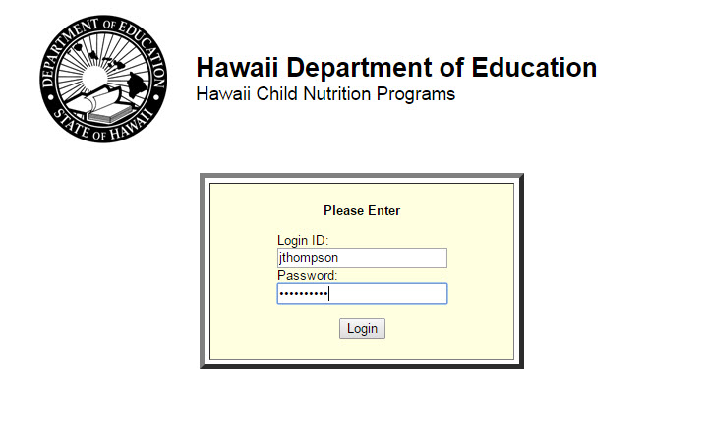
Step 1: Login to HCNP_S
Website: www.cnpweb.org/hawaii
Notes:
Now getting right into it, Step 1 would be to login to HCNP Systems using your login ID and password. Make sure everything is correct and click login.
*If you cannot login to your account or do not have an account please contact HCNP.
Update all users + passwords before starting school year.

Slide 3
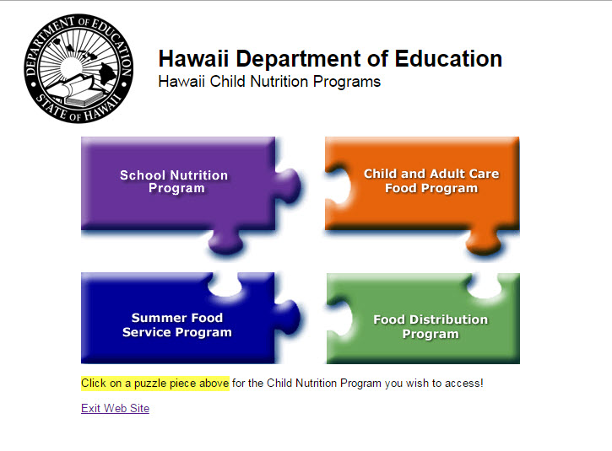
Step 2: Click to Select your CN Program
NSLP, CACFP, or SFSP
Notes:
After you have successfully logged in, Step 2 would be to select your Child Nutrition Program. NSLP Sponsors would click the School Nutrition Program Purple Puzzle Piece and CACFP Sponsors would click the Child and Adult Care Food Program Orange Puzzle Piece.

Slide 4
Step 3: Click through the Notice Screen
Notes:
After clicking your correct CN program you should see a notice screen with your program and specialist’s email on it. Step 3 would be to click the continue button either on the top or bottom of the notice screen.

Slide 5
Step 4: Click to select current Program Year
Program Year has a begin date and an end date
To choose the current program year, choose the year of when the dates of the training courses fall in between the begin date and the end date
Ex. Between July 1, 2015 (begin date) to June 30, 2016 (end date), PY = 2016
Notes:
Now you will see the Program Year Selection, so Step 4 would be to click on the current Program Year. In order to do so, you have to figure out which program year it is. To choose the current year, look at the program’s year begin date and end date. If the Training Course, you wish to register for is in between those dates you would click on that year. For example: NSLP Program Year starts on July 1 and ends on June 30 of the following year. You would pick the year that the June falls on. EXAMPLE: If the training course is between July 1, 2015 (begin date) to June 30, 2016 (end date), the Program Year would be 2016.

Slide 6
Step 4: Click to select current Program Year (cont’d)
NSLP
CACFP
Notes:
To get a better picture here is what NSLP and CACFP Program Year Selections look like. NSLP in purple and CACFP in orange. To Select a Program Year Click the year underlined in BLUE.

Slide 7
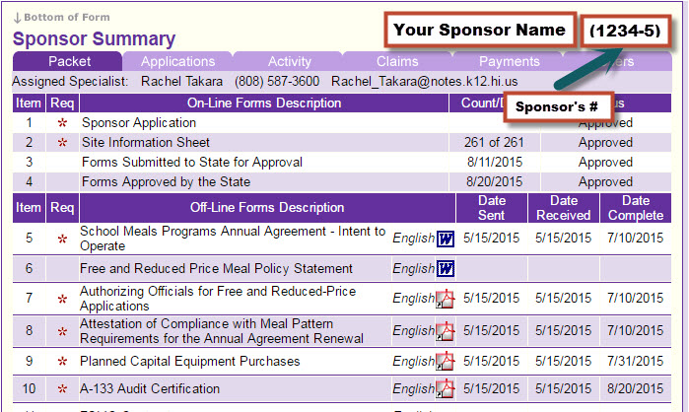
Step 5: Look over Sponsor Summary
Sponsor Summary will appear, ensure that this is your Sponsor
Notes:
After you have selected your current program year, now you will see the Sponsor Summary screen that looks like this. Step 5 is to ensure that this is your Sponsor by checking on the upper right corner for Your Sponsor Name and the Sponsor’s number.

Slide 8
Step 6: Click on the Training Menu link
Upper left-hand side of webpage next to Applications
Notes:
On the same page as Sponsor Summary, look to your upper left hand side of the page and you will see the Training menu right next to where it says Applications. Step 6 would be to click on the Training Menu.

Slide 9
Step 7: Click on the Sponsor Registration Entry Link
Under Training Menu → Menu Item
Notes:
After clicking Training Menu it will direct you to the Training Menu items: this includes view course requirements, sponsor registration entry, and attendee course evaluation. For Step 7, you want to click Sponsor Registration Entry.

Slide 10
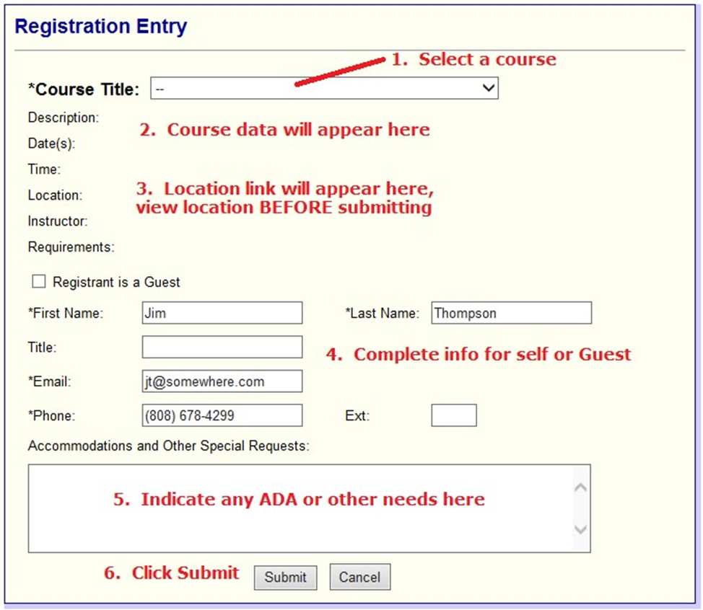
Step 8: Complete Registration Entry Form
***Following slides will have explicit instructions to fill out the Registration Entry Form
Notes:
Now you have the Registration Entry form, for Step 8 you will need to complete the registration entry form and we will break it down in the following slides.

Slide 11
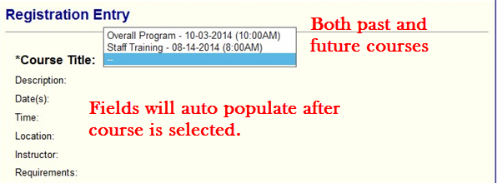
Step 8: Complete Registration Entry Form (cont’d)
Select your desired Course (*Course Title)
Notes:
Step 8 #1: Select your desired course. When you click on the drop down list on right of the *course title, it will populate future and past courses for you to select from. The Course Title will also include the Date & Time.

Slide 12
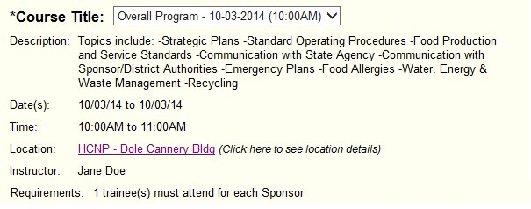
Step 8: Complete Registration Entry Form (cont’d)
Look Over Course Data
once course is selected, course data will appear
ensure it is your desired course
Notes:
Step 8 #2: After you have selected your desired course, you will look over your course data and ensure it is your desired course. The Course data will include a short Description of the course, Dates, Time, Location, Instructor, and requirements.

Slide 13
Step 8: Complete Registration Entry Form (cont’d)
Click Location link to see Facility Details
Click this link to
see Facility Details
Notes:
Step 8 #3: While looking over the course data, make sure you know which facility the course will be held at. So for further location details, click on the location link. This will be underlined and have in parentheses (Click here to see location details).

Slide 14
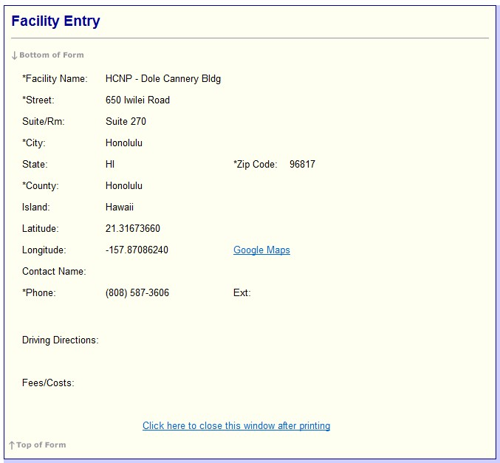
Step 8: Complete Registration Entry Form (cont’d)
Location link will appear here → Facility Details, view location BEFORE submitting
Verify island is okay
Goes to Google map
of Facility’s exact
location
:
Notes:
After clicking the Location link, you will be directed to another page Facility Entry which will have more Facility details such as Facility Name, Address, Contact name and phone number of the Facility, and there will also be google maps available for directions.

Slide 15
Step 8: Complete Registration Entry Form (cont’d)
Complete info for Self or Guest
if Guest, click box that indicates “Registrant is a Guest”
Registering someone as a Guest should only be used for Sponsor employees who must receive training that are NOT users of CNPweb
Notes:
Step 8 #4: After looking thoroughly over the course data and facility details, now you can fill out registrant information.
If you are registering yourself, and logged in as yourself, the information will populate for itself. So just look over it and clarify it is the right information.
If you are registering for someone else, you will click the box that says “Registrant is a Guest” and the information for yourself will disappear and you will fill out the Guest Registrant information. Registering someone as a Guest should only be used for Sponsor employees who must receive training that are NOT users of CNPweb.

Slide 16
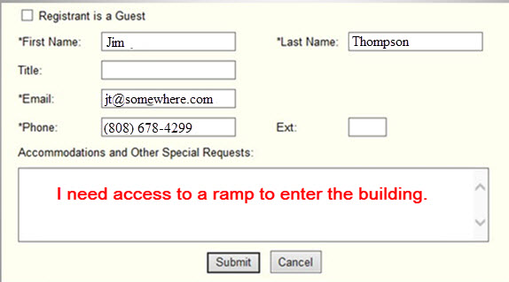
Step 8: Complete Registration Entry Form (cont’d)
Indicate any ADA or other needs (accommodations)
Click Submit
Notes:
Step 8 #5: After you are done in putting the Registrant Information then you can indicate any ADA or other needs (accommodations) you will need. For example: if you have a facility request and need a ramp to enter the building just input “I need access to a ramp to enter the building.”
#6: Once you check that all the information that is on your Registration Entry Form is accurate and complete, you may now click Submit.

Slide 17
Step 9: Print your Registration Entry
Click Training Menu link
Notes:
So, Step 9 would be to print out your registration. So in order to get back to your registration form, #1 would be click the Training Menu link.

Slide 18
Step 9: Print your Registration Entry
Click on View Course Requirements
Under Training Menu → Menu Item
Notes:
Step 9 #2: Click on View Course Requirements, this would be Under Training Menu.

Slide 19
Step 9: Print your Registration Entry
View Course Requirements → Courses for User
The “Sponsor Course Requirements” page lists all of the courses available in the Program Year and their scheduled status.
You may also use this page as another way register for a course
Notes:
Step 9 #3: After clicking view course requirements, you will see all the courses required for the user you are logged into. The “Sponsor Course Requirements” page lists all of the courses available in the Program Year and their scheduled status. You may also use this page as another way register for a course.

Slide 20
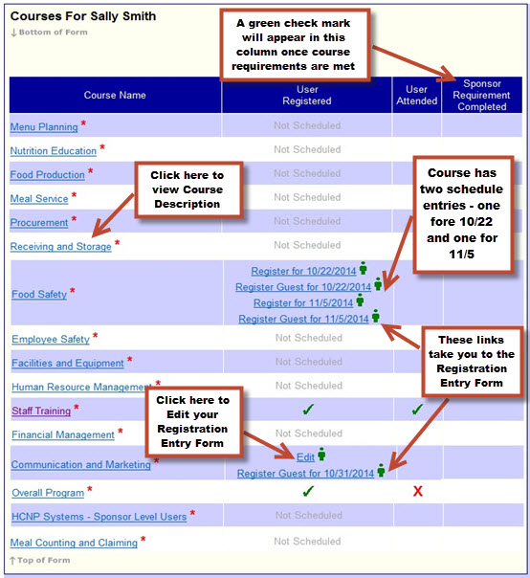
Notes:
This is what it should look like, but for today’s purpose we will not be going over each text box, but you can look at it during your own time to review.

Slide 21
Course Requirements Legend
= Course is required for the selected Sponsor
= Sponsor has met the courses requirement
= Course has not reached capacity, i.e., it is not full and Sponsor users can still register for it
= Course has reached capacity, i.e., it is full and no more registration will be allowed
= Sponsor has registered for a course and does not attend, after the course has been taught
Notes:
Here is the Course Requirements Legend that you can use for the previous slide, again you may review this at your own time.

Slide 22
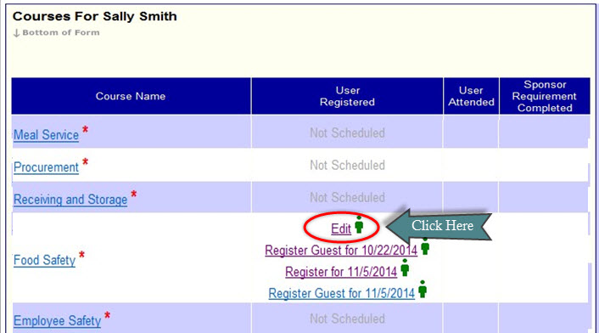
Step 9: Print your Registration Entry
Look under Course Name for the course that you just registered for
Click Edit
Notes:
So moving on to Step 9 #4: Look under Course Name for the course that you just registered for
On the right of the course name it should have several different links, so for Step 9 #5: click on Edit to view your registration entry.

Slide 23
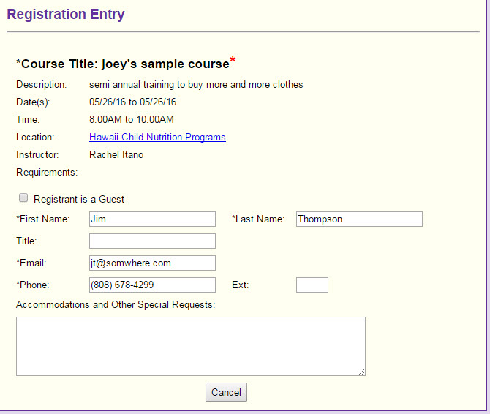
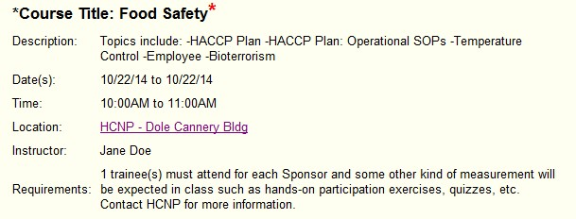
CONGRATULATIONS! YOU’RE DONE WITH REGISTRATION!
Print this out & BRING TO CLASS!
Notes:
Then it will take you to the Registration Entry form. All you need to do is print this page and bring it with you to the Training course you have registered for and will be attending. For PC, press Ctrl + P. AND YOU’RE DONE!

Slide 24
To track your training hours for this training session:
USDA Professional Standards Learning Objectives
Key Area 3: ADMINISTRATION
→ Program Management (3200)
This institution is an equal opportunity provider.
Notes:
Thank you so much for listening to the How to Register for a Course/Training on the HCNP Systems Training session! To track your training hours for this training session: USDA Professional Standards Learning Objectives Key Area 3: ADMINISTRATION → Program Management (3200). This institution is an equal opportunity provider.

