Slide 1


Civil Rights and
Child Nutrition Programs
(revised 7/2016) by
Hawaii
Child Nutrition Programs
Notes:
Introduction: Pass out handouts and sign in
Hello everyone thank you very much for attending our annual training. Today we are going to review Civil Rights Compliance in the Child and Adult Care Food Program. The propose of this training is to assure that all your staff understand and can recognize discrimination, Civil Rights complaints, and procedures.

Slide 2
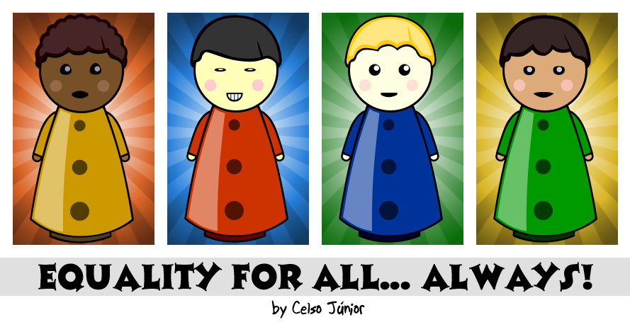
What are
Civil Rights?

Slide 3
Civil rights are the rights of individuals to receive equal treatment (and to be free from unfair treatment or "discrimination") in a number of settings; including education and employment.

Slide 4

Civil Rights and Child Nutrition Programs
Benefits of Child Nutrition Programs (CNP) must be available to all eligible people in a nondiscriminatory manner.
All Institutions participating in a Child and Adult Care Food Program (CACFP) and receiving federal $$ must implement civil rights requirements.
Notes:
Read all slide

Slide 5

History of Civil Rights Laws
Title VI of Civil Rights Act of 1964- Prohibits discrimination on the basis of race, color and national origin.
Title IX of Education Amendment of 1972- Prohibits discrimination on the basis of sex.
Section 504 of Rehabilitation Act of 1973- Disability
Age Discrimination Act of 1975- Prohibits discrimination on the basis of age.
Civil Rights Restoration Act of 1987- Recipients of federal funds must comply with civil rights laws in all areas, not just programs receiving federal funding.
Notes:
These are the important Civil Rights Laws

Slide 6


What is Discrimination?

Slide 7

Discrimination is the unjust or prejudicial treatment of different categories of people or things, especially on the grounds of race, color, age, sex, national origin, or disability.
Notes:
Read slide

Slide 8

Discrimination
The 4
“D”s
When an individual or group of individuals are:
Delayed in receiving benefits or services others receive
Denied benefits or services others receive
Treated Differently than others to their disadvantage
Given Disparate treatment for something which does not seem discriminatory, but has a discriminatory impact.
Notes:
1.) These are the 4 D’s when determining discrimination
1.) Read slide

Slide 9
Areas of Compliance
Annual Training
Assurances
Public Notification System
Data Collection
Reasonable Accommodation of Persons with Disabilities
Limited English Proficiency
Customer Service
Conflict Resolution
Complaint Procedure
Compliance Review
Resolution of Noncompliance

Slide 10
CACFP Meal Compliance
CACFP meal benefit forms (MBF) must be distributed and processed in a nondiscriminatory manner.
Meal benefit forms must accessible to all.
Distribution of MBF’s must be done in a way that does not discriminate within the six protected classes.
Does meal service allow equal participation regardless of race, color, sex, age, national origin, or disability?
Notes:
Read all slide

Slide 11
Civil Rights Training
All staff should:
Receive training on compliance annually
Be able to identify complaints
Handle complaints in accordance with procedures
Understand basic right of individual to file complaint
Notes:
Identify

Slide 12

CNPs have six
“Protected Classes”
Race
Color
Sex
Age
National Origin
Disability
Notes:
The class of religion is not a protected class in the Child Nutrition Program

Slide 13
Assurances
To qualify for Federal assistance, the Institution must provide written assurance that CNP will operate in compliance with all nondiscrimination laws, regulations, instructions, policies, and guidelines.
Covered in “Agreement Between the Institution and the Department of Education, Hawaii Child Nutrition Programs”
Notes:
1.) Read Slide
2.) The Institution’s agreement defines your compliance.

Slide 14

“And Justice For All”
Poster must be displayed in prominent areas where participants and potential participants will be able to view it.
Notes:
14
You can place the poster in the meal service area, school lobby, or in the Main Office. It has to be visible to the children, teachers, and parents. We do have posters in our office for your Institution so let me know your needs. You also need to check to see that you have the current poster. Failure to post current poster will be a finding during a review. 1999 revised

Slide 15

Nondiscrimination Statement Long Version (part 1)
In accordance with Federal civil rights law and U.S. Department of Agriculture (USDA) civil rights regulations and policies, the USDA, its Agencies, offices, and employees, and institutions participating in or administering USDA programs are prohibited from discriminating based on race, color, national origin, sex, disability, age, or reprisal or retaliation for prior civil rights activity in any program or activity conducted or funded by USDA.

Slide 16
Nondiscrimination Statement Long Version (part 2)
Persons with disabilities who require alternative means of communication for program information (e.g. Braille, large print, audiotape, American Sign Language, etc.), should contact the Agency (State or local) where they applied for benefits. Individuals who are deaf, hard of hearing or have speech disabilities may contact USDA through the Federal Relay Service at (800) 877-8339. Additionally, program information may be made available in languages other than English.

Slide 17
Nondiscrimination Statement Long Version (part 3)
To file a program complaint of discrimination, complete the USDA Program Discrimination Complaint Form, (AD-3027) found online at: http://www.ascr.usda.gov/complaint_filing_cust.html, and at any USDA office, or write a letter addressed to USDA and provide in the letter all of the information requested in the form. To request a copy of the complaint form, call (866) 632-9992. Submit your completed form or letter to USDA by:

Slide 18

Nondiscrimination Statement Long Version (part 4)
(1) mail: U.S. Department of Agriculture
Office of the Assistant Secretary for Civil Rights
1400 Independence Avenue, SW
Washington, D.C. 20250-9410;
(2) fax: (202) 690-7442; or
(3) email: program.intake@usda.gov
This institution is an equal opportunity provider.

Slide 19


Nondiscrimination Statement Short Version
“This institution is an equal opportunity provider.”
Use short version on all documents pertaining to CACFP where space is limited.
Long version is preferred when there is allowable space. ie. Family Handbooks

Slide 20
Materials requiring nondiscrimination statement include:
Meal Benefit Forms
Menus
Employee Handbook
Newsletters
Flyers
Websites
Brochures
Advertisement
Notes:
1.) Here are some of the materials that you can included the nondiscrimination statement on.

Slide 21

Public Notification
All sites must provide materials in appropriate translations concerning availability and nutritional benefits of meals in CNPs.
USDA NSLP translations website http://www.fns.usda.gov/cacfp/meal-benefit-income-eligibility
All CNPs must display 11x17 “And Justice For All” nondiscrimination poster in a prominent place.
Notes:
1.) Read slide
2.) You can find translations of the Free and Reduced Policy and Procedures on the USDA website.

Slide 22
Public Notification (continued)
CNPs must make program information available to the public upon request.
  Free & Reduced Price Press Release
Upon initial visit, parents must be given specific program information pertinent to receipt of benefits through CNPs.
  Meal Benefit Form
Nondiscrimination statement and a procedure for filing a complaint must be readily available to households participating in program.
Notes:
Read slide

Slide 23


Data Collection and Maintenance
Ensure that racial/ethnic data are collected annually and maintained on file for 3 years + current year for each site
Two Categories shall be used when collecting and reporting race and ethnicity
1.) Ethnicity- Hispanic/Latino or Non-Hispanic/Non-Latino
2.) Race- American Indian or Alaskan Native
Black or African American
Native Hawaiian or Other Pacific Islander
White
Asian
Notes:
1.) Read Slide
2.) Data collection can be addressed in application process, Students enrollment forms, etc. This data is collected for the purpose of nondiscrimination procedures.

Slide 24

Data Collection and Maintenance
(continued)
Complete Civil Rights Ethnic Data Report annually by October 31.
Parents are asked to voluntarily identify racial/ethnic group of children on MBF.
Visual identification may be used by Institution to determine a child’s racial/ethnic category.

Slide 25

Limited English Proficiency
If a significant number or proportion of eligible population needs service or information in a language other than English to be informed of or to participate, the institution shall take reasonable steps to provide appropriate language translations to such persons.

Slide 26

Limited English Proficiency (continued)
Consider ….
Number of Limited English Proficiency individuals participating in CNP
Frequency of contact
Nature and importance of Program
Resources available

Slide 27
Reasonable Accommodation of
Persons with Disabilities
Disability: physical or mental impairment which substantially limits one or more of an individual’s major life activities, has a record of such an impairment, or is regarded as having such an impairment
Disabilities are defined based on Section 504 of the Rehabilitation Act/Americans with Disabilities Act and Part B of Individuals with Disabilities Education Act (IDEA)
  Examples: Orthopedic, visual, speech, hearing impairments; cerebral palsy; epilepsy; muscular dystrophy; multiple sclerosis; cancer; heart disease; food anaphylaxis (severe food allergy); metabolic diseases (such as diabetes)

Slide 28

What is the center’s responsibility to participants with disabilities?
Provide facilities for participants with disabilities
  Examples: accessible parking lots, entrances and exits, halls, elevators, restrooms, service animals, alternative arrangements for service
Provide appropriate information in alternative formats for persons with disabilities
  Example: Braille program materials, sign language interpreters
Provide food substitutions for students with disabilities when documented in writing by a licensed physician or State licensed health care professional.
Notes:
Read slide
2)USDA has special rules that applies to milk substitution for children with medical of special dietary needs.
For a student with a disability, the school can omit or substitute fluid milk based on the written statement form a licensed physician. The meal may consist of only four components and a beverage from home, if prescribed by a licensed physician.
For a student who does not have a disability, under Over vs Serve, a meal without fluid milk can be reimbursable. If there is no Offer vs Serve, a reimbursable meal must include milk or an acceptable milk substitute provided by the school. If the school does not offer an acceptable milk substitute for those without disabilities, the student has to take the fluid milk for the meal to be reimbursable.

Slide 29
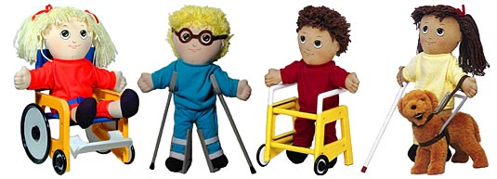
Customer Service
All participants must be allowed equal opportunities to participate in CN programs regardless of race, color, national origin, sex, age, disability
All participants must be treated in the same manner
(i.e. seating arrangements, serving lines, services and facilities, assignment of eating periods, methods of selection for meal benefit approval and verification processes)

Slide 30

Conflict Resolution
USDA recommends using an Alternative Dispute Resolution (ADR) program
  ADR: use of a neutral third party (usually a person acting as a facilitator) to resolve informally a complaint of discrimination through use of various techniques

Slide 31



Recognizing
a
Civil Rights Complaint

Slide 32

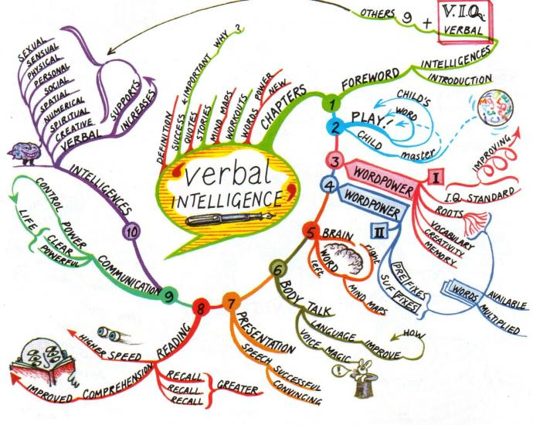


Unequal Treatment
Verbal
In writing
Observed

Slide 33
Handling a Complaint
CACFP Civil Rights Official enters complaint on log.
Complainant completes Civil Rights Complaint Form
Resolve at the site level.
Submit complaint report to HCNP within 5 working days.
Notes:
33
1.) These are some samples of how to handle a complaint
2.) Read slide
3.) There should be one SFA official in charge of Civil Rights complaints and procedures. This person will log all complaints in CNP Civil Rights Procedure Manual.

Slide 34

How soon does a complaint need to be filed?
Complainant has up to 180 days from alleged incident to file a complaint.
Notes:
1.) Read Slide

Slide 35
Civil Rights Complaint Procedure
Civil Rights complaint received by Institution
(verbal or written)
Civil Rights complaint documented
in Civil Rights Complaint Log
Institution gives complainant Civil Rights Complaint Form or
Institution assists complainant to complete Form.
If complainant returns Civil Rights Complaint Form to Institution,
Institution forwards Civil Rights Complaint Form to HCNP within 5 working days
.
Notes:
This is an example of how the Civil Rights complaint procedures are to be gathered, documented and forwarded- in this order.
There should be one Institution official in charge of Civil Rights complaints and procedures. This person will log all complaints in CNP Civil Rights Procedure Manual.

Slide 36
Civil Rights Complaint Log
Must be dated
Keep for current + 3 years, even if no complaints have been received
Notes:
1.) All complaints must be logged and kept for 3 years plus the current year even if there are no complaints. If the state requires more you must follow the state request. Three years is only a mandate by the USDA.

Slide 37
Civil Rights Complaint Form
CR Complaint Form must be readily available at all sites for all staff.
Make every attempt to help complainant complete CR Complaint Form.
If the household cannot fill out the complaint form, the center staff is responsible to assist the family to complete the document.
Notes:
The Civil Right complaint form must be easily accessible for all Staff.

Slide 38
CNP Civil Rights Procedure Manual
Sections for
  1) Institution CR complaint procedure
  2) CR complaint forms and log (make copies).
  4) FNS Instructions 113-1
  5) Training forms – Sign-in sheet, agenda, etc.
Civil Rights Coordinating Official must sign complaint log.
Notes:
38
1.) When creating a Civil Rights Procedure Manual you can you this reference for organization proposes. This Manual must be implemented in all programs.
2.) Read slide/ show CNP Civil Rights Procedure Manual
3.).) All Civil Rights information is confidential information and must be in a locked area.

Slide 39

Compliance Review Purpose
To ensure that CNPs are in compliance with Civil Rights Requirements
Notes:
When we review your program we want to insure the you are following the Civil Rights Requirements.

Slide 40
Noncompliance
There are NO “minor” or “major” categories of noncompliance. All instances of non-compliance are considered equally.
  No matter the level or severity of noncompliance, it must be reported and it must be corrected.

Slide 41
Examples of Noncompliance
Denying an individual or household the opportunity to apply for FNS program benefits or services on the basis of race, color, sex, age, national origin, or disability
Providing FNS program services or benefits in a dissimilar manner on the basis of race, color, sex, age, national origin, or disability
  Example: Serving lunch to an African American child but serving a snack/modified meal to an Asian American child

Slide 42
Examples of Noncompliance
Selecting FNS program sites or facilities in a manner that denies an individual access to FNS program benefits, assistance, or services on the basis of the six protected classes (race, color, national origin, etc.)
  Example: Serving meals on site to toddlers and preschoolers. Parents of infants must bring in formula and food for their infant.

Slide 43
Resolution of Noncompliance
If noncompliance is indicated, a corrective action plan must be implemented immediately to achieve voluntary compliance within 30 days
Corrective Action Plan: a plan describing the agency’s actions to be taken to resolve noncompliance with civil rights requirements

Slide 44
Common Review Findings
And Justice for All poster is not visible where families and the general public can read it
Nondiscrimination statement is missing from CNP documents
Civil Rights File is not complete
  Log, complaint process, training sign-in sheet

Slide 45
Civil Rights “Must Do List”
Offer all CNPs in a nondiscriminatory manner so that all students have equal access to CACFP meals.
Complete Civil Rights Ethnic Data Report annually by October 31.
Train staff annually on Civil Rights compliance.
Implement Complaint Procedure.
Notes:
Read all slides

Slide 46
Civil Rights “Must Do List” (continued)
Make available CNP Civil Rights procedures and forms.
Prominently display the “And Justice for All” poster.
Place nondiscrimination statement on all printed CNP materials available to public including Web site.

Slide 47

Thank You

